Slide 1
Chapter 20 A Strategic Advantage

Slide 2
Using International Logistics for Competitive Advantage
Communication Challenges
International English
Special English
Metric System
Cultural Sensitivity
Specific Advice

Slide 3
Communication Challenges
One of the most difficult aspects of international business is communicating effectively and accurately.
An additional challenge for the international logistics manager is that most communications with foreign counterparts are conducted in an impersonal fashion: e-mail, fax, and letters.
Most international communications take place in English, the native language of only about 5 percent of the world’s population.
English has become “everybody’s second language” because it is a relatively easy language to learn.

Slide 4
Difficulty of Languages
Languages easiest to learn (closest to English)
Roman alphabet, similar grammar, similar syntax | Spanish, French, Dutch, Italian, Portuguese, Norwegian, Swedish, German
Languages difficult to learn
Roman alphabet, different grammar, different syntax | Indonesian, Turkish, Icelandic, Czech, Hungarian, Vietnamese, Polish, Slovak, Finnish
Languages very difficult to learn
Different alphabet, different grammar, very different syntax | Hebrew, Russian, Greek, Hindi, Thai
Languages extremely difficult to learn
Complex alphabet, multiple alphabets or no alphabet, very different grammar, very different syntax | Chinese (Cantonese and Mandarin), Japanese, Korean, Arabic

Slide 5
Communication Challenges
Communicating effectively means making sure that the person for whom the message is intended has no doubt about the meaning of the message:
The vocabulary is clear and unambiguous: native English speakers should use International English and Special English.
The units used should be metric.
The message should be culturally sensitive.

Slide 6
International English
Native English speakers should strive to make the meaning of the communication absolutely clear to the non-native speaker:
“Business and technical documents intended for those who read English as their second language must be unusually simple, unambiguous, and literal. Ideally, they should be edited for ease of translation.”
Edmond Weiss
It is best to use a technique called International English (developed by Ed Weiss) to achieve good communication in written documents.

Slide 7
International English—First Rule
Always assume that the person for whom English is a second language is relying on a dictionary for some words.
A person trying to understand a new word should not have to determine which of many definitions is the correct one:
“Our company’s sales took off 25 percent last year” can be easily misunderstood, since to “take off” is first defined as to “remove [one’s clothes]” in many dictionaries. For many non-native English speakers, it is understood as “sales declined 25 percent.”
A better sentence is “Sales increased 25 percent.” There is no possible misunderstanding.

Slide 8
International English—Second Rule
Always proofread carefully and avoid all grammatical and spelling errors.
A sentence where there are misspellings and grammatical errors will be much more difficult for a non-native English speaker to understand.
“Our company would like to except your offer” is a sentence with which a native speaker will have no issue, but a non-native speaker will not understand it. Was the offer accepted, or was it rejected for being exceptionally bad (or too high priced, or some other issue)?

Slide 9
International English—Third Rule
Always make sure that quantitative information (dates, currencies, etc.) can be understood without doubt.
U.S. customary dates are written as MM/DD/YY, while Europeans prefer DD/MM/YY and the Chinese prefer YY/MM/DD.
A contract date of 12/11/18 will be understood as December 11, 2018 by an American, 12 November 2018 by a Dutch, and 18 November 2012 by a Chinese reader.
Always write dates as 11 December 2018. That way, no confusion can possibly take place.

Slide 10
International English—Fourth Rule
Always use simple and short sentences.
Although short and simple sentences may appear too simplistic to native readers, they are generally better understood by non-native readers.
Compare this first sentence with: “Short and simple sentences may appear too simplistic to native readers. Short sentences are better understood by non-native readers.”
Even though the two shorter sentences would not earn a good grade in an English composition class, there is no way they can be misunderstood.

Slide 11
International English—Fifth Rule
Never use idioms that are sport- or military-related, as they are rarely, if ever, understood properly.
Here is a sentence from the British newspaper The Guardian, reporting on a cricket test (game):
“He had enough nous to admit he had "bowled too many four balls" after taking 5-42 in the second innings at Old Trafford, which suggests he will be able to keep his feet on the ground.”
It is as easily understandable to a non-native English speaker as this sentence from the New York Times reporting on a baseball game is:
[He] struck out the only batter he faced, bailing the [team] out of a bases-loaded jam in the top of the seventh. ”

Slide 12
Special English
Special English is a reduced-vocabulary English developed by the Voice of America, the U.S. government-sponsored news organization that broadcasts worldwide.
“The goal was to communicate by radio in clear and simple English with people whose native language was not English.”
Voice of America’s website
The rules of Special English should be used when communicating with non-native speakers, whether in person or by telephone.

Slide 13
Special English—First Rule
Sentences should be short and contain only one idea.
It is easier for a non-native listener to hear small and short sentences, since there is less information to remember before the entire meaning of the sentence is understood.
This recommendation, which was very important in written communication, is critical for in-person and telephone conversations.

Slide 14
Special English—Second Rule
The vocabulary should be limited to correct and accurate terms.
Although lots of native speakers pay careful attention and eliminate sentence fragments such as “like” and “you know what I mean” in their speech, others are less careful.
Eliminating all such “fillers” and all local idiomatic or cultural references (references to sport figures or television characters, even in “small talk”) allows non-native listeners to understand the meaning of the communication.

Slide 15
Special English—Third Rule
The speed at which the sentences are spoken should be slower.
It is always much easier for a non-native speaker to understand people who speak slowly than people who speak fast.
It is also much easier to understand someone who articulates and enunciates clearly rather than someone who only pronounces part of the words: “laboratory” rather than “labo’tory,” “license plate” rather than “licen’ plate,” or “picture” rather than “pitcher.”

Slide 16
Special English—Fourth Rule
Repeating a sentence does not mean repeating it louder, but repeating it with different vocabulary.
If a non-native English speaker asks a native speaker to repeat a sentence, the native speaker should not repeat the sentence louder, as if the person had difficulty hearing. Instead, the native speaker should repeat the sentence using slightly different vocabulary.
The reason the non-native speaker is asking to hear the sentence again is because the person did not understand the vocabulary used, or could not determine the sentence structure, and needs to hear it again.

Slide 17
Metric System
The metric system has been adopted worldwide, and is the measurement system officially followed by almost all countries.
Since information is better processed when it is familiar, U.S. exporters should utilize the metric system in their communication, as very few foreigners understand the U.S. system of measurement.
It is advisable to use both metric and standard measurements on the packaging used in transportation, so that the dimensions and weight are clear to all people involved in the handling of the goods.

Slide 18
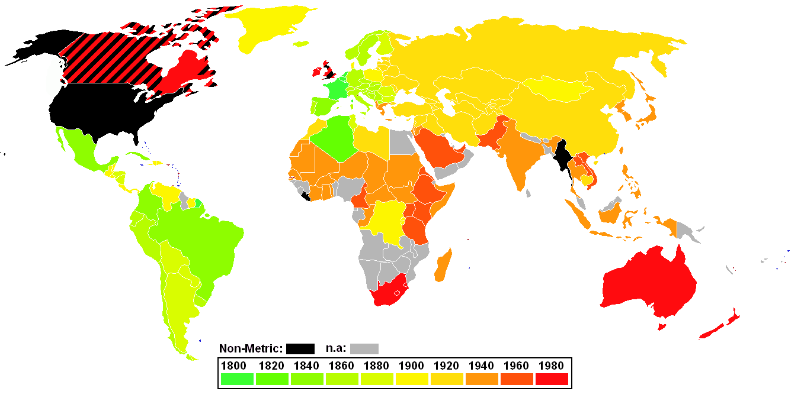
The adoption of the metric system. The U.S., Liberia and Burma/Myanmar are the only hold-outs. Britain and Canada are in the midst of (reluctant) conversion.

Slide 19
Metric System
A simple translation of measurements will convey the meaning correctly, but not always clearly.
It is better to use measurements that are conventional in the country of the importer.
A 55-gallon drum can become a 208.2-liter drum, but the importer is used to 200-liter drums.
A shipment of oil, expressed in barrels (42 gallons each), can become a shipment expressed in liters, but the importer is used to buying oil by the metric tonne.
A vehicle, sold in the U.S., has its gas mileage expressed in miles per gallon, but the importer wants it expressed in liters per 100 kilometers (30 mpg ≈ 7.8 l/100 km).

Slide 20
Cultural Sensitivity
It is always advisable to make sure all communications and interactions are made in a culturally-sensitive way. However, learning a culture is extremely time consuming, so a few pointers help.
Forms of Address
Whether people address each other formally or informally, whether they use formal titles or not, it is difficult to offend someone by being too formal, so it is best to err on the side of formality.
Work Culture
Whether there is a large divide between work and private life, or none, it is best to assume they are separate until ample evidence proves otherwise.

Slide 21
Cultural Sensitivity
Speed at which People Operate in the Work Place
Some cultures prefer enquiries to be answered very quickly, to reflect interest. Others favor a delay to demonstrate careful and considerate answers. It is always advisable to mimic the response time received from the importer.
Work Day
The way people typically organize their work day (the time at which they arrive at work, the time at which they leave, the length of their lunch break) determines when it is appropriate to make contact, particularly by phone. This information is readily available from various sources.

Slide 22
Specific Advice
Managers involved in international logistics can use several other strategies to allow their companies to gain a competitive advantage in the market place:
The term of payment best suited for the importer
The best choice of currency
The correct Incoterms® rule
The best possible document preparation
The best packaging decision
A solid warehousing and distribution center network
Solid inventory policies to prevent stock out and rush orders
Quality control systems in place

Slide 23
Terms of Payment
An exporter intent on increasing its sales should choose to display that it is confident in the ability of the importer to pay for the goods by using an open account term of payment.
If it is unsure about the ability of the importer to pay, it should consider purchasing a credit insurance policy.
More secure methods of payment may be tempting, but they increase the probability of not getting the sale, because the importer does not like to be considered a poor risk.
An exporter can be confident it will get paid if it uses the proper term of payment.

Slide 24
Currency of Payment
An exporter intent on increasing its sales abroad should offer all of its quotes in the importer's currency and determine the most appropriate hedging strategy for that particular transaction.
Using the importer’s currency makes it easier for the importer to compare multiple quotes, especially for an importer with little international trade experience.
It is always possible to quote in the exporter’s currency if the importer prefers that alternative.
A simple hedging strategy can eliminate an exporter’s currency fluctuation risk; a sophisticated option hedging strategy can help the exporter benefit from currency fluctuations.

Slide 25
Incoterms® Rule
An exporter should offer to provide the importer with the most customer-friendly Incoterms® rule quote (either DAP or DDP), and, if necessary, use the services of a competent freight forwarder to deliver this level of service.
Should the importer want to shoulder more responsibilities, it is always possible for the exporter to reduce its involvement and ship under a DAT or an FCA Incoterms® rule.
Ideally, the exporter should quote multiple Incoterms® rules, letting the importer choose the number of responsibilities it wants to shoulder.

Slide 26
Document Preparation
Accurate and timely document preparation and delivery are an essential part of international logistics and of the smooth transfer of goods from an exporter to an importer.
An exporter intent on increasing its sales should be thorough and meticulous in the way it prepares the documents that it provides to the importer.
This should be reflected in the first contact, the pro-forma invoice, and be communicated to the importer by emphasizing the experience of the company at providing accurate and thorough documents.
Excellent software programs exist to help exporters provide thorough and accurate international documentation.

Slide 27
Packaging
Good handling of the packaging requirements by the exporter will also help considerably in the smooth transfer of goods from the exporter to the importer.
Goods that arrive in good shape, crates and boxes that are easy to dismantle, shipments that are clearly marked for appropriate handling, packaging materials that can be readily reused or recycled, all give a positive image of the exporter.
Good packaging practices are more expensive than not-so-good ones. However, there are substantial savings with reductions in damaged goods, as well as misplaced and mishandled shipments.

Slide 28
Warehousing
Appropriately designed and located warehouses and distribution centers reduce lead times and allow a company to provide faster delivery to its customers.
Warehouses can also provide value-added services to customers.
Warehouses are an integral part of the international supply chain and they can provide a company with a marketing advantage over its customers.

Slide 29
Inventory Management
Good inventory management practices allow companies to deliver goods to their customers when the goods are needed. The items are in inventory and available for sale.
Good inventory management practices also lower costs, which allows a company to be more profitable or allows a company to sell at a lower price.
Good inventory management practices allow companies to inform their customers of the status of an order.
In all cases, good inventory management practices translate into a competitive advantage.

Slide 30
Quality Controls
Manufacturing processes for which capability studies have been conducted can provide customers with evidence that suppliers can produce parts within the customers’ specifications.
Monitoring production through statistical process controls provide customers with confidence that products are consistent and can be used in production as soon as received.

Slide 31
Cumulative Effects
It is likely that a company cannot gain a competitive advantage by simply communicating clearly or providing excellent documentation. It needs to also offer good payment terms and appropriate Incoterms® rules.
It is also evident that a company does not need all of its processes and procedures to be perfect in order to command a marketing advantage.
However, efforts to optimize several aspects of its international-trade operations can yield significant returns by increasing the likelihood of clinching a sale.

