Slide 1
Chapter 19
Supply Chain Operations—Quality

Slide 2
Quality Management
Quality Assurance
Statistical Quality Control Concepts
SPC with Attributes
SPC with Variables
Process Capability
Continuous Improvement
Quality Standards
Quality as a Marketing Tool

Slide 3
Quality Assurance
Until the 1980s, quality was the responsibility of a Quality Assurance department.
Quality Assurance was a process of taking a sample of incoming products and testing them to determine whether they were conform to the requirements of the buyer. Quality Assurance standards had been developed by the U.S. military and had “names” such as MIL-STD-105E and MIL-STD-414.
By the mid-1980s, the supplier was the entity responsible to provide quality control to ensure that parts were conform.

Slide 4
Statistical Quality Control
Collection of Historical Data
Statistical Process Control tools were first adopted by the Japanese manufacturers under the leadership of W. Edwards Deming and Joseph Juran. The tools were later were adopted worldwide.
Statistical process control involves four practical steps:
The collection of historical data
The calculation of statistics
The creation of control charts
The plotting of new data on the charts

Slide 5
Statistical Quality Control
Historical Data
The collection of historical data is meant to determine the “natural” variation in a manufacturing process, or the amount of variation that happens when the process is working correctly.
Historical data is therefore collected after the process has been confirmed to work correctly, serviced recently, so it works as intended, without problem.
The historical data collection consists of a minimum of 30 samples.

Slide 6
Statistical Quality Control
Statistics, Control Charts, New Data
The collection of historical data allows the manufacturer to calculate some statistics, such as means and standard deviations, that describe the natural variation of the process.
The statistics are used to create control charts.
The control charts are visual aids that allow a process operator to quickly determine whether a process is working correctly or not, by plotting the most recent process data on the charts.
If the process is not working correctly, the operator has immediate information that allows the problem to be corrected.

Slide 7
Statistical Quality Control
Attributes and Variables
Statistical Process Control is managed differently for attributes and for variables.
Attributes are binary variables (they can only take the values 0 or 1): 0 indicates that the product is conforming, and 1 indicates that the product is non-conforming.
  A painted surface is free of defects (0) or has bubbles (1)
  A part fits into another part (0) or does not (1)
  A piece of cloth has no surface defects (0) or does (1)
Variables are continuous variables that can take any value: a diameter, a length, an electric resistance, a temperature.

Slide 8
Statistical Quality Control
SPC with Attributes
The historical data consists of a minimum of m=30 samples, each of a minimum size of n=50 observations.
For each sample, the proportion p of defective parts is determined; the historical data therefore yields 50 different proportions of defectives, from p₁, the proportion of defectives from the first sample, to p_{m}, the proportion of defectives for the m-th sample.

Slide 9

Statistical Quality Control
SPC with Attributes
Two statistics are calculated on the historical data:
The average proportion of defectives, $\overline{p}$:
$\overline{p}$ = $\frac{\sum_{i=1}^{i=m}{pi}}{m}$ = $\frac{p1+p2+p3+…+pm}{m}$
The standard deviation of the proportion of defectives, $σ:$
$σ=$ $\sqrt{\frac{\overline{p}(1−\overline{p})}{n}}$

Slide 10
Statistical Quality Control
Normal Distribution
Before moving on to the chart built from these statistics, a quick reminder about the Normal Distribution:

Slide 11
Statistical Quality Control
The Normal Distribution
There are three important facts from a normal distribution that are used in statistical process control:
The area under the curve between the mean minus one standard deviation and the mean plus one standard deviation (the area under the curve between -1 and 1 on the figure on the preceding slide) represent 68.26 percent of the entire area under the curve.
Between -2 and 2, the area under the curve is 95.44 percent of the entire area under the curve.
Between -3 and 3, the area under the curve is 99.73 percent of the entire area under the curve.

Slide 12
Statistical Quality Control
SPC with Attributes
A single chart is created with these statistics, called the p=chart, and it uses the characteristics of the Normal Distribution:

Slide 13

Statistical Quality Control
SPC with Attributes
From the Normal Distribution’s characteristics, it can be inferred that very few samples will have a proportion of defectives that is greater than $\overline{p}+3σ$ and very few will have a proportion of defectives that is smaller than $\overline{p}−3σ.$
Only about 0.13 percent of the samples will have proportions of defectives above $\overline{p}+3σ$ and only about 0.13 percent of the samples will have proportions of defectives below $\overline{p}−3σ$.
The value $\overline{p}+3σ$ represents the Upper Control Limit, and the value $\overline{p}−3σ$ represent the Lower Control Limit of the p-chart.

Slide 14
Statistical Quality Control
SPC with Attributes
Once the p-chart is created, the operator can start plotting the current data on it. Current data is collected from subsequent samples of size n=50, and the proportion of defectives determined in each sample. They are then placed on the chart.

Slide 15
Statistical Quality Control
SPC with Attributes
In most instances, the current data falls well within the control limits.
However, there are some instances in which the current data show that the process is “out of a control” and does not work correctly. The operator uses the chart to determine those instances, and after they are identified, stops the process to rectify the situation.
Those “out-of-control” situations are easily identifiable on the p-chart.

Slide 16
Statistical Quality Control
Out-of-Control Situations
The operator will stop the process and attempts to determine what went wrong when the proportion of defectives in one sample is either above the UCL (case ①) or below the LCL.
The probability that such an event happened by chance alone is only 0.13 percent, so it’s likely that “something else” caused it, and therefore the process is not functioning normally.
This allows the operator to identify problems quickly.

Slide 17
Statistical Quality Control
Out-of-Control Situations
Another out-of-control situation is when the proportion of defectives in two consecutive samples is either near the UCL or near the LCL (case ②).
The definition of “near” the UCL/LCL is “between 2 and 3 standard deviations” from the mean.
The probability that two consecutive samples fall in that interval by chance alone is 0.046 percent, so the process is out of control and not working correctly.

Slide 18
Statistical Quality Control
Out-of-Control Situations
To facilitate the operator’s ability to determine “near,” some companies use a colored chart: two consecutive samples in the same red area constitute an out-of-control situation.

Slide 19
Statistical Quality Control
Out-of-Control Situations
Another out-of-control situation is when the proportion of defectives in seven consecutive samples is either above the mean (case ③) or below the mean.
The probability that seven consecutive samples fall above the mean by chance alone is 0.78 percent, so the process is out of control and not working correctly.
Other out-of-control situations exist when there is a trend in the data, or the process is behaving erratically, but these situations are more difficult to detect.

Slide 20

Statistical Quality Control
SPC with Variables
In the case of variables, the historical data consists of a minimum of m=30 samples, each of a minimum size of n=4 observations.
For each sample, the average measurement of the variable in the sample is calculated ($\overline{X}$) as well as the range of measurements (R):
$$\overline{X}=\frac{\sum_{i=1}^{i=n}{Xi}}{n}=\frac{X1+X2+…+Xn}{n}$$
$$R=XMAX−Xmin$$

Slide 21

Statistical Quality Control
SPC with Variables
Two statistics are calculated on the historical data:
The average of the average measurements, or the grand average, $\overline{\overline{X}}$:
$\overline{\overline{X}}$ = $\frac{\sum_{i=1}^{i=m}{\overline{Xi}}}{m}$ = $\frac{\overline{X}1+\overline{X}2+\overline{X}3+…+\overline{X}m}{m}$
The average range, $\overline{R}:$
$\overline{R}=\frac{\sum_{i=1}^{i=m}{Ri}}{m}$ = $\frac{R1+R2+R3+…+Rm}{m}$

Slide 22

Statistical Quality Control
SPC with Variables
Two charts are built using these statistics:
The $\overline{X}$-chart:

Slide 23
Statistical Quality Control
SPC with Variables
And the R-chart:

Slide 24
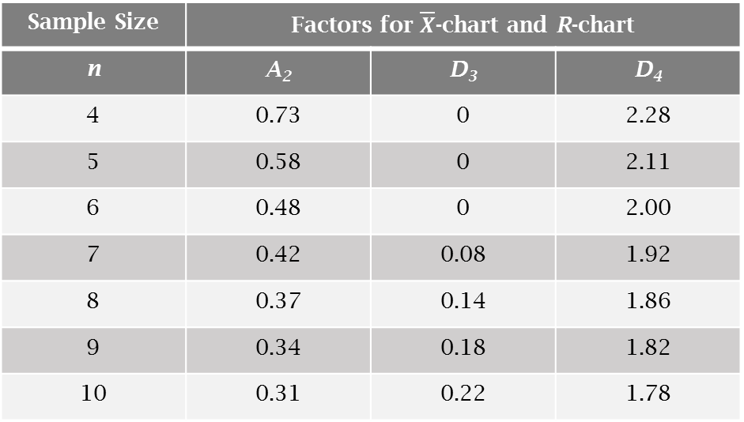
Statistical Quality Control
SPC with Variables
The charts (and their respective control limits) are built using the two statistics that were calculated on the historical data, and three coefficients found in the following table:
Sample Size | Factors for $\overline{X}$-chart and R-chart
n | A₂ | D₃ | D₄
4 | 0.73 | 0 | 2.28
5 | 0.58 | 0 | 2.11
6 | 0.48 | 0 | 2.00
7 | 0.42 | 0.08 | 1.92
8 | 0.37 | 0.14 | 1.86
9 | 0.34 | 0.18 | 1.82
10 | 0.31 | 0.22 | 1.78

Slide 25

Statistical Quality Control
SPC with Variables
The control limits for the $\overline{X}$-chart are:
The control limits for the R-chart are:
These upper- and lower-control limits approximate three standard deviations above the mean and three standard deviations below the mean.

Slide 26

Statistical Quality Control
Out-of-Control Situations
Out-of-control situations for SPC with variables are identical to out-of-control situations with attribute data. The process is out of control if either of the $\overline{X}$-chart or the R-chart:
    has a single sample above the Upper Control Limit or below the Lower Control Limit
    has two consecutive samples near the UCL or near the LCL
    has five consecutive samples above or below the mean
    exhibits a trend
    displays erratic behavior

Slide 27
Statistical Quality Control
Process Capability
While a process may be working correctly (be in control), it does not indicate whether it is capable of producing within the specifications of the customer.
In order to make this determination, it is necessary to conduct a capability study, which measures the degree to which the process is capable of manufacturing parts that meet the specifications.
Specifications are expressed as 200mm ± 0.3mm or as 15Ω ± 0.01Ω
The Upper Specification is 200.3mm and the Lower Specification is 199.97mm.

Slide 28
Statistical Quality Control
Process Capability
In order to determine whether a process is capable of manufacturing parts within the specifications, the C_{pk}, the coefficient of capability of a process needs to be calculated:
Oftentimes, though, companies refer to their processes’ capabilities in sigmas, as in our process is five-sigma capable, as shown in the next slide’s table.

Slide 29
Statistical Quality Control
Process Capability
The C_{pk} determines the number of non-conforming parts (per million) that a process will produce:
C_{pk} | Defects per million | sigmas
1.00 | 2,700 | ± 3.0
1.20 | 318 | ± 3.6
1.33 | 63.3 | ± 4.0
1.40 | 26.7 | ± 4.2
1.50 | 6.8 | ± 4.5
1.60 | 1.59 | ± 4.8
1.67 | 0.573 | ± 5.0
1.80 | 0.067 | ± 5.4
2.00 | 0.002 | ± 6.0

Slide 30
Statistical Quality Control
Continuous Improvement
Whenever a process is not capable, or its coefficient of capability Cpk is not high enough, it is possible to use statistical methods to reduce the natural variation in the output of a process.
Efforts to reduce variation are called continuous improvements. Motorola implemented a process called Six Sigma that was designed to get all manufacturing processes within the company and its suppliers to have a C_{pk} of 2.0 (six sigmas).
The most frequently used variation-reducing technique involves statistical methods such as ANOVA, which are commonly called Taguchi methods.

Slide 31
Statistical Quality Control
Six-Sigma
Six Sigma, the strategy that originated within Motorola, was very successful in making the company more quality focused and competitive.
The Six-Sigma strategy generated a lot of process improvements in manufacturing, and it was embraced by many companies.
It was eventually widely adopted by General Electric, and Jack Welch expanded the idea into a company-wide commitment to process improvements in all areas, and the elimination of waste and inefficiencies.
Employees in charge of process improvements were called Six-Sigma black belts.

Slide 32
Statistical Quality Control
Quality Standards
Quality standards were first standards of performance, so that parts made by one manufacturer would be usable with parts made by another manufacturer. These standards still exist and are managed by industry organizations, such as ISO, ANSI, DIN, JIS, AFNOR, API, and many others.
In 1987, the International Organization for Standardization (ISO) created the ISO-9000 standard that changed the emphasis of quality standards from performance to procedures.
In order to be ISO-9000 certified, a company had to document the processes it followed, and make sure that all employees followed these written procedures.

Slide 33
Statistical Quality Control
ISO 9000
Because ISO 9000 forced companies to evaluate and document their production processes, they modified those that were not optimal and ended up with better processes.
The U.S. car manufacturers incorporated all the aspects of ISO 9000 into a new standard that they called QS 9000, to which they added a minimum coefficient of capability (the C_{pk} had to be at least 2).
The QS 9000 standard was first applied to tier-one suppliers (companies that sold directly to the car manufacturers), and then eventually to tier-two and tier-three suppliers. The certification process was conducted by the automobile manufacturers themselves.

Slide 34
Quality as a Marketing Tool
Customers expect products that are made well and consistently. Therefore quality should not be a competitive advantage, but something that customers simply expect.
However, companies that have manufacturing processes for which capability studies have been conducted can provide customers with evidence that they can produce parts within the customer’s specifications.
Finally, companies that monitor their production through statistical process control can provide their customers with evidence that their products are consistent and therefore can be used in production as soon as received.
In those respects, a company can gain a competitive advantage by implementing quality control tools.

