Slide 1
Chapter 18
Supply Chain Operations—Inventory

Slide 2
Inventory Management
Aspects of Inventory Management
Economic Order Quantity Model
Economic Lot Size Model
Safety Stock
A-B-C Classification
Material Requirements Planning
Inventory Management as a Marketing Tool

Slide 3
Dependent and Independent Demand
Inventory techniques make two fundamental distinctions:
Dependent Demand items have sales that depend on the sales of another item; tires depend on the sale of cars, hydraulic hoses depend on the sale of earth-moving equipment, and memory chips on the sale of computers.
Independent Demand items are sold directly to the end users. Tires are sold to tire retailers, hydraulic hoses to heavy-equipment repair shops, and memory chips to companies upgrading their current systems. Their sales are independent of the sales of another product.

Slide 4
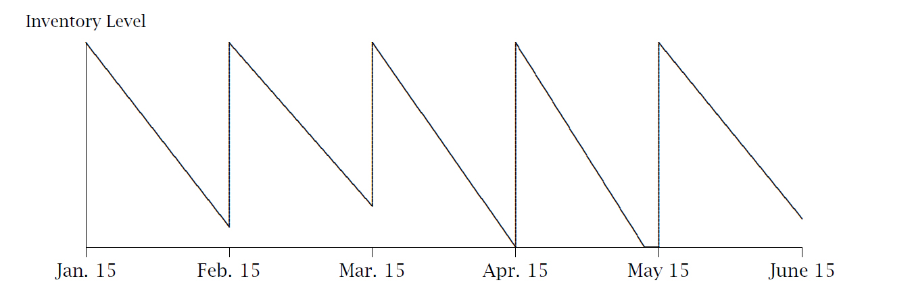
Management Alternative I
There are two ways to approach inventory management. The first is the periodic re-order model:
The inventory is replenished at regular intervals, and the quantity of goods re-ordered changes.

Slide 5
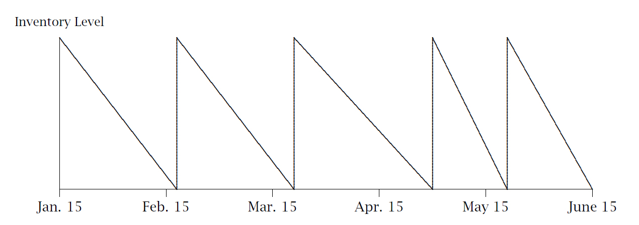
Management Alternative II
The most frequently used alternative is the fixed-order-quantity model:
The inventory is replenished whenever inventory level reaches a certain point. The periodicity changes.

Slide 6
Inventory Costs
Inventory management involves trade-offs between several costs:
    Ordering costs
    Set-up costs
    Holding (Carrying) costs
    Shortage costs

Slide 7
Ordering Costs
Inventory ordering costs are incurred whenever a purchase is made. They are unaffected by the size of the order. They include:
    The transaction costs associated with making an international purchase: international wire transfers, letters of credit, and bank fees.
    The document costs, such as certificates of origin, import license, customs brokerage fees.
    The time spent, as all international purchases take more time than domestic purchases.

Slide 8
Set-up Costs
Set-up costs are similar to ordering costs: they are incurred every time a new production process is initiated. They are unaffected by the quantity produced. They include:
    The process-change costs associated with switching from making one type of part to making another type of part. Different raw materials, different settings, different speed.
    The time involved in making the change, from employees’ costs to production downtime costs.

Slide 9
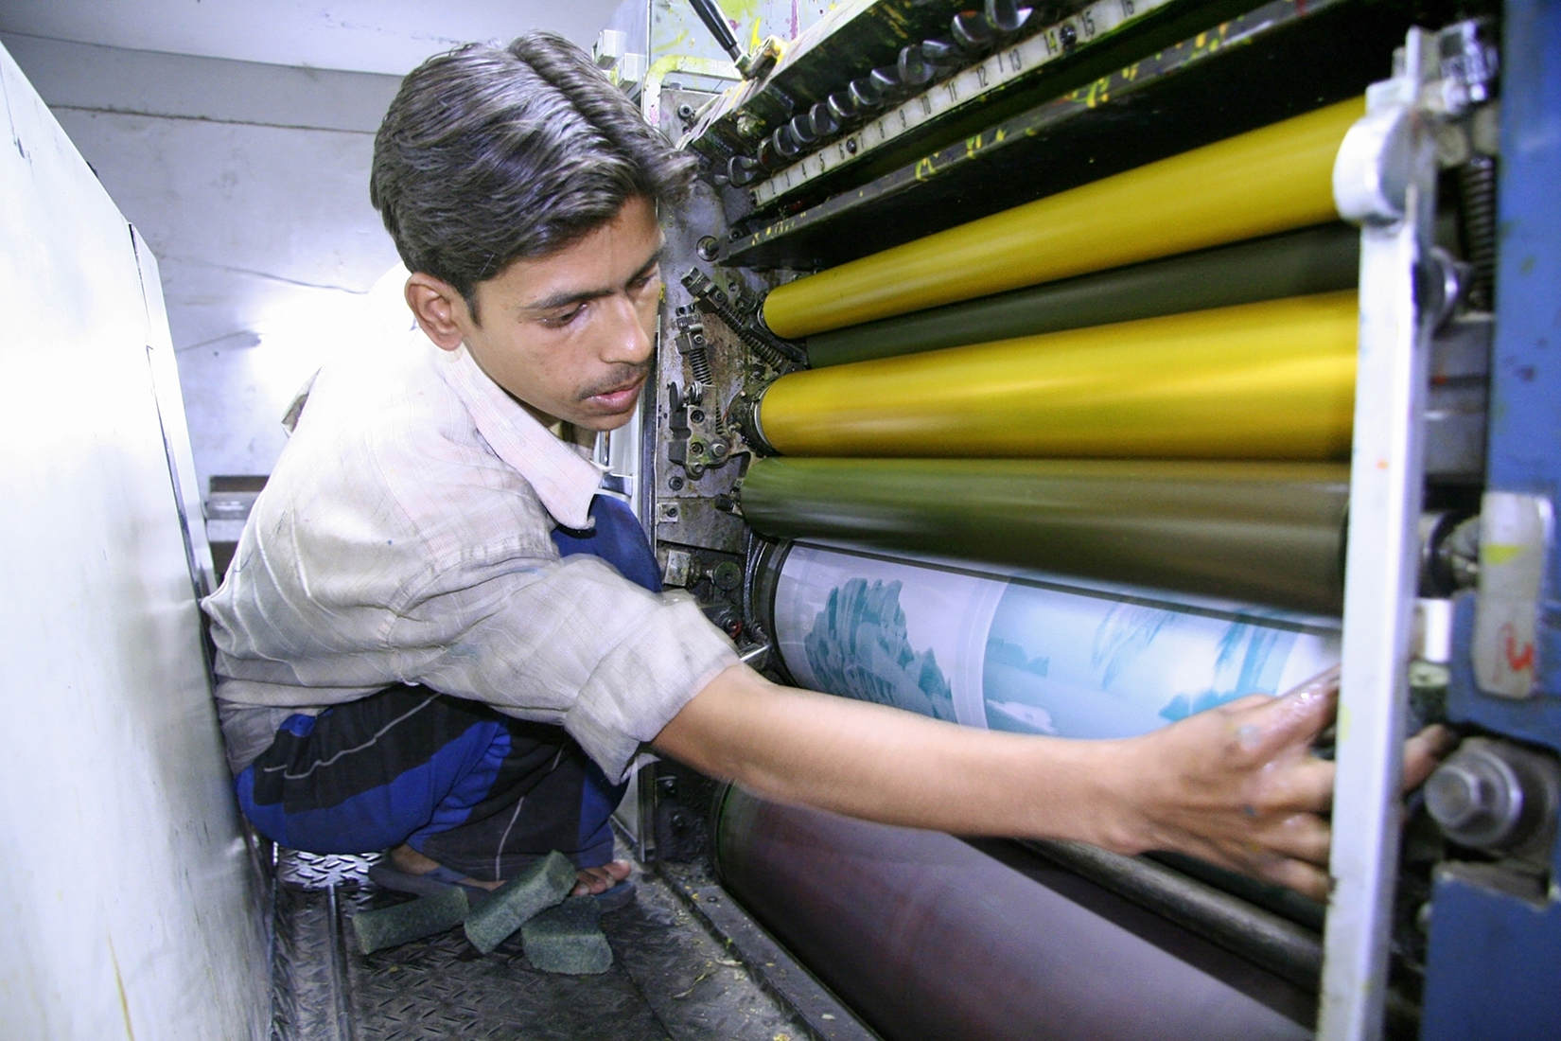
An offset printing machine incurs a setup cost when production changes from one job to another.

Slide 10
Holding Costs
Inventory holding costs are linked to the number of goods held in inventory. They include:
    The capital costs of inventory, since the amount of money immobilized in inventory (asset) is financed through a corresponding liability (owner’s equity or borrowed funds).
    The warehousing costs, such as space, insurance, utilities, taxes, personnel, equipment depreciation.
    Other costs such as “shrinkage” and obsolescence.

Slide 11
Shortage Costs
Inventory shortage costs are incurred when the company cannot supply the item because it is not in inventory:
    It can be a single cost when the company anticipates the shortage and expedites a replenishment shipment by requesting air shipment.
    It can be a cost per unit, as the company fulfills the order later (backorder), but has to cover shipping costs.
    It can be a cost per unit per period if the part is needed for production. As production is interrupted, it costs money every day that the part is unavailable.

Slide 12
Economic Order Quantity
By managing the number of goods it orders every time it places an order, a company observes the trade-off between:
The ordering costs, which decrease when the quantity ordered increases, since the number of orders decreases.
The holding costs, which increase when the quantity ordered increases, as more items are kept in inventory.

Slide 13
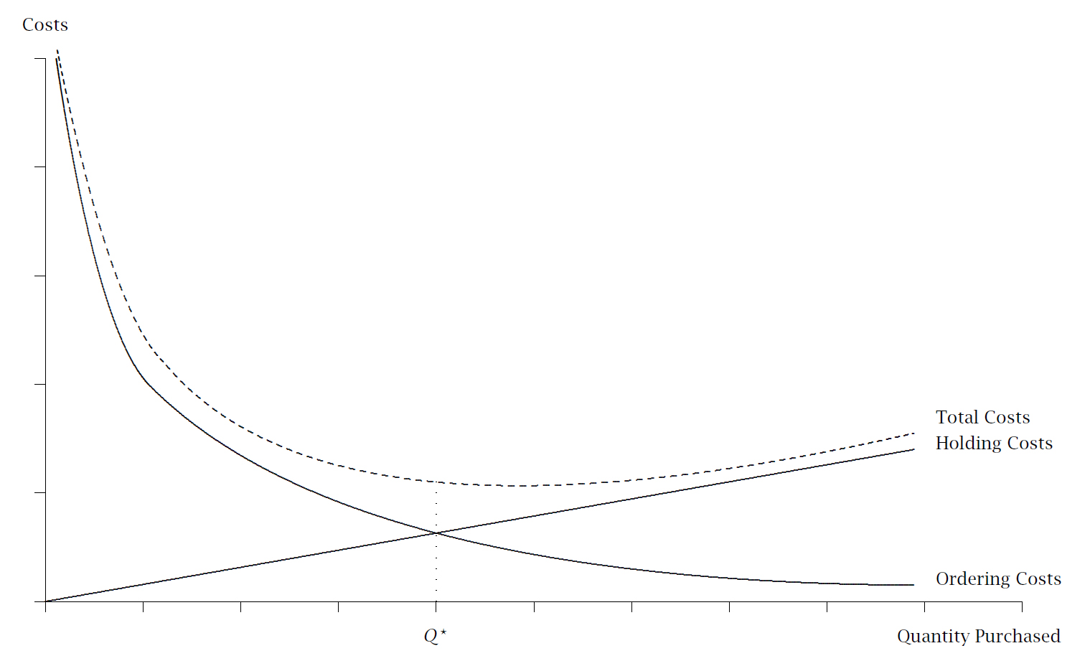

Slide 14

Economic Order Quantity
The Economic Order Quantity (EOQ) is the number of items that the firm should purchase, every time it purchases these goods, so as to minimize its ordering costs and holding costs:
where:
  D is the demand for the product, expressed in units per year
  C_{o} is the cost of placing an order
  C_{h} is the cost of holding one unit in inventory for a year

Slide 15
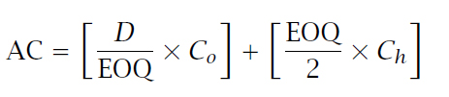
Economic Order Quantity
When purchasing the Economic Order Quantity (EOQ), the firm incurs annual costs, composed of ordering costs and holding costs:
Where:
  D/EOQ is the number of times that the firm orders
  C_{o} is the cost of placing an order
  EOQ/2 is the average inventory
  C_{h} is the cost of holding one unit in inventory for a year

Slide 16
Economic Lot Size
By managing the number of goods it manufactures every time it decides to produce an item, a company observes the trade-off between:
The setup costs, which decrease when the quantity manufactured increases, since the number of setups decreases.
The holding costs, which increase when the quantity ordered increases, as more items are kept in inventory.

Slide 17

Economic Lot Size
The Economic Lot Size (ELS) is the number of items that the firm should manufacture, every time it decides to produce these goods, so as to minimize its setup costs and holding costs:
Where:
  D is the demand for the product, expressed in units per year
  P is the production rate, expressed in units per year
  C_{s} is the cost of setting up the manufacturing process
  C_{h} is the cost of holding one unit in inventory for a year

Slide 18


Economic Lot Size
When manufacturing the Economic Lot Size (ELS), the firm incurs annual costs, composed of setup costs and holding costs:
Where:
  D/ELS is the number of times that the firm manufactures the product
  C_{s} is the cost of placing an order
  C_{h} is the cost of holding one unit in inventory for a year
  is the average inventory level
$\frac{ELS}{2}$x$\frac{P−D}{D}$

Slide 19
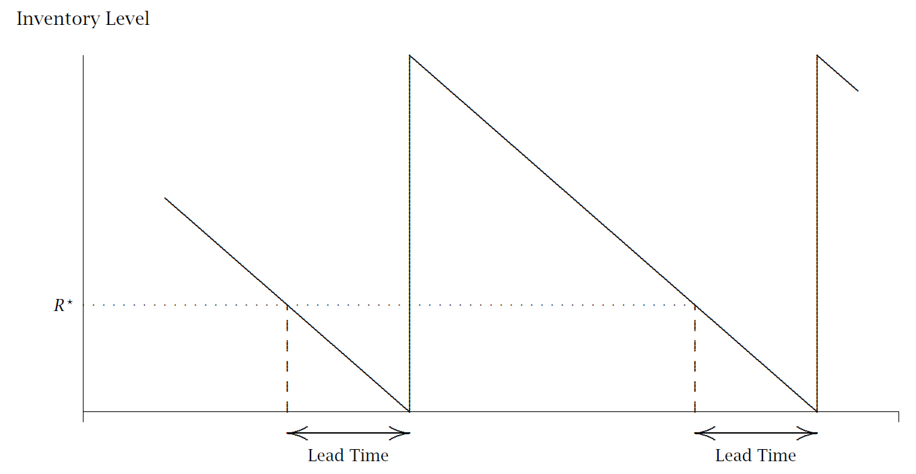
Lead Time
The lead time is the period between the moment an order is placed and the time at which it arrives.

Slide 20
Reorder Point
The lead time corresponds to the amount of time that the goods need to arrive.
The firm reorders the goods when the inventory level has reached a point that is equal to the expected demand during the lead time.
That inventory level is called the reorder point.

Slide 21
Safety Stock
Since there is variation in the demand during the lead time, firms can carry a safety stock to ensure that they have enough inventory to fulfill demand.
The next diagram shows a case where demand is less than anticipated (case ①). When the demand is more than anticipated (case ②), the company has to “dip” into its safety stock.

Slide 22
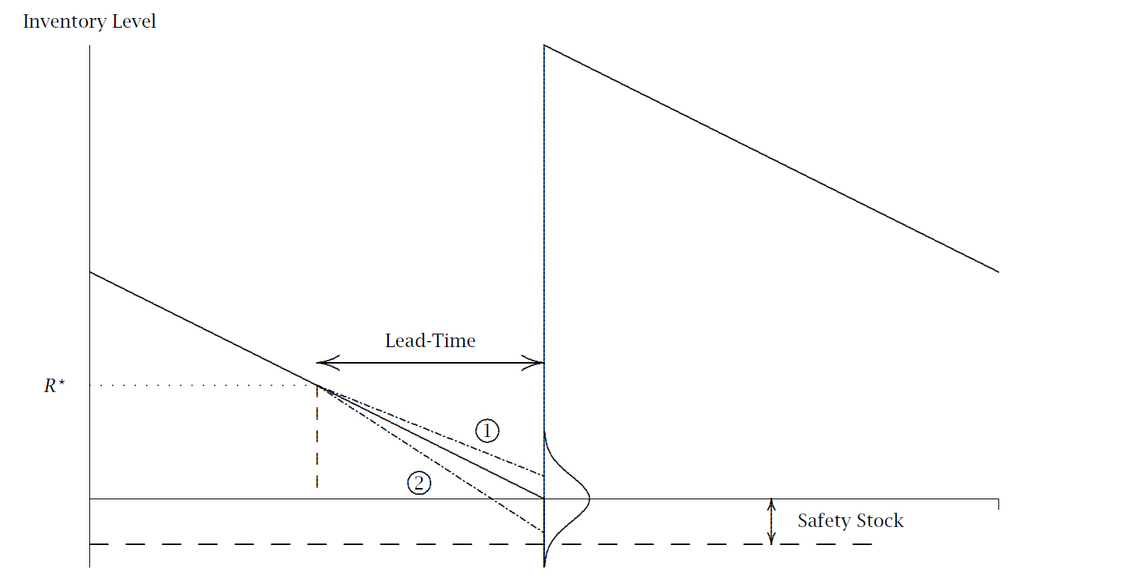

Slide 23
Safety Stock Determination
The number of items in a safety stock depends on the expected variation in the demand in the lead time and the service level that a company wants to achieve.
The variation in the demand during the lead time is expressed by the standard deviation of the demand during the lead time.
The service level is the probability that the firm has the item in inventory if a customer places an order during the lead time.

Slide 24
Safety Stock Determination
The safety stock is:
SS = z_{service level} x σ_{LT}
where:
z_{service level} is the z-score of the service level that the firm wants to maintain.
σ_{LT} is the standard deviation of the demand during the lead time.

Slide 25


Safety Stock Determination
The safety stock is also be affected by the variation in the length of the lead time, especially in a global environment. The standard deviation during the lead time then becomes:
where:
L is the expected length of the lead time (in days).
σ_{d} is the standard deviation of the demand each day.
$\overline{d}$ is the average demand per day.
σ_{L} is the standard deviation of the length of the lead time.

Slide 26
Re-order Point Determination
The re-order point is determined as:
R* = D_{LT} + SS
where:
D_{LT} is the expected demand during the lead time.
SS is the safety stock that the company has determined it wants to maintain.

Slide 27
A-B-C Classification
Inventory managers adopted Pareto’s Law and created the A-B-C classification with three groups:
A-class products require careful monitoring and updated order quantities when forecasts change. B-class products are less carefully monitored, and order quantities changes every 3-5 years. C-class products are managed with rule- of-thumb techniques.
Group | Percentage of Products | Percentage of Costs
A | 20 | 80
B | 30 | 15
C | 50 | 5

Slide 28
Materials Requirement Planning
MRP
Materials Requirement Planning is a technique that can only be used for dependent-demand items.
It allows a company to use the planned sales of its finished products to determine:
    What to make/buy
    How many to make/buy
    When to make/buy them
    Whether some orders need to be expedited (completed earlier than originally planned) or de-expedited

Slide 29
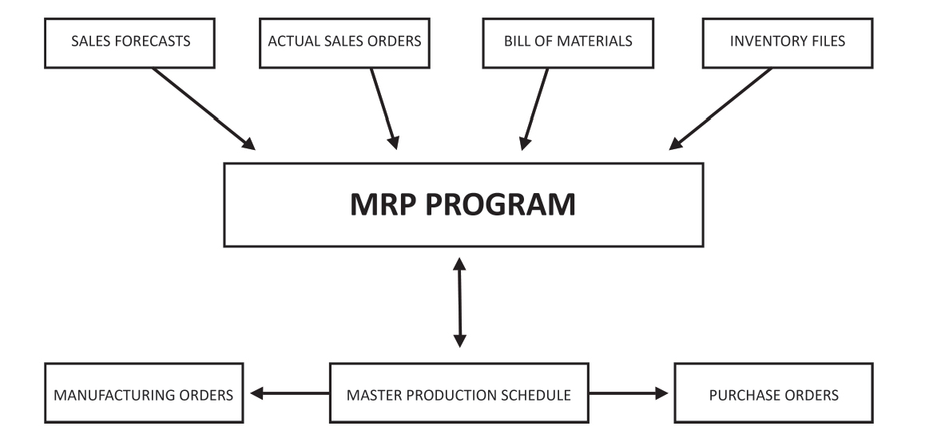
Materials Requirement Planning
  MRP uses several files to make this process possible:

Slide 30
Materials Requirement Planning
Bill of Materials
The bill of materials file lists all the items that are needed to make the final product:
The final product is assembled from Sub-Assembly 1, Sub-Assembly 2, and Part A. Sub-Assembly 1 is made by combining Parts B and C, and Sub-Assembly 2 is made by combining 4 units of Part D.
Final Product
Sub Assy 1
Part A
Sub Assy 2
Part B
Part C
Part D (4)

Slide 31
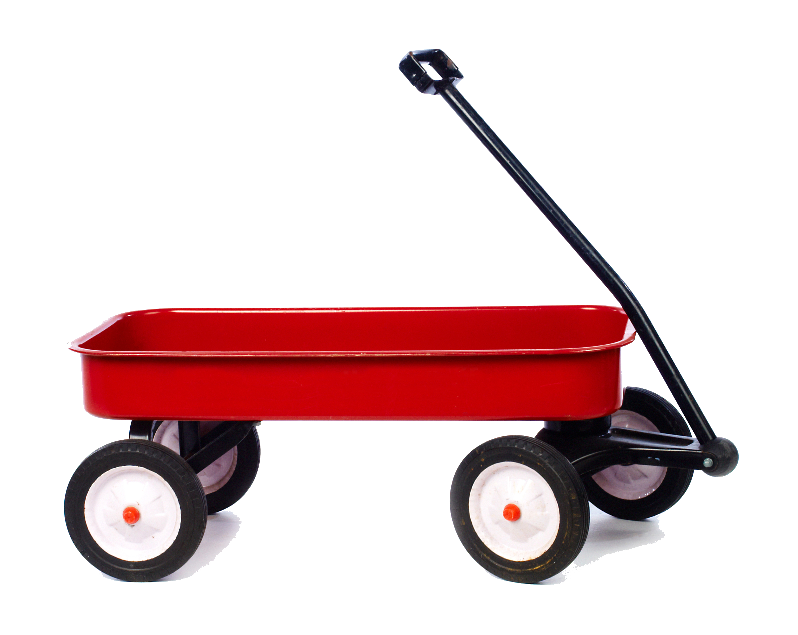
Materials Requirement Planning
Bill of Materials
The next slide will be the bill of materials for the following toy:

Slide 32
Materials Requirement Planning
Bill of Materials

Slide 33
Materials Requirement Planning
Bill of Materials
The bill of materials shows that the wagon (level 0) is made with six parts (level 1 parts):
      One wagon tray (part 101-050)
      One rear-wheel subassembly (part 101-051)
      One front-wheel subassembly (part 101-052)
      10 ¼ bolts (parts 101-025)
      10 ¼ nuts (parts 101-026)
      10 ¼ washers (parts 101-027)
In turn, each level-1 sub-assembly is made with level-2 parts, and each level-2 part is made with level-3 parts.

Slide 34
Materials Requirement Planning
Bill of Materials
The bill of materials also includes two other pieces of information:
  The lot size (how many parts to make at once [Economic Lot Size] or how many parts to purchase at once [Economic Order Quantity]). When the lot size is L4L, that indicates that the quantity to be made is flexible (lot-for-lot).
  The lead time (the time between the moment the order is placed (for manufacture or for purchase) and the time at which the lot is completed or arrives.
With the bill-of-materials file, the inventory files, and an order for the final product, the Master Production Schedule can be created.

Slide 35
Materials Requirement Planning
Master Production Schedule
For each week, the Master Production Schedule keeps track of, or determines:
    Gross Requirements: The number of units ordered or forecast to be sold.
    On-Hand: The number of units already in inventory.
    Net Requirements: The number of units needed to be obtained because the gross requirements are higher than the number of units on hand.
    Planned Order Receipts: The number of units expected to be received.
    Planned Order Releases: The number of units for which a purchase order or a manufacturing order is expected to be released.

Slide 36
Materials Requirement Planning
Master Production Schedule
A Master Production Schedule for which there are no orders and for which the initial quantity on hand is 0.

Slide 37
Master Production Schedule
Order for 24 wagons in week 8
Order for 24 in week 8
Net requirements are 24 since there are no wagon in inventory
Planned order releases are for 24 in week 7, since the lead time is one week
Planned Order Receipts are 24 because lot size is lot-for-lot

Slide 38
Materials Requirement Planning
The company needs to obtain the parts necessary to start making the 24 wagons in week 7
10 units on hand
Gross requirements of 24 in week 7
Planned order releases are for 75 in week 4, since the lead time is three weeks
Planned Order Receipts are 75 units because lot size is 75 trays
Net requirements are 14 since there are 10 trays in inventory

Slide 39
Materials Requirement Planning
The company needs to obtain the parts necessary to start making the 24 wagons in week 7
18 units on hand
Gross requirements of 24 in week 7
Planned order releases are for 200 in week 6, since the lead time is one week
Planned Order Receipts are 200 units because lot size is 200.
Net requirements are 6 since there are 18 rear-wheel sub-assemblies in inventory

Slide 40
Materials Requirement Planning
The company needs to obtain the parts necessary to start making the 24 wagons in week 7
52 units on hand
Gross requirements of 24 in week 7
Net requirements are 0 since there are more front-wheel sub-assemblies in inventory than are needed
Inventory decreases to 28, since 24 are taken from an inventory of 52 units

Slide 41
Materials Requirement Planning
The company needs to obtain the parts necessary to start making the 200 rear-wheel subassemblies in week 6
Net requirements are 0 since there are 450 wheels in inventory
450 units on hand
Gross requirements are 400 in week 6, since there are two wheels per rear sub-assemblies. Had there been front sub-assemblies to be made, gross requirements for wheels would have included enough to make them

Slide 42
Materials Requirement Planning
Just-In-Time Inventory Systems
Just-in-Time inventory systems where first developed by Toyota with a system of cards (called kanban).
Each Toyota production batch was accompanied by a card. When the batch started to be used on the assembly line, the card was sent back to the production area, and it triggered the production of another batch. This system was very effective at eliminating inventories of component parts.
Few companies adopted the kanban system, but the just-in-time concept was implemented with the help of the MRP system.

Slide 43
Materials Requirement Planning
Just-In-Time Inventory Systems
Materials Requirement Planning (MRP) allows companies to manufacture “just in time”:
    Reductions in lot sizes were achievable because of reductions in set-up costs, mostly due to technological improvements. Set-up costs have a direct impact on the size of lot sizes.
    Lower technology costs have allowed MRP programs to run in real time—rather than in batch mode—and MRP programs of suppliers are linked to MRP programs of Original Equipment Manufacturers. This allows changes in forecasts and sales to have an immediate impact on the entire supply chain.

Slide 44
Materials Requirement Planning
Derivatives
The benefits of Materials Requirement Planning (MRP) programs in manufacturing environment triggered the development of similar dependent-demand programs:
      Manufacturing Resources Planning (MRP II) is a program similar to MRP, but that includes data on costs, and allows production times to be changed, to accommodate holidays, staff shortages, and so on.
      Distribution Resources Planning (DRP) is a program that uses the “pull” principle and applies it to retail. The retail sale “pulls” the demand for the product in the supply chain, from wholesaler to the manufacturer.

Slide 45
Materials Requirement Planning
Derivatives
Another derivative product is Enterprise Resources Planning (ERP) that includes all of the programs that are necessary to run a corporation, from an MRP II to a warehouse management module, an accounting module, a finance module, a human resources management module and so on.
The growth of ERP was triggered in part by the success of MPR II programs, which were successful in controlling manufacturing costs, but mostly by concerns about legacy management systems affected by the Y2K transition.

Slide 46
Inventory Management as a Marketing Tool
A benefit of good inventory management is that companies are able to deliver goods to their customers when the goods are needed. There is a greater likelihood that the item is in inventory and available for sale.
Good inventory practices also lower costs, which allows a company to be more profitable or allows a company to sell at a lower price, which translates into a competitive advantage.
Good inventory practices (an MRP) allows companies to inform their customers of the status of an order.

