Slide 1
Chapter 17 Customs Clearance

Slide 2
Customs Clearance
Duty Determination
Non-Tariff Barriers
Customs Clearance Process
Foreign Trade Zones

Slide 3
Duty Determination
Duty is the amount of tax paid on an imported good. The amount of duty that an importer has to pay is determined by three factors:
The type of goods (their classification)
The value of the goods (their valuation)
The country from which the goods originated (the rules of origin)
The tariff is the rate at which an import is taxed; the rate is dependent on the classification of the goods, as well as their country of origin. The tariff rate is also called the duty rate.

Slide 4
Classification
For almost all countries, the classification of goods follows the Harmonized System (HS) of Classification. Every product has an international 6-digit code which is used to determine the product’s tariff rate. Countries can add up to 4 additional digits.
Here are the classification numbers for golf shoes in the U.S.:
The first six digits represent the “root” of the international coding. The last four digits are “country- specific.’’
6402.19.05 | Golf Shoes
30 | For Men
60 | For Women
90 | For Other People

Slide 5
Classification
The Harmonized System is a very large list, comprised of:
21 sections, divided by product or material
97 chapters (the first 2 digits of the HS number)
Each chapter is then divided into headings (the first 4 digits of the HS number)
Each heading is then divided into subheadings (6 digits).
The correct classification of an imported good is generally made by the importer and then verified by the Customs Office.

Slide 6
Classification—Rules of Interpretation (I)
Classifications are made according to very specific rules of interpretation:
The section, chapter, and heading only serve as guides, and the correct classification may be in a different section, chapter, and heading altogether.
The classification of an incomplete or unfinished product is that of the finished product. For example, shipments that contain all of the subassemblies for a final product should be classified as the final product rather than as individual parts. This is true of chemical compounds as well.

Slide 7
Classification—Rules of Interpretation (II)
When in doubt between two classifications, the one with the most specific description is the correct one. However, if the product is made up of several parts, each of which would lead to a different classification, then the classification that lends it its “essential character” is the correct one.
When there is no category under which a specific product can be classified, then the classification that should be used is that of a product that would be most like it.

Slide 8
Classification—Rules of Interpretation (III)
Containers and packaging materials are classified with the products with which they enter: such would be the case for camera cases, for example. However, if the container has usage beyond the product itself, then it must be entered and classified separately.
When comparing classifications, only descriptions at the same level should be compared; it is not appropriate to compare a heading to a subheading, for example.

Slide 9
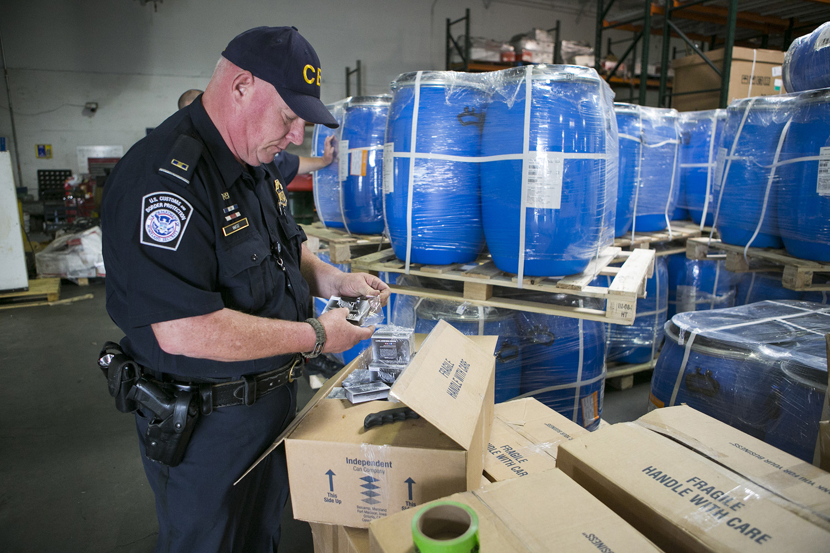
U.S. Customs and Border Protection agents routinely inspect goods to ensure correct classification.

Slide 10
Valuation
Most duty is collected based on the value of the goods. Customs terminology is that duty is collected ad valorem.
It is therefore very important to determine the correct value of the goods.
For customs’ purposes, valuation is generally the amount billed by the exporter and shown on the invoice.
However, there are some cases where the invoice amount is modified or superseded.

Slide 11
Valuation and Incoterms® Rules
For most countries, the dutiable amount, the amount on which duty is calculated, is the “landed value” of the goods. This is interpreted by most countries as the CIF or CIP value of the goods (the amount that the importer would pay if the purchase was made on a CIF or CIP basis). Others use the CFR or CPT value.
If the invoice is for an FAS transaction, the costs of international transportation and insurance are added to the invoice value to determine the dutiable amount.
If the invoice is for a DAP transaction, the costs of on carriage in the importing country should be deducted from the dutiable amount.

Slide 12
Valuation and Incoterms® Rules
The United States uses a different standard for dutiable amount.
Goods imported in the United States are valued on an FAS or FCA basis, or the value of the goods as they were leaving the exporting country.
A U.S. importer receiving goods on a CIF or CIP basis should therefore deduct the costs of international transportation and insurance from the invoice value to determine the dutiable amount.
In all cases, it is therefore critical to have exporters provide as much detail as possible on invoices so that the importer can determine the correct dutiable amount, and pay the least duty.

Slide 13
Valuation
In some cases, customs determine that the invoice amount is not reliable, and another dutiable amount should be used.
There are four alternative methods used by customs authorities worldwide to determine how goods must be valued:
Comparative method
Deductive method
Computed or reconstructed value method
Method of last resort

Slide 14
Alternative Methods of Valuation (I)
Comparative Method
The dutiable value of the goods is based upon the value of identical or similar goods imported in similar quantity to the same country.
Deductive Method
The value of the goods is determined from the price at which identical or similar goods are sold within 90 days of importation in the importing country, using “normal” markups in the distribution channel.

Slide 15
Alternative Methods of Valuation (II)
Computed or Reconstructive Method
The value of the goods is determined by computing the manufacturing costs of the goods, adding customary expenses for overhead, as well as a reasonable profit.
Method of Last Resort
Customs use well-trained and well-informed Customs officials to determine the value of the goods imported; no specific guidelines are given, other than that the valuation cannot be “arbitrary.”

Slide 16
Rules of Origin
The third element necessary to determine the duty that will be applied to a specific import is the country of origin of the goods.
Goods are given a country of origin based upon a set of rules that are known as “rules of origin.”
Rules of origin follow one of the two following methods:
Substantial transformation
Change in Harmonized System Classification

Slide 17
Substantial Transformation
The country of origin of a product is the country in which it acquired its most substantial transformation.
The determination of the “substantial transformation” can be very difficult in some cases and can lead to widely different results and interpretations.
The “substantial transformation” rule is the one followed by most countries for manufactured goods.
The country of origin of a computer has been based on the country of manufacture of the motherboard, that of the final assembly of the product, and that of the operating system.

Slide 18
Change in H.S. Classification
The country of origin is the country in which the last change in the Harmonized System classification of the product occurred.
This method can sometimes lead to a product's country of origin being a country in which a fairly inconsequential transformation took place, and where little value was added.
This method is the one currently followed by the United States for textile products.
Silk scarves, hand-painted in Italy (and that would therefore have been “made in Italy” under the “substantial transformation rule”), are “made in China” under the “change in HS classification” rule because they were woven in China.

Slide 19
Tariffs
The tariff rate for an imported product is found in the tariff schedule, which lists all the possible Harmonized System classification categories, as well as their associated tariff rates for the different types of countries.
Most tariff schedules are two- or three-column schedules, giving two or three different rates for each product classification, depending on the country of origin.
The United States has a two-column tariff schedule, with the countries with which it has “Normal Trade Relations (NTR)” in column 1 and the ones with which it does not in column 2.

Slide 20
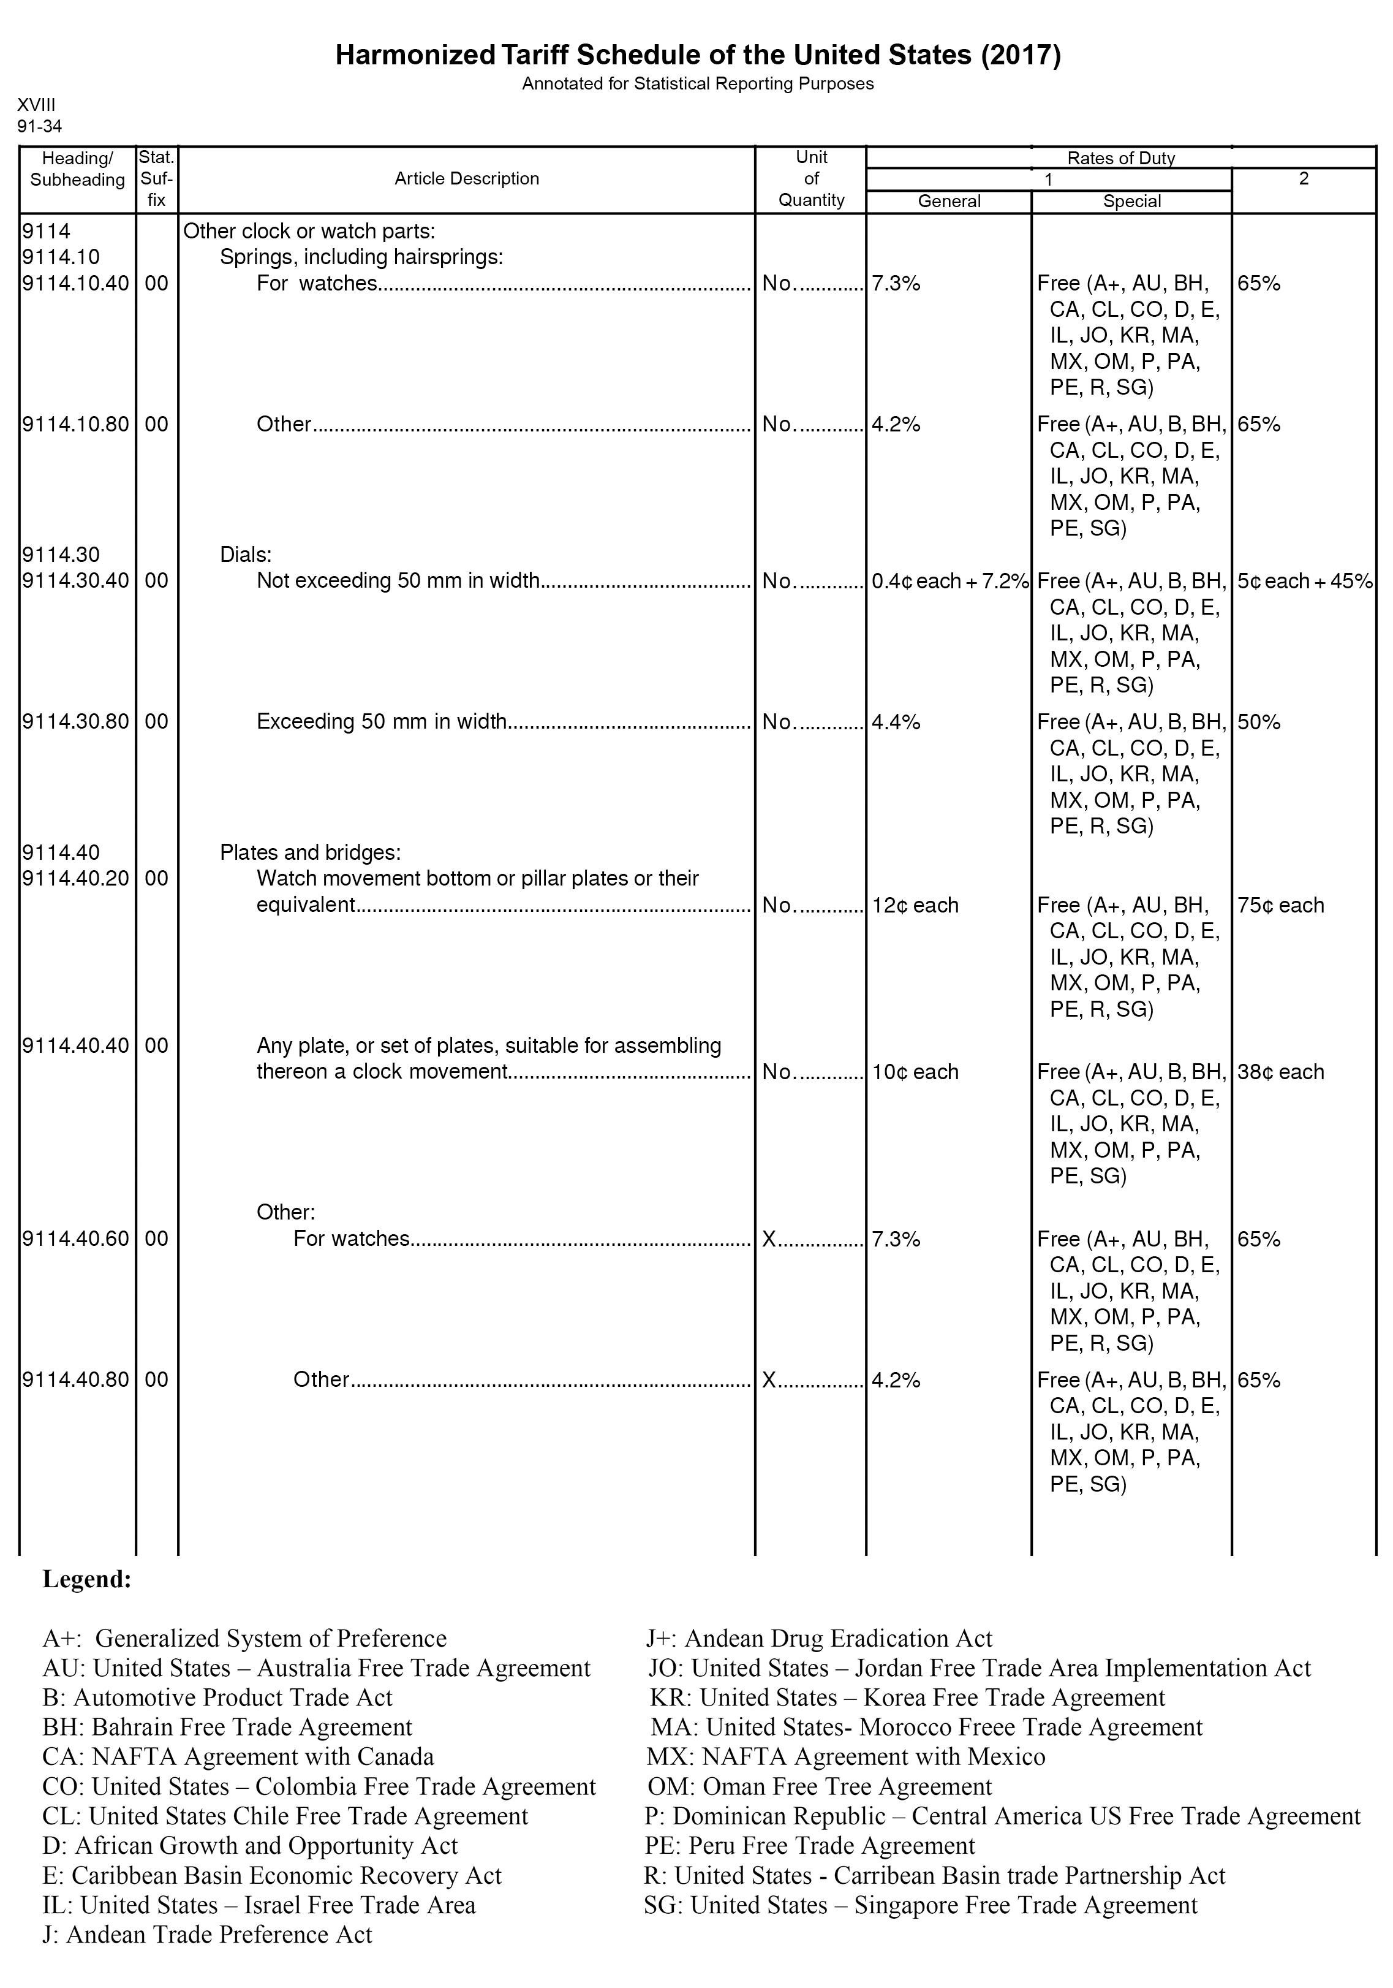
The Tariff Schedule of the United States is dense and complicated.

Slide 21
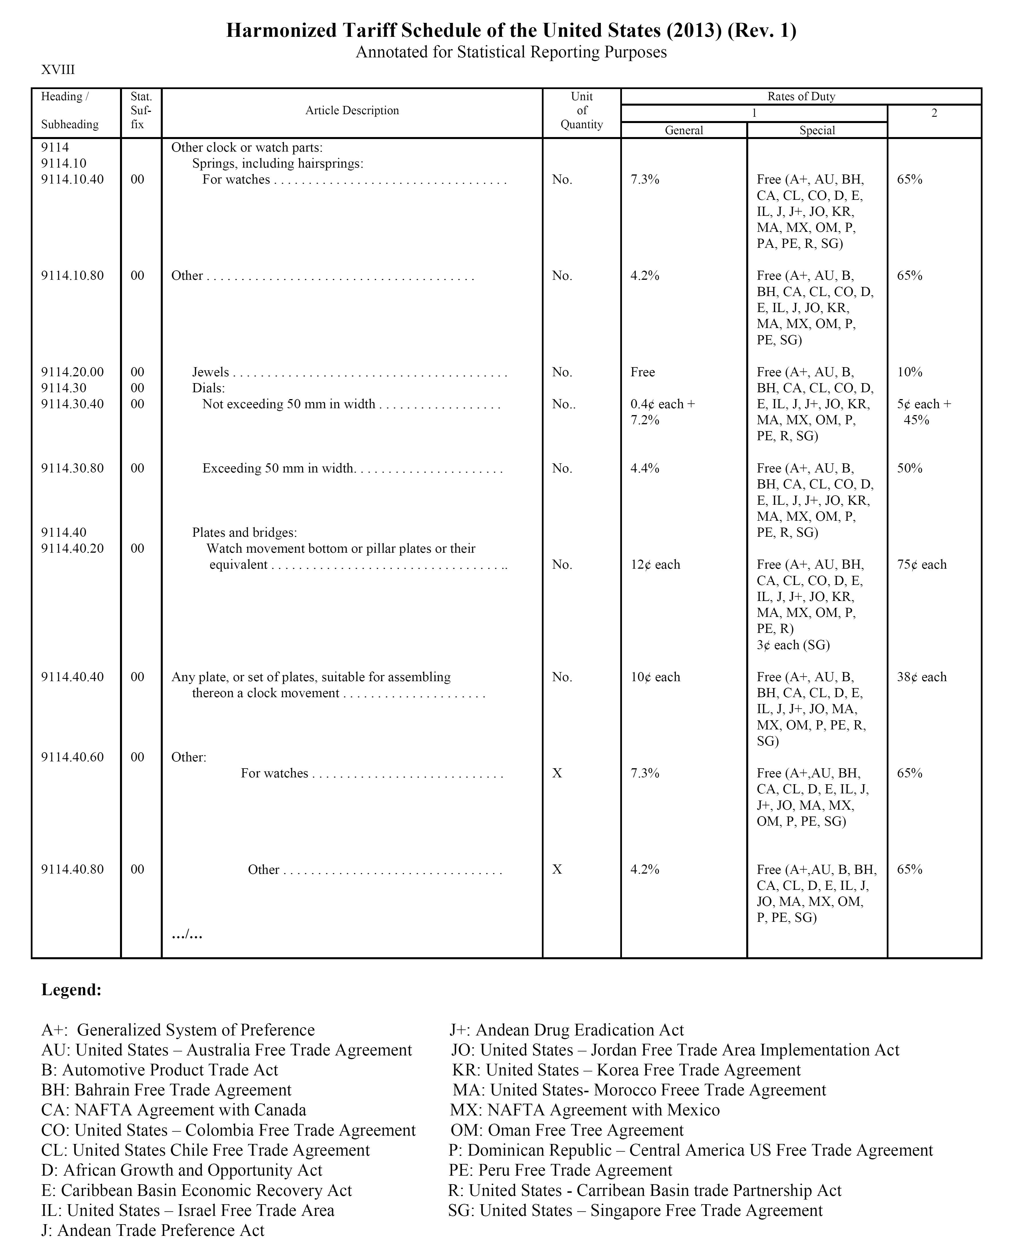
The Tariff Schedule of the United States divides countries between Column 1 (NTR) and Column 2 (non NTR). Column 1 is further divided between the General rate and the Special rate granted to countries with which the U.S. has a free-trade agreement.

Slide 22
The classification is by H.S number and description.

Slide 23
Once classification and country of origin are determined, the tariff rate is easily found.
For dials of 35 mm in diameter coming from Switzerland, the tariff is $0.004 per unit + 7.2 % of the invoice value.

Slide 24
Duty
A watch dial (35mm in diameter) is classified as 9114.30.4000 by the United States.
For a dial whose country of origin is Switzerland, the duty rate would be a compound rate; the importer would be charged 7.2 percent of the invoice value (FCA) and 0.4 cents for each dial.
For a dial whose country of origin is Australia (AU code), there would be no duty, because of the U.S. – Australia Free Trade Agreement.
For a dial whose country of origin is Libya, the duty rate would be 45 percent of the invoice value (FCA) and 5 cents for each dial.

Slide 25
Dumping
Some exporters sell the products they are exporting at a price that is considered “too low” by the importing country’s Customs Office. The purpose of the strategy is to gain market share in the importing country.
Such a strategy is called dumping.
In order to counter this strategy, importing countries can implement anti-dumping duty, that is collected in addition to the regular import duty.
Anti-dumping duty can reach very high levels. Some are 150 to 200 percent of the value of the imported goods.

Slide 26
Other Import Taxes (I)
In addition to duty, several countries will collect additional taxes based on the value of the goods.
These additional taxes are a way of creating additional revenues from imports. Such taxes challenge the boundaries of the General Agreement on Tariffs and Trade (GATT) and the rules of the World Trade Organization (WTO).
The following are some examples of other taxes:
Punitive duty
Border traffic tax
Safeguard tax
Temporary protection tax

Slide 27
Other Import Taxes (II)
Punitive Tax
The United States, unhappy about a decision by the European Union to give preferential treatment to bananas imported from certain countries, retaliated by placing a 100 percent duty on certain items coming from any of the European Union countries: cashmere, blue cheese, “handbags covered in plastic sheeting,” and so on.
Border Traffic Tax
Russia, in order to “make a more accurate tally of border flows of people, cargo, and means of transportation,” imposes a 1 percent tax on all goods crossing its borders. Russian travelers are taxed at 0.8 percent of their monthly income.

Slide 28
Other Import Taxes (III)
Safeguard Tax
Argentina, after being chastised by the WTO for having increased its duty rate on footwear, reduced them, and immediately re-imposed them through an emergency “safeguard tax” designed to protect its footwear industry against foreign competition.
Temporary Protection Tax
The United States imposed a 33 percent additional tariff on brooms from Mexico to allow U.S. manufacturers to increase their efficiency so that they could compete against imports. It repealed such tax two years later, noting that the industry had not taken advantage of this protection period to improve its efficiency.

Slide 29
Value-Added Tax
Value-Added Tax (VAT) is a tax perceived by many countries that is very similar to a sales tax, but that is collected whenever that product’s value is increased. The VAT on imports is collected at the point of entry in the country.
VAT accounting is handled in such a way that only the final consumer of the product actually pays the tax. It is not a cost to the importer.

Slide 30
Non-Tariff Barriers
Non-tariff barriers are policies and actions that have the effect of reducing the number of items imported in a specific country. Non-tariff barriers are essentially prohibited by the GATT and WTO.
The most frequently used non-tariff barriers are quotas. There are two types of quotas: absolute quotas and tariff-rate quotas.
However countries will use other means to restrict imports, such as national standards of performance or safety, pre-shipment inspections, and other “unusual requirements.”

Slide 31
Absolute Quotas
An absolute quota is a limit, set by the importing country’s government, on the quantity of a specific commodity that can be imported in a given year.
The United States had no absolute quotas as of August 2013.
Until 2005, the United States had absolute quotas on textile products originating in China. The quotas were eliminated in January 2005, which caused some significant market disruptions, and therefore re-established for two years under an agreement with China on “quantitative restraints.”

Slide 32
Tariff-Rate Quotas
Under a tariff-rate quota, the importing country places a two-tiered tariff rate on a specific product. Until a specific number of units has been imported, the tariff is low; once the quota is reached, the tariff goes up, sometimes many-fold.
The United States has had a tariff-rate quota on sugar for a very long time, restricting the import of sugar from all of the major sugar-producing countries in the world. The quota is 1.1 million tonnes, or about 10 percent of the U.S. consumption.
Before the quota is reached, the duty is $0.01406 per kilogram; after it is reached, the duty is $0.3387 per kilogram, or 32 times higher.

Slide 33
National Standards
At times countries enact “safety measures” designed to protect their populations from defective, dangerous, or unhealthy products.
When these requirements are only targeting products made abroad, especially if they are based dubious or non-scientific data, they become non-tariff trade barriers.
The European Union restricts the import of genetically-modified cereals and of hormone-treated beef, despite having no evidence of their potential harm.

Slide 34
Pre-Shipment Inspections
Pre-Shipments Inspections (PSI) are performed by independent companies to determine that the goods shipped are the ones ordered by the importer, in the correct quantity, and sufficiently well packed for an international shipment. PSIs are performed at the point of departure of the goods destined to be exported.
PSIs are non-tariff barriers when they become too frequent and cumbersome.
Indonesia and Thailand require that all imports be subject to Pre-Shipment Inspections.

Slide 35
Other Non-Tariff Barriers
Many countries have been known to enact strange rules with regards to imports, typically aimed at protecting a certain domestic industry.
Other countries require a virtual endless number of approvals and documentation before goods may be imported.
France once required all imported VCRs to be inspected in a specific small town, located far from the entry port. This inspection was done very slowly with the intended consequence of preventing VCRs from entering the country.

Slide 36
Customs Clearance Process
Entry
Clearance
Liquidated Entry
Protest
(if necessary)

Slide 37
Customs Clearance Process
Entry
The process by which an importer notifies Customs it has imported a product.
Clearance
The term used to signify that the goods have been imported into a country, duty has been paid, and they have been released by Customs.
Liquidated Entry
An entry that has been successfully reviewed by Customs authorities and for which duty has been paid.
Protest
The formal request by an importer to have Customs reconsider the classification of a good, its valuation, or the determination of its country of origin.

Slide 38
Required Documentation
At the minimum, the following three documents are required by every country to make an entry:
A form designated for entry (specific to the importing country)
A Certificate of Origin to ascertain the country of origin
A Commercial Invoice with enough information to determine value and classification
However, certain goods require much greater documentation.
It is very important to have good invoices. The importer (and Customs) determines the classification of the goods and the dutiable amount from the invoice submitted by the exporter.

Slide 39
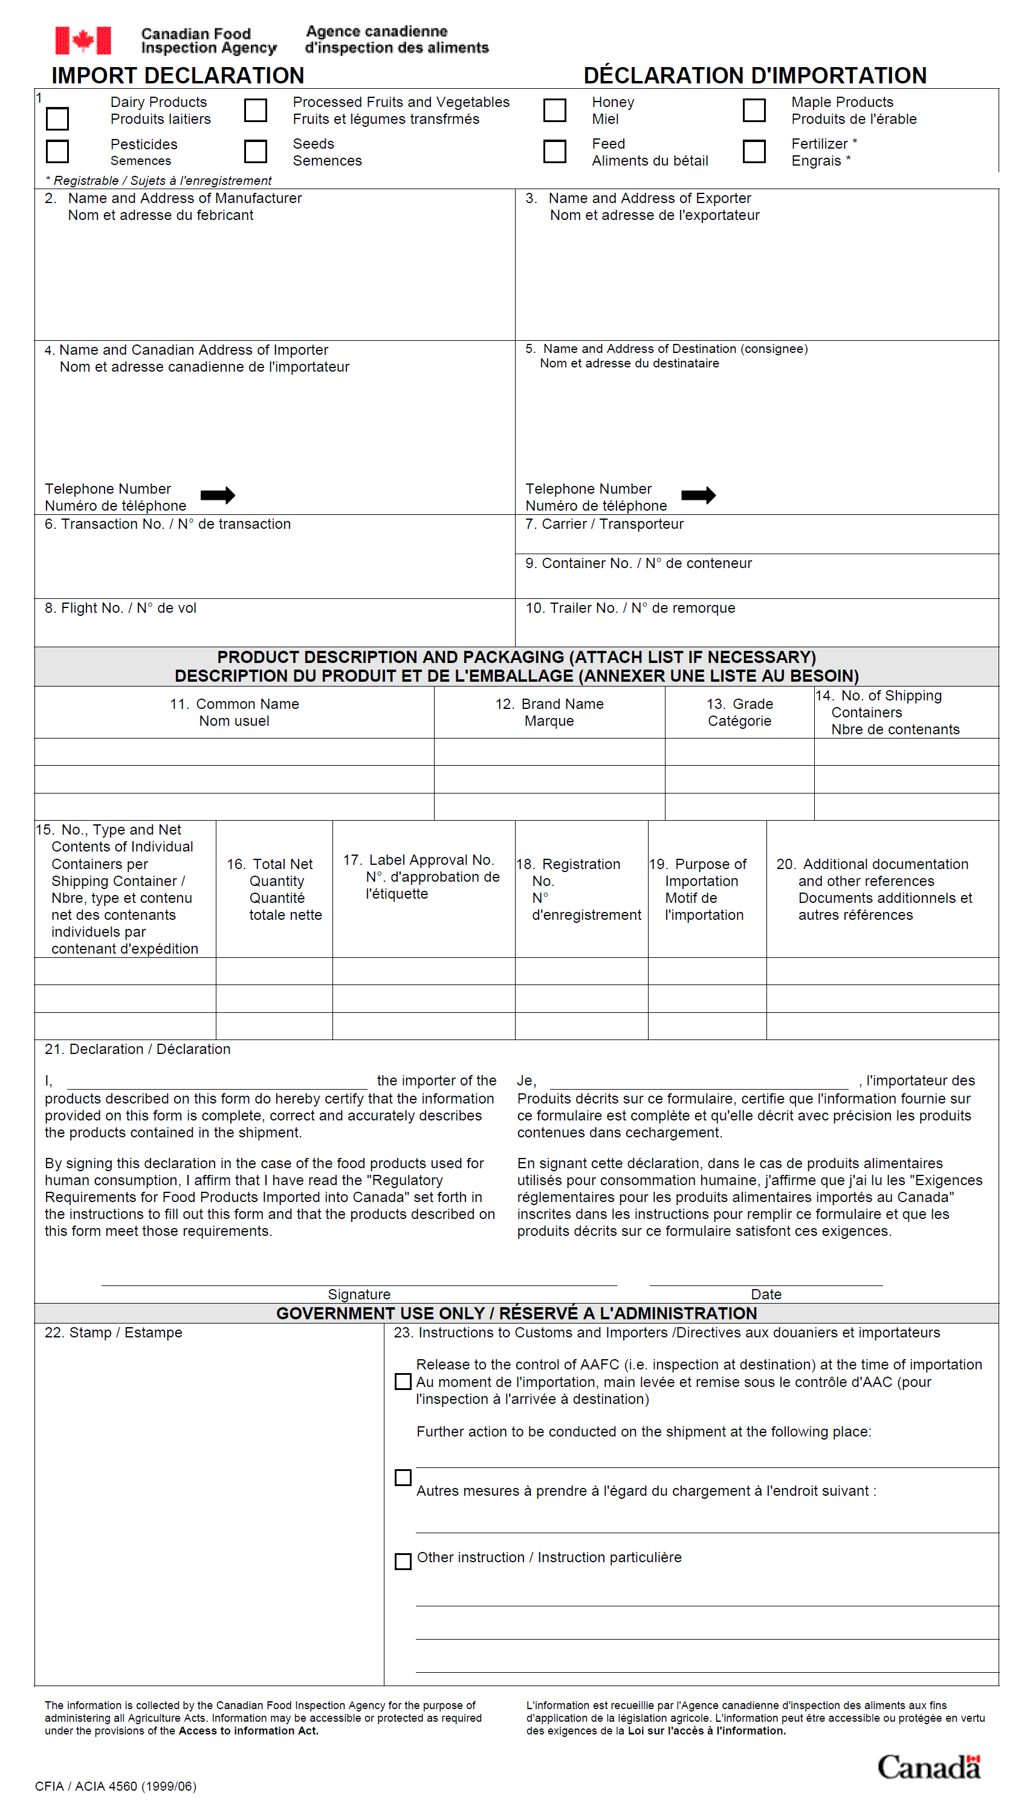
A Canadian Import Declaration.

Slide 40
Customs Clearance Process
Required Markings
All products must have the marking “Made in [name of country]” or “Product of [name of country].”
Merchandise Visas
For products whose importation is limited by quotas, and particularly for textile products, a bilateral monitoring system has been implemented by the importing and exporting countries. These types of goods require a special visa to be allowed in the importing country.

Slide 41
Customs Brokers
Customs Broker
An independent firm, representing the importer, and that has acquired the knowledge and experience required to make import entries efficiently and to deal with Customs effectively.
Customs Bond
Customs require the importer or the Customs broker to post a bond.
A bond is either a sum of money deposited with Customs, from which any unpaid duty can be withdrawn, or an insurance policy with a surety company that acts as a guarantor of the importer or the Customs broker, and which it would be required to pay if the duty were not paid on time.

Slide 42
Customs Standards
Reasonable Care
A standard of behavior, set and enforced by U.S. Customs, that is expected of importers if they want their Customs entries to be cleared quickly and keep Customs inspections to a minimum.
Informed Compliance
A standard of training and performance. If an importer has been found compliant, the likelihood that one of its shipments is going to be inspected is minimal, therefore minimizing delays at entry and allowing the importer to organize its supply chain more predictably. It also lowers costs, as merchandise is cleared quickly.

Slide 43
Duty Drawbacks
A duty drawback is a tax break granted by some countries, including the United States, to exporters who are using imported parts in the products they export.
In the United States, Customs will refund 99 percent of the duty paid by an importer for:
Imported products that are re-exported unused
Imported parts that are used — without substantial transformation — in the assembly or manufacturing of products that are eventually re-exported
Unfortunately, in many countries, including the U.S., the process of applying for duty drawback can be cumbersome.

Slide 44
Foreign Trade Zones
Foreign Trade Zones (or free-trade zones [FTZ]) are specific locations of a country that have acquired a special Customs status. They are areas of a country that, for Customs purposes, are located “outside” of a country. This means goods can be shipped to FTZs without paying duties or being subject to quotas.
It is only when the goods leave the FTZ and enter the country that they are subject to duty.
In most countries, goods admitted in an FTZ must be legal in the country in which the zone is located: the exemption applies only to Customs' purposes, not to other legal requirements.

Slide 45
Foreign Trade Zones
Exporter
Duty free
Foreign Trade Zone
Duty
Collected
Duty
Collected
Customers
Customers
Country A
Country B

