Slide 1
Chapter 14 Packaging for Export

Slide 2
Packaging for Export
Introduction to Packaging
Packaging for Each Mode of Transportation
Security
Hazardous Goods
Refrigerated Goods
Packaging as a Marketing Tool

Slide 3
Packaging Functions
Packaging has three functions:
It protects the goods during transport
It allows the handling of goods without damage
It is part of the customer service strategy of the firm: good packaging reflects positively on the exporter’s firm.
Although the costs of packaging generally increase as the protection of the goods increases, it is important to remember that insurers will deny damage claims if they observe improper packaging.
Packaging is always the responsibility of the exporter, regardless of the Incoterms® rule used in the transaction.

Slide 4
Packaging Terminology
Primary packaging is what the final consumer sees.
Secondary packaging is what the retailer/wholesaler handles.
Tertiary packaging is what is used for transportation.

Slide 5
Packaging Objectives
There are three objectives of proper tertiary packaging:
Protect the goods in transit from mechanical damage: breakage, crushes, nicks, and dents (these perils represent roughly 43 percent of all claims made by shippers to their insurance companies).
Protect the goods from water damage: sea water, rain, floods, and container sweat (15 percent of claims made).
Protect the goods from theft and pilferage (21 percent of claims made).

Slide 6
Ocean Cargo Packaging
Shipments that are small in size and weight can either be full-container-load (FCL) or less-than-container-load (LCL):
An FCL shipment utilizes the entire capacity of a container, whether it is by weight or by volume.
An LCL shipment utilizes less than the entire capacity, and is mixed with other goods, so that an entire container can be utilized. The other goods are from other shippers, and the remainder of the container is filled by a consolidator or a Non-Vessel-Operating Common Carrier.
Shipments of packaged goods that are not placed in a container are called “break-bulk” shipments.

Slide 7
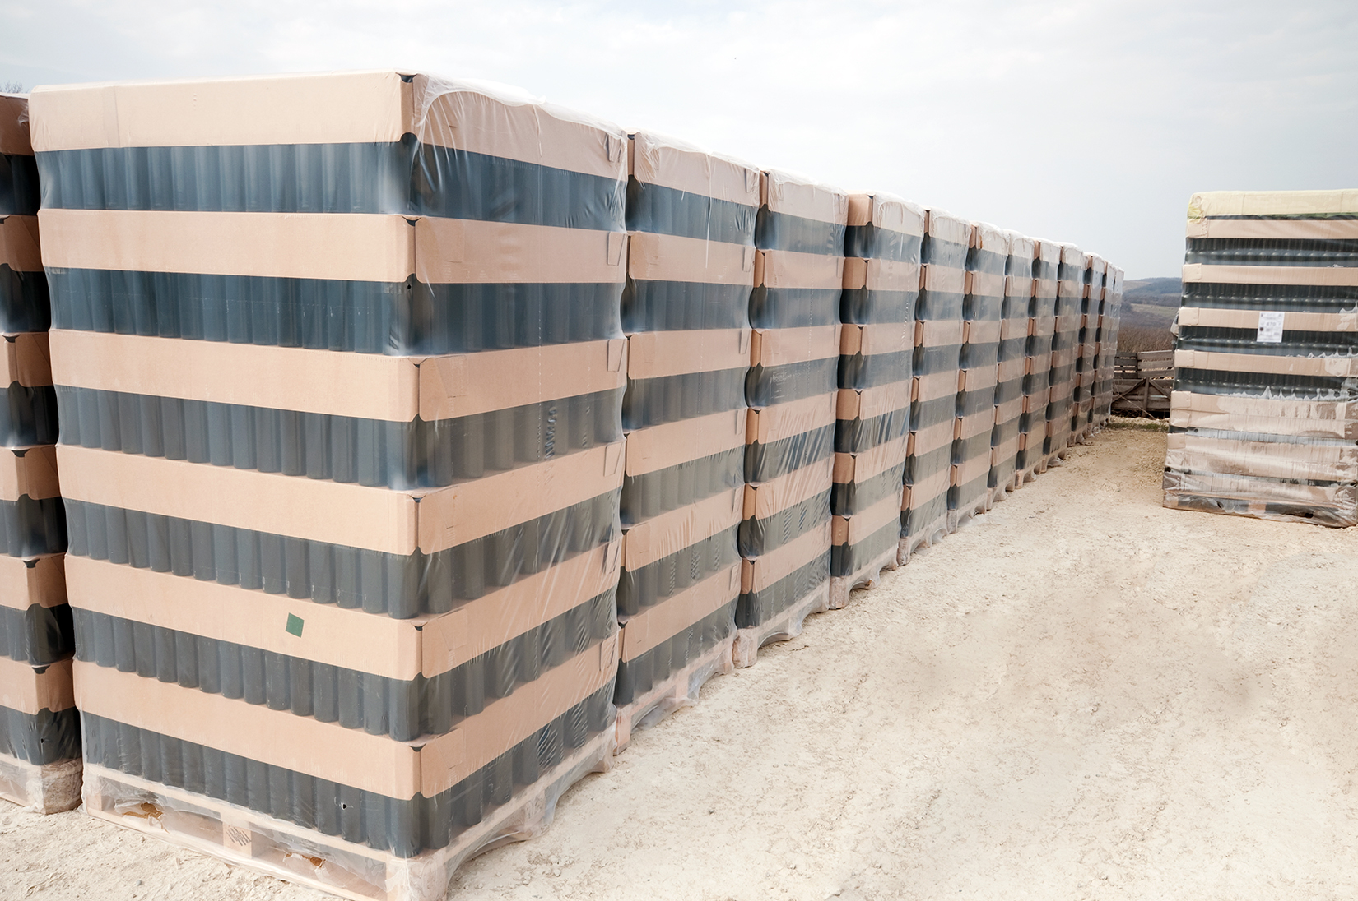
FCL ocean cargo should be unitized, so the use of mechanical equipment is necessary to move the goods as a unit. Most often, this is done with a pallet.

Slide 8
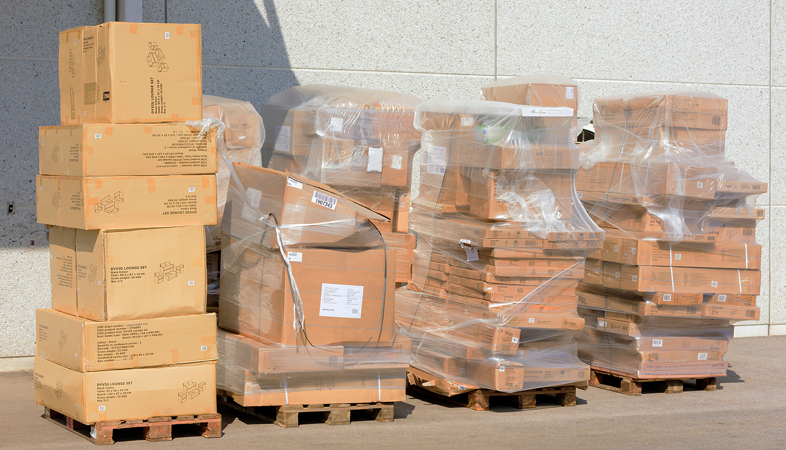
Pallets that are well constructed allow the goods to be protected during handling. Poorly-assembled pallets (mismatched cartons, no stretch wrap, no corner protection) give a poor image of the exporter.

Slide 9
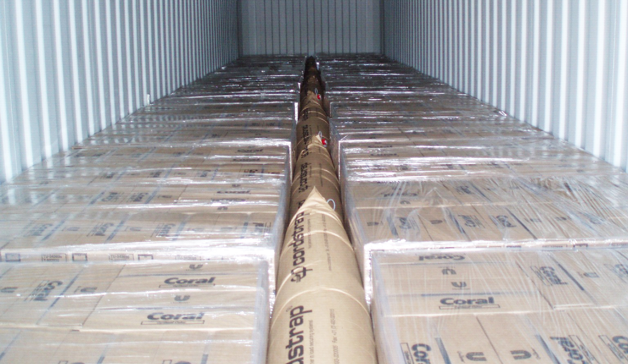
FCL palletized cargo should be prevented from moving in the container by using dunnage or blocking. Inflatable dunnage is always of the right size.

Slide 10
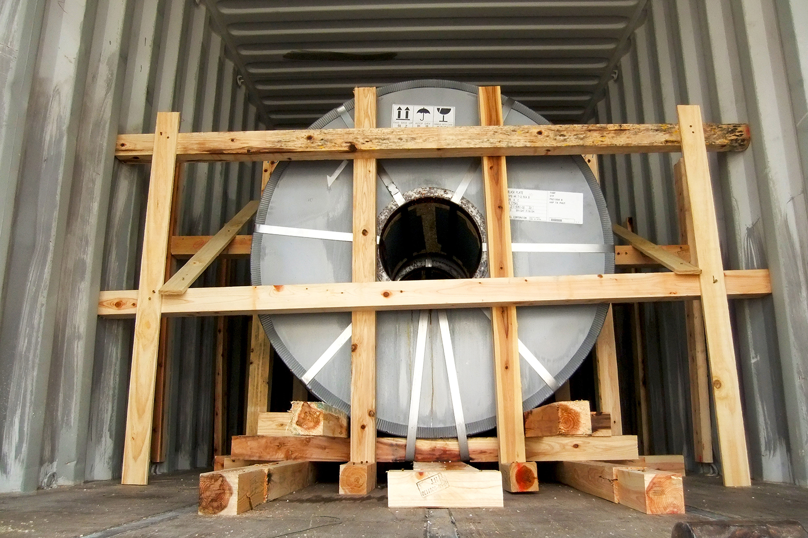
If the cargo does not fill the container completely, the goods should be centered in the container and solidly braced against the walls.

Slide 11
FCL Ocean Cargo
FCL cargo should be loaded according to the following rules:
The center of gravity should be at the center of the container, front-to-back, and side-to-side.
The heavier items should be at the bottom.
The goods should be braced with blocking or dunnage.
The goods should be placed on pallets or dunnage to raise them above the floor of the container (to protect them from water damage).
A desiccant should be used to protect from ambient humidity.

Slide 12
LCL Ocean Cargo
LCL cargo should be even better protected than FCL cargo. The goods are likely to be handled more frequently and be placed near goods that may not have been well packaged.
LCL cargo should be boxed or crated with strong corners (in case another cargo is placed on top of it), protected from humidity with shrink wrap or stretch wrap, and well marked with handling instructions.

Slide 13
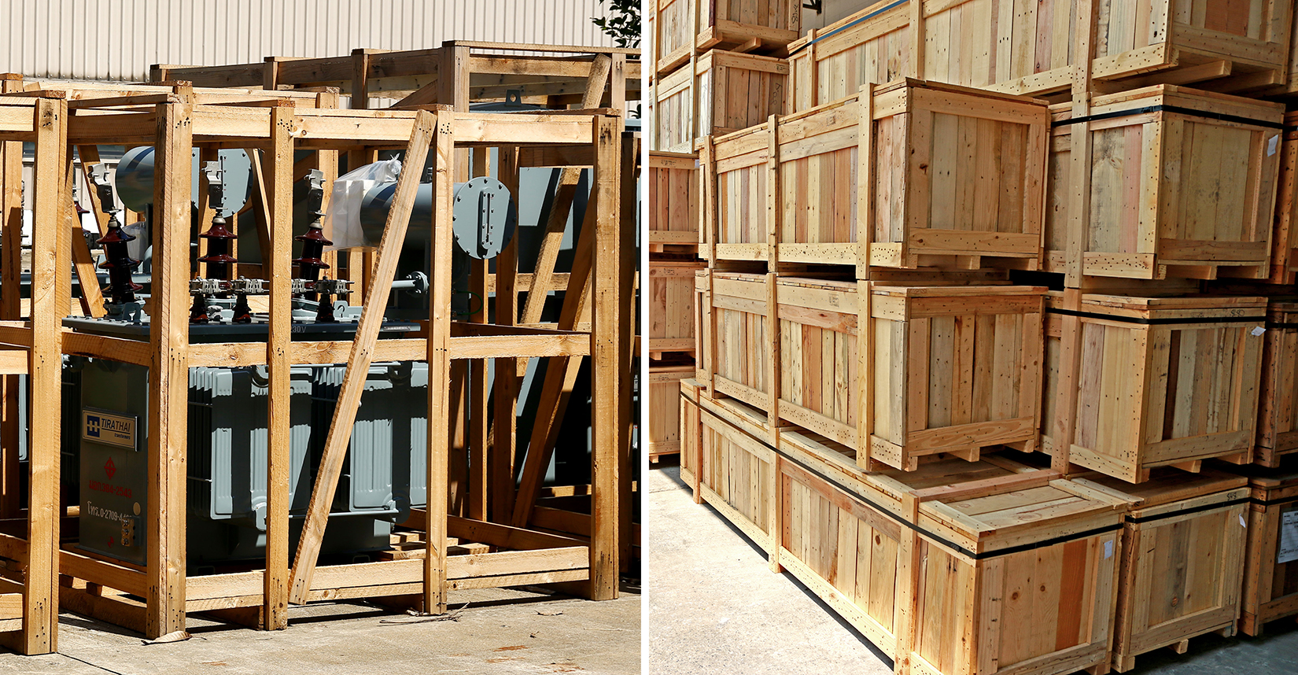
Crates and boxes used for LCL cargo.

Slide 14
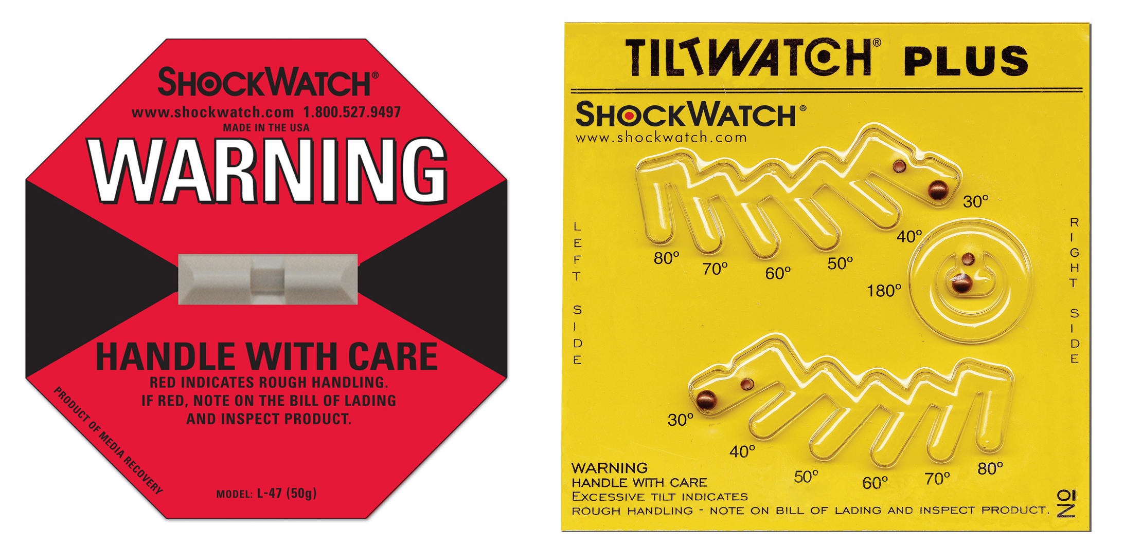
Two means of recording whether a box was mishandled in transit.

Slide 15
Breakbulk Ocean Cargo
Breakbulk cargo (general cargo) is not placed in a container, but is placed directly into the hold of a ship. It is generally too large or too heavy to be placed in a container.
Breakbulk cargo must be packaged so that it can be handled at all steps of the voyage. Most of the time, it is placed in crates or boxes.
Some breakbulk cargo is placed on flat-top containers if it is small enough to be placed on top of a stack of containers.

Slide 16
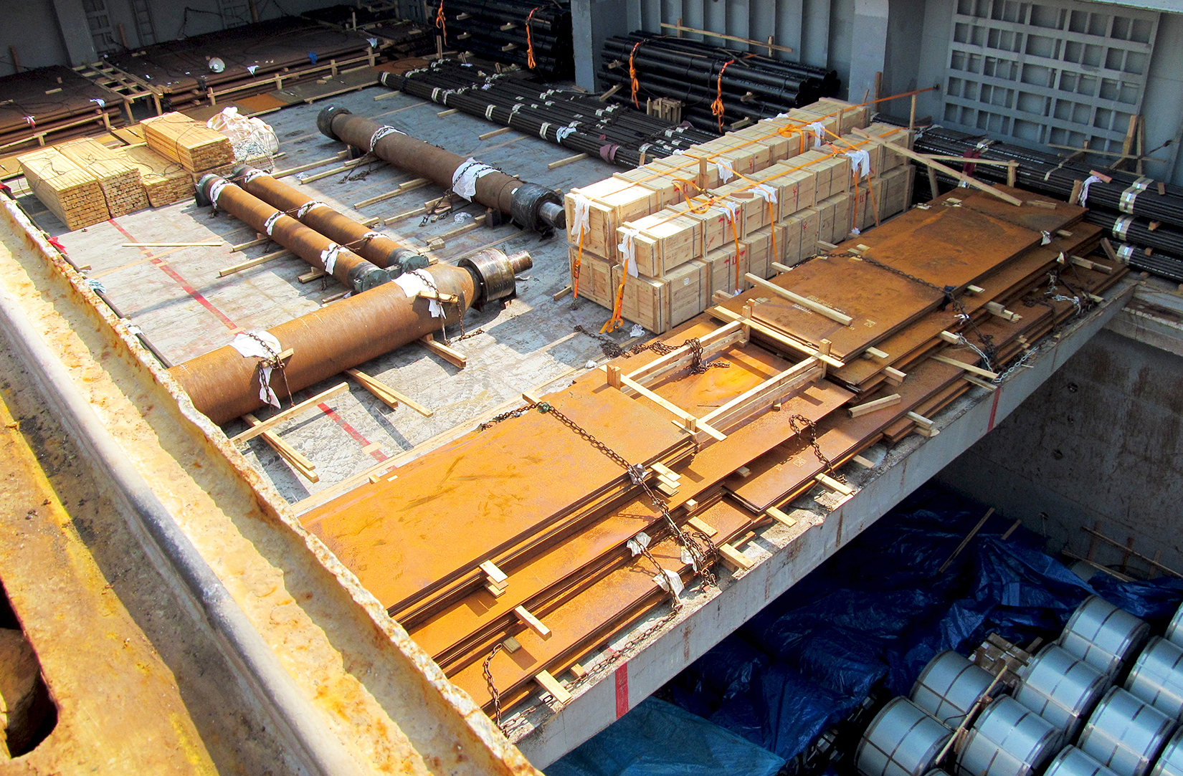
Breakbulk goods are placed directly in the cargo hold of a breakbulk ship. Some are in boxes.

Slide 17
Breakbulk Ocean Cargo
Breakbulk packaging alternatives includes unitized packages that can be handled by human labor, such as bags, bales, or drums, and those can be only be handled with mechanized equipment, such as flexible intermediate-bulk containers and rolls.
Some breakbulk cargo is actually not packaged at all and the goods are placed directly in the ship’s hold.

Slide 18
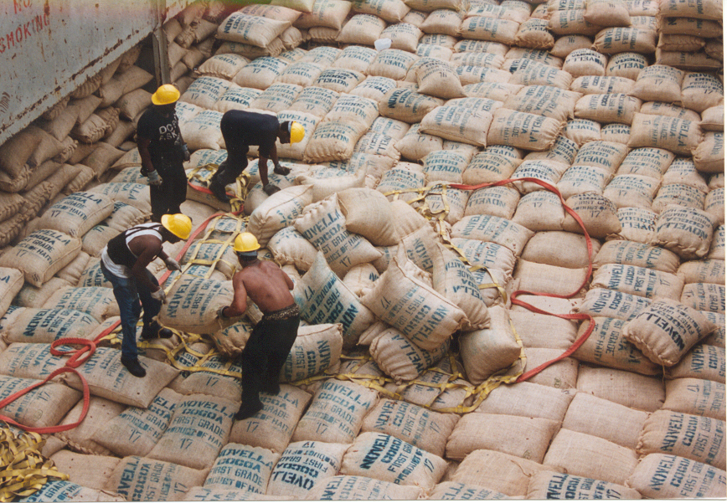
Cocoa beans bags placed directly in the cargo hold of a ship.

Slide 19
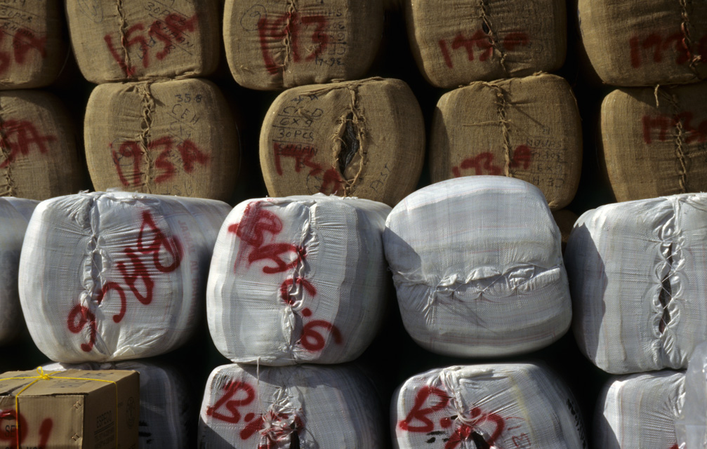
Cotton packaged in bales in a warehouse awaiting shipment.

Slide 20
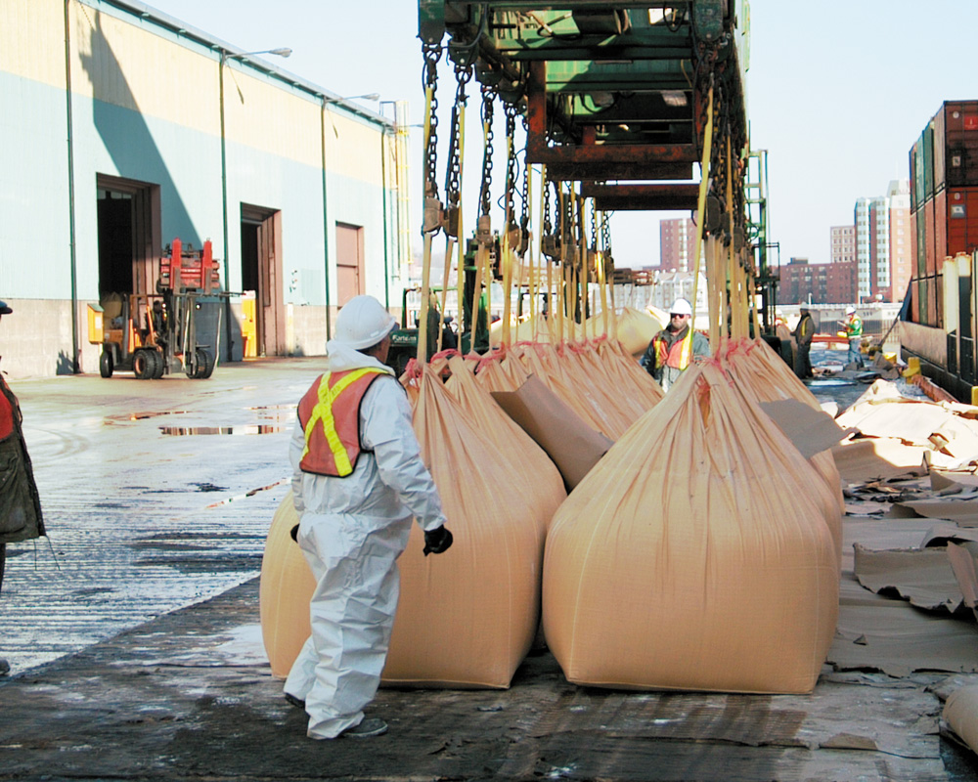
Tapioca packaged in flexible intermediate-bulk containers.

Slide 21
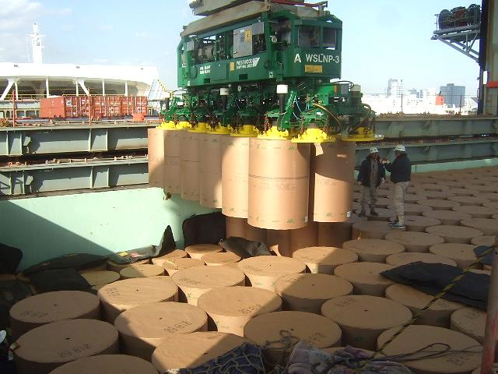
Rolls of paper unloaded with a vacuum system.

Slide 22
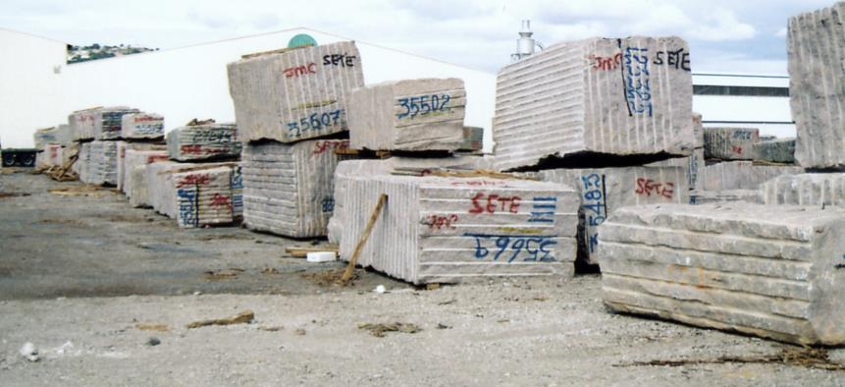
Granite blocks in the port of Sète, France, and on their way from the port to a finishing plant.

Slide 23
Breakbulk Cargo Markings
The International Plant Protection Convention (IPPC) mandates that wood used for packing or dunnage be treated with chemicals to prevent insect infestations.
Marking international shipments with international handling pictorials help protect them from poor handling (they are not language specific), as well as from theft and pilferage.

Slide 24
The International Plant Protection Convention (IPPC) mandates that wood used for packing or dunnage be treated with chemicals to prevent insect infestations.

Slide 25
Marking international shipments with international handling pictorials help protect them from poor handling, as well as from theft and pilferage.

Slide 26
Bulk Cargo
Bulk cargo (dry or wet bulk) is cargo that is placed directly in the holds of the ship, without packaging of any kind.
Containerized cargoes and breakbulk cargoes are loaded and unloaded using cranes, one unit at a time.
In contrast, bulk cargo is loaded and unloaded with continuous methods such as vacuum pumps, conveyor belts, pipes, augers, ...and so on.

Slide 27
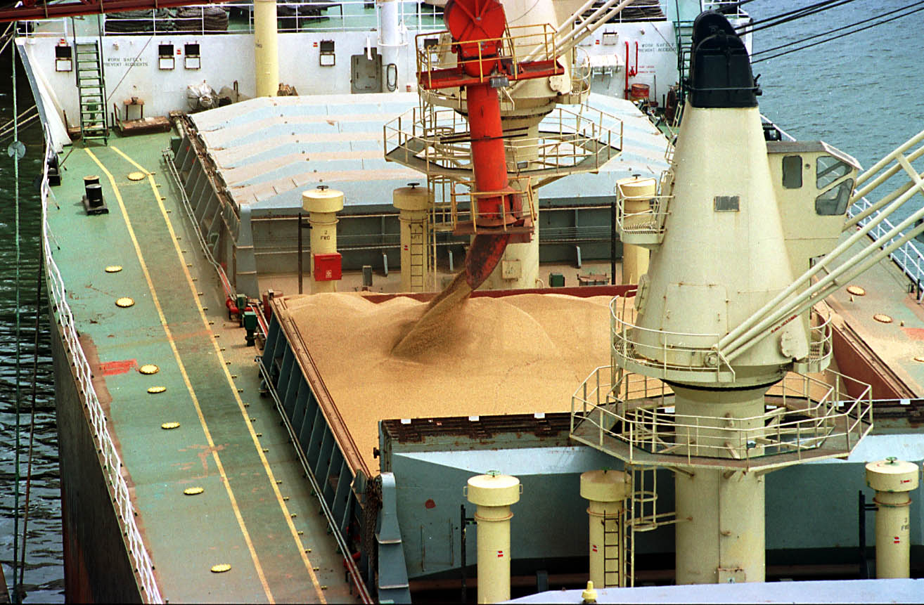
Dry bulk cargo (grain) is loaded using a conveyor belt and a chute.

Slide 28
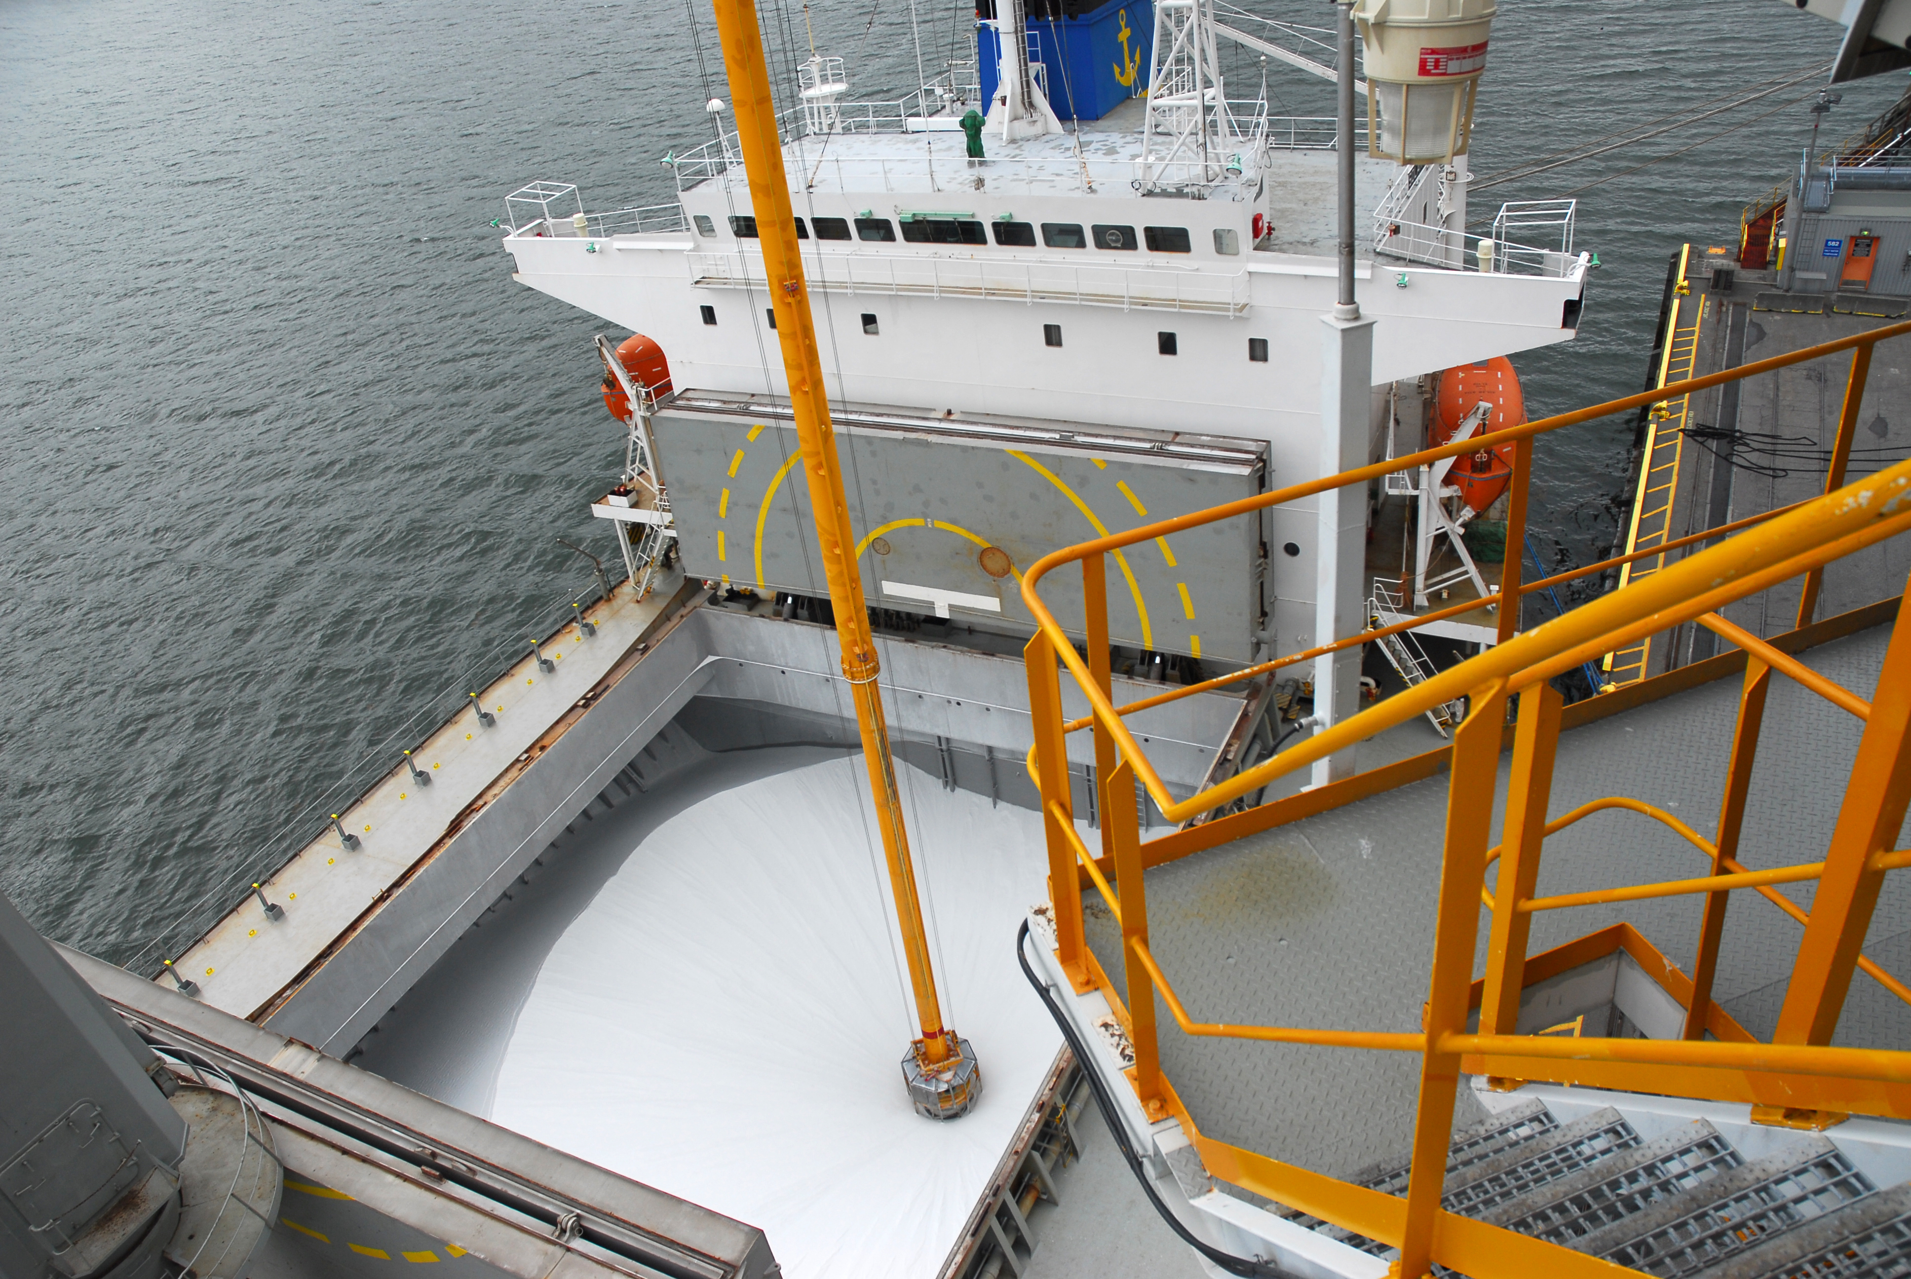
Dry bulk cargo (alumina) can be unloaded using a vacuum pump.

Slide 29
Air Transport
Air transport is less hazardous to cargo than ocean transport: nevertheless, cargo should be well protected for air transport.
Secondary packaging is not appropriate for air shipment because it does not sufficiently protect goods during the flight and airport handling operations, and the commercial markings of the packaging make the goods a tempting target for thieves.
Air cargo containers are designed to facilitate the loading and unloading of aircraft, and not to act as intermodal containers used in other means of transportation.

Slide 30
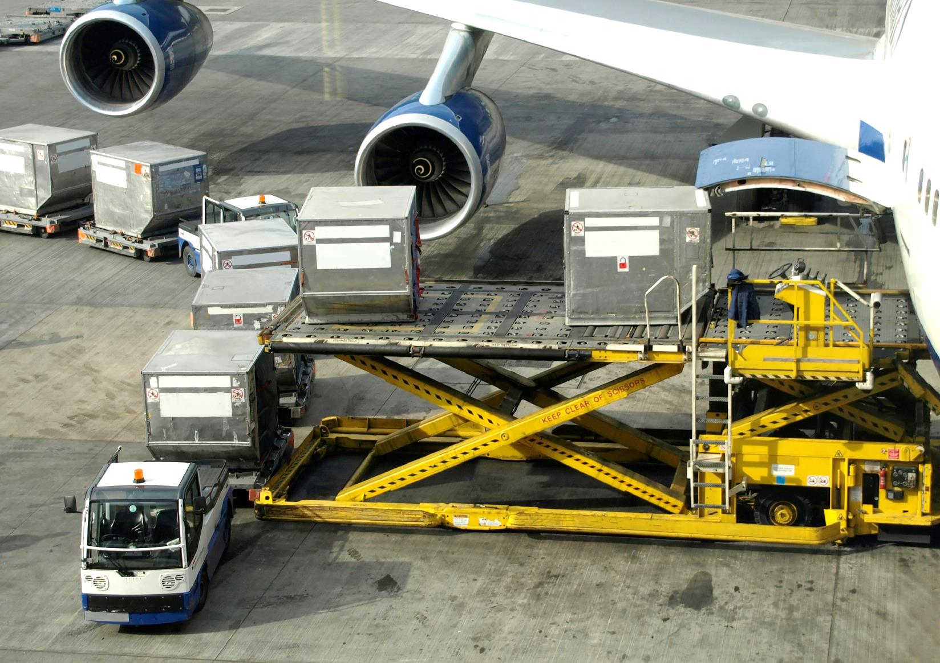
Air cargo containers are different from ocean cargo containers and only facilitate handling.

Slide 31
Road and Rail Transport
Goods will generally travel by road for a portion of their international voyage, but the main international carriage can be by ocean, air, or rail. Packaging needs are dictated by the main mode of transportation.
Rail transportation requires the same level of packaging as ocean transportation; goods are subjected to sudden accelerations and decelerations, as well as exposure to bad weather and changing temperatures.
Rail companies provide packaging guidelines for shippers.

Slide 32
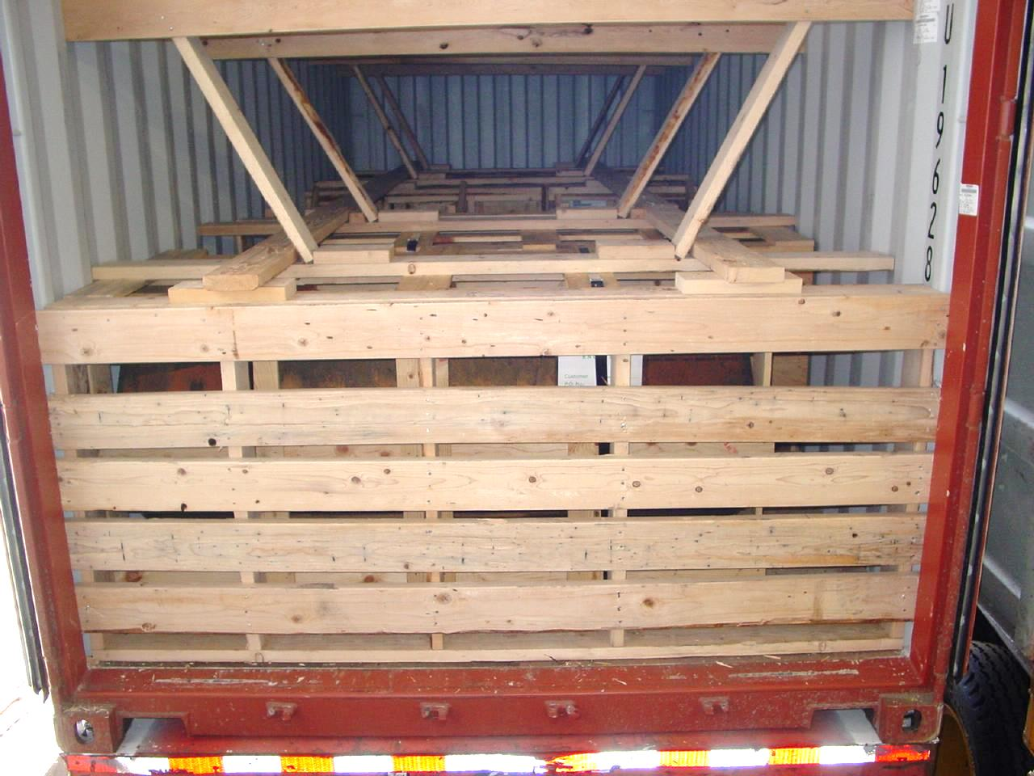
Container cargo traveling by rail should be as carefully braced as it is for ocean transportation.

Slide 33
Security
Packaging security issues center around pilferage and theft.
Good packaging security practices include:
Tamper-proof seals on all FCL shipments.
Measures designed to hide the nature of the goods being shipped (making secondary packaging “anonymous”).
Measures designed to keep shipment information confidential.

Slide 34
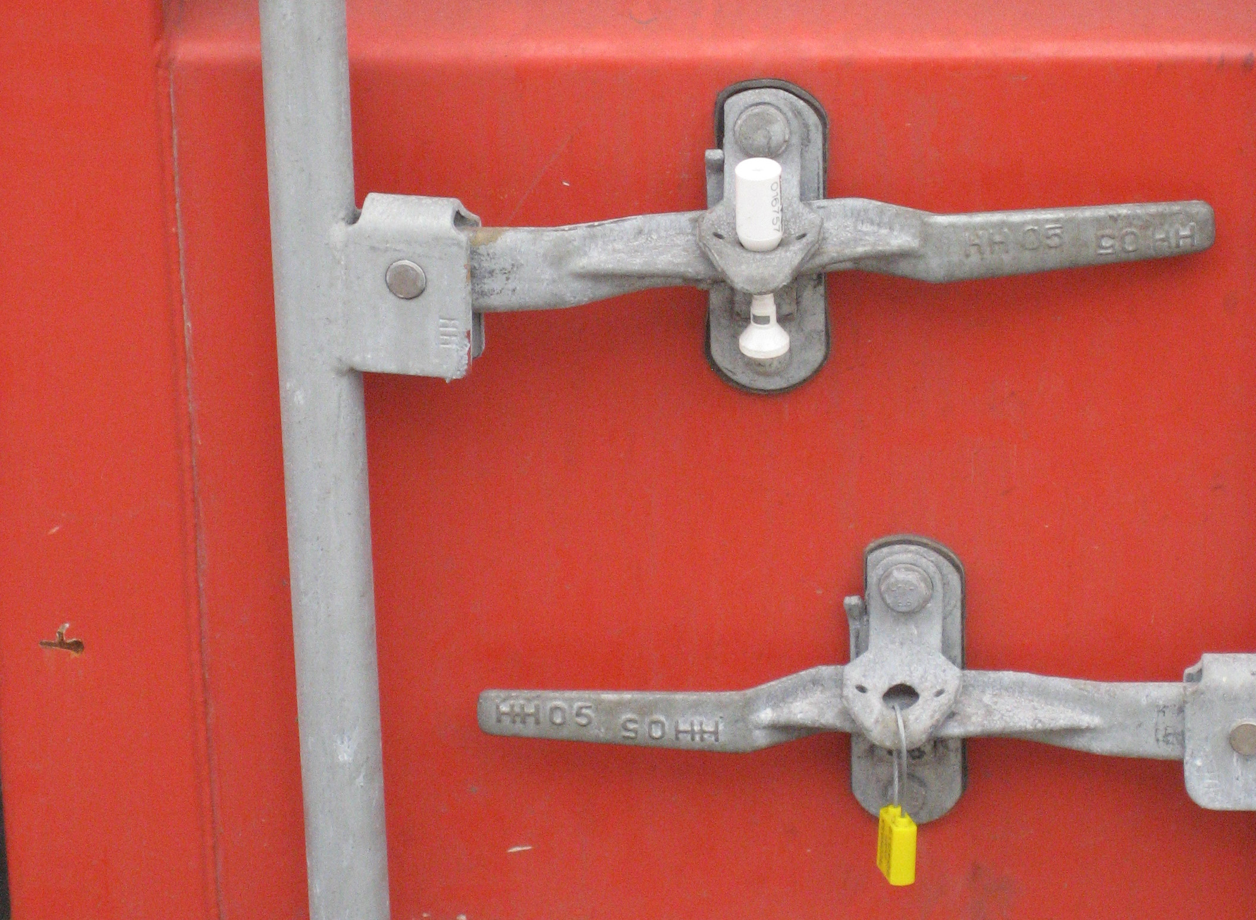
Container seals: the top one is a bolt seal, the bottom one is a wire seal. Bolt seals are required for shipments to the United States.

Slide 35
Dangerous Goods
Hazardous cargo can be shipped by ocean and by air, but most dangerous goods (flammable, explosive, or toxic goods) are shipped by ocean.
If they are containerized, they are shipped “above deck” rather than “under deck.”
The shipment of dangerous goods by sea is regulated by the International Maritime Organization.
The shipment of dangerous goods by air is regulated by the International Air Transport Association (IATA).

Slide 36
Refrigerated Goods
Goods requiring refrigeration make up another category of cargo that demands particular care and specialized packaging services.
Refrigerated goods usually require very specific handling, and therefore, most refrigerated goods travel “alone,” and are not mixed with other refrigerated goods.
Goods requiring refrigeration are placed in refrigerated containers that are self-powered, or powered through the ship’s electrical system. They can also be placed in refrigerated holds in the ship.

Slide 37
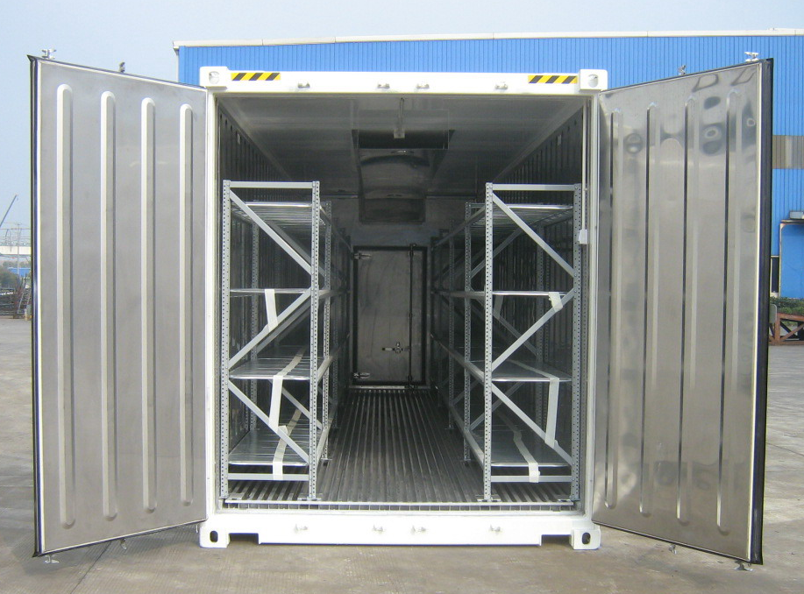
Reefers sometimes include shelves to facilitate air circulation and prevent temperature differences in the unit.

Slide 38
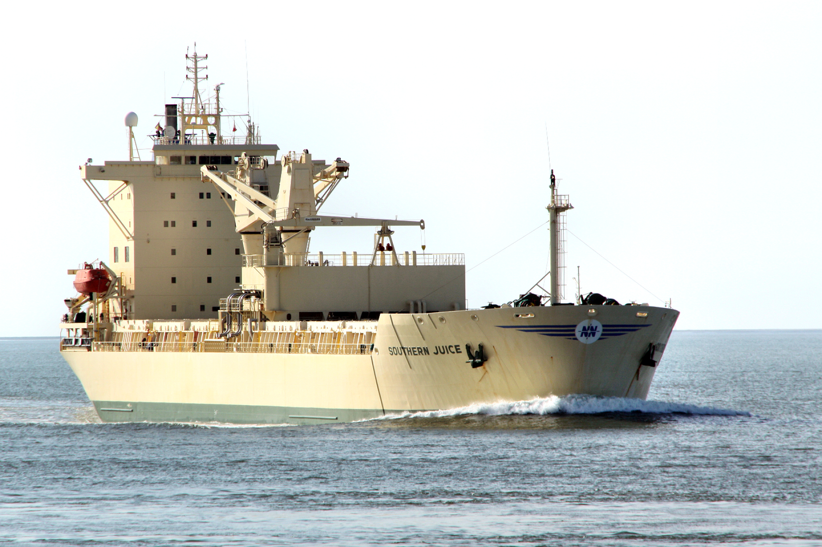
Refrigerated cargo can travel by refrigerated ship; a ship designed to transport fruit juice.

Slide 39
Retail Packaging Issues (I)
Consumer packages (primary packaging) may need to be different from country to country to accommodate consumer preferences.
Packaging Size
Consumer preferences dictate packaging sizes: products are smaller in countries in which retail shopping is done frequently, and larger in those in which consumers shop at greater intervals.
Packaging Design
The customary design of the package for a type of product may be different. The color preferences may be different. The shape or materials of the package may be different.

Slide 40
Retail Packaging Issues (II)
Consumer packages (primary packaging) may need to be different from country to country to accommodate legal and environmental requirements.
Legal requirements
Legal requirements influence the sizes of packages; some countries require multiples of simple metric units (one kg or one liter).
Storage and Transportation Environment
There are a number of environmental factors, such as high humidity, heat, or cold, that influence the design and materials used in primary packaging.

Slide 41
Retail Packaging Issues (III)
Secondary packaging may need to be different from country to country to accommodate trade requirements.
Legal requirements
Laws may restrict the size of secondary packaging. For example weight must be kept below a threshold, so that it can be handled by hand.
Storage and Transportation Requirements
There may be a standard pallet size that dictates how large a secondary packaging unit must be.

Slide 42
Packaging as a Marketing Tool
A benefit of a good packaging policy is the goodwill that it generates with the importer, and the marketing benefits that can be derived from it.
Importers welcomes shipments that arrive packaged carefully enough that they do not have to worry about having to challenge invoices or ask for the replacement for damaged goods.
Good packing enhances the relationship between exporter and importer, and builds trust.

