Slide 1
Chapter 13 Multimodal Transportation

Slide 2
Multimodal Transportation
Truck Transportation
Rail Transportation
Intermodal Transportation
Freight Forwarders
Project Cargo
Other Means of Transportation

Slide 3
Truck Transportation
In many parts of the world, trucking is a vital way of shipping internationally.
In some areas of the world, it represents 100 percent of the international traffic.
In others, it is a lower percentage, but trucking is still a significant part of the international traffic volume.
Importantly, though, trucking is almost always the mode of transportation for the “first mile” and the “last mile” of a shipment’s itinerary.

Slide 4
Truck Transportation
The critical issues for a shipper using truck transportation are the many different national rules and regulations that govern truck transportation. These rules influence:
The weight that can be placed in the truck
The hours that the truck can operate
The size of the equipment that can be used
The number of hours a driver may work
The training that a driver must have
These differences make for very different trucking practices from country to country.

Slide 5
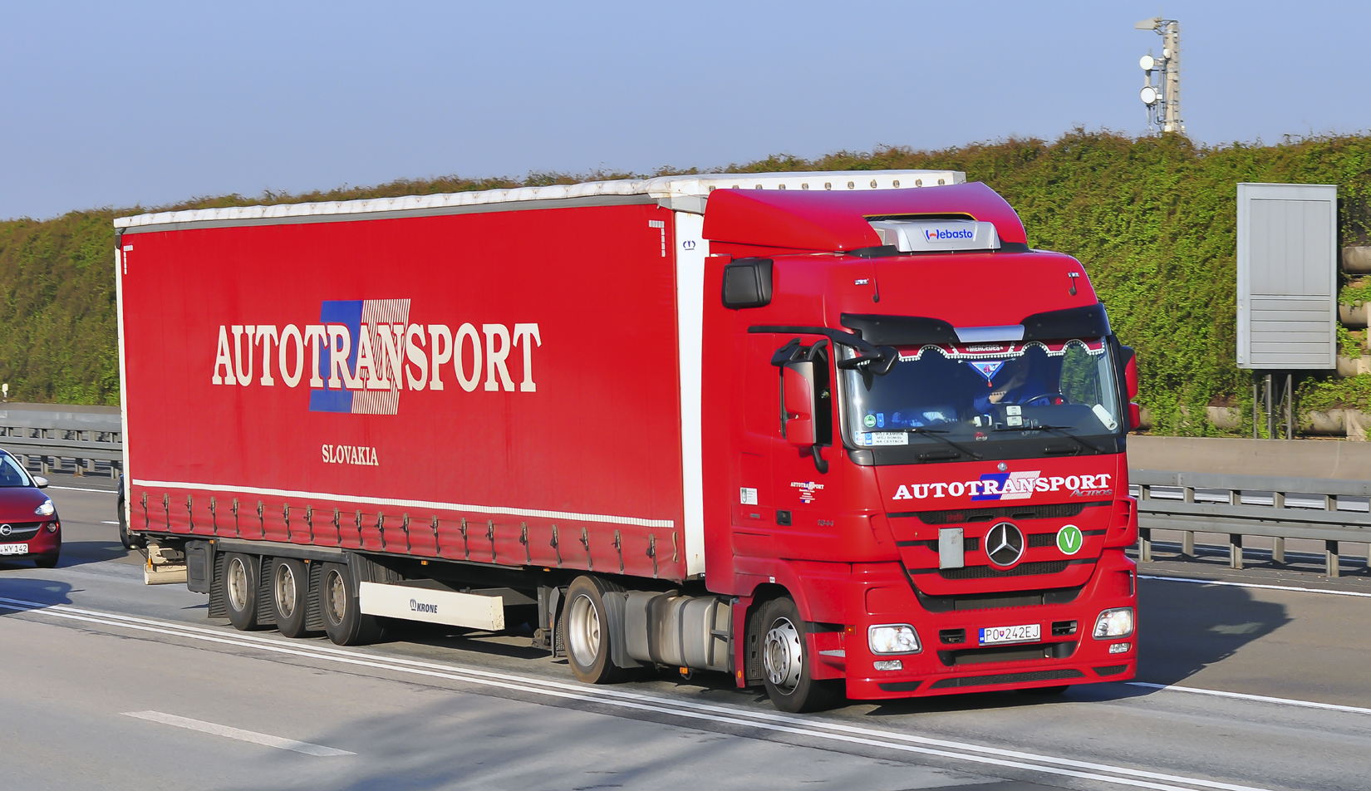
A European truck is limited to an overall length. The tractor is compact to allow for maximum trailer size.

Slide 6
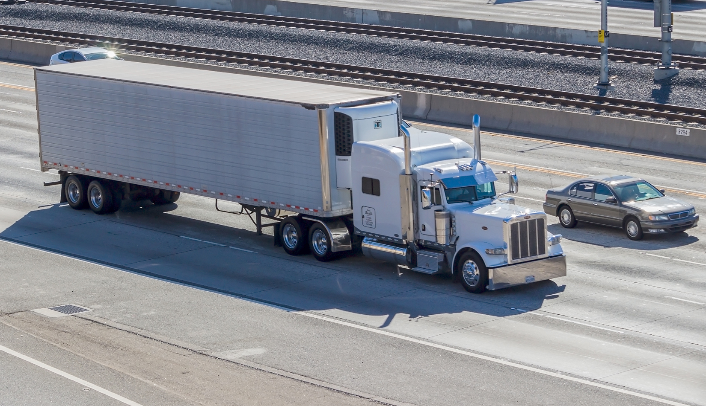
North American trucks are limited by the size of the trailer, with no constraints on the size of the tractor.

Slide 7
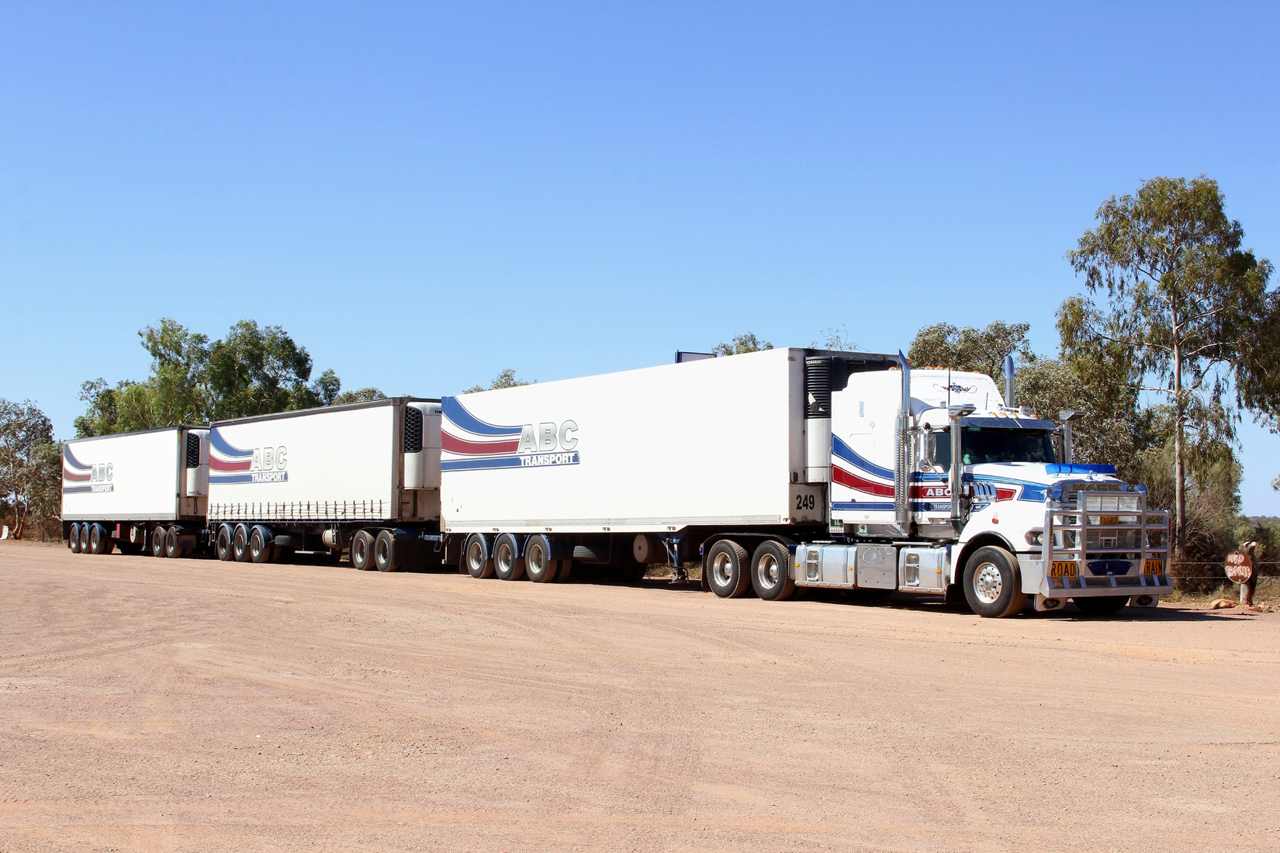
Australian trucks have fewer limitations on the number of trailers, leading to the concept of “road-trains.”

Slide 8
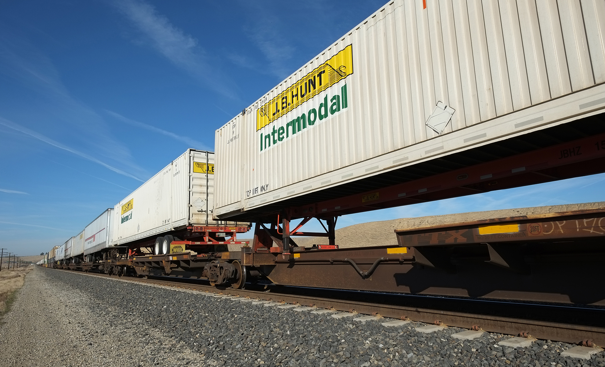
North American trailers are carried over long distances by “piggy-back” trains.

Slide 9
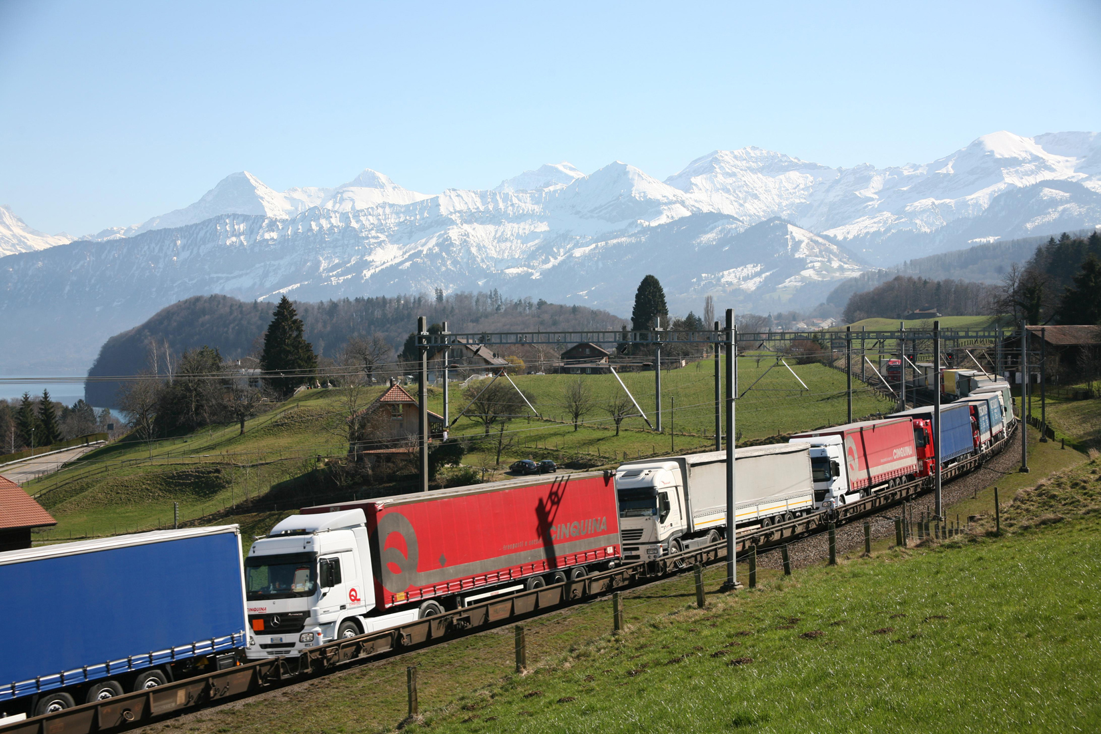
In Switzerland, regulations do not allow international trucks to cross the country. They are transported by piggy-back trains from one border to the other.

Slide 10
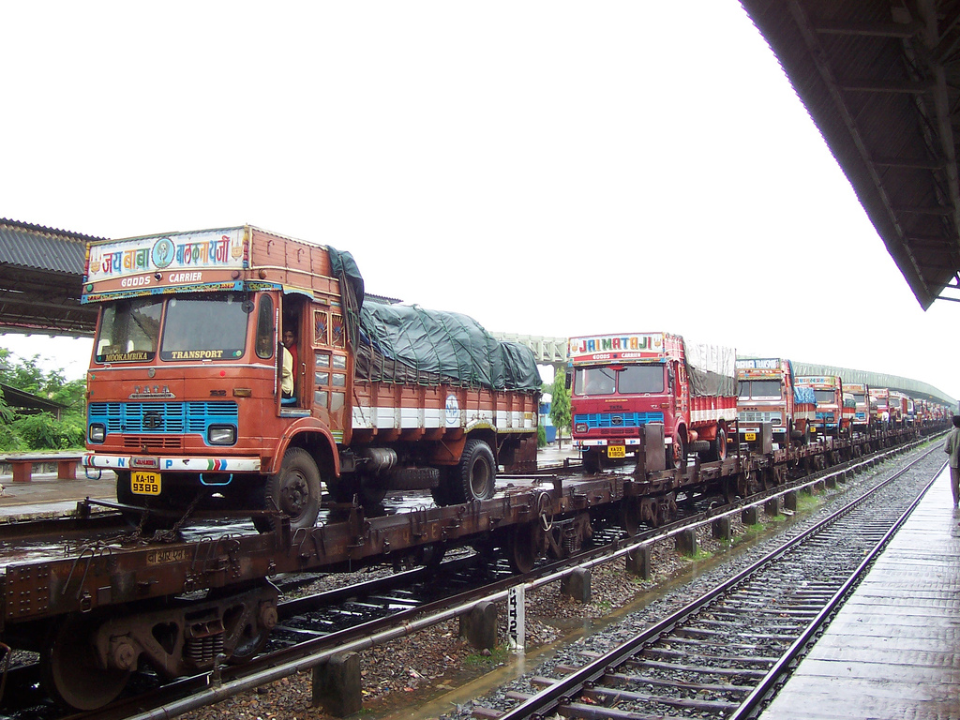
In India, congested roads encourage truckers to use piggy-back trains on some routes.

Slide 11
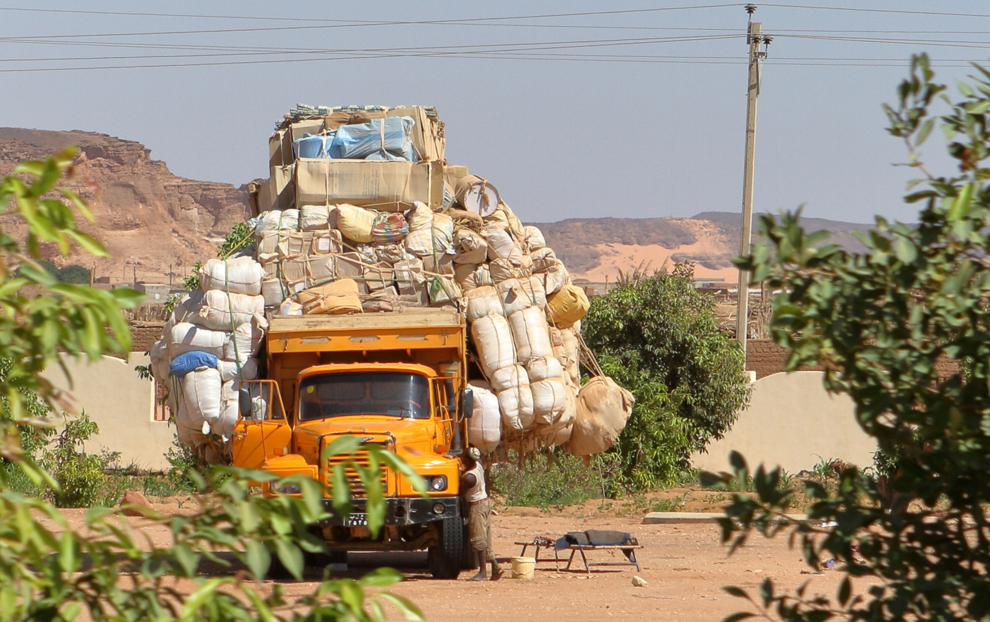
In many developing countries, the maximum weight capacities of trucks are routinely exceeded.

Slide 12
Rail Transportation
Rail transportation is also an important mode of transportation for international shipments, although it is mostly a domestic mode for the United States.
Nevertheless, a significant amount of cargo moves by rail in the U.S. In 2012, more than 40 percent of all ton-miles shipped long-distance in the U.S. was shipped by rail.
Rail transport has an approximate 18 percent market share for international cargo movements in the European Union when measured in FTKs.

Slide 13
Rail Transportation
Rail transportation is dominated by three issues:
The ownership of the railroad, which can be private (the United States) or public (most of the remainder of the world).
The infrastructure, such as issues of gauge (width of the tracks), electrification, curves, maintenance, and so on, which dictates the types of goods shipped and the speed at which they are delivered.
The relationship between passenger traffic and merchandise traffic, and which has priority over the other. In the U.S., merchandise traffic has priority, in many other countries, it’s passenger traffic that has priority.

Slide 14
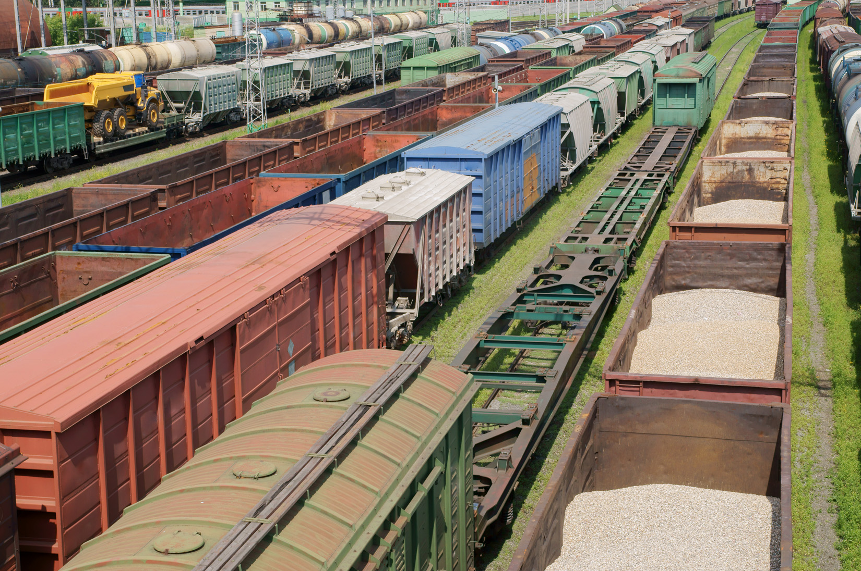
Traditional railcars tend to be specialized. General merchandise is transported in boxcars.

Slide 15
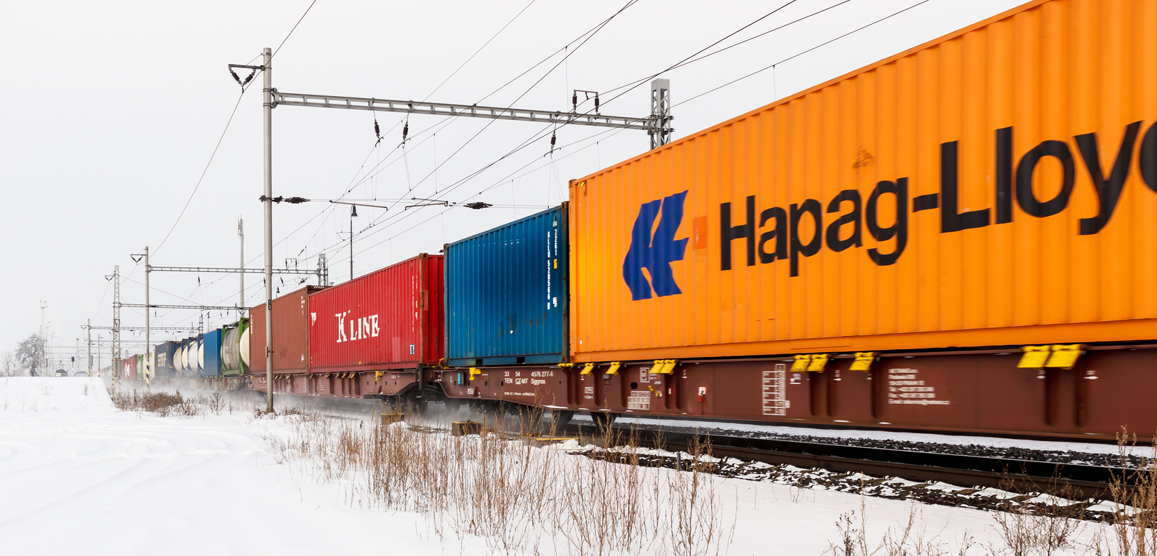
European trains carry containers in single stack because of the overhead electric lines.

Slide 16
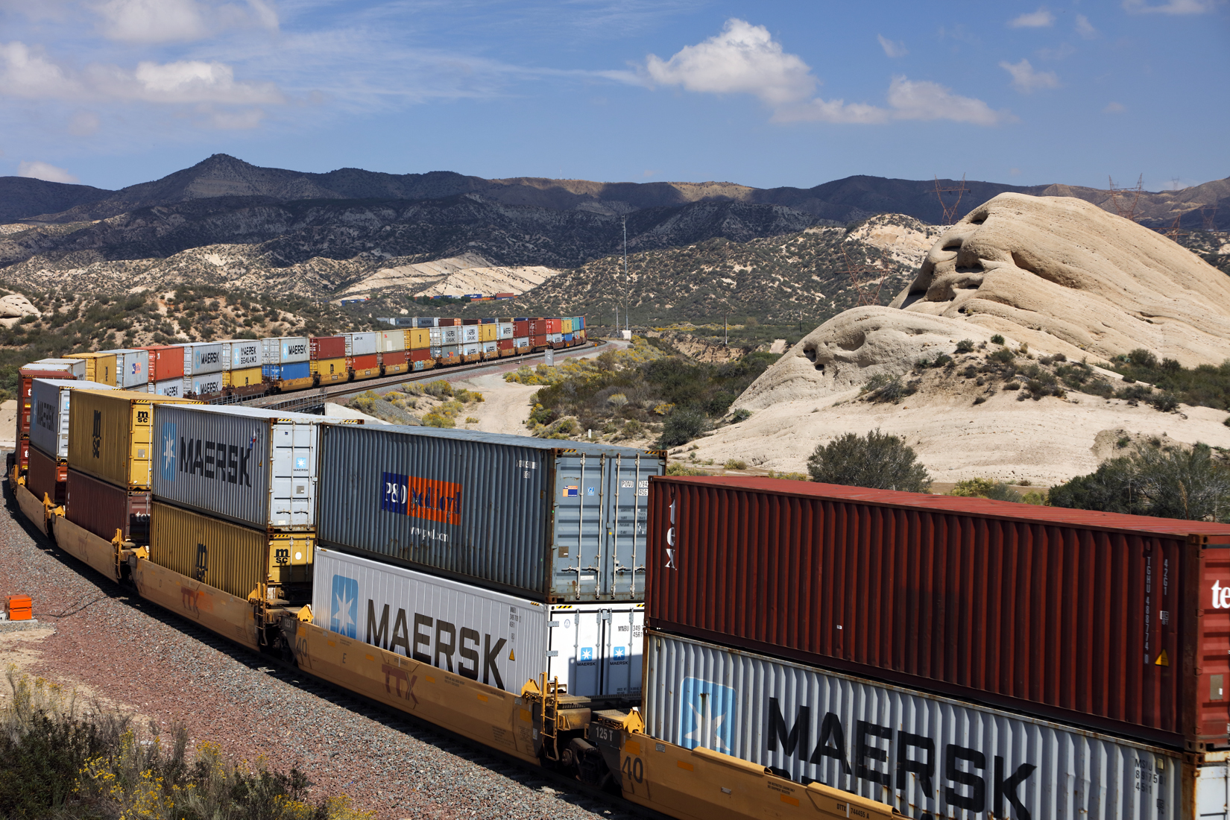
North-American trains carry containers in double stacks.

Slide 17
Intermodal Transportation
A shipment that takes more than one mean of transportation from its departure to its point of destination, using only one bill of lading, is said to be intermodal or multimodal.
Another term used for the same concept is co-modality.
International intermodal transportation is strongly linked to the creation of the container, which is ideally suited to be shipped by truck, train, or ship, and can be easily transferred from one mode of transportation to another.
The modern container was invented by Malcom McLean.

Slide 18
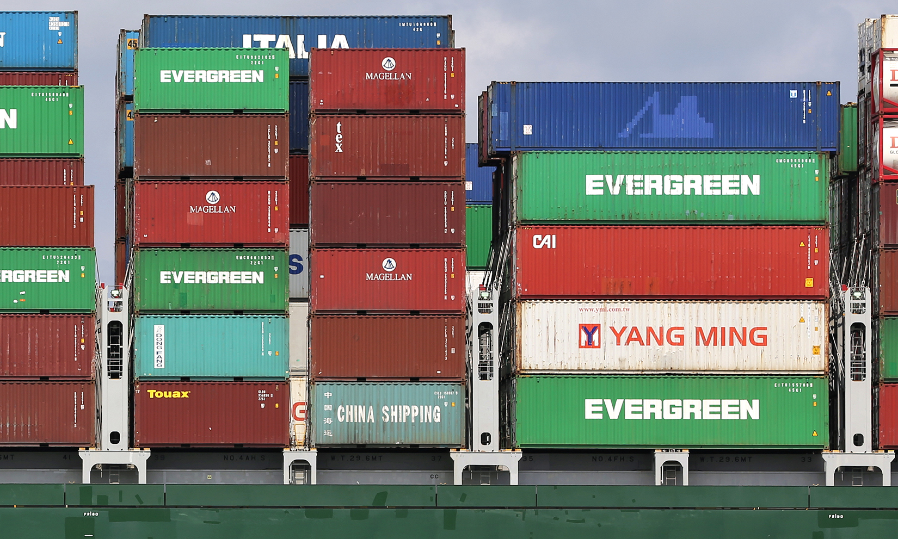
The most common containers are the 40-foot high-cube container, on the right, and the 20-foot container, on the left.

Slide 19
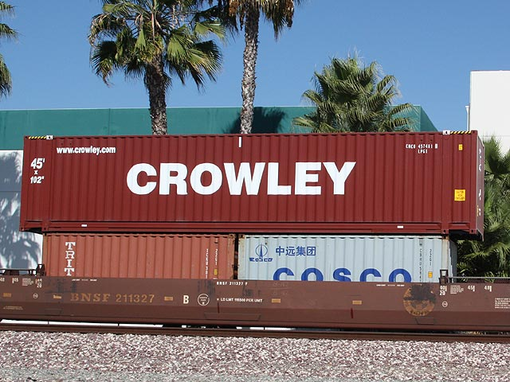
Oversize goods can be shipped in an extended-length container (45-foot long in this case).

Slide 20
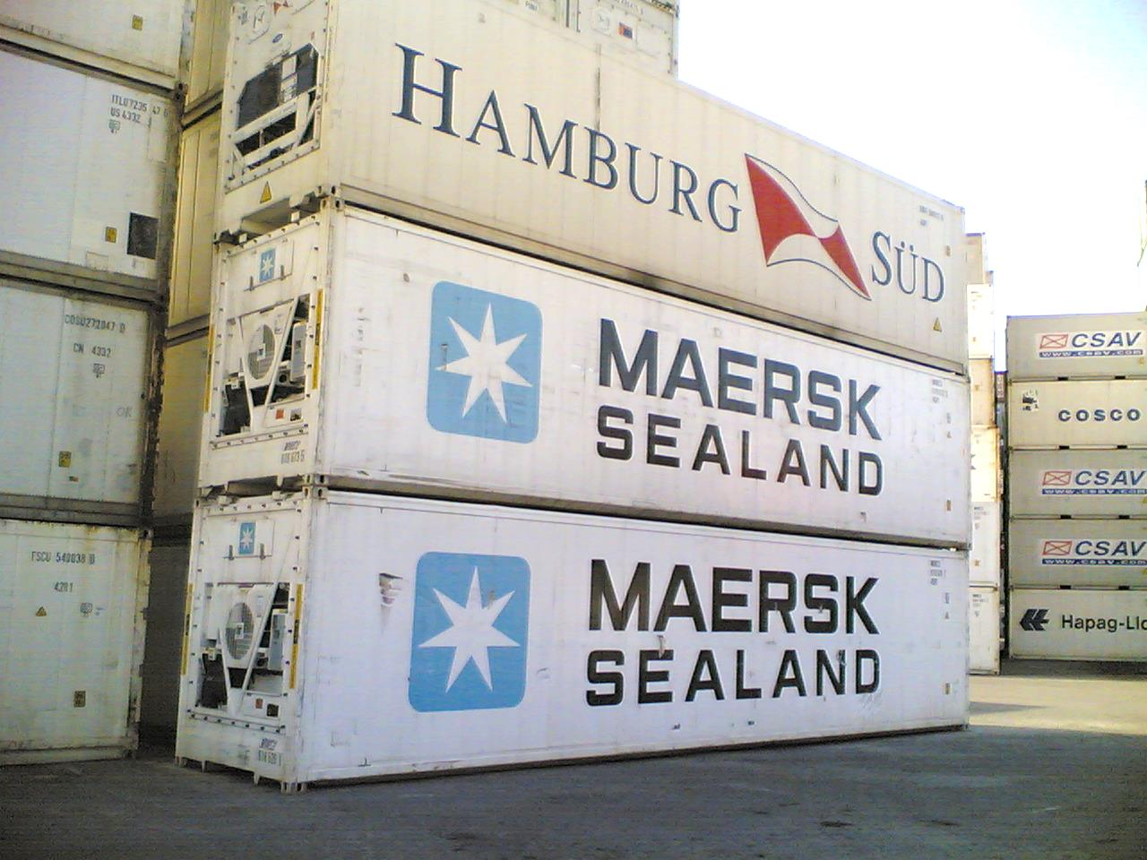
Goods that need a controlled-temperature environment are shipped in refrigerated containers, or “reefers.”

Slide 21
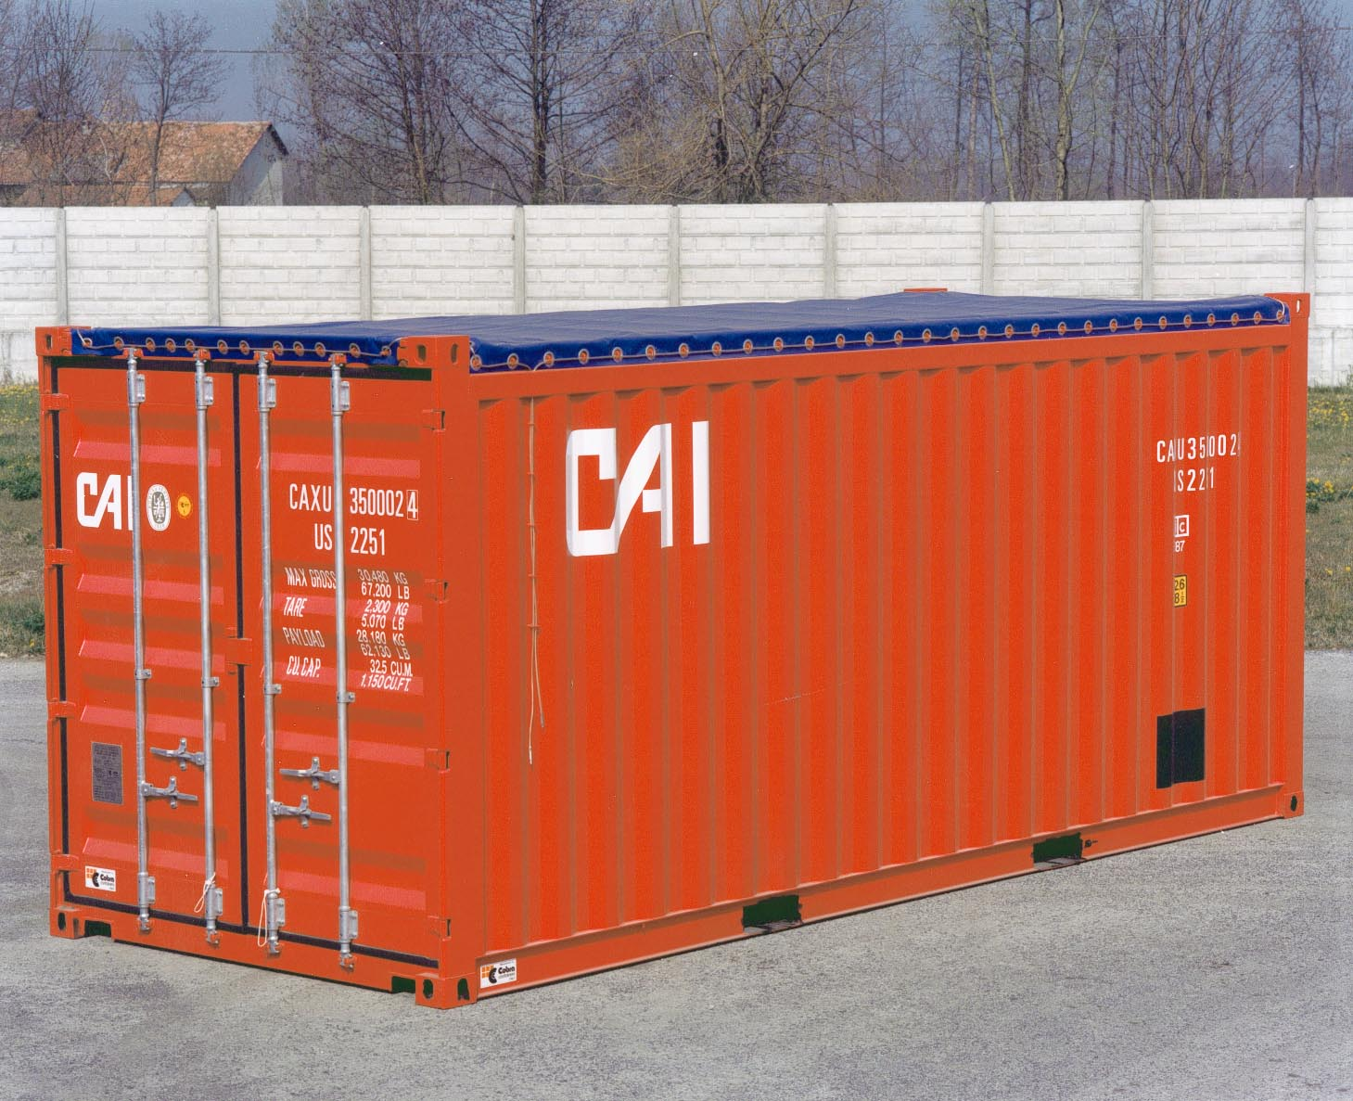
Goods that cannot fit through the doors of a traditional container are shipped in an “open-top” container, that is eventually covered with a tarpaulin.

Slide 22
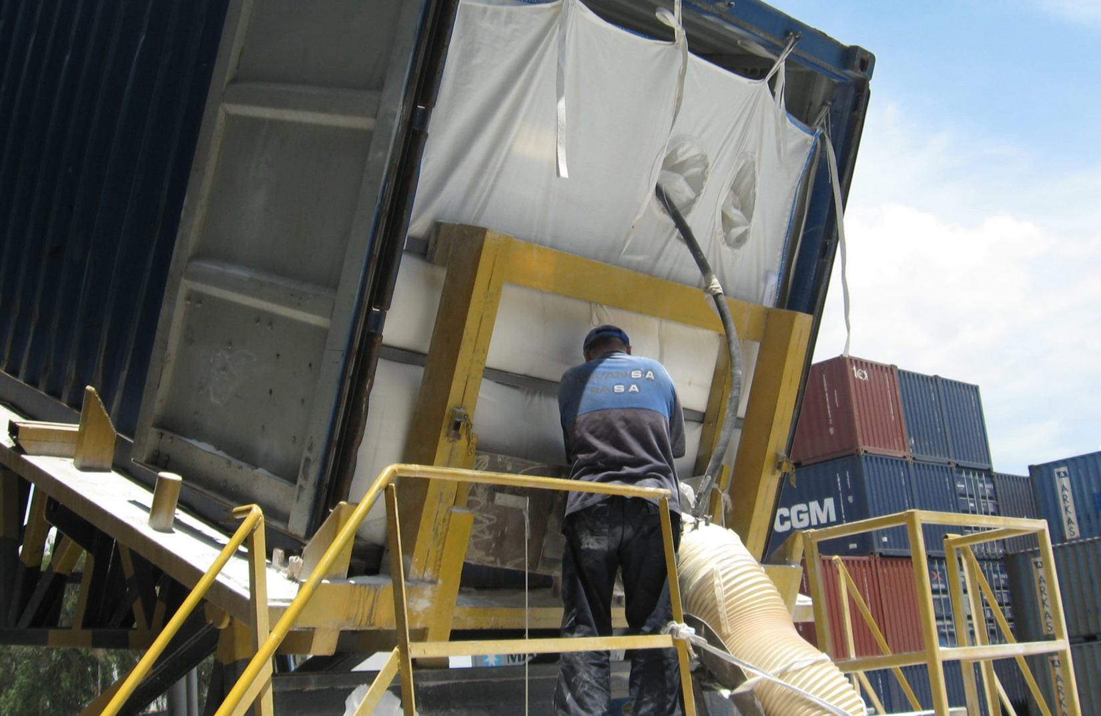
Containers can also hold dry bulk goods, such as plastics, grain, or fertilizer.

Slide 23
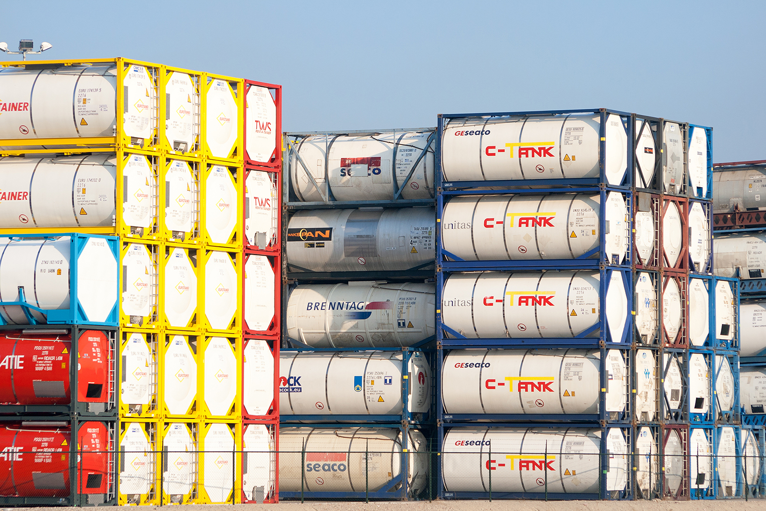
Liquids travel in liquid-bulk containers.

Slide 24
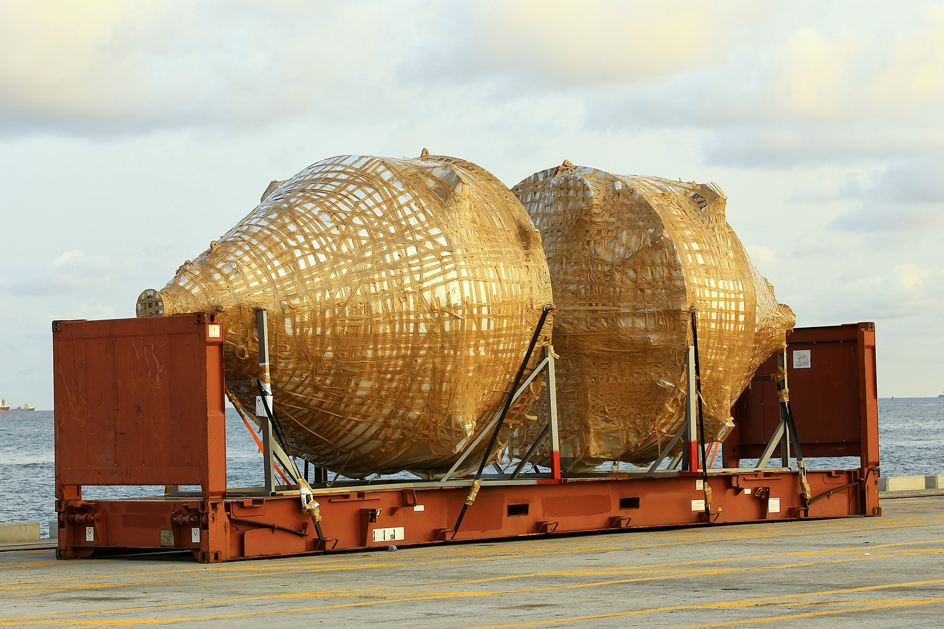
Oversize cargo is shipped on a “flat rack” container.

Slide 25
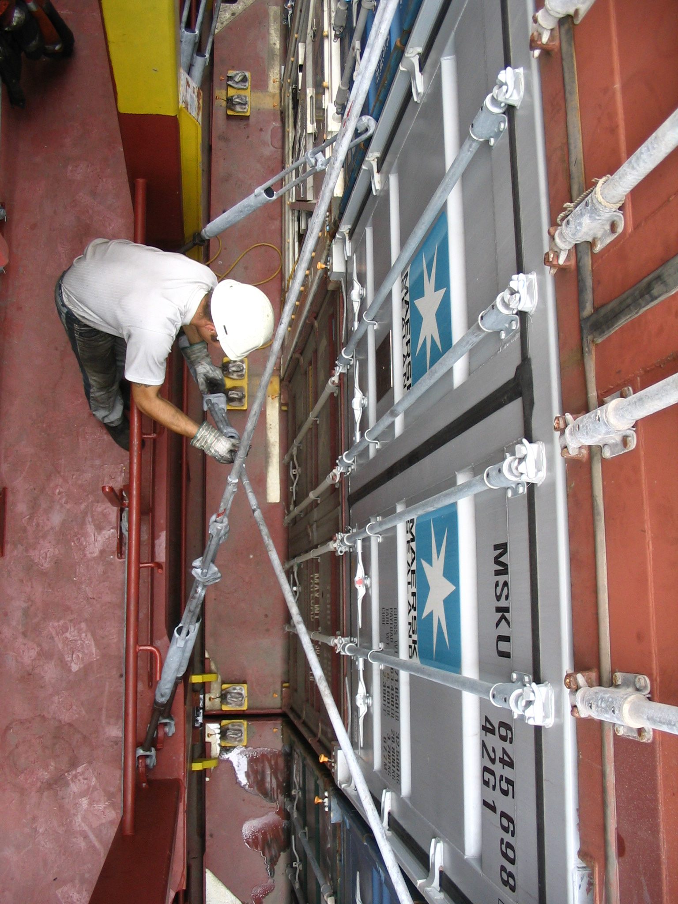
Containers are held by lash bars onto the deck of a ship.

Slide 26
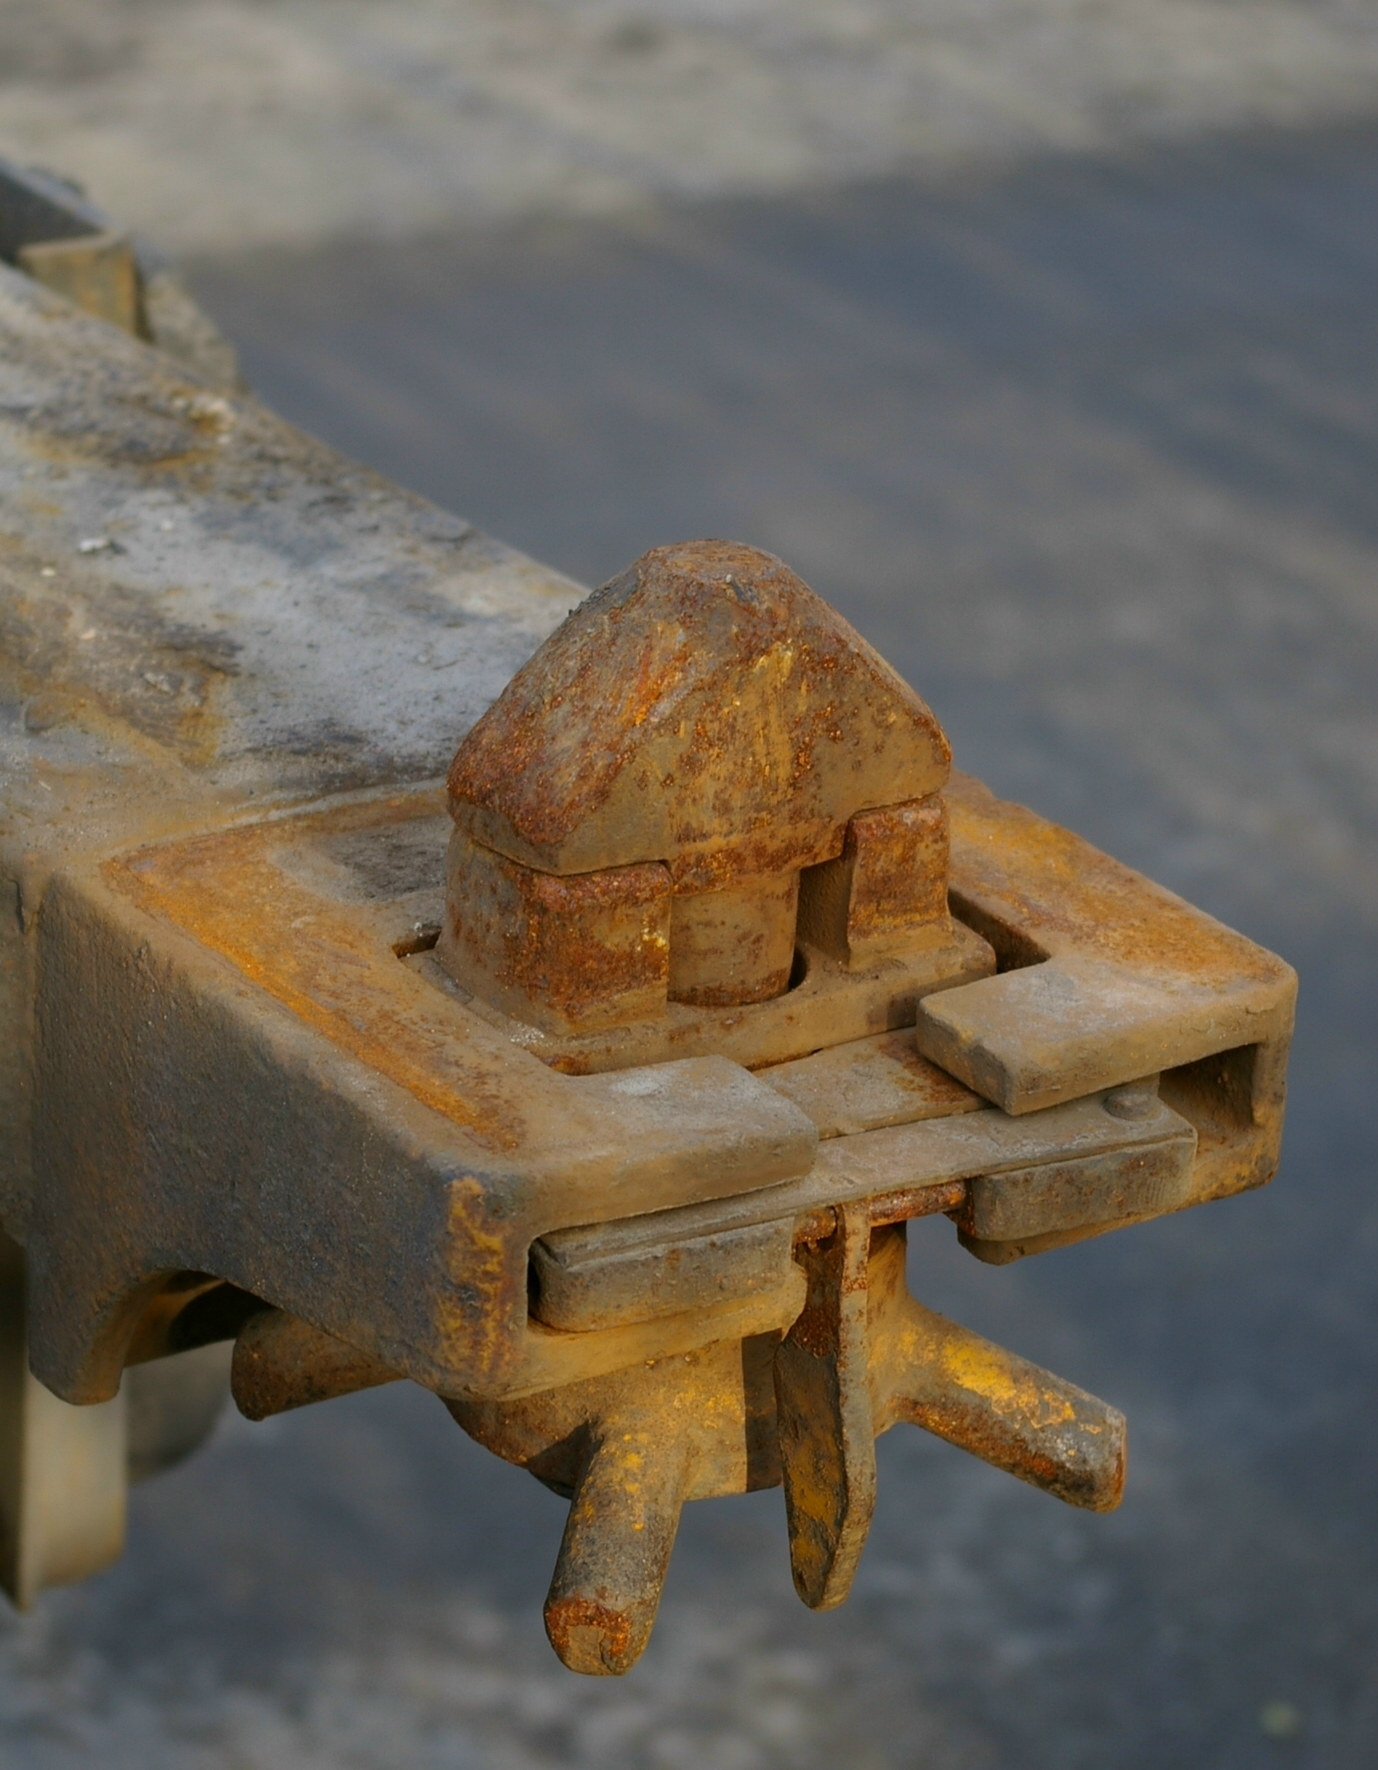
Containers are also held by twist locks onto a ship’s deck, on top of each other, or on a truck’s chassis.

Slide 27
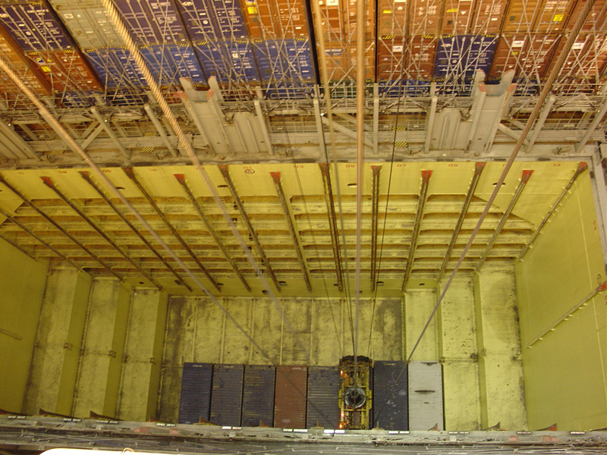
Under deck, containers are loaded into holds, and held in place with the help of slides.

Slide 28
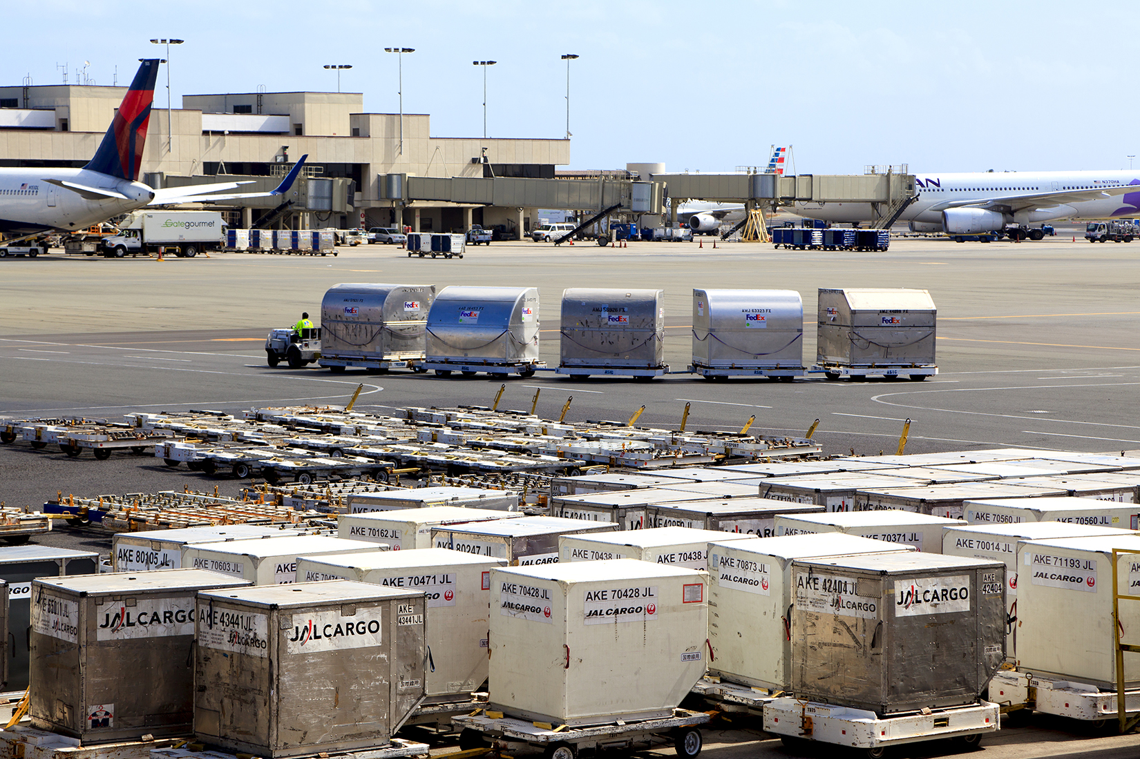
Air cargo containers are less standardized and are not meant to be used in intermodal transport.

Slide 29
Intermodal Transport
The increased importance of containerization in intermodal transport has created new transportation models, such as land bridges and intermodal yards.
Land Bridge
For goods that are shipped from Asia to Europe, it is often more economical to ship goods by ocean to the West Coast of North American, unload the containers, transport them by rail to the East Coast before shipping them by ocean to Europe. The more costly alternative is to ship the goods through the Panama Canal.
Intermodal Terminal / Dry port
A location where containerized goods change means of transportation.

Slide 30
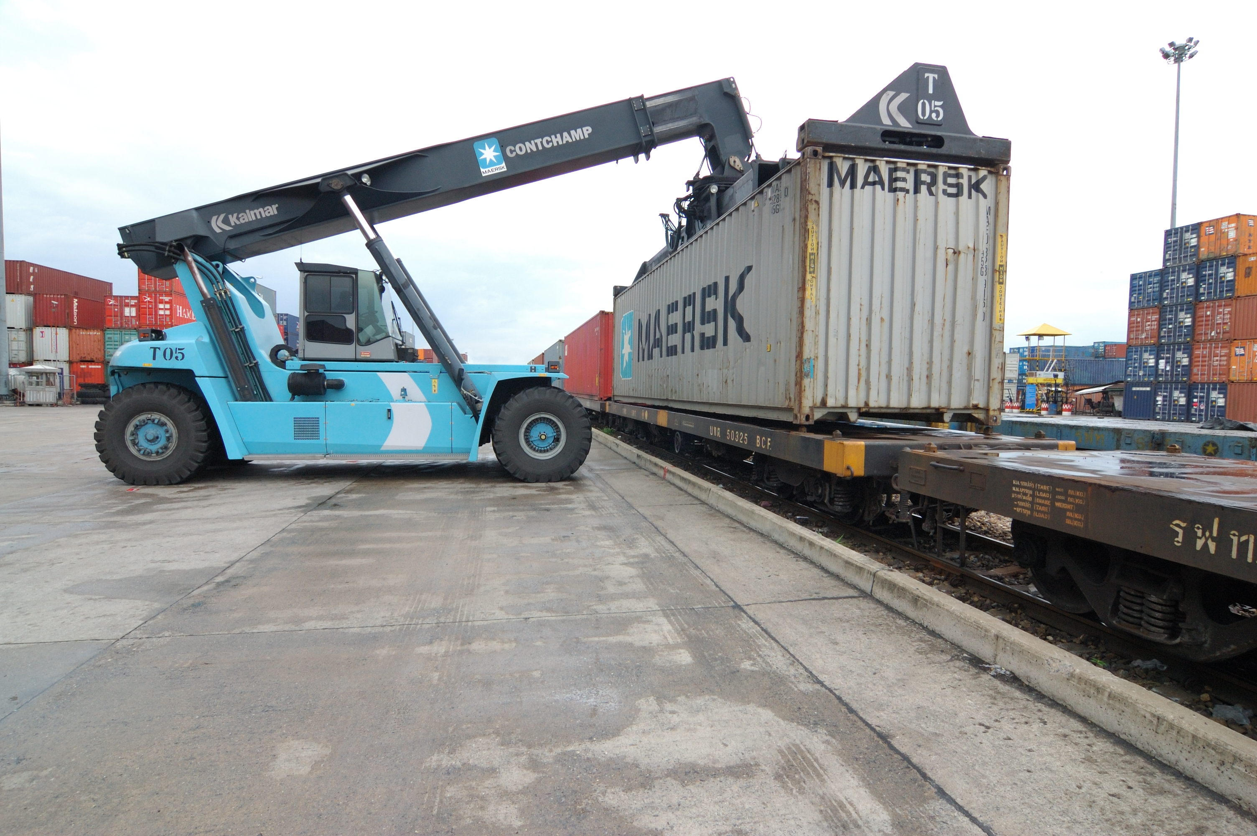
An intermodal yard transfers containers from trucks to trains, or vice-versa. Here, a container stacker performs that task.

Slide 31
Liability Conventions
The liability conventions governing land transportation and intermodal transportation are still governed by the liability conventions that are in place for each mode of transportation, and each country.
The Rotterdam Rules, a new liability convention (2009) that limits carriers’ liability to SDR 875 per package or SDR 4 per kilogram, was designed specifically for intermodal shipments: It is likely to be adopted by most countries by 2020.

Slide 32
Freight Forwarders
Because international transportation is so complex, many shippers rely on freight forwarders to handle their international shipments.
Freight forwarders arrange all aspects of transportation and paperwork for a shipper, from following the exporting country’s requirements to clearing Customs in the importing country.
Freight forwarders are essentially travel agents for freight.

Slide 33
Project Cargo
Project cargo is a type of cargo that requires more advance planning because of its size, weight, or volume.
Shippers need to take into account the cargo’s dimensions and weight, in order to determine whether it will fit under bridges, inside tunnels, and around curves. Many project cargo shipments can take months to plan thoroughly, and often require specialized knowledge.
Shippers also have to account for the special permits that the cargo will need.

Slide 34
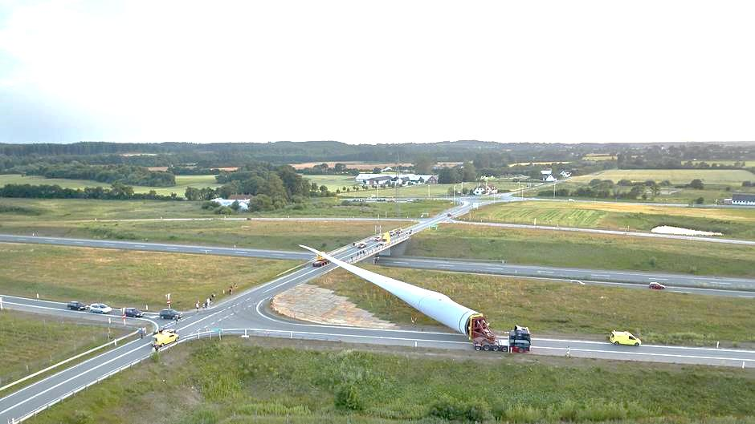
Because of their length and unusual shape, wind turbine blades are “project cargo,” necessitating careful transportation planning.

Slide 35
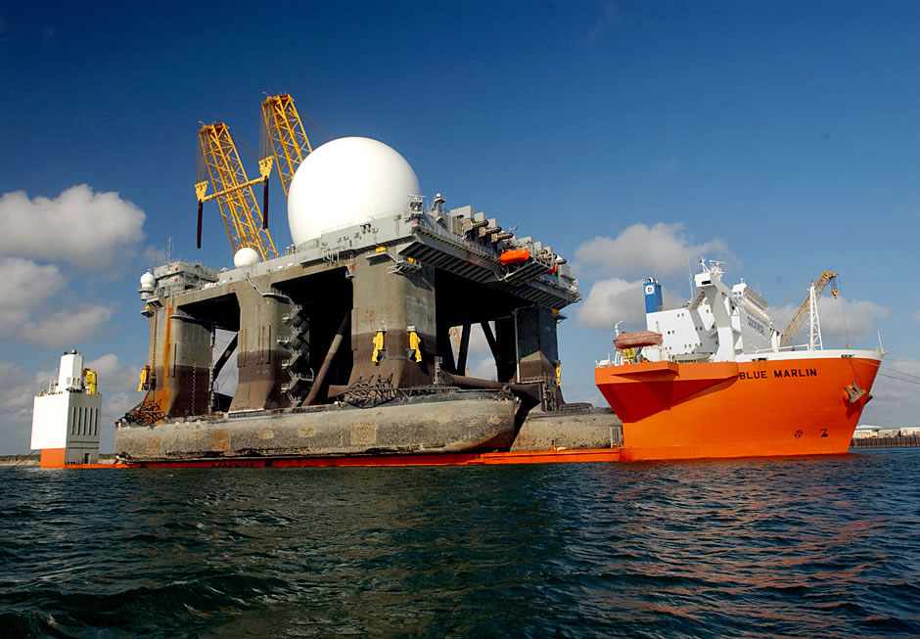
Project cargo can be unusually large, necessitating specialized ships, called heavy-lift ships.

Slide 36
Other Means of Transportation
Pipelines
Pipelines can be used for the transport of liquid cargo (petroleum oil, refined oil products, water), and gasses (generally natural gas), as well as coal, in the form of slurry, a mix of powdered coal and water. Pipelines are essential to the transport of energy products.
Barges
Barges are flat-bottomed boats, are designed to carry cargo on rivers and canals. Some are self-propelled and others are designed to be pushed or pulled. In the United States, barges carry mostly bulk cargo (grain, coal, minerals), but in Europe and China, they also carry containers, automobiles, and other general cargo.

Slide 37
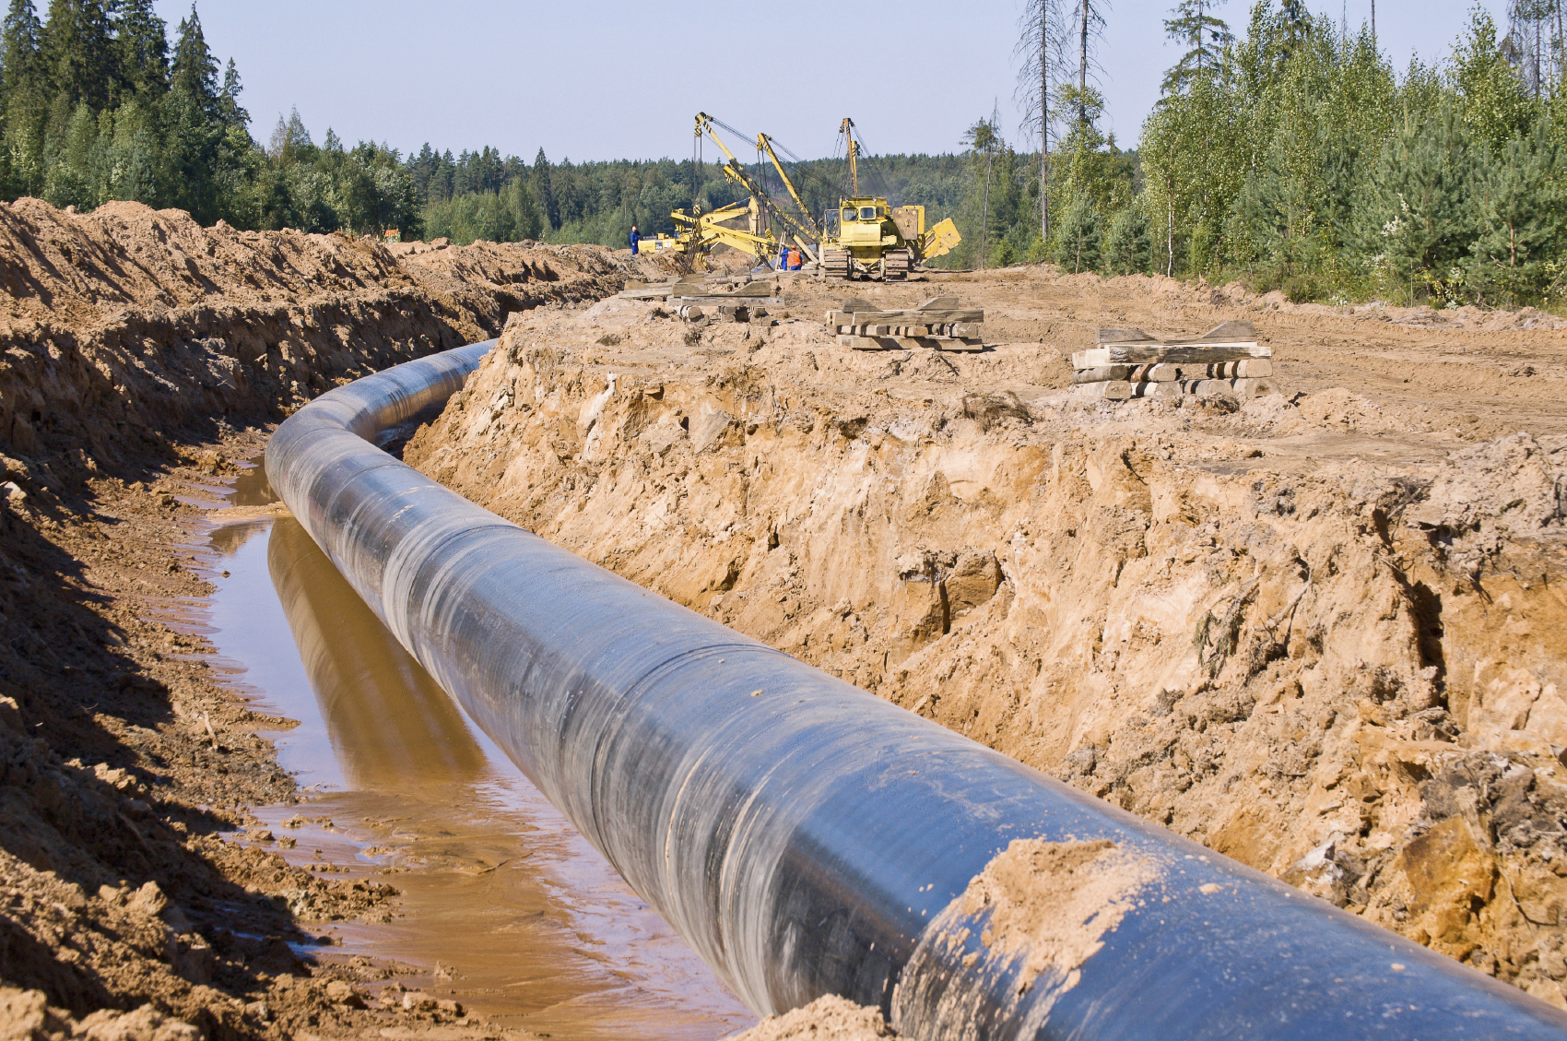
The Russia-European Union gas pipeline.

Slide 38
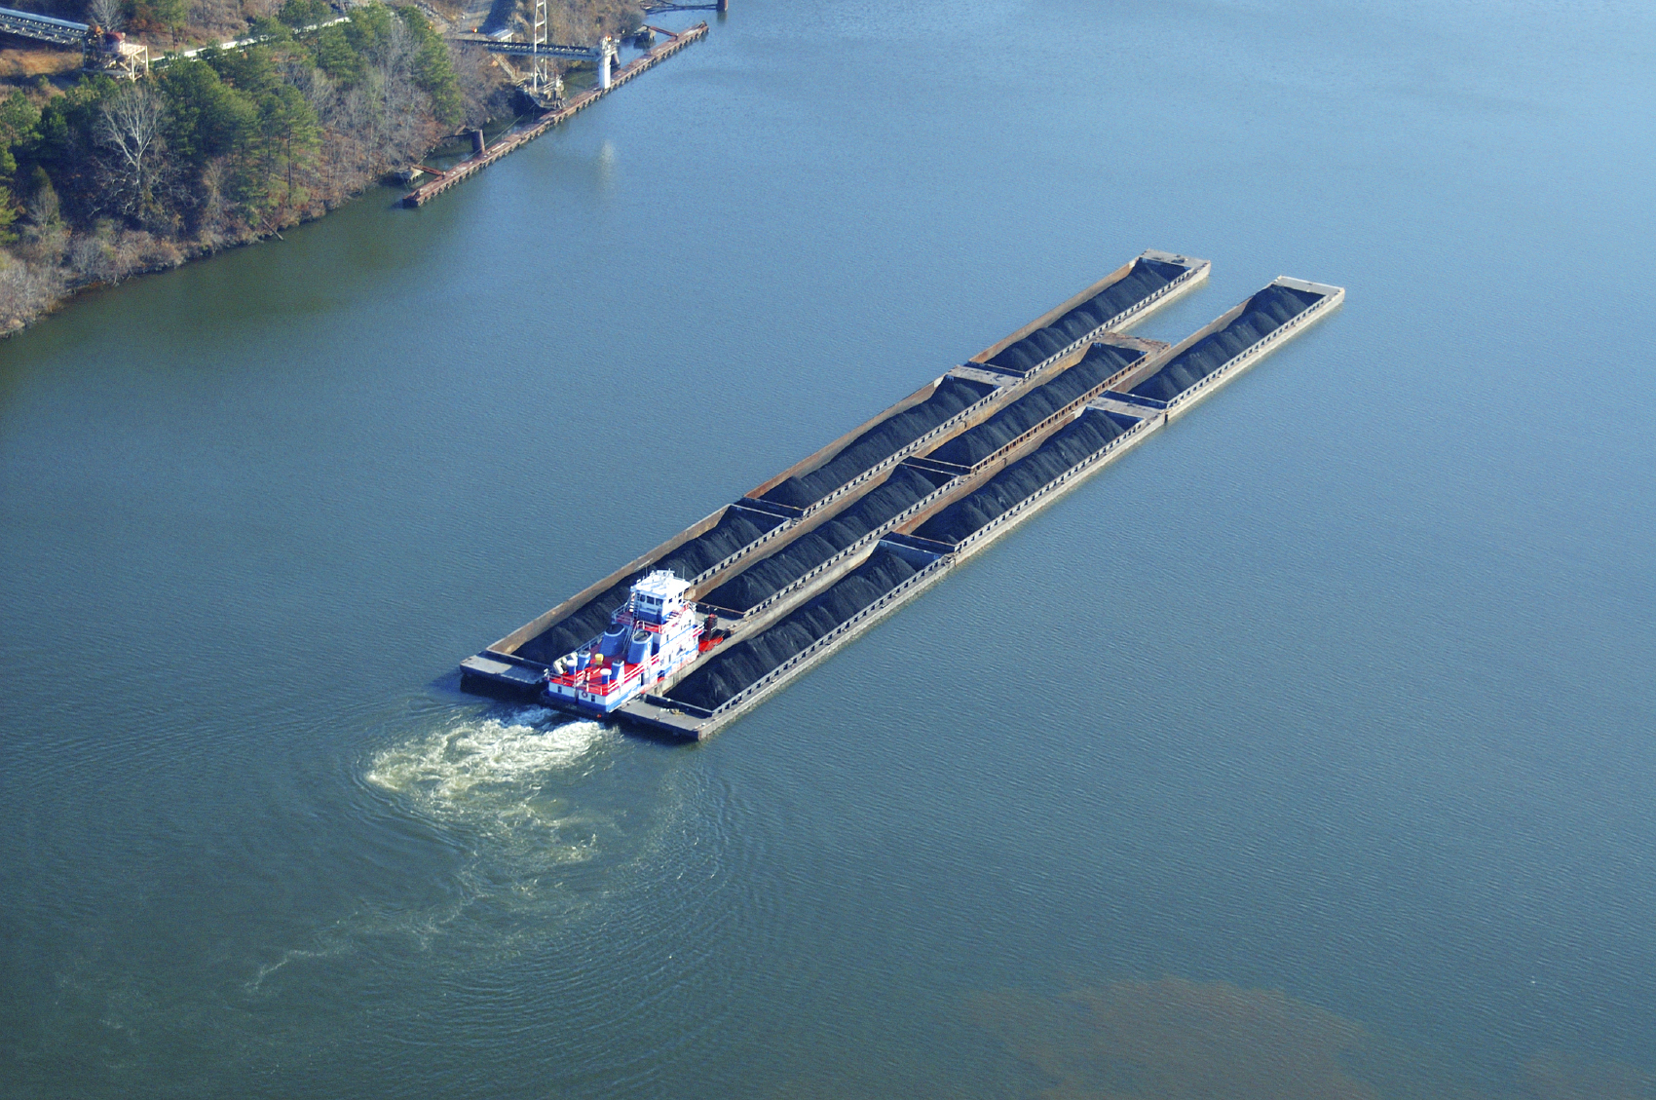
In the United States, barges are often moved in groups, pushed by a tugboat and carry bulk commodities.

Slide 39
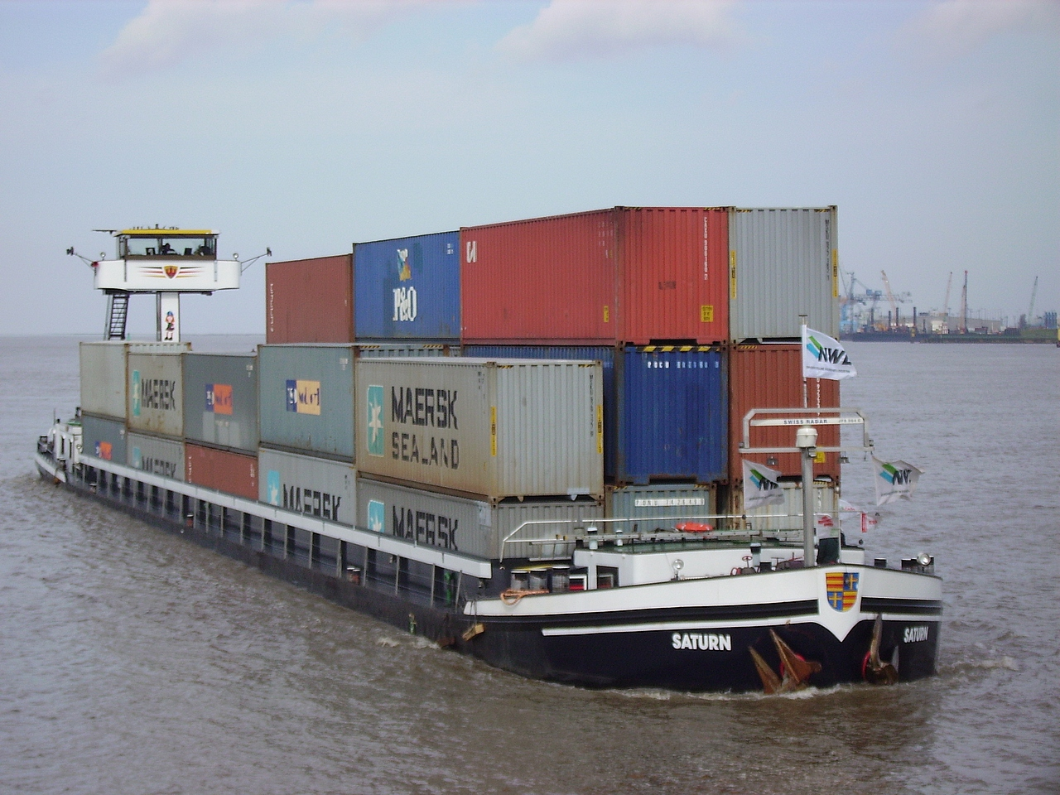
In Europe, barges are generally self-propelled and can also carry general cargo or containers.

Slide 40
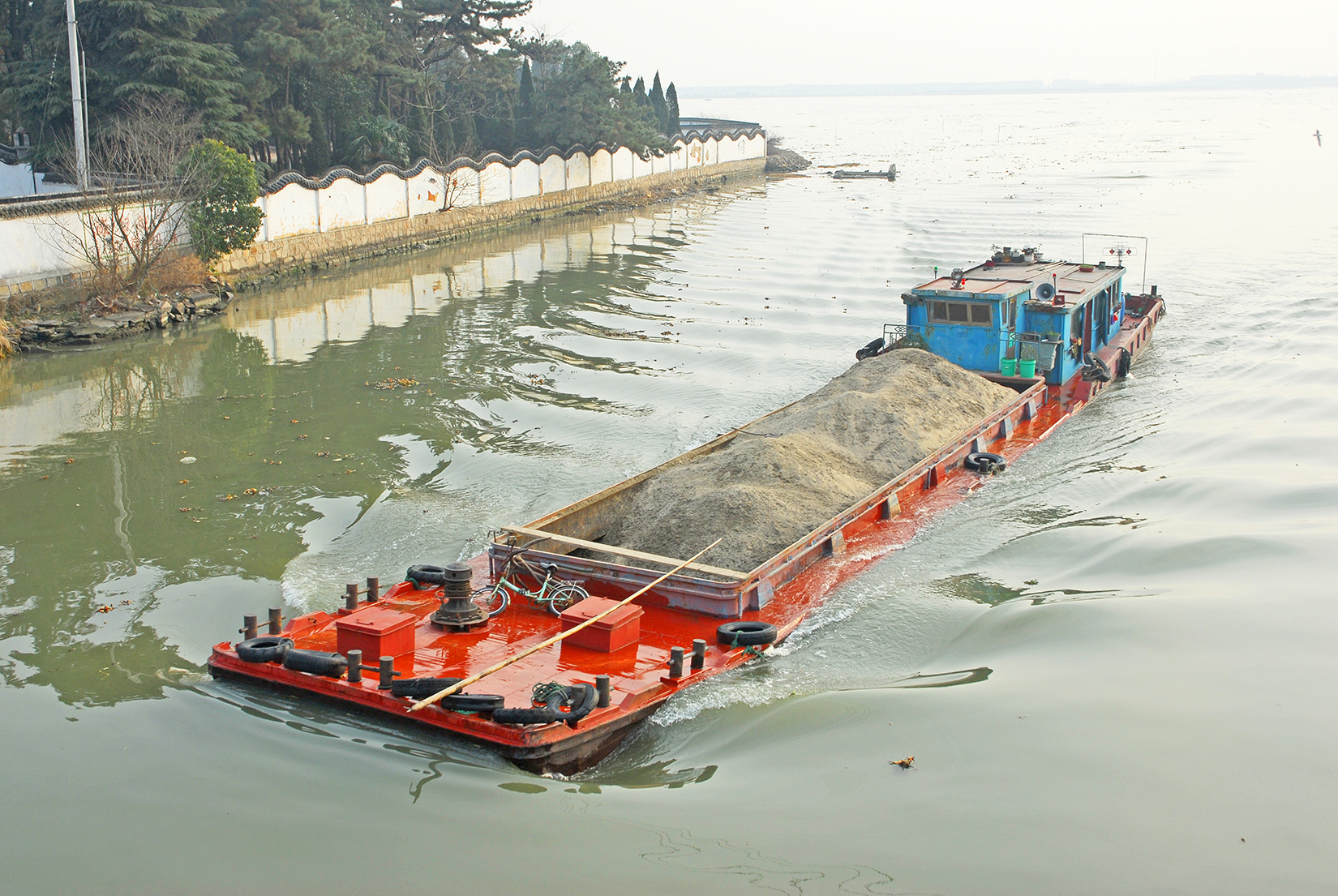
Barges are also used for bulk cargo. Here is one in China.

