Slide 1
Chapter 12 International Air Transportation

Slide 2
International Air Transportation
Types of Service
Types of Aircraft
International Regulations
Freight Tariffs
Environmental Issues
Security

Slide 3
Types of Service
Cargo can travel by air under one of five different types of services:
Airmail Services
The origin of air freight, air mail services still account for a small percentage of all shipments.
Express air services
Express air services guarantee a pre-determined delivery date; the service is called “time-definite delivery,” generally the next day or overnight. Examples include FedEx, UPS, DHL.

Slide 4
Types of Service
Scheduled Airfreight Services
Air freight is transported by airlines that operate on a regular schedule between two cities.
The airline can operate a passenger aircraft, in which case the cargo is placed in the belly of the airplane, or a freighter, in which case the cargo is placed on the main deck of the aircraft. On rare occasions, the freight and the passengers share space on the main deck, in an aircraft called a “combi,” or combination aircraft.
Regulations restrict the type of cargo that is allowed to be shipped on passenger aircraft.

Slide 5
Types of Service
Charter Airfreight Services
Charter services do not operate on a regular schedule and depend on demand. they fulfill emergency shipments of large parts, or operate on seasonal traffic, such as wine, flowers, or fruits.
Leased Airfreight Services
Freight can also travel in leased aircraft. Leases are contracts between the owner of the aircraft and the user, and can take multiple forms.
Leased aircraft are used by carriers to reduce their capital costs, and to satisfy short-term demand fluctuations (end-of-year volume increases).

Slide 6
Top Cargo Airlines
Top Ten Cargo Airlines (2015) in millions of FTKs
1 | FedEx | 15,799
2 | Emirates | 12,157
3 | UPS Airlines | 10,807
4 | Cathay Pacific Airways | 9,935
5 | Korean Air Lines | 7,761
6 | Qatar Airways | 7,660
7 | Lufthansa | 6,888
8 | Cargolux | 6,309
9 | Singapore Airlines | 6,083
10 | Air China | 5,718
Source: IATA World Air Transport Statistics

Slide 7
Top Cargo Airports
Top Fifteen Cargo Airports (2015) in ‘000s of tonnes loaded
1 | Hong Kong | HKG | 4,422
2 | Memphis | MEM | 4,291
3 | Shanghai | PVG | 3,274
4 | Anchorage | ANC | 2,624
5 | Incheon/Seoul | ICN | 2,596
6 | Dubai | DXB | 2,506
7 | Louisville | SDF | 2,351
8 | Tokyo | NRT | 2,122
9 | Frankfurt | FRA | 2,076
10 | Taipei | TPE | 2,025
11 | Miami | MIA | 2,005
12 | Los Angeles | LAX | 1,932
13 | Beijing | PEK | 1,890
14 | Singapore | SIN | 1,887
15 | Paris | CDG | 1,861
Source: ACI World Air Traffic

Slide 8
Types of Leases
Wet Lease
A lease agreement in which the owner of the aircraft provides the airplane, insurance, maintenance, fuel and a flight crew. The lessee has to cover all other costs, such as airport fees.
Dry Lease
A lease agreement in which the owner of the aircraft provides only the airplane to the lessee, who is responsible for all other costs.
ACMI Lease
The owner of the aircraft provides the airplane, crew, maintenance, and insurance to the lessee. The lessee has to cover all other costs, such as fuel and airport fees.

Slide 9
Types of Aircrafts
Passenger Aircrafts
Freighters
Combi Aircrafts
Quick-Change Aircrafts

Slide 10
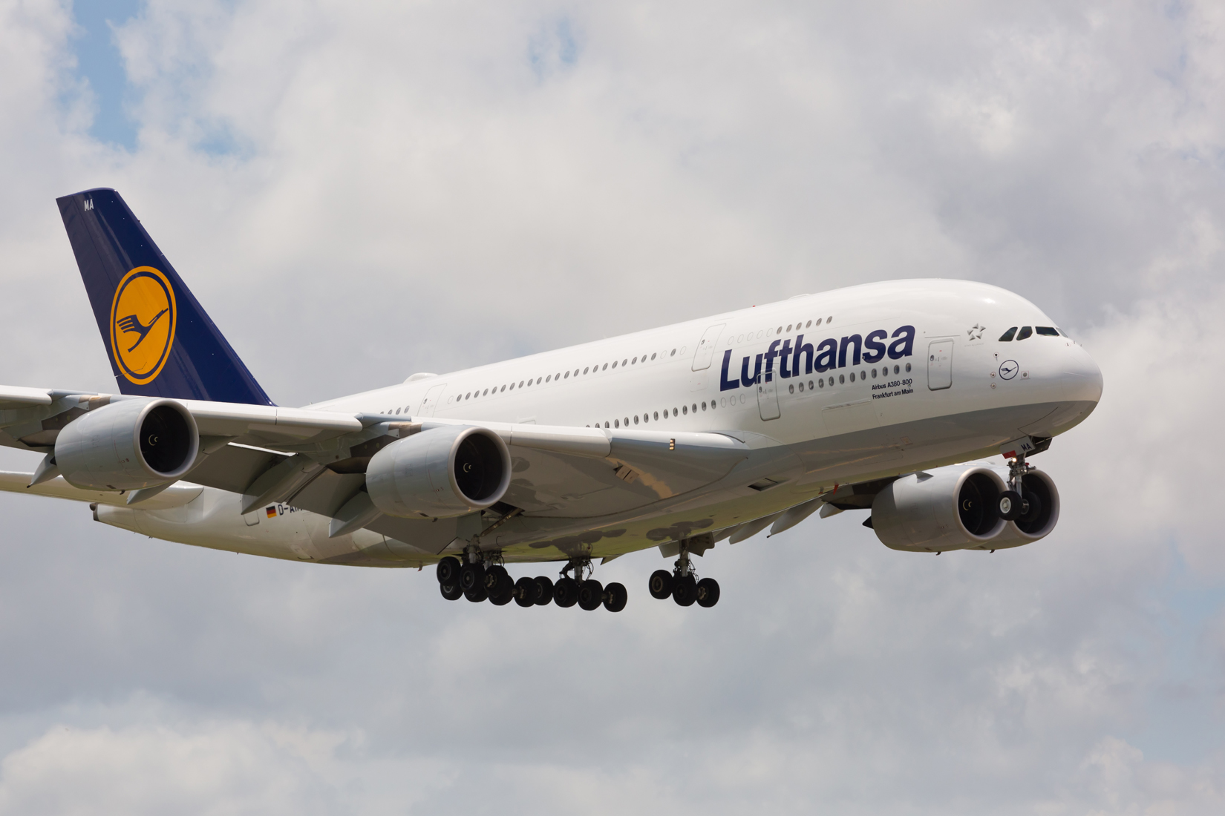
A passenger aircraft, such as the Airbus 380 is designed to carry passengers on the main deck(s) of the aircraft.

Slide 11
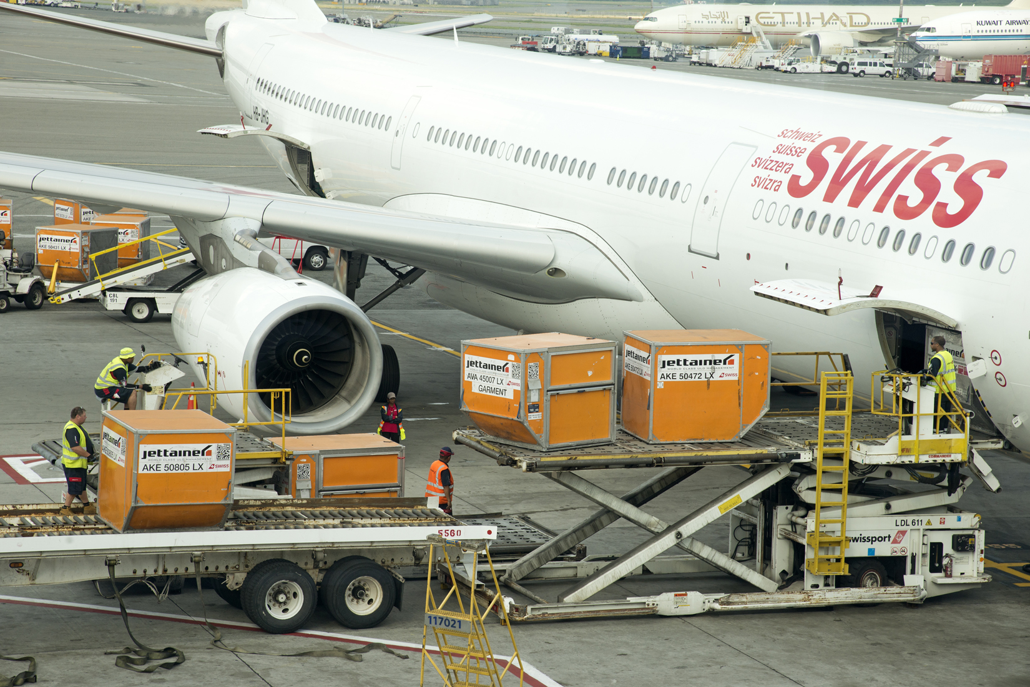
A passenger aircraft carries freight in its belly, on the lower deck (Airbus 330).

Slide 12
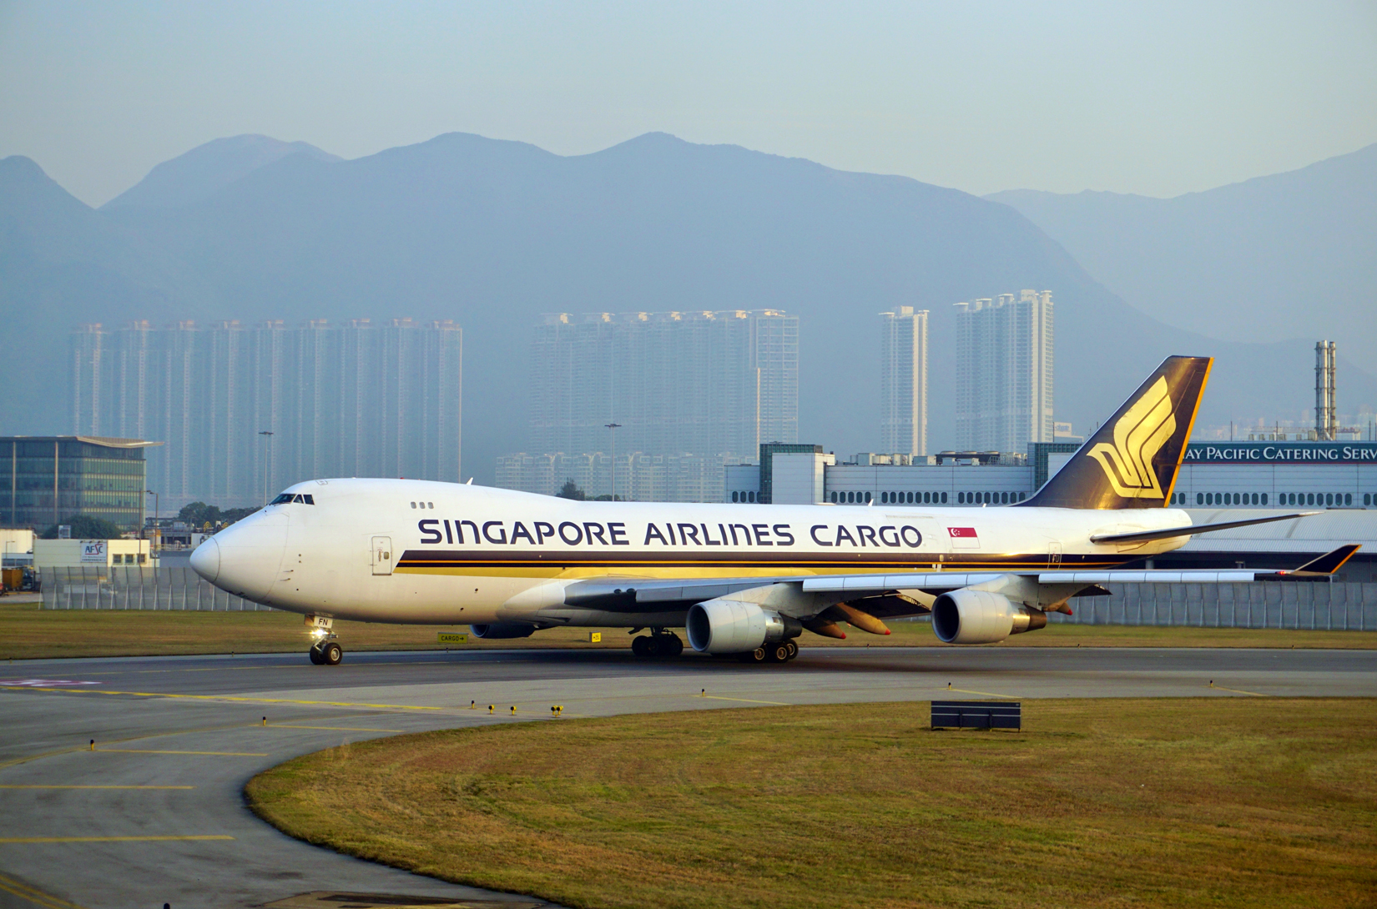
A cargo aircraft carries cargo on the main deck. Here a Boeing 747F.

Slide 13
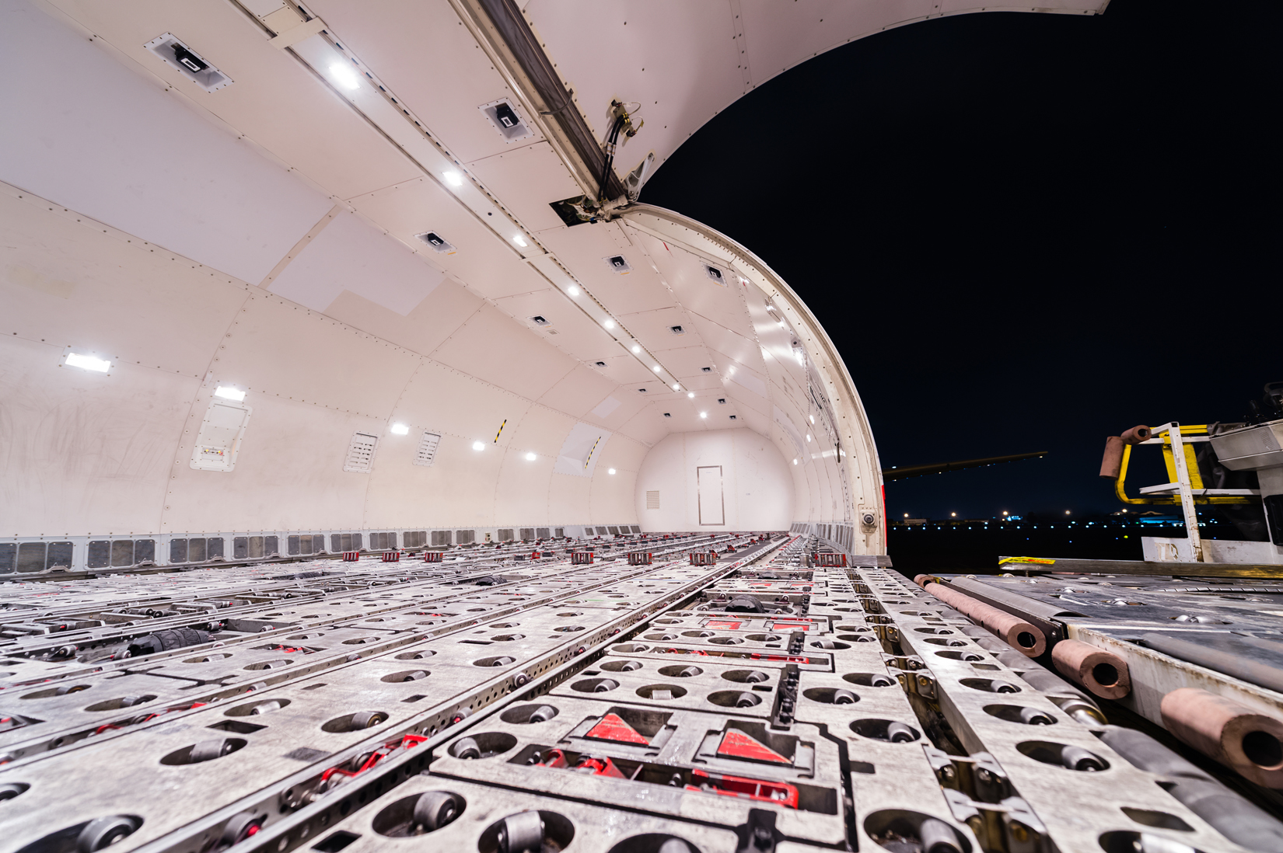
A cargo aircraft carries cargo on the main deck. The roller deck of an Airbus 300F.

Slide 14
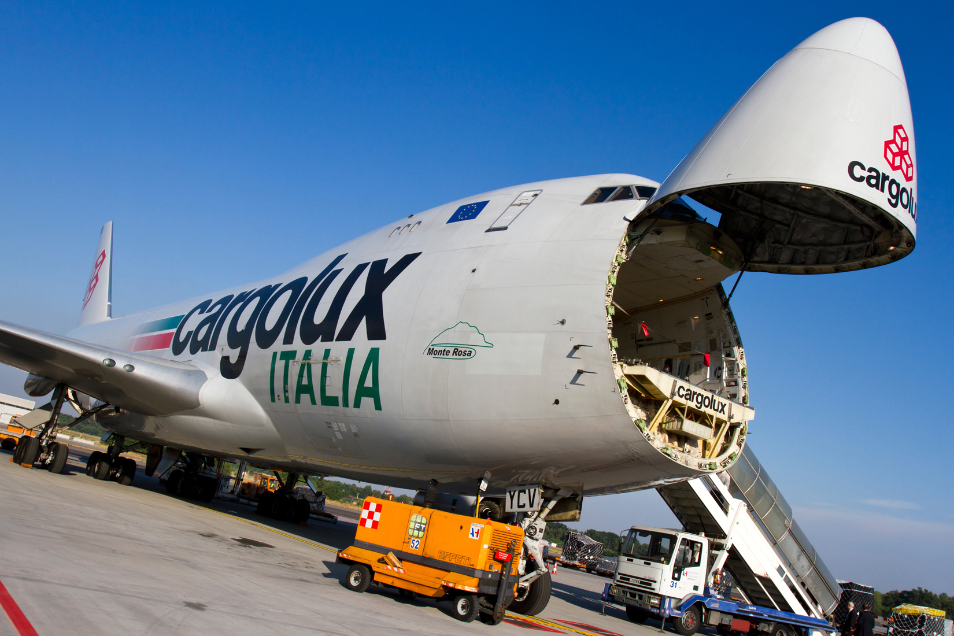
A cargo aircraft (Boeing 747F) can be loaded through its nose.

Slide 15
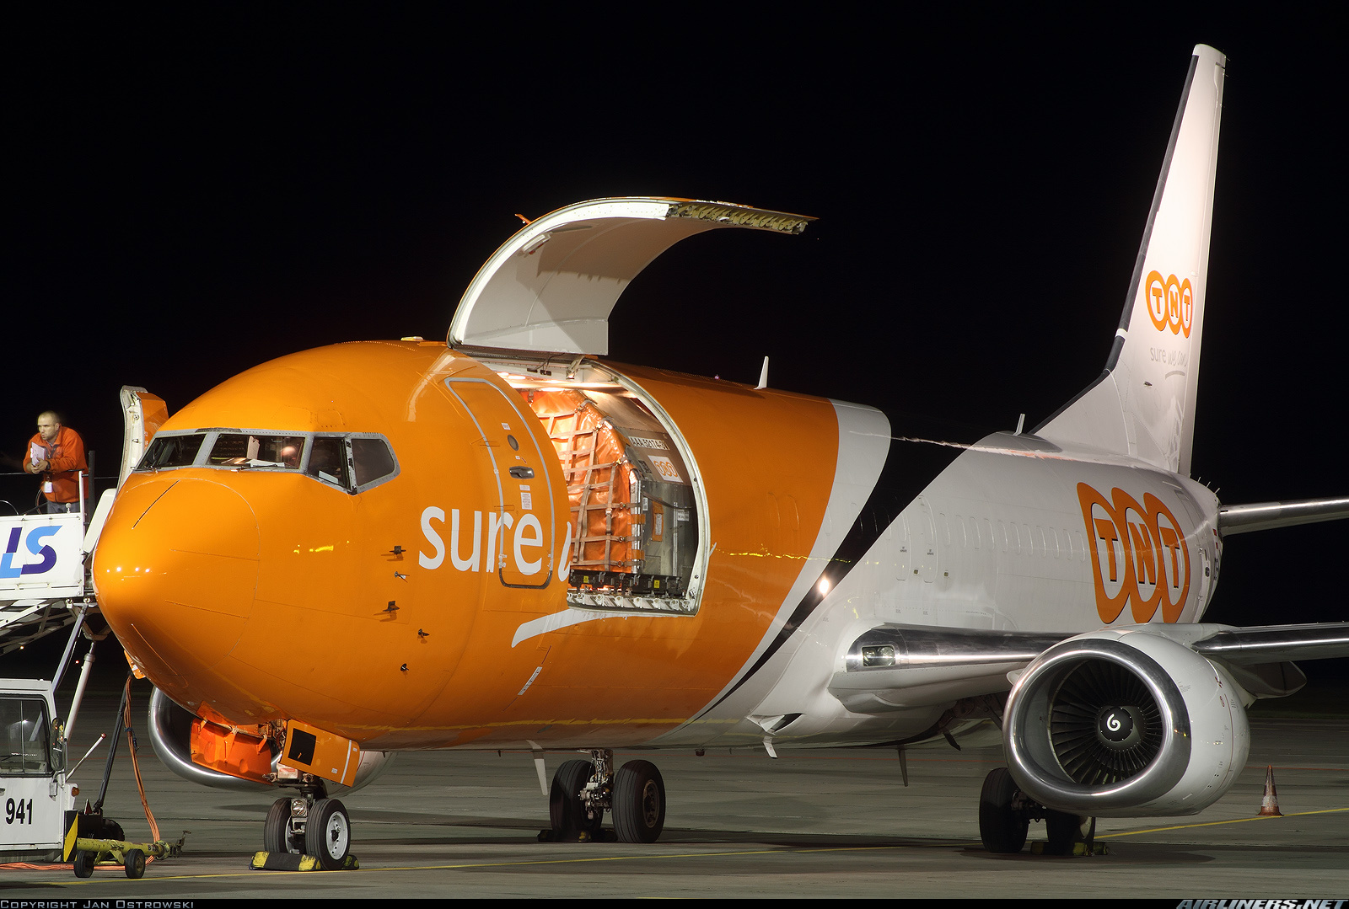
A passenger-to-freighter aircraft conversion (Boeing 737) loaded through a side door.

Slide 16
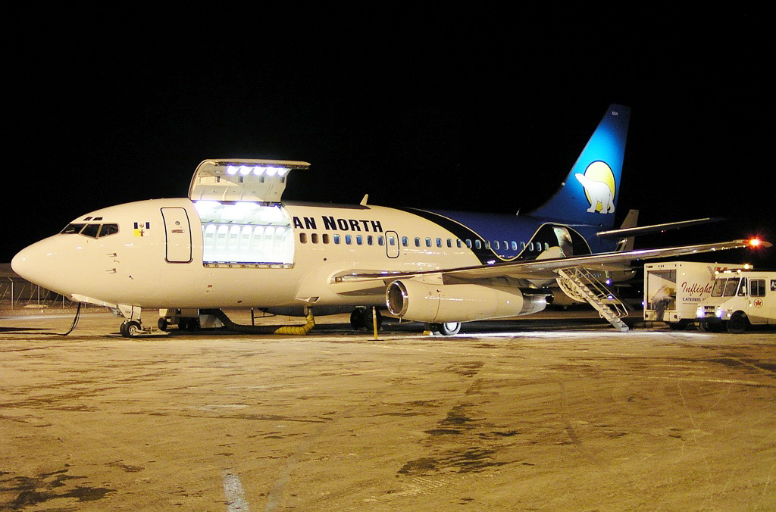
A combi aircraft carries both cargo and passengers on the main deck.

Slide 17
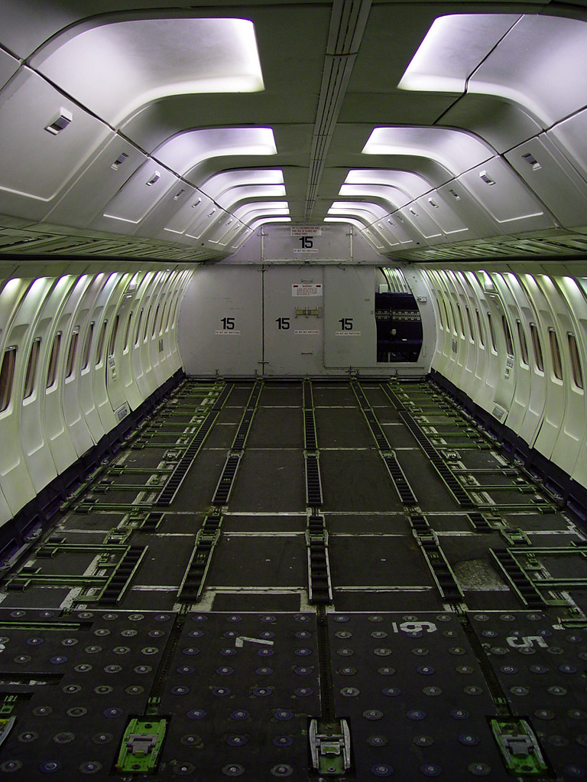
A combi aircraft carries both cargo and passengers on the main deck.

Slide 18
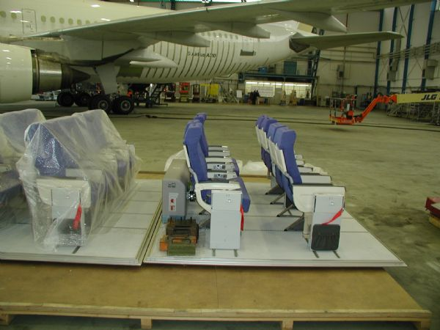
A quick-change aircraft uses seat pallets on the main deck.

Slide 19
Types of Aircraft
Some charter aircrafts are hired to transport goods that cannot be shipped through traditional airfreighters:
The goods do not fit into a regular freighter because there are too heavy and/or too large.
Goods need to be delivered to a location not serviced by regular routes.
Goods need to be delivered to an airport where the runway is sub-standard, or the cargo handling facilities are poor.
Several aircraft have been designed to service these specific needs.

Slide 20
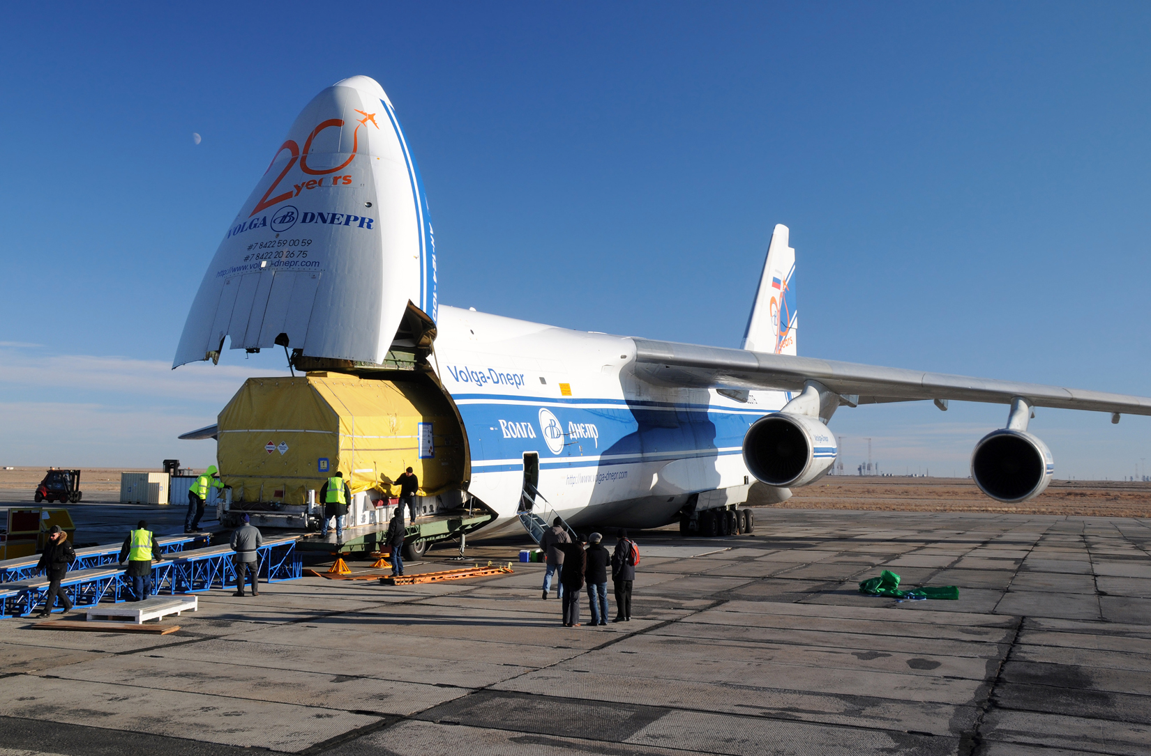
The Antonov 124 Ruslan handles project cargo.

Slide 21
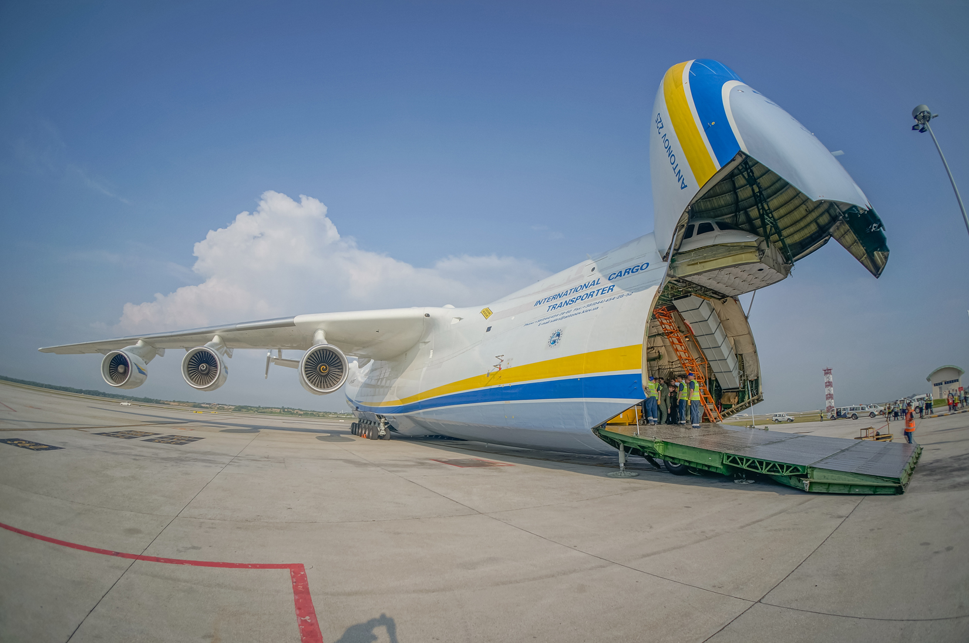
The Antonov 225 Mriya handles project cargo.

Slide 22
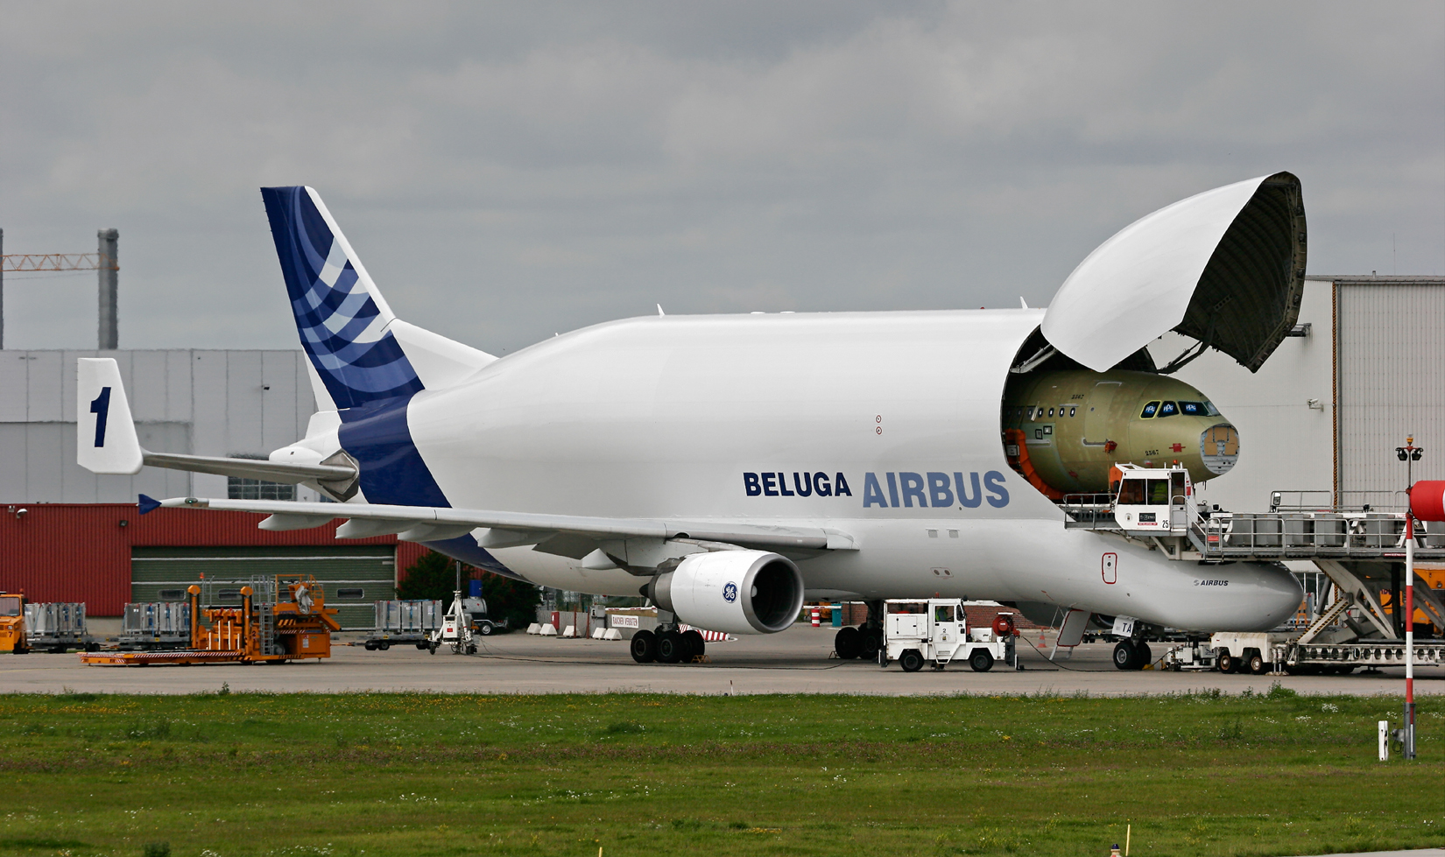
The Airbus Beluga carries aircraft cargo.

Slide 23
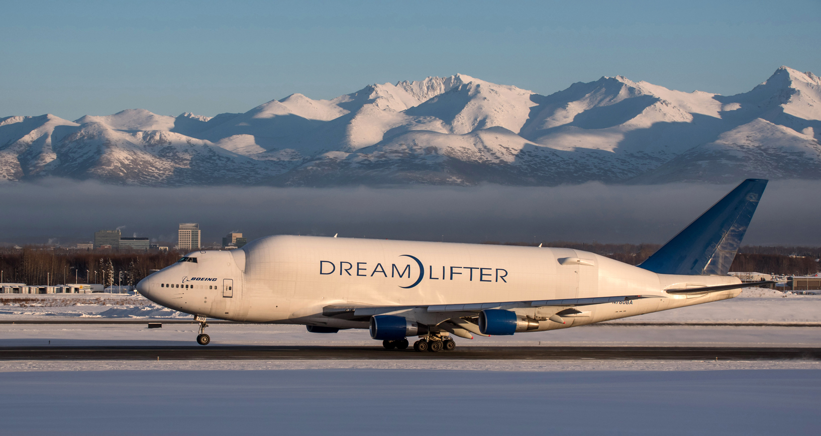
The Boeing Dreamlifter carries aircraft cargo.

Slide 24
International Air Regulations
International Air Transport Association
The International Air Transport Association (IATA) works with governments and airlines to ensure that goods move around the world as easily as if they were traveling domestically.
International Civil Aviation Organization
The International Civil Aviation Organization (ICAO), an agency of the United Nations, designs and implements standards for international civil aviation practices regarding safety, security, and other operational issues.

Slide 25
International Air Regulations
International aviation operates under the principle that every country has complete and exclusive sovereignty over its airspace.
No scheduled international air service may operate over or into the territory of a country without specific authorization.
Recent developments, such as open-skies agreements, have relaxed those restrictions. Under open skies agreements, air carriers from one country are allowed to serve any of the other country’s airports.

Slide 26
Freight Tariffs
The tariff structure on international air cargo is much simpler than that used by the ocean cargo industry. It is based on the weight and volume of the cargo.
Airlines will calculate the freight charge two ways:
The weight of a shipment
The volume weight of the shipment, also called “dimensional weight,” that is calculated based upon the dimensions of a shipment.
The airline will then charge the higher of the two prices.

Slide 27
Environmental Issues
Because of their heavy reliance on fossil fuels, airlines and aircraft manufacturers have been active in reducing the carbon footprint of the industry. IATA and ICAO have been involved in those efforts as well.
Progress on noise reduction has also been made in the last two decades. Still, some airports close at night to reduce the impact of air traffic on the populations living near airports. This affects cargo transport substantially, since most of the airfreighter traffic takes place at night. Some freight traffic is therefore diverted to secondary airports.

Slide 28
Air Cargo Security
Security concerns in the air freight industry are dominated by requirements similar to the ones put in place by the Transportation Safety Administration as well as Customs and Border Protection in the United States.
Advanced Manifest Rule: All cargo manifests must be sent to CBP at least four hours before the cargo is to arrive in the U.S.
Certified Cargo Screening Program: All cargo shipped on passenger aircraft must be 100-percent inspected prior to being loaded. Inspections must be conducted by Certified Cargo Screening Facilities.

