Slide 1
Chapter 11 Ocean Transportation

Slide 2
Ocean Transportation
Types of Service
Size of Vessels
Types of Vessels
Flag
Liability Conventions
Non-Vessel-Operating Common Carriers
Security

Slide 3
Types of Service
Ocean cargo moves under one of two types of services:
Liner Service
A service provided by a ship that operates on a regular schedule, traveling from a group of ports to another group of ports.
Tramp Service
A service provided by a ship that does not operate on a regular schedule and is available to be chartered for any voyage, from any port to any port.

Slide 4
Vessel Measurements (Weight)
Deadweight Tonnage
The total carrying capacity of ship, measured in long tons or metric tonnes, and is determined as the difference in water displacement when the ship is empty and when it is fully loaded.
Cargo Deadweight Tonnage
Obtained by subtracting the weight of the bunker, crew-related items and stores for a specific voyage. It is the actual cargo capacity of a ship for a given voyage.
It is the measure of greatest interest to shippers, as it is the theoretical carrying capacity of a ship.

Slide 5
Vessel Measurements (Volume)
Gross Tonnage
The total volume of a ship’s carrying capacity, measured as the space available below deck, and expressed in tons, which are in this case hundreds of cubic feet.
Gross Registered Tonnage (GRT)
Gross Tonnage calculated a specific way, generally for the purpose of determining the fee that a ship will pay to use a canal (Panama GRT, or Suez GRT).
Net Tonnage
Obtained by subtracting the volume occupied by the engine room and the space necessary for the operation of the ship (crew quarters, bridge, ...etc.) from the gross tonnage.

Slide 6
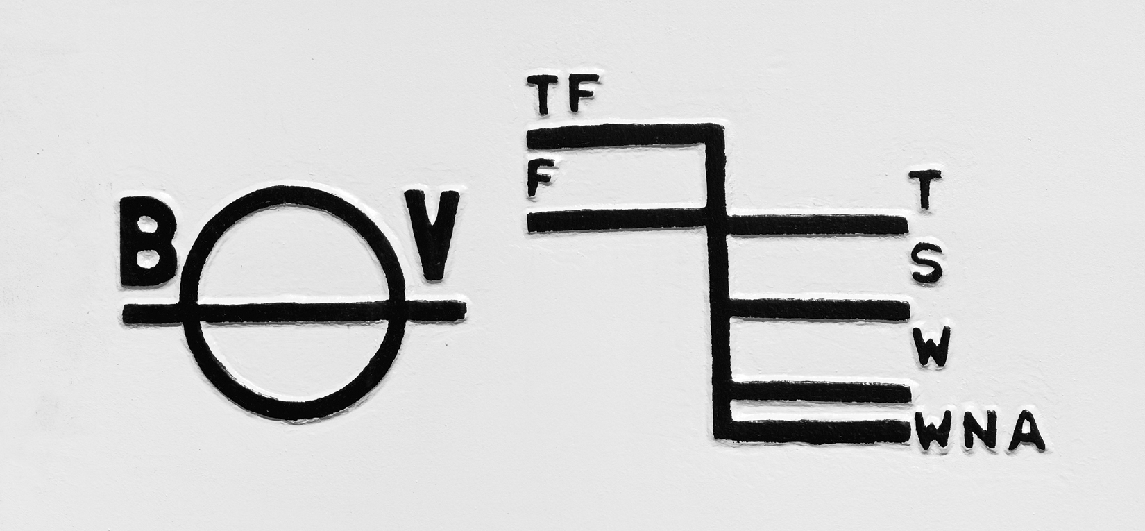
Plimsoll Mark & Load Lines
The Load Lines indicate how heavily a ship can be loaded.
The Plimsoll Mark shows the Classification Society of the ship.
TF: tropical fresh water — F: fresh water — T: tropical line
S: summer line —W: winter line — WNA: winter North Atlantic line.

Slide 7
Size of Vessels
Multiple categories of vessels exist:
Panamax
A ship of the maximum size that can enter the locks of the Panama Canal. The locks are 110 feet wide, 1000 feet long.
Post-Panamax
A ship that is too large to enter the locks of the Panama Canal.
Handy Size
A ship in the 10,000 to 50,000 dead-weight ton range.

Slide 8
Size of Vessels
Suez-Max
A ship roughly 150,000 dead-weight tons, the maximum size that can fit through the Suez Canal.
Cape-Size
A large dry-bulk carriers of a capacity greater than 80,000 dead-weight tons. The term relates to the ships that originally could not fit through the Suez Canal and had to go around Africa by way of the Cape of Good Hope.
Aframax
A large oil carrier of a capacity between 80 and 120,000 dead-weight tons. Named after the Average Freight Rate Assessment system.

Slide 9
Size of Vessels
Very Large Crude Carrier (VLCC)
An oil tanker of up to 300,000 dead-weight tonnage.
Ultra-Large Crude Carrier (ULCC)
An oil tanker of more than 300,000 dead-weight tonnage.
Very Large Ore Carrier (VLOC)
A very large ore carrier, of more than 200,000 dead-weight tonnage.
Ultra Large Ore Carrier (VLOC)
A very large ore carrier, of more than 300,000 dead-weight tonnage.

Slide 10
Types of Cargo
Ocean cargo is generally divided into four categories:
Wet bulk—liquid cargo that is loaded directly into the hold of a ship
Dry bulk—dry cargo that is loaded directly into the hold of a ship; although dry, it takes the shape of the hold. Grain, for example.
Breakbulk—cargo that is packaged (bales, boxes, drums, crates, pallets) but not containerized. Vehicles are also considered break-bulk cargo.
Containers—Cargo that is placed in containers before it is loaded onto a ship. Cargo containers are metallic boxes that are 8.5 x 8 x 20 or 8.5 x 8 x 40 feet.

Slide 11
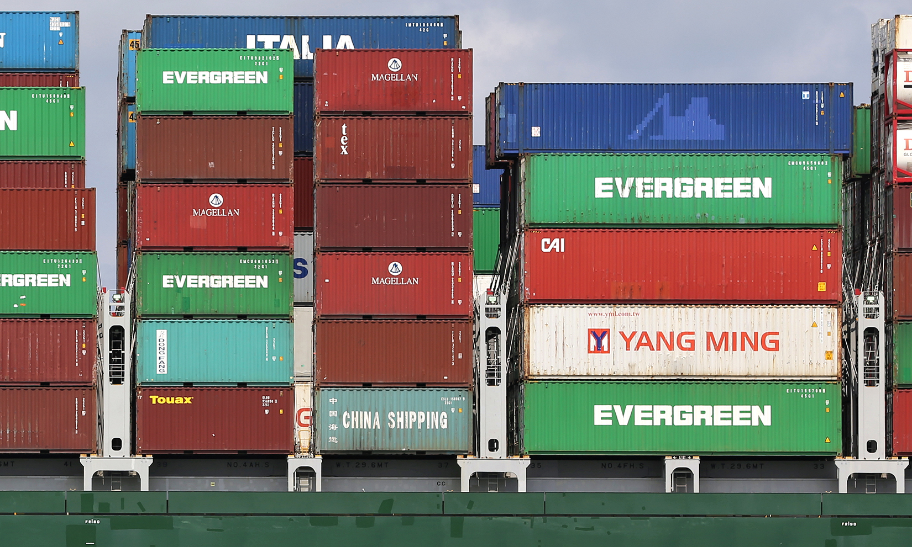
20-foot and 40-foot containers aboard a ship

Slide 12
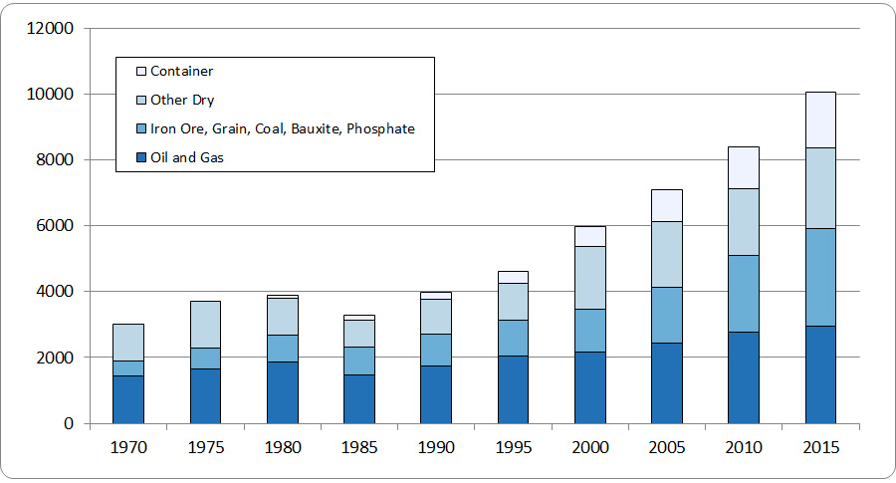
Volume of Ocean Cargo, by Type
In millions of tons. Source: Review of Maritime Transport 2016.

Slide 13
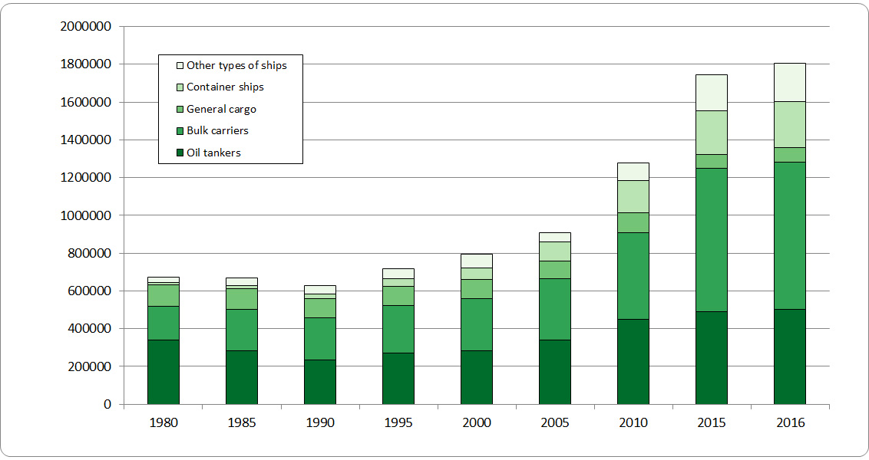
Vessel Capacity, by Type
In millions of DWTs. Source: Review of Maritime Transport 2016.

Slide 14
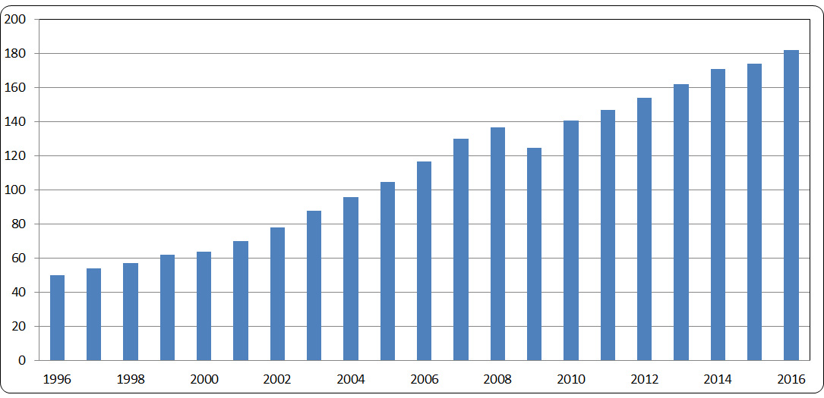
Volume of Containerized Cargo
In millions of TEUs. Source: Review of Maritime Transport 2016.

Slide 15
Types of Ships
Container Ships
Roll-On/Roll-Off Ships
Break-Bulk Ships
Combination Ships
Crude Carriers
Product and Chemical Carriers
Dry-Bulk Carriers
Gas Carriers

Slide 16
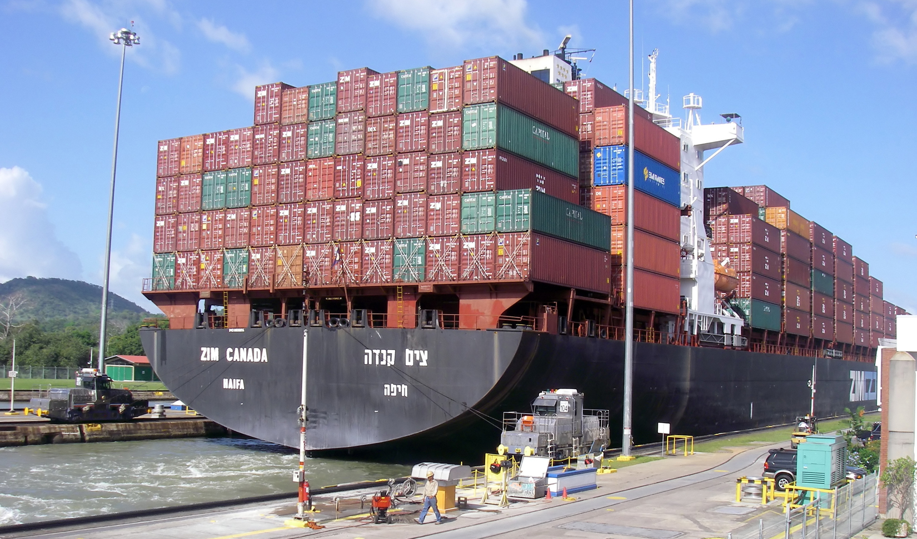
A Panamax container ship in the Miraflores Locks on the Panama Canal

Slide 17
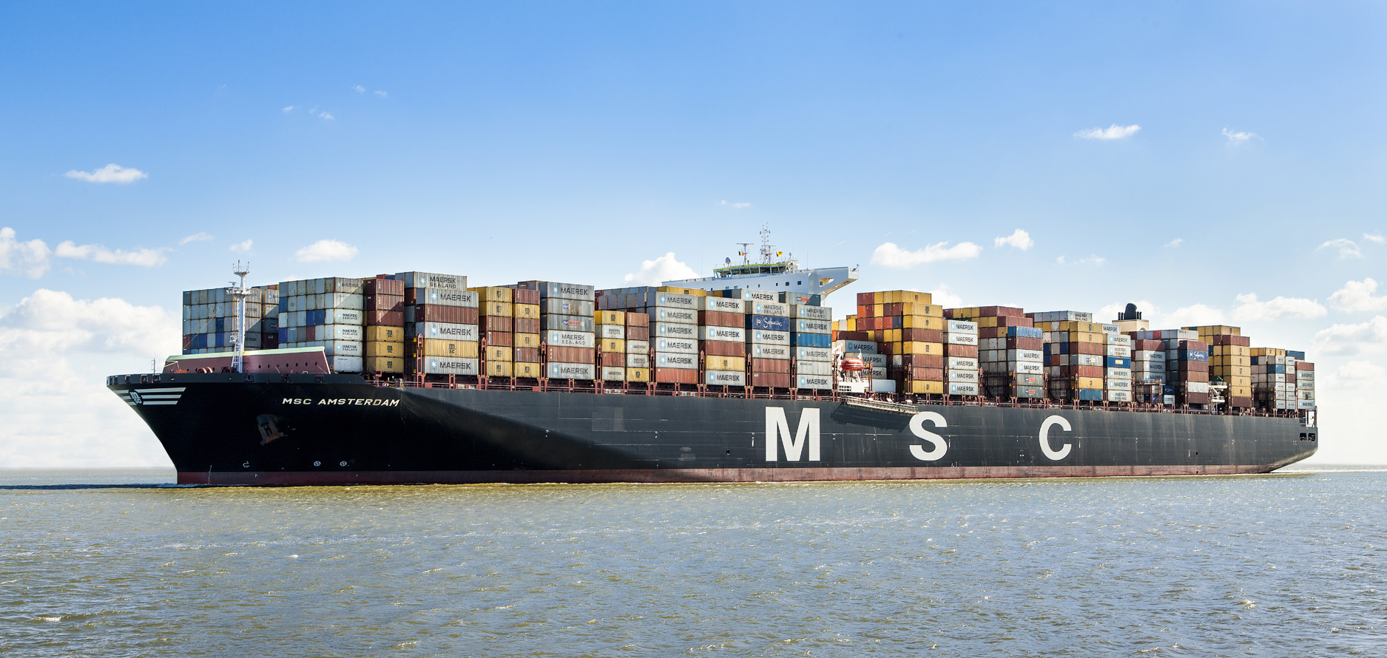
A post-Panamax container ship with 16 containers abreast.

Slide 18
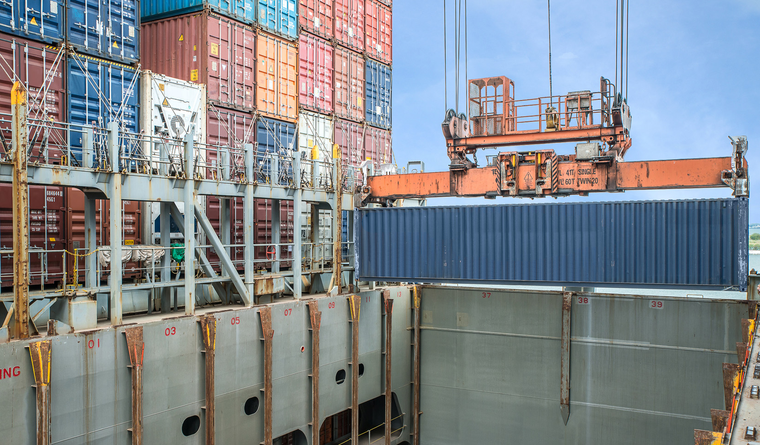
Containers being loaded below deck, using slides.

Slide 19
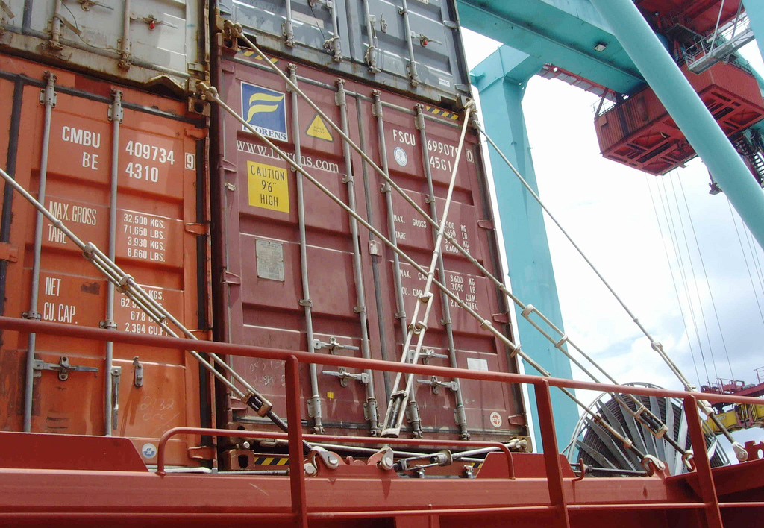
Containers lashed aboard a containership.

Slide 20
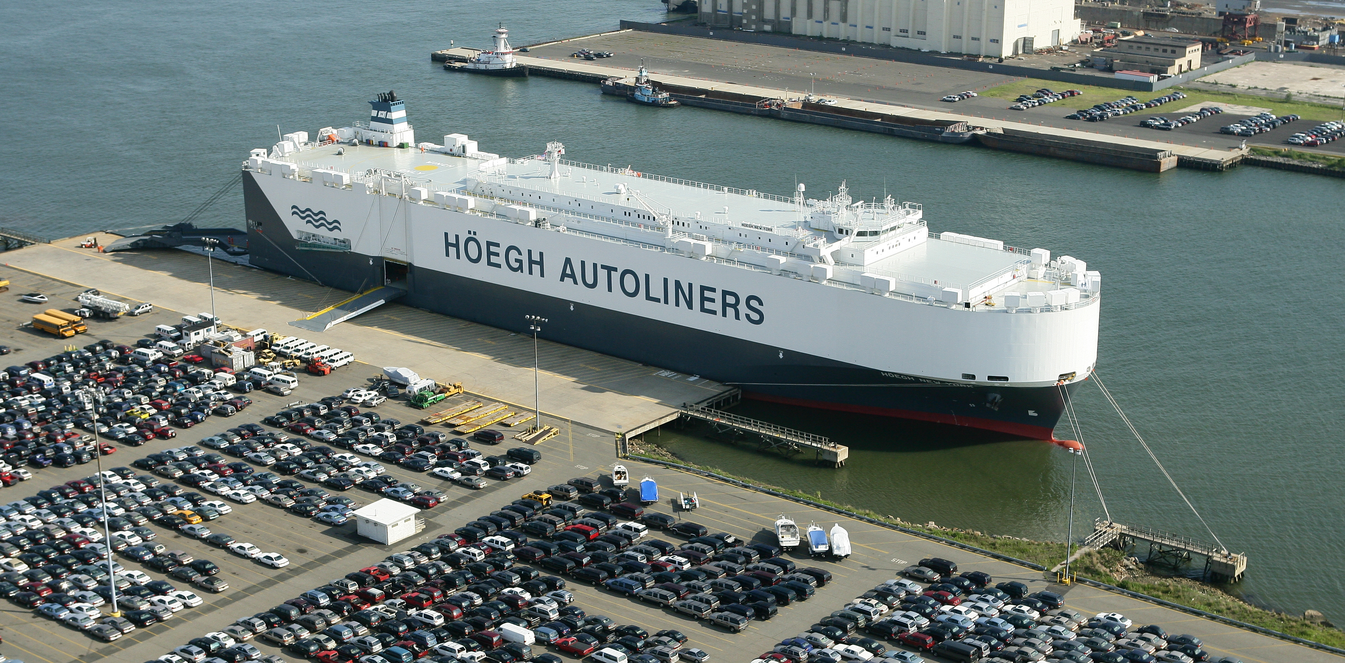
A Roll-on/Roll-off ship.

Slide 21
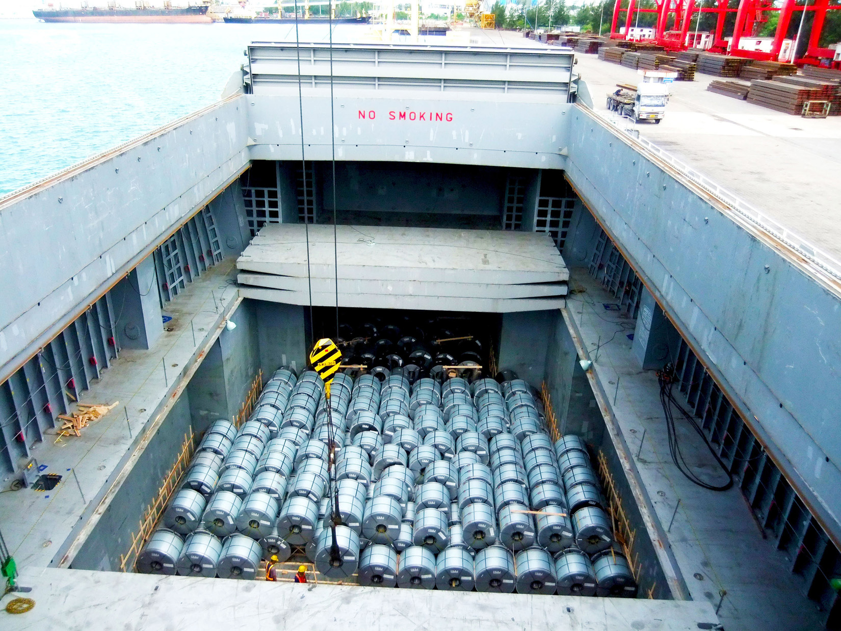
A general cargo (breakbulk) ship.

Slide 22
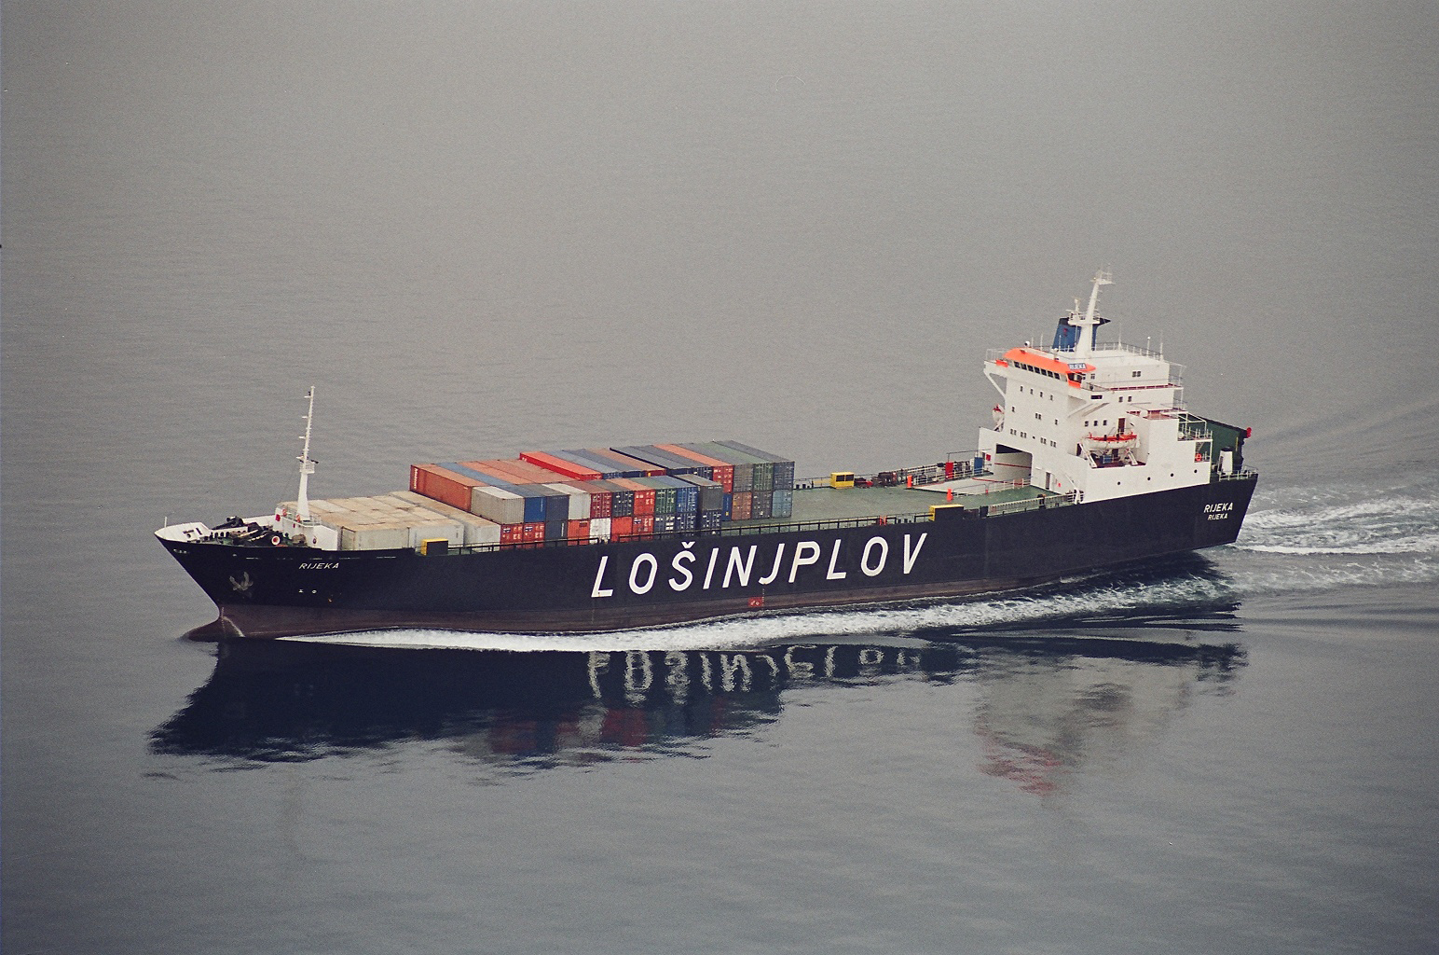
A combination ship.

Slide 23
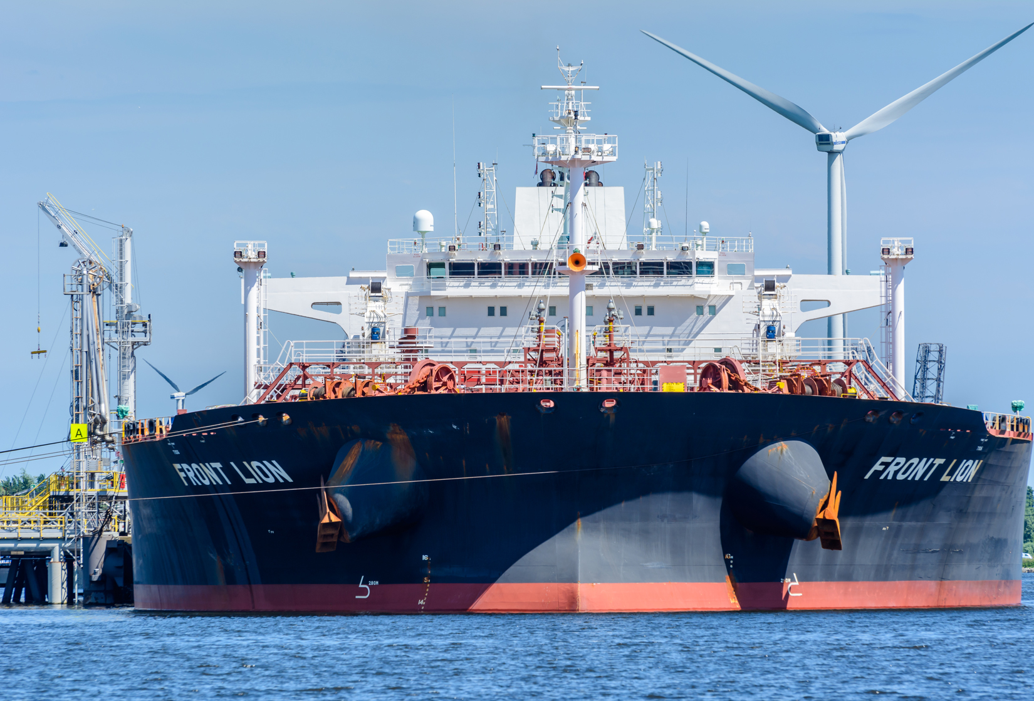
A very large crude carrier (VLCC).

Slide 24
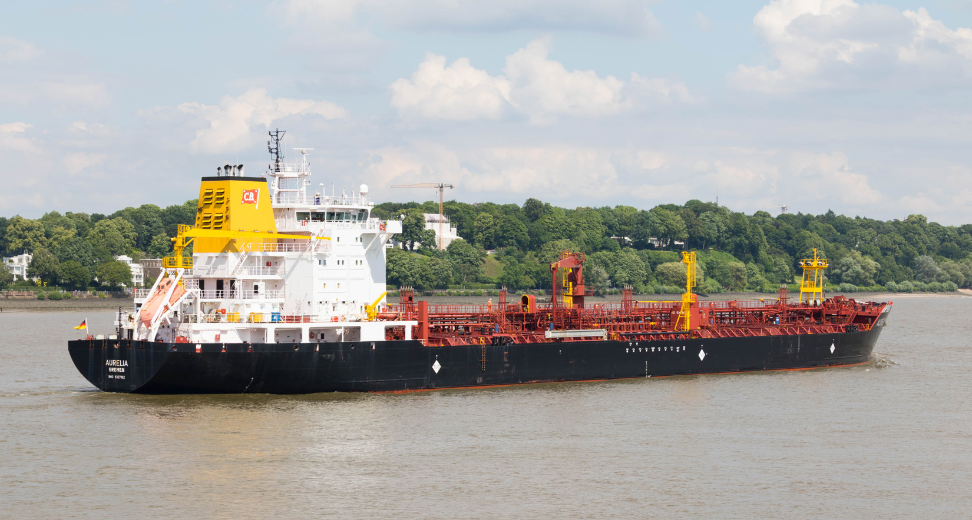
A chemical or product carrier.

Slide 25
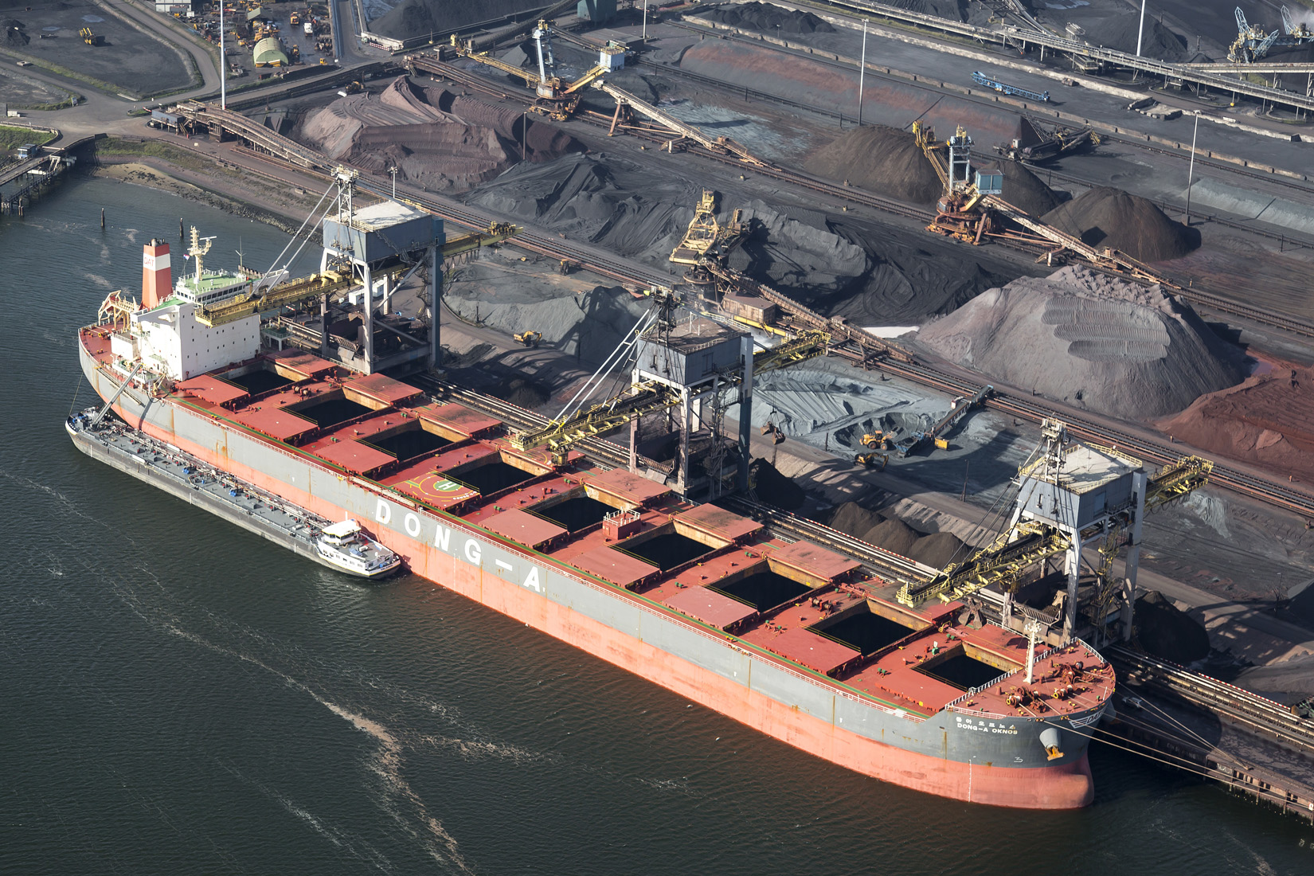
A dry-bulk carrier.

Slide 26
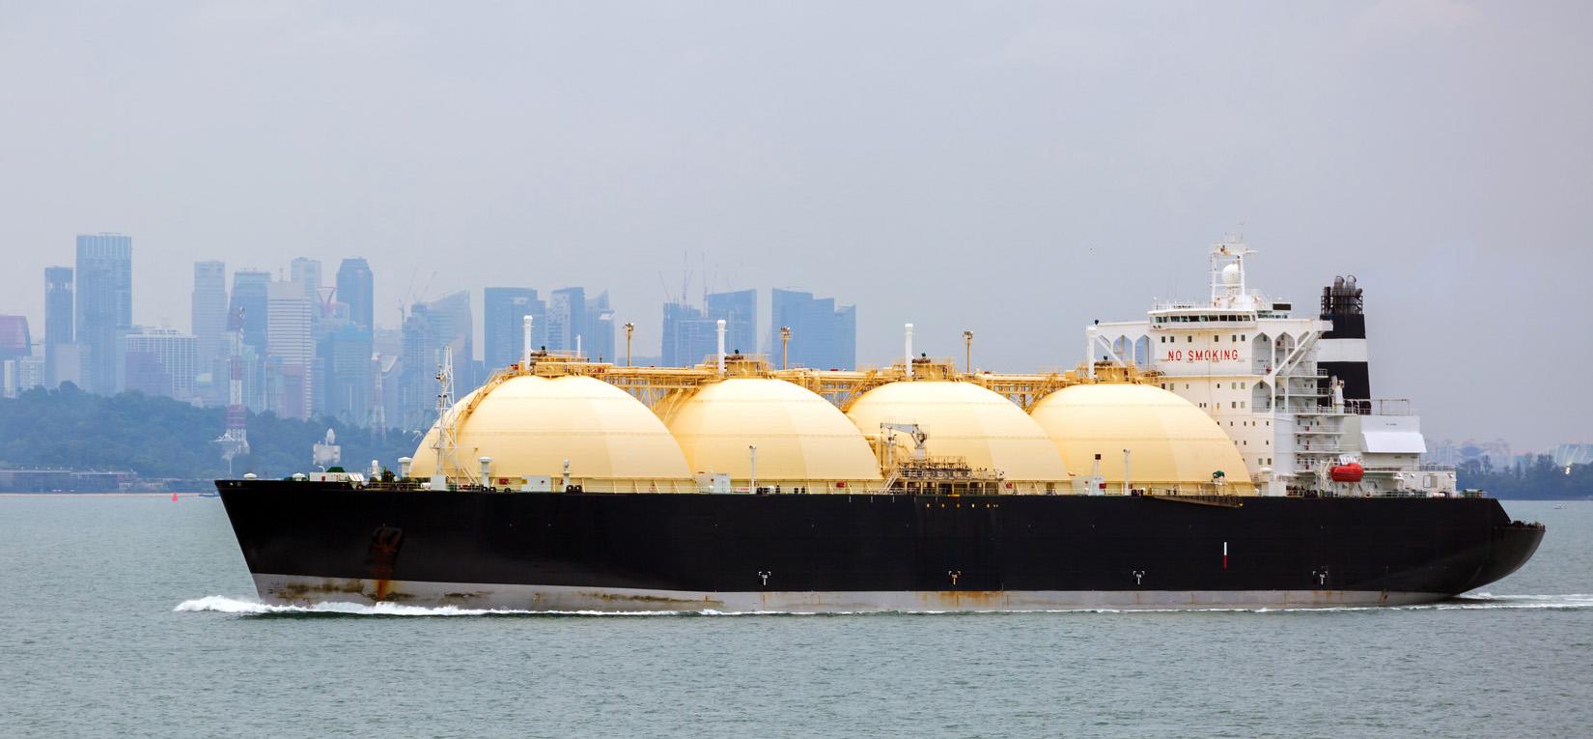
A liquefied natural gas carrier.

Slide 27
Flag
According to international convention, every ship must be registered in a specific country and fly that country’s flag.
The country in which a ship is registered determines:
The laws that are applicable onboard the ship (the ship is an extension of the country’s territory)
The taxes that the ship owners will pay
The regulations that are followed onboard the ship, and their corresponding costs.
In most instances, ship owners have the ability to choose the flag that their ship will fly.

Slide 28
Flag Choice
Ship owners tend to choose flags that have low costs and few regulations. Such flags are called flags of convenience.
The countries that are considered to have “flags of convenience” are:
Panama
Liberia
as well as a handful of other small countries.
Not all countries that allow ships from any nationality to fly their flag are “flags of convenience.” Most just have either an open registry or a secondary registry which are just convenient to ship owners.

Slide 29
Fleet by Flag of Registry
Country | Number of Vessels | Total DWT (in 000s)
Panama | 8,153 | 334,368
Liberia | 3,185 | 206,351
Marshall Islands | 2,943 | 200,069
Hong Kong | 2,515 | 161,787
Singapore | 3,607 | 127,193
Malta | 2,101 | 94,992
Bahamas | 1,450 | 79,541
China | 4.052 | 75,568
Greece | 1,386 | 73,568
Cyprus | 1,053 | 33,313

Slide 30
Liability Conventions
Hague Rules
A 1924 convention that limits carriers’ liability to $500 per package. This is the convention followed by the United States and U.S. carriers.
It also allows carriers to invoke seventeen defenses to avoid liability.
Hague-Visby Rules
A 1968 liability convention that limits carriers’ liability to SDR 667 per package or SDR 2 per kilogram, whichever is higher. This is the convention followed by most countries.

Slide 31
Liability Conventions
Hamburg Rules
A 1978 convention that limits carriers’ liability to SDR 835 per package or SDR 2.50 per kilogram, whichever is higher. It also eliminates most of the “defenses” a carrier could use to discharge itself of liability. This convention has been ratified by few countries, none of which are large trading countries.
Rotterdam Rules
A new liability convention (2009) that limits carriers’ liability to SDR 875 per package or SDR 4 per kilogram, eliminates most of the “defenses,” and that is likely to become the most commonly adopted convention by 2020.

Slide 32
Non-Vessel-Operating Common Carriers
Non-Vessel-Operating Common Carriers (NVOCC) are shipping companies that do not own or operate their own ships.
They operate by purchasing space on a ship on a given voyage and then selling this space to companies that need to ship cargo.
Sometimes, the NVOCC has only one container onboard a ship and consolidates multiple shippers’ cargo in that container.

Slide 33
Security
Security concerns in ocean cargo shipments are dominated by two types of requirements. In the United States, those requirements are implemented by Customs and Border Protection (CBP).
Pre-shipment notifications
In the U.S., it is called the Importer Security Filing (10+2 rule). All cargo manifests must be sent to CBP at least 24 hours before the cargo is to arrive in the U.S.
Pre-shipment inspections
In the U.S., it is called the Container Security Initiative (CSI). CBP inspectors, located in foreign ports, inspect cargo before it is loaded on ships bound for the U.S.

Slide 34
Some Freight Charges
ARB
Arbitrary Charge (Cleaning Fee)
BAF or FAF
Bunker adjustment factor, or Fuel Adjustment Factor (Surcharge)
CAF
Currency Adjustment Factor
CY/CY
Container Yard to Container Yard
CFS/CY
Container Freight Stations to Container Yard movement of Cargo
Chassis Charge
Charge for a truck chassis in the port of departure or destination
THC
Terminal Handling charge, or Container Yard Charge

