Slide 1
Chapter 10 International Insurance

Slide 2
International Insurance
International Insurance
Perils of International Shipments
Risk Management
Insurance Policies
Lloyd’s
Commercial Credit Insurance

Slide 3
International Insurance
There are many pitfalls in international insurance:
Many of the risks are misunderstood. While historically most shippers were located near sea ports, today most are located inland, and have no idea what dangers international shipments face.
The complexity of the field is substantial: not only is there a minimum of six different standard insurance policies, but there are also countless variations in the specific clauses that can be included or excluded.
The vocabulary used is unique, with several terms have completely different meaning than in everyday language. It is important to learn some insurance vocabulary.

Slide 4
International Insurance
The problems are compounded by the fact that:
The Incoterms® rules are somewhat misleading. Although both CIF (Cost, Insurance, and Freight) and CIP (Carriage and Insurance Paid) mention insurance, they refer to the most basic coverage available, which is inadequate for many goods.
The carriers offer very limited coverage. Under the various international liability conventions, carriers offer very basic coverage, with very low limits, and are exempt of liability in many cases.

Slide 5
International Insurance Glossary (I)
A risk is the chance (or the probability) of a loss. Several types of risks exist:
Speculative Risk
The chance (or probability) of a loss or a gain. Not insurable.
Pure Risk
The chance (or probability) of a loss. Insurable.
Objective Risk
The actual probability of a loss, determined from actuarial data.
Subjective Risk
The perceived probability of a loss by an individual or company.

Slide 6
International Insurance Glossary (II)
Insurance policies cover specific perils and the premiums are based on the hazards of a particular shipment:
Peril
The event that brings about a loss.
For example, theft, fire, or piracy.
Hazard
A situation that increases the probability of a peril and therefore of a loss.
Certain regions of the world are more hazardous than others.

Slide 7
International Insurance Glossary (III)
Marine Cargo Insurance policies use unusual vocabulary, specific to the types of perils that a cargo faces in an international voyage:
General Average
A loss incurred on an ocean voyage that is general in the sense that it involves all of the cargo owners on board.
If the captain of the ship saves a portion of the cargo by unloading some of the cargo at sea, it is also a general average.
Particular Average
A partial loss incurred by a cargo owner on an ocean voyage.

Slide 8
International Insurance Glossary (IV)
Other types of perils of an international voyage:
Jettison
The act of throwing overboard part of the cargo of a ship (or the fuel of an airplane) in an attempt to lighten the ship.
Barratry
An act of disobedience or willful misconduct by the captain or the crew of a ship that causes damage to the ship or the cargo.

Slide 9
Perils of the Sea
Cargo at sea can be damaged by a number of perils:
Cargo movement
Water damage
Fire
Sinking and Stranding
Piracy
Theft
Collision
... and several more.

Slide 10
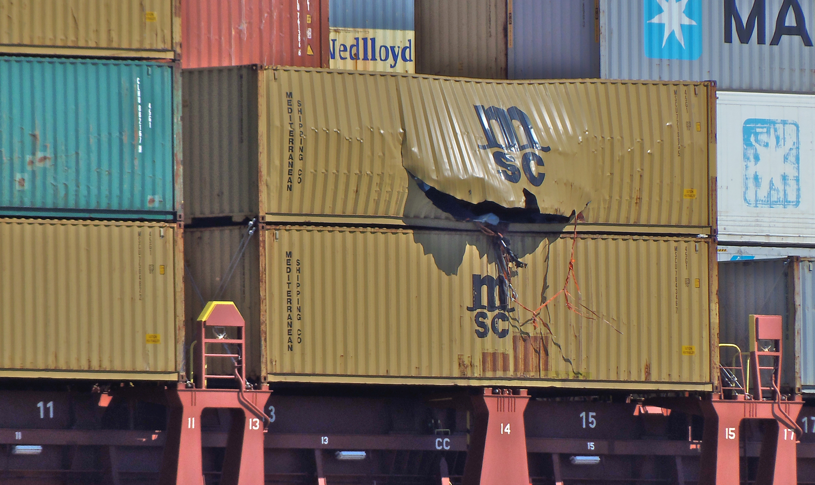
Cargo Movement
Cargo can be damaged or lost due to the movements of the ship.

Slide 11
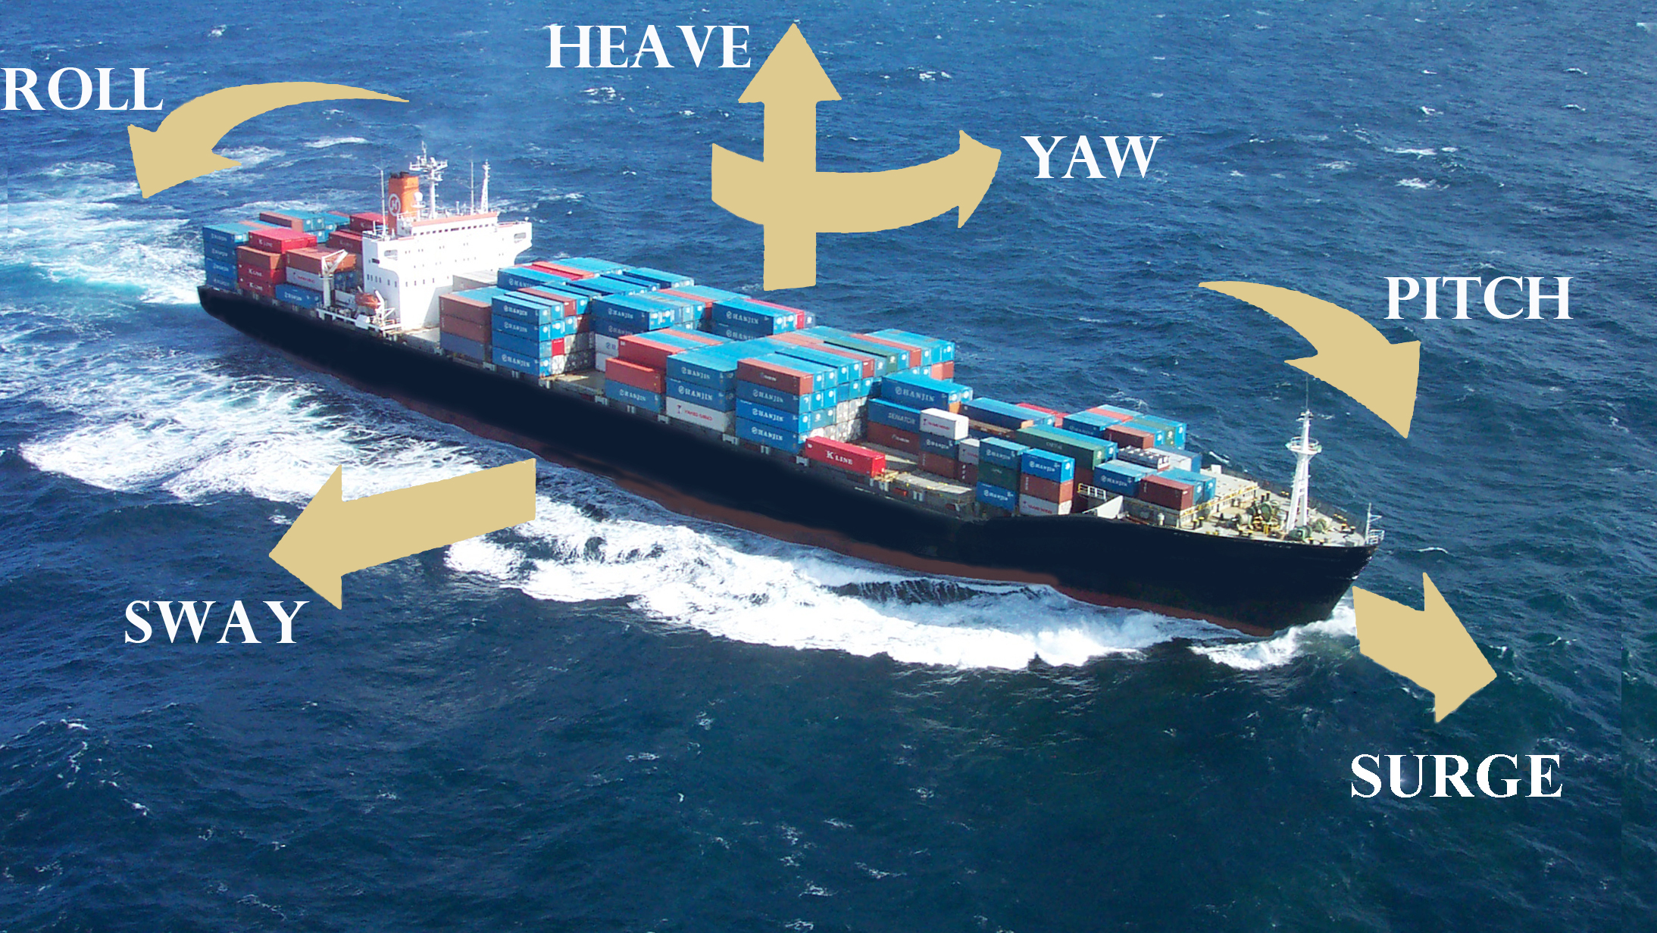
Ship Movement
A shipment by ocean is subjected to numerous ship movements.

Slide 12
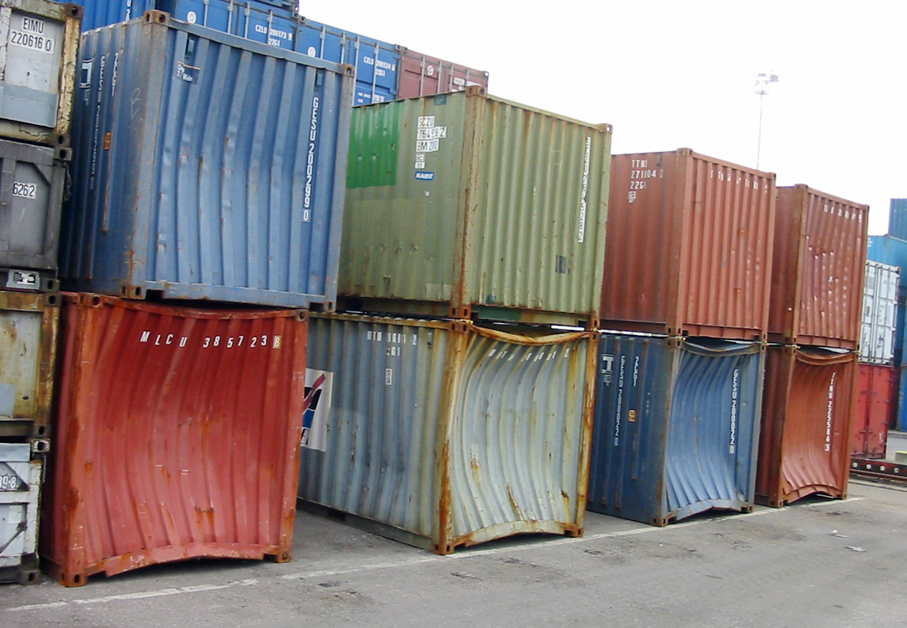
Wave Damage
In stormy seas, waves pound the ships and can damage the containers on board.

Slide 13
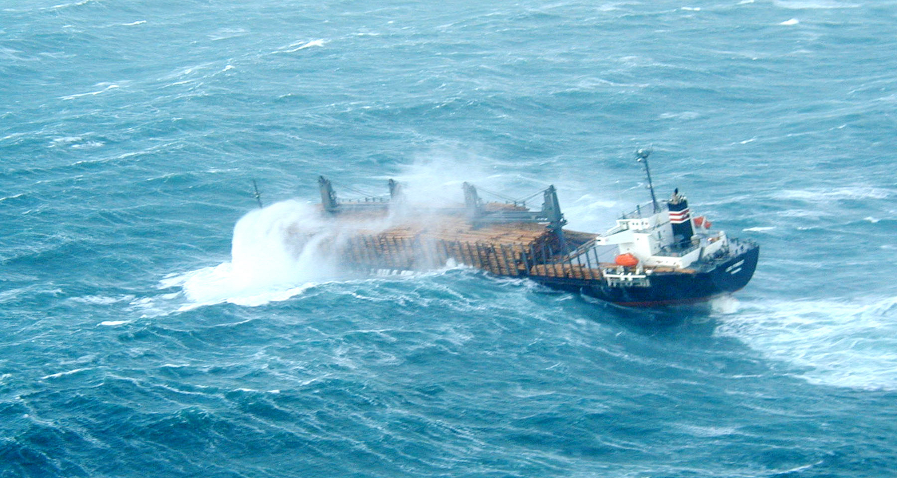
Water Damage
As ships encounter stormy seas, waves wash overboard and can slowly infiltrate the containers or cargo on board.

Slide 14
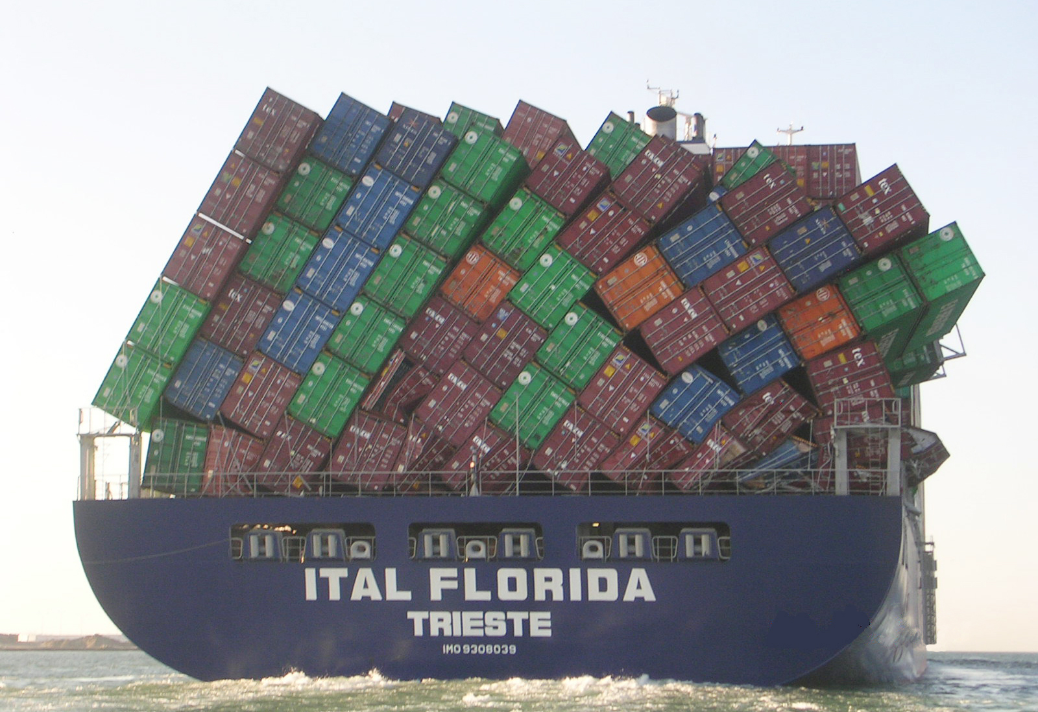
Overboard Losses
Containers are tied down, but the lash bars can fail, causing container stow collapses.

Slide 15
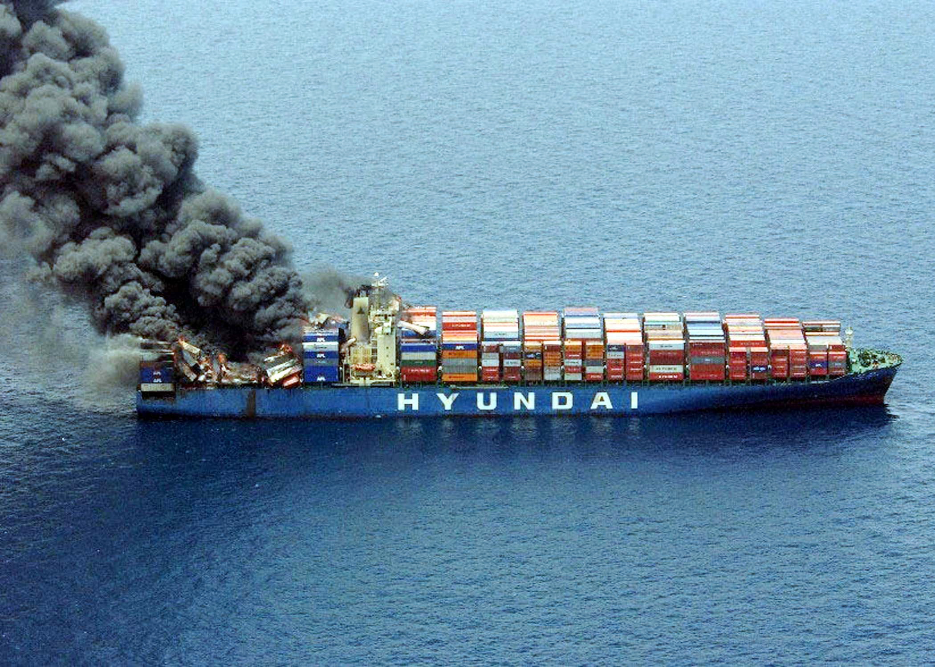
Fire
Dangerous cargo can only travel internationally by ocean, and ships’ ability to fight fires is limited.

Slide 16
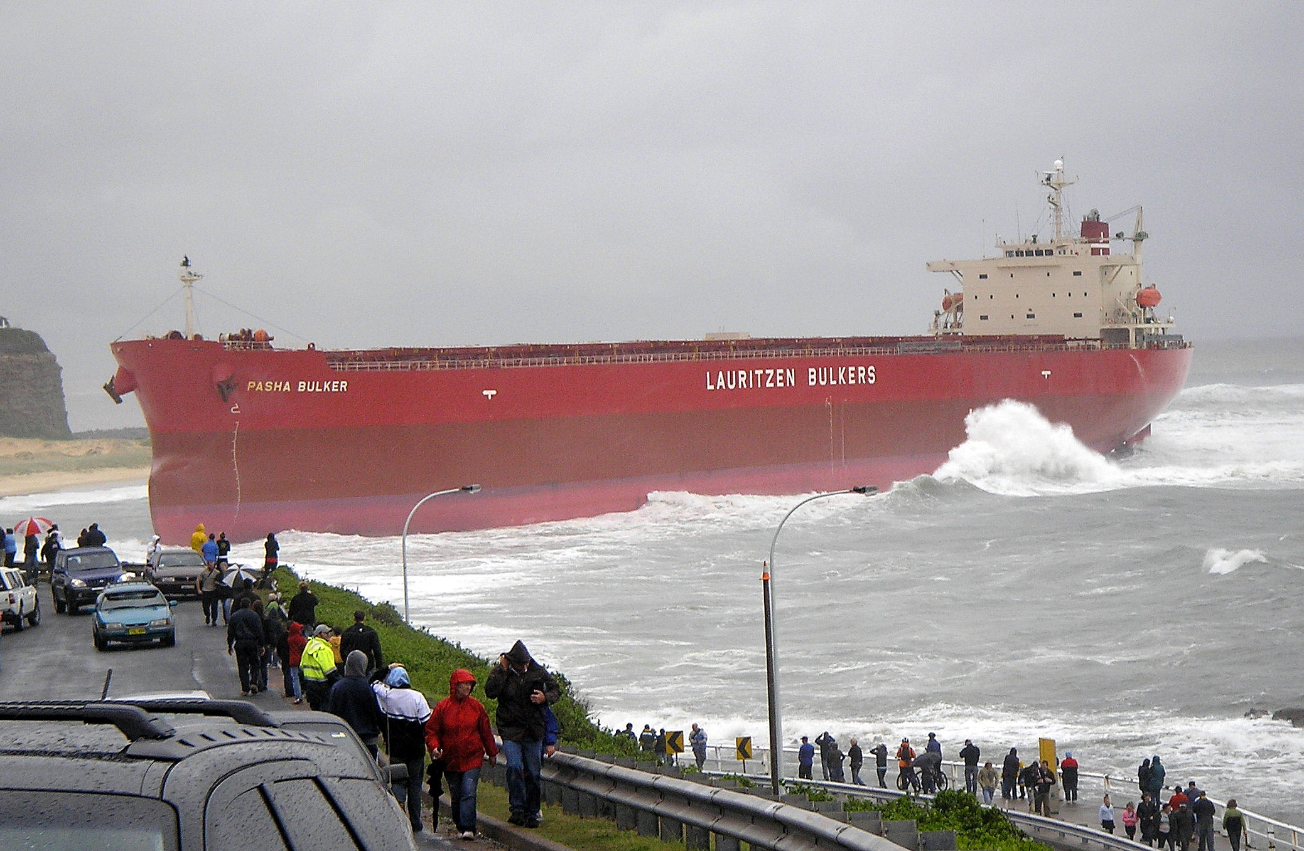
Stranding
Ships can get stranded when their machinery breaks down.

Slide 17
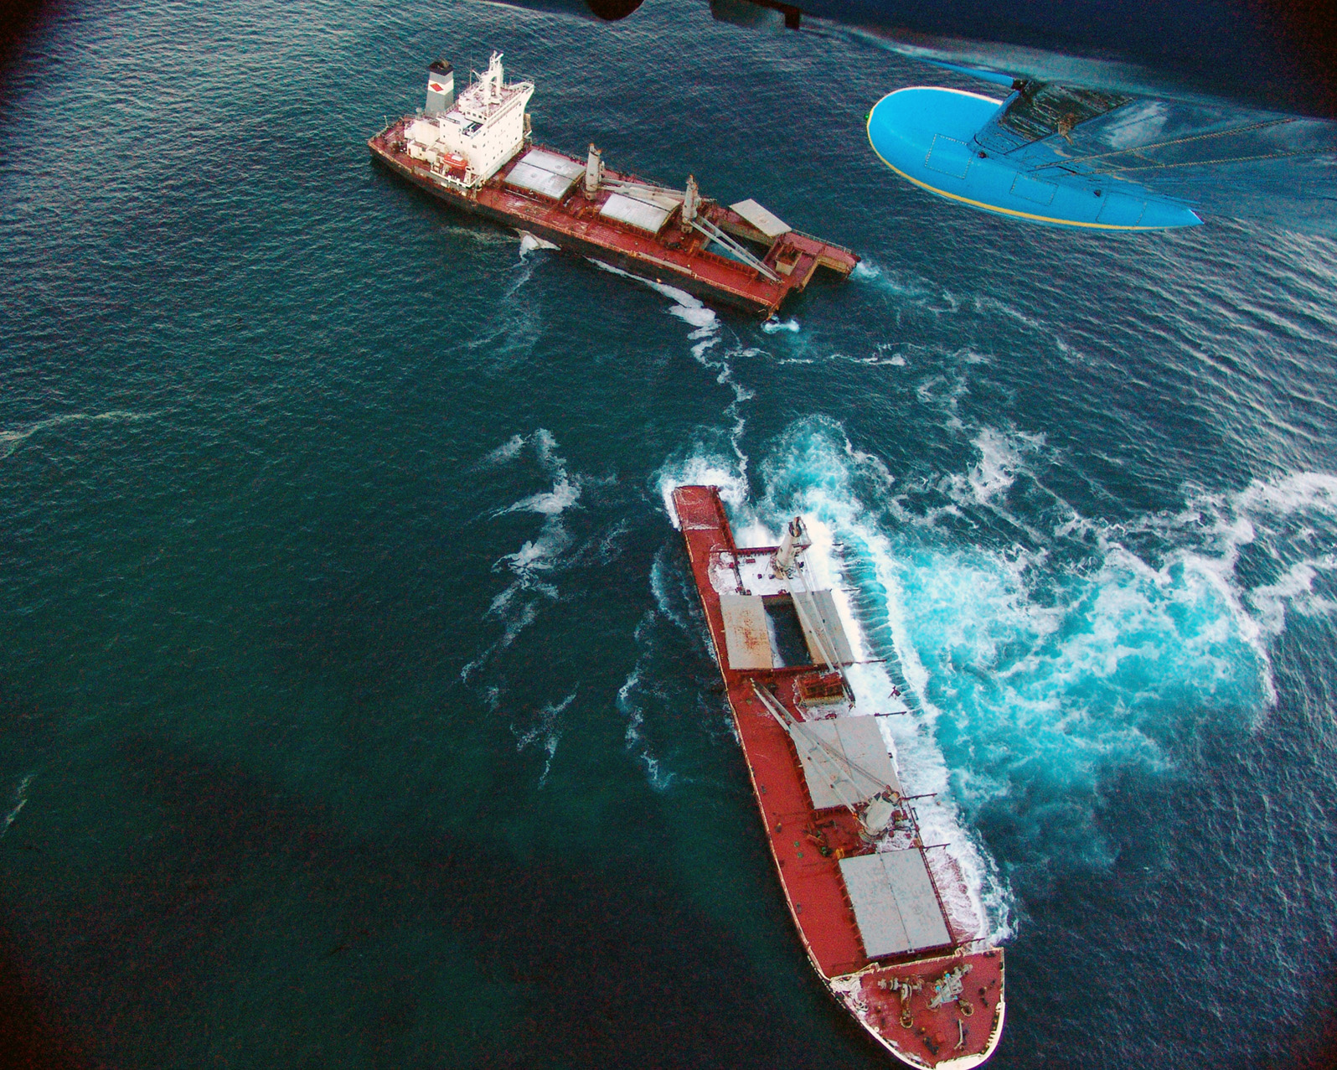
Sinking
Ships can be damaged by rough seas and sink.

Slide 18
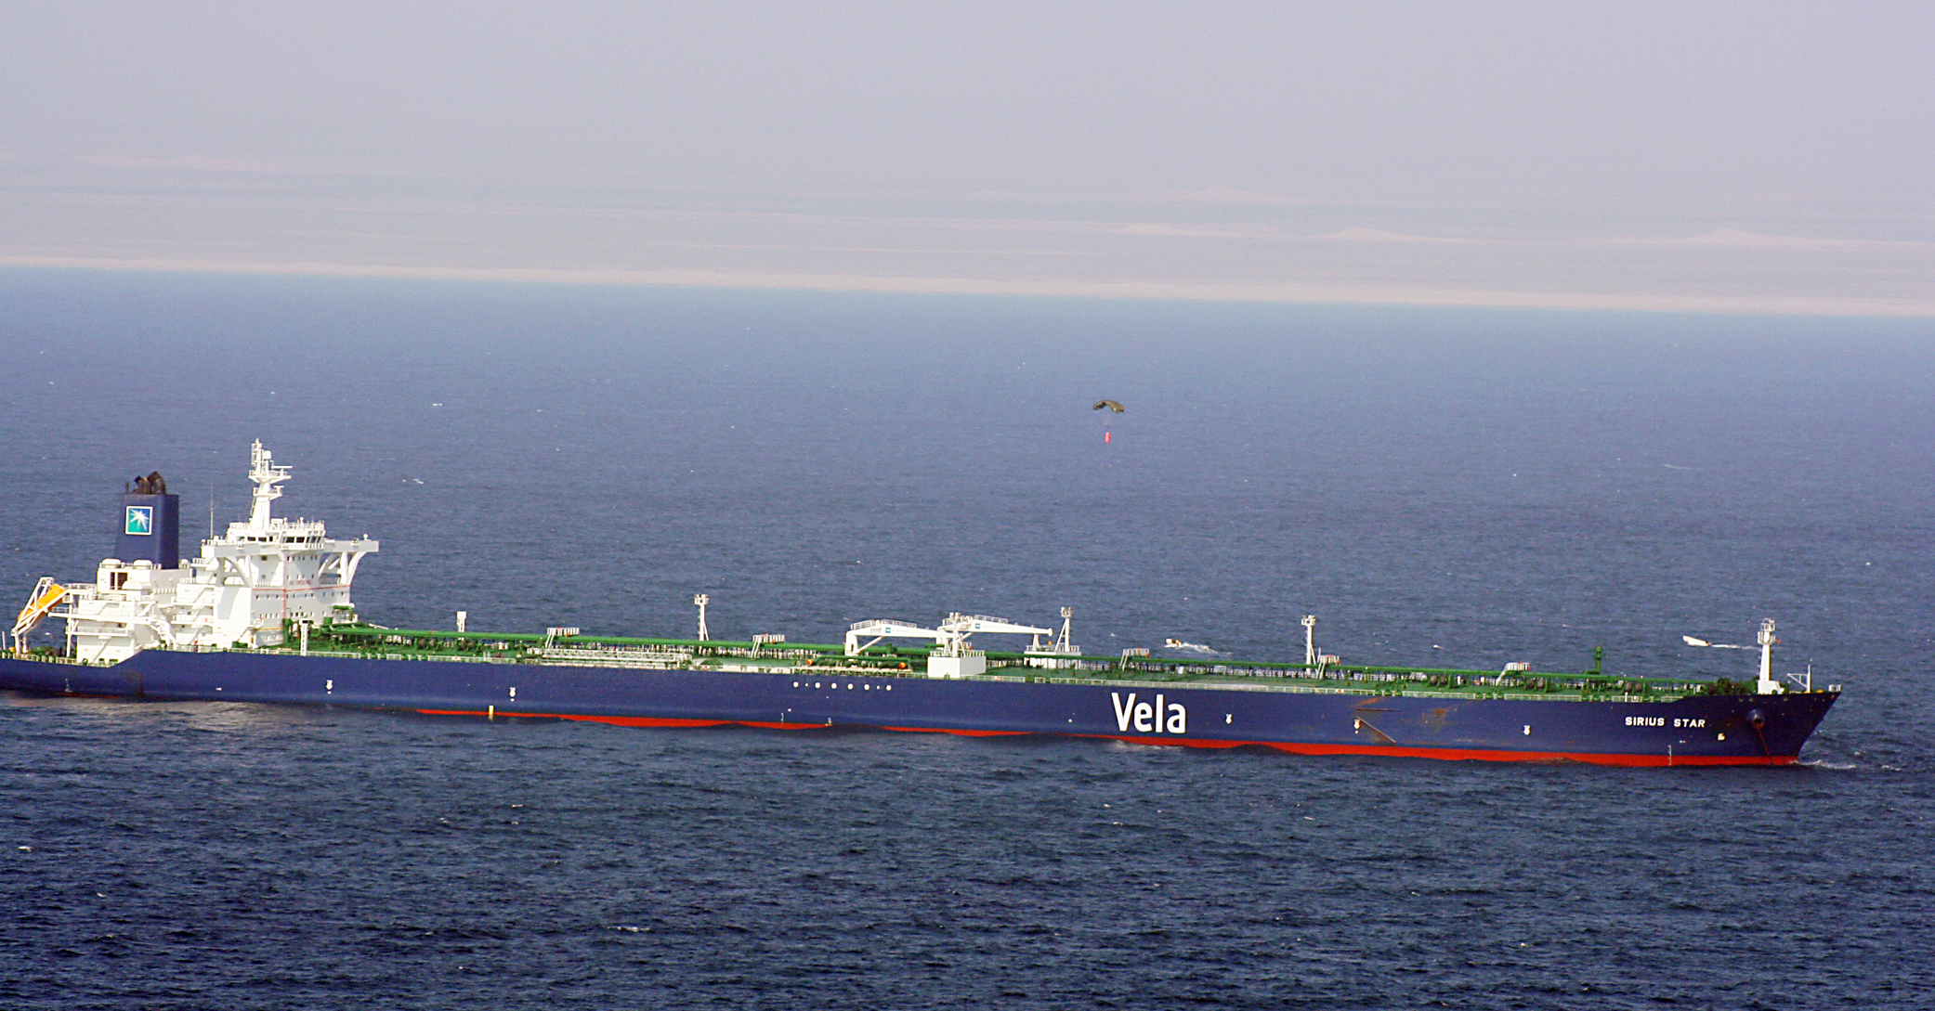
Piracy
Ships can be attacked by pirates. Here, the ransom is dropped onto the Sirius Star.

Slide 19
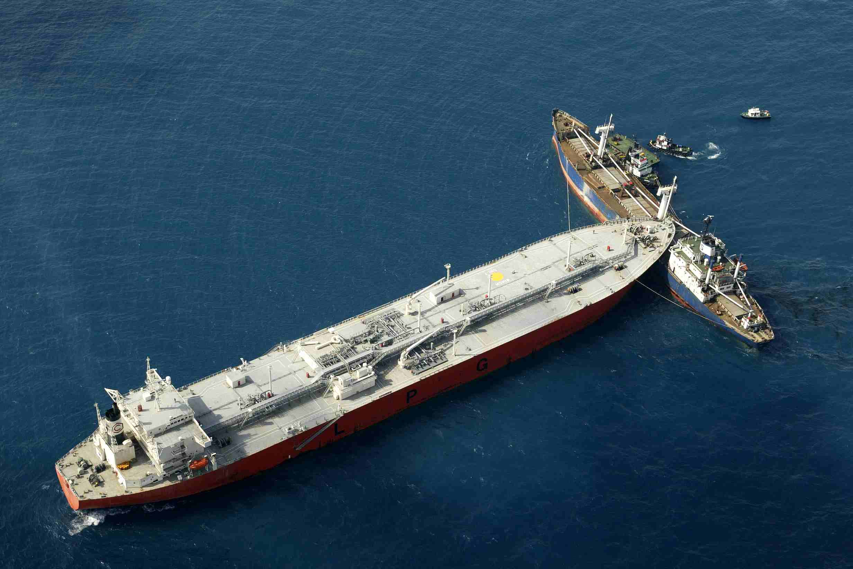
Collision
Ships are far from maneuverable. Sometimes collisions happen and cargo is delayed or damaged.

Slide 20
Theft
Theft is a much greater risk on shore, specifically in transit to the port of departure and from the port of arrival, but it is a significant concern.
Pilferage
Unplanned theft, based upon the opportunity to steal cargo.
Organized Theft
Deliberate and carefully-planned theft of cargo or containers.
System’s Theft
The use of technology to access the files of a particular shipment, and steal it. That way the theft may not be detected for a few days.

Slide 21
Other Perils of the Sea
Ocean cargoes are exposed to a number of other perils:
Other cargo contaminating or affecting the cargo
Stowaways damaging the cargo
A government seizing or arresting the ship
The owners of the ship declaring bankruptcy
The port shutting down because of a strike
Weather delaying loading or unloading of the cargo
... and so on.

Slide 22
General Average
The concept of general average is unique to marine insurance.
If there is a major loss during a voyage, the costs are shared by the owner of the ship and all of the cargo owners, including the owners of the goods that were not damaged.
In other words, if 25 percent of the containers of a ship (and the ship) are damaged in a fire, then the owners of the undamaged containers (75 percent of the cargo) are held financially responsible for the losses to the 25 percent and to the ship owner.
The concept is that all parties have a vested interest in a successful voyage, and therefore they all share the risk.

Slide 23
Perils of Air Shipments
Although there are generally fewer perils in air transportation than in ocean transportation, goods are still exposed to many of the same risks:
Cargo handing (before loading and after being unloaded)
Cargo movements (significant accelerations and decelerations as well as turbulence “bumps” during flight)
Theft and pilferage (especially since high-value goods are often shipped by air)
Water damage (cargo can be left on the tarmac, exposed to the elements)
However, there are risks specific to air shipments.

Slide 24
Perils of Air Shipments
There are two risks specific to air shipments:
Changes in temperature
Cargo en route from a tropical area (Singapore) to another warm-weather area (Los Angeles) may transit at an airport such as Anchorage, exposing the goods to potentially very cold temperatures, even though the shipper did not expect them to be.
Changes in atmospheric pressure
Cargo may be placed in aircraft that are only partially pressurized, or may be not pressurized at all (less likely).

Slide 25
Risk Management
A company involved in international trade can manage its exposure to international transportation risks in one of three ways:
Retain the risks
Transfer the risks to an insurance company
Adopt a mixed approach
The difficulty in determining the proper strategy is the correct assessment of the risks of a particular shipment.

Slide 26
Risk Retention
Some companies decide that it is more economical to not purchase insurance for international transportation risks. They are:
Very large international traders with many shipments. Their insurance premiums would be higher than the expected values of their losses.
Exporters or importers with little exposure. They are shipping or buying goods of such little value, in such small shipments, that a loss would have few financial consequences.
Exporters or importers that have little relative exposure because international transactions represent such a small percentage of their business.
Firms that do not evaluate their international transportation risks clearly.

Slide 27
Risk Transfer
Some firms decide it is best to transfer their international transportation risks to an insurance company. In exchange for a premium, these firms are covered against their losses:
Firms with high exposure. The value of the goods they ship is high, and the loss of some of these shipments would be a substantial financial blow to their operations.
Firms with high relative exposure. Even though the amounts at stake may be small, they are relatively high for these firms, as a percentage of their sales.
Firms that lack experience in international trade. They insure because they are uncomfortable with the risks involved or unable to properly assess their exposure.

Slide 28
Mixed Approach
A firm can use a mixed approach, retaining some of the risk and transferring the rest. This strategy can be achieved in two different ways:
The decision is made based upon the maximum amount of exposure that a firm is willing to risk: this objective is traditionally achieved with the use of a deductible or a franchise.
The decision is made based on the types of risks that the firm is willing to take, and those that it would rather transfer to an insurance company.

Slide 29
Marine Cargo Policies
There are two possible ways to purchase marine cargo policies:
Open Cargo Policy
An insurance contract with which a firm insures every international shipment it makes for a fixed period of time. Such a policy is formally known as an Open Ocean Cargo Policy and it automatically covers all the shipments of the insured.
Special Cargo Policy
An insurance contract valid for one specific shipment.

Slide 30
Marine Cargo Policies
Marine Cargo Insurance can be purchased from two sources:
An insurance agent, who can assist the firm in obtaining the most appropriate coverage, given its product mix and its risk management strategy; as such, agents sell most open ocean cargo policies.
A freight forwarder, who can provide “generic” coverage for a given shipment almost immediately; as such, freight forwarders sell a lot of special cargo policies.

Slide 31
Marine Cargo Policies
There are two major groups of policies that can be purchased in order to protect cargo during an ocean or air shipment:
The first group is governed by British Law and was completely rewritten in 1982, and modified further in 2009. This group of insurance policies seems to have become the standard for many countries. They are known as the Institute Marine Cargo Clauses policies, Coverage A, B, or C.
The second group is older, with some antiquated clauses and more modern ones, and is mostly written by U.S.-based insurance companies. These traditional policies are known as “All Risks,” “General Average,” and “Free of Particular Average” policies.

Slide 32
Coverage Exclusions
Regardless of the coverage purchased, insurance policies will not cover the following risks:
Improper packaging—Damage caused by packaging insufficient for an international ocean or air voyage.
Inherent vice—Damage caused by an ordinary natural change in the goods; wood warping, steel rusting, ... and so on.
Ordinary leakage—Decrease in weight due to evaporation, ordinary wear and tear (miles on a vehicle transported).
Unseaworthy vessel
Nuclear war

Slide 33
Institute Cargo Clauses—Coverage A
Coverage A is an all-risks policy in that it covers “all risks of loss or damage to the subject-matter insured,” except for some risks that are specifically excluded, such as war, seizure of the cargo or ship by a government, or strikes and civil disturbances.
A policy written with Coverage A of the Institute Marine Cargo Clauses is identical in all countries.
Coverage A is the maximum coverage that an exporter or an importer would need to purchase in the case of a shipment traveling on most trade lanes in the world.

Slide 34
Institute Cargo Clauses—Coverage B
Coverage B is a “named perils” policy, as it lists specifically the risks that it will cover.
The list of covered perils includes fire, stranding, sinking, collision, jettison, washing overboard, water damages, and total losses during loading and unloading; however, losses due to bad weather are not covered, and neither are partial losses happening during loading and unloading of the ship, theft, condensation and improper stowing by the carrier.
Coverage B is best for goods that have a good tolerance for bad weather, such as bulk raw materials including coal, iron ore, polymer pellets, and lumber.

Slide 35
Institute Cargo Clauses—Coverage C
Coverage C is also a “named perils” policy. The list of covered perils is limited to fire, stranding, sinking, collision, and jettison; it does not include washing overboard, rough weather damages, or water damages, and losses during loading and unloading.
Coverage C is the minimum coverage required by the Incoterms CIF and CIP.
It is insufficient for most containerized goods, with the possible exception of goods that are unlikely to be affected by an international voyage in any way, and, if lost overboard, would not be a major loss. There are very few cargoes that fit this description.

Slide 36
All-Risks Policies
An “All Risks” policy is an older—but still very commonly used, particularly in the United States—-type of policy. All-risk policies are not standardized, unlike Coverage A.
Under all-risks policies, all risks are covered, except those specifically excluded. For example, an all-risks policy often excludes the risk of war.
All-risks policies can be written with U.S. or British clauses and coverage is different based upon that determination. For a United States all-risks policy to be enforceable, the goods have to be shipped “under deck.”
Finally, all-risks policies are written in non-contemporary English terms, which makes them difficult to comprehend.

Slide 37
With Average Policies
A “With Average” policy is a “named perils” policy: only those perils that are listed in the policy are covered, and no other.
This type of policy covers fewer perils than an all-risks policy, but a few more than a Coverage B policy. Traditionally, a with-average policy excludes condensation damage to the goods, theft, improper stowage by the carrier, leakage and breakage, but covers heavy seas, and damage occurring while loading and unloading.
With-average policies vary substantially, and therefore great care should be taken in making sure a specific peril is covered. They are written in non-contemporary English, and include clauses that are either U.S. or British clauses.

Slide 38
Free of Particular Average Policies
“Free of Particular Average” policies are named-perils policies, that cover total losses, but only cover partial losses in some circumstances.
A free-of-particular-average policy would cover partial losses if they result directly from a fire, a stranding, a sinking, or a collision (American version), or if they occur on the same voyage that a fire, a stranding, a sinking, or a collision occurs, without these perils having directly caused the loss (English version).
Free-of-particular-average policies cover fewer perils than with- average policies, such as damage to the goods while loading and unloading. They are not appropriate for most goods.

Slide 39
Marine Cargo Clauses
Some clauses will always be included in a marine insurance cargo policy: here are some of them.
General Average
The insurer will cover the General Average responsibilities of a shipper toward the ship owner and the other cargo owners.
Constructive Total Loss Coverage
The insurer will reimburse the shipper for goods that have been abandoned after a stranding or a sinking, as long as the costs of recovering the goods and making them marketable is greater than their value. If it is possible to recover the goods at a cost lower than their value, then the insurance company pays for these costs.

Slide 40
Marine Cargo Clauses
Sue and Labor
The shipper will act in the best interest of the insurance company when a loss occurs. The principle is that, after a loss, the insured should protect the cargo from further damage, as it would if it had not been insured, in order to keep the loss to a minimum. The insurer will pay for the costs of protecting the cargo.
Inchmaree Clause
A clause which ensures goods are covered in the event of a burst boiler, broken propeller shaft, as well as errors in navigation and seamanship.

Slide 41
Marine Cargo Clauses
Strikes Coverage
All standard policies include a clause, called the “Strikes, Riots, and Civil Commotions” (S.R. & C.C.) clause in the American policies and the “Strikes Exclusion" clause in the Institute Marine Cargo policies, which excludes coverage of damage to cargo due to strikes and other civil disturbances.
War and Seizure
A clause that excludes coverage of damage to cargo due to war and warlike situations, such as the seizure of a ship by a foreign government or the accidental collision of a ship with a mine. American policies call this clause the “Free of Capture and Seizure” clause.

Slide 42
Marine Cargo Clauses
Some policies will add clauses to standard coverage:
Warehouse to warehouse Coverage
An addition to a policy which covers the goods from the time they leave the exporter's warehouse until the time they arrive at the importer's warehouse, or fifteen days after they arrive in the port of destination, whichever occurs first.
Difference in Conditions
An addition to a standard policy, “Difference in Conditions” coverage is designed to fill the gap between what an importer would like to have covered under its open cargo policy and what is covered under its supplier's CIF or CIP coverage.

Slide 43
Other Marine Insurance Policies
Hull Insurance
Hull insurance is contracted by the ship owner to cover the risk of damage to the ship when it is involved in a peril, such as grounding or fire. It also covers the owner in case of a complete loss, such as a sinking.
This policy also covers the ship owner‘s liability toward the cargo owners in the case of a general average.

Slide 44
Other Marine Insurance Policies
Protection and Indemnity
Protection and Indemnity (P&I) is another form of insurance for a ship owner; it is a protection against liability to other parties when a ship sinks or is damaged.
In the last few decades, it has meant liability for oil spills—specifically cargo spills, but also ship fuel spills—in the oceans and on beaches, and their extensive clean-up costs.
However, it also includes the ship owner’s liability toward the crew (injury, death) or in repatriating stowaways.
P&I insurance is provided by P&I Clubs, groups formed by ship owners to share their mutual liabilities.

Slide 45
Airfreight Cargo Policies
Airfreight cargo policies mirror the coverage provided under Coverage A of the Institute Marine Cargo Clauses, or provided by an all-risks policy. However, they exclude:
Improper packing
Inherent vice
Ordinary leakage
Un-airworthy aircraft
Nuclear war

Slide 46
Filing an Insurance Claim
There are several steps in filling a proper insurance claim:
Notifying the insurance carrier
Protecting of the damaged cargo
Filing the claim
Understanding carrier liability limits
The liability limits of carriers, both ocean and air, are significant and will be covered in Chapters 11 and 12.

Slide 47
Lloyd’s of London
Although it is often considered an insurance company, Lloyd's of London is actually the oldest insurance market in the history of shipping.
An insurance company makes a profit from the difference between a large number of small premiums (its revenues) and a small number of large losses (its expenses).
Through Lloyd’s, insurance policies are written for risks that are uncommon, or risks that do not generate a lot of premiums, and therefore traditional insurance companies cannot operate their traditional business model.

Slide 48
Lloyd’s of London
Through Lloyd’s, companies that need a risk covered are placed in touch with syndicates, or groups of people who are willing to take that risk.
Syndicates are made up of members who:
Share the premium proceeds if there is no loss
Share the costs of the loss if there is a loss
A syndicate is therefore made up of members who are wagering that a loss will not occur. They “win” when there is no loss, and “lose” when there is one.

Slide 49
Lloyd’s of London
Members of a syndicate can either be:
Bespoke Names — individuals with great wealth who join a syndicate to add to their investment portfolio.
Corporate Members — corporations that join a syndicate to increase their diversification strategy.
Bespoke Names have the distinct characteristic of having unlimited liability (on all their personal assets) for the risks that the syndicate undertakes. Corporate Members have limited liability.
Because of this characteristic, syndicates are increasingly constituted of corporate members.

Slide 50
Credit Insurance
International commercial transactions include their own risks:
Commercial Risk
The risk presented by the customer defaulting on its obligation to pay, for whatever reason. For example, a customer encounters financial difficulties, or has a complaint about the product and withhold payment.
Political (or Country) Risk
The risk presented by the country in which the transaction takes place. For example, the government raises tariffs, freezes accounts of foreign currencies, or the country does something to cause other countries to institute an embargo against them.

Slide 51
Credit Insurance
Commercial and political credit risks can be managed in the same manner as transportation risks:
Retain the risk
Transfer the risk to an insurance company
Follow a mixed strategy of retaining some of the risks and transferring others

Slide 52
Credit Insurance—U.S. Programs
Export-Import Bank (Ex-Im Bank)
Its mission is to help create jobs in the United States by supporting export sales. It offers political credit insurance and loan guarantees.
Overseas Private Investment Corporation (OPIC)
Its purpose is to encouraging private investments in developing countries. OPIC offers several programs of loans, political insurance, and private equity investment funds.
Small Business Administration (SBA)
SBA has programs designed to help exporters finance sales abroad: working capital loans and long-term loans for capital investments.

Slide 53
Credit Insurance—Private Companies’ Products
Foreign Credit Insurance Association (FCIA)
FCIA offers products that combine the Ex-Im Bank's political insurance coverage and commercial credit insurance products.
Lloyd’s
Certain Lloyd's syndicates have added coverage of political risks to their underwriting portfolio and present the advantage of offering insurance for countries for which the United States' government will not provide any, such as Afghanistan, Albania, or Belarus.
Private Insurance Companies
Companies such as Euler-ACI and COFACE offer commercial credit insurance policies.

