Slide 1
Chapter 9 International Documents

Slide 2
International Documents
Documentation Requirements
Invoices
Export Documents
Import Documents
Transportation Documents
Documents as a Marketing Tool

Slide 3
Documentation Requirements
Most international transactions require numerous documents:
It is important that each of these documents be filled correctly and within a specific time frame. Each document has different requirements.
It is common to issue more than one original document – one for each of several parties.
Most countries still require documents to be printed on paper and not submitted electronically.

Slide 4
Invoices
Commercial invoices for transactions conducted in an international environment are much more complete and detailed than in a domestic environment. They must include:
A detailed description of the goods, with HS number, so that the goods can be classified correctly by Customs
The Incoterm s® rule of the transaction
Details on the costs of domestic transportation, loading, insurance, etc., so as to help Customs determine the dutiable value of the goods
Details on the weight and dimensions of the goods
Details on the itinerary of the shipment
The terms of payment

Slide 5
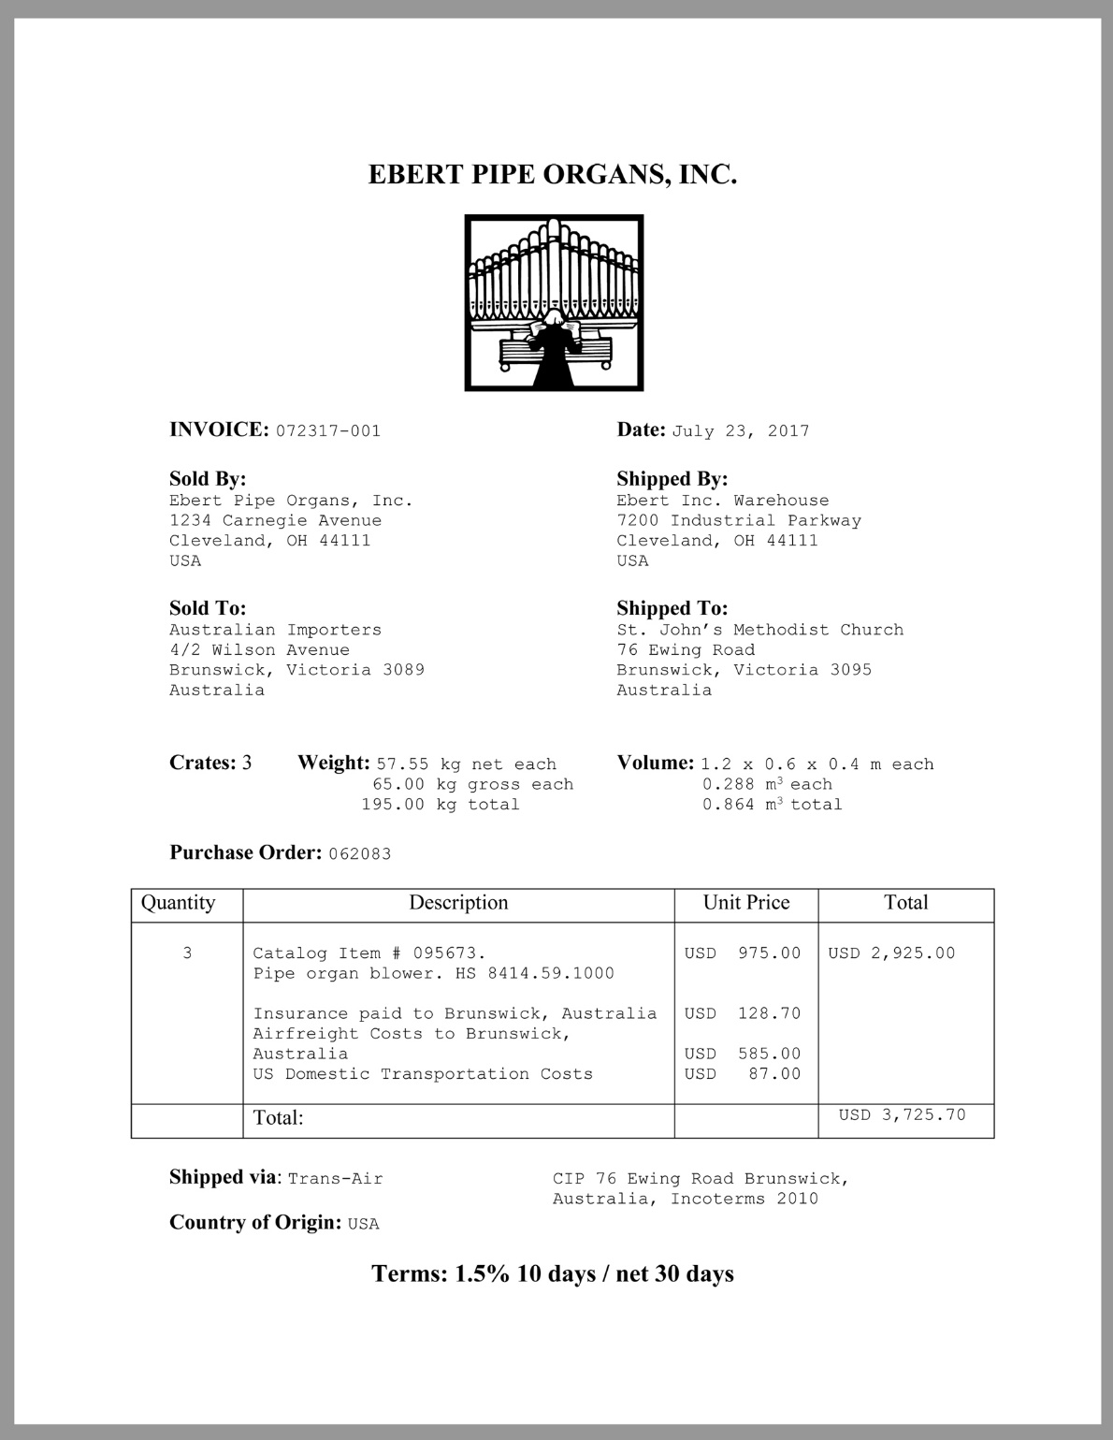
A simple
international
invoice

Slide 6
Other Invoices
Pro forma Invoice
A quote (preview of the commercial invoice) provided by the exporter to the importer for the purpose of obtaining a letter of credit.
Consular Invoice
A commercial invoice that is printed on stationery provided by the consulate of the country in which the good will be imported.
Specialized Invoice
Some countries require that invoices be printed on special forms.

Slide 7
Export Documents
Export License
Destination Control Statement
Export Country’s Regulations
Shipper’s Export Declaration
Certificate of End-Use

Slide 8
Export License
An export license is an express authorization by a given country’s government to export a specific product before it is shipped.
What types of products need an export license?
Depending on the country of export, it could be:
National treasures, antiques, or works of art
Products put under control for political or military purposes
Scarce natural resources

Slide 9
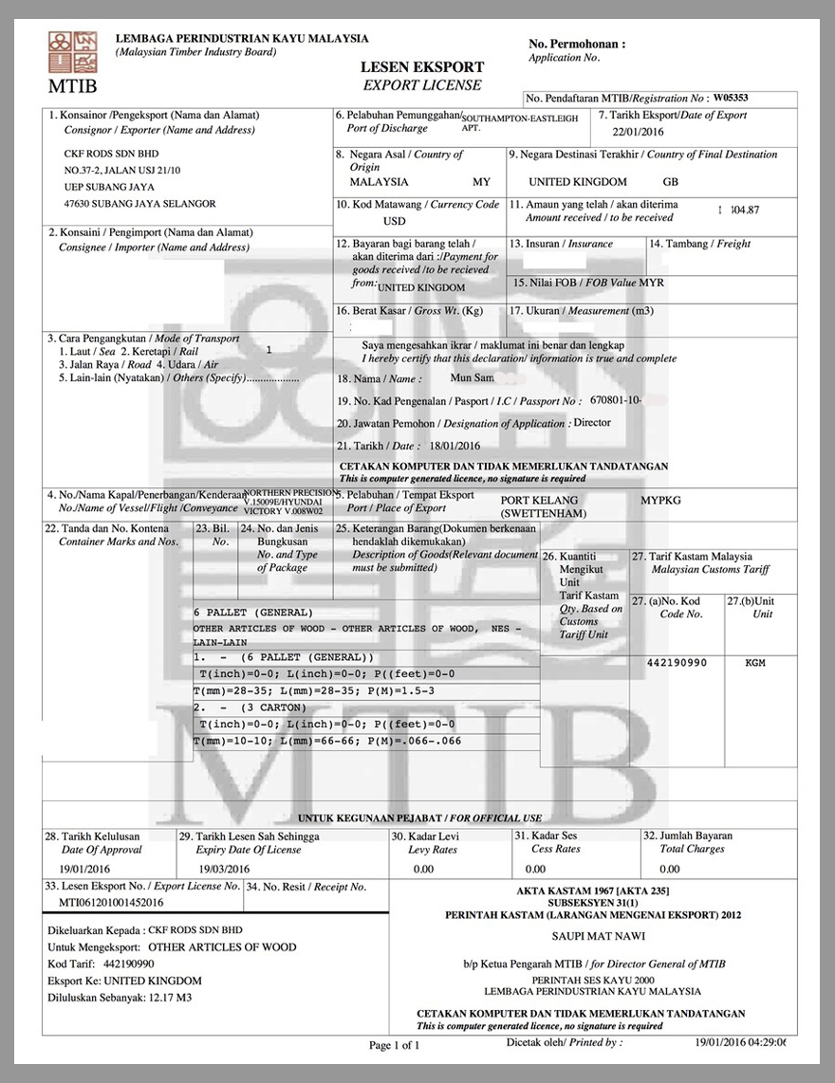
An Export License from the Timber Board in Malaysia

Slide 10
U.S. Export Controls
The United States export control policies (regrouped under the Export Administration Regulations [EAR] and administered by the Bureau of Industry and Security) focus on three elements to determine if an export needs a license:
The type of product exported
The person or entity purchasing the product
The ultimate country of destination
It is the always the responsibility of the exporter to insure that the goods can be legally exported from the United States.

Slide 11
U.S. Export Controls—Product
The Bureau of Industry and Security maintains a Commerce Control List, in which all products of concern to the United States are given an Export Control Classification Number (ECCN).
Products need a license because they may be potentially dangerous or have “dual use.”
Goods in the CCL may fall under the control of one or more government agency including the Department of Defense, Department of State, or the Drug Enforcement Agency.
Items not requiring a license are classified as “EAR99.” Most goods are classified EAR 99.

Slide 12
U.S. Export Controls—Person or Entity
Even if a product is classified as EAR99, exporters still need to determine if the purchaser of the product is on one of several lists:
The Entity List
The Unverified List
The Specially Designated Nationals and Blocked Persons List
The Denied Persons List
A product sold domestically can still be subject to export controls, if the purchaser is on one of these lists.

Slide 13
U.S. Export Controls—Country
The U.S. government considers some countries “friendly” and others “unfriendly.”
For five countries, the U.S. has a total embargo, and no products can be exported there: Currently the U.S. has an embargo on Cuba, Iran, North Korea, Sudan, and Syria. For other countries there are many limits to what can be shipped there: Burma/Myanmar, the Democratic Republic of the Congo, Iraq, the Ivory Coast, Liberia, Libya, Somalia, Yemen, and Zimbabwe.
If a license is necessary, an exporter needs to obtain an Individual Validated Export License, or the express authorization to ship to a country.

Slide 14
Destination Control Statement
A Destination Control Statement is required for products that have obtained a Validated Export License:
“This merchandise licensed by U.S. for ultimate destination [country]. Diversion contrary to U.S. law prohibited.”

Slide 15
Export Electronic Information
The Export Electronic Information (EEI) declaration to the U.S. Customs and Border Protection is a data-collection process used to tabulate what products are exported from the United States, and to which countries they are exported. It is required for all shipments worth $2,500 or more per item.
Most other countries have a similar data-gathering export requirement. The European Union has a similar requirement, called the Single Administrative Document.
Interestingly, the United States does not require an EEI declaration for shipments to Canada but it is required for shipments to the U.S. Virgin Islands, Puerto Rico, and Guam.

Slide 16
End-Use Certificate
An End-Use Certificate is a document required by some exporting countries in the case of sensitive exports, such as ammunition, to ensure that the product is used for acceptable (to the exporting country’s government) purposes.

Slide 17
Export Taxes and Quotas
Some countries require exporters to pay an export tax on certain commodities.
Export quotas are a limit, set by the exporting country’s government, on the quantity of a specific commodity that can be exported in a given year.
Governments control their exports when the commodity that is exported is scarce. They can also do it when their country is one of the few that produces a particular product.

Slide 18
Import Documents
Importing Country’s
Regulations
Certificate of Insurance
Import License
Certificate of Inspection
Certificate of Free Sale
Phyto-Sanitary Certificate
Certificate of Origin
Consular Invoice
Certificate of Manufacture
Certificate of Analysis
Import Forms
Certificate of Certification
Other Certificates

Slide 19
Origin of the Goods
Certificate of Origin
A Certificate of Origin is a document provided by the exporter’s chamber of commerce that attests that the goods originated from the country in which the exporter is located.
Certificate of Manufacture
A Certificate of Manufacture is a document provided by the exporter’s chamber of commerce that attests that the goods were manufactured in the country in which the exporter is located.
The NAFTA Certificate of Origin is actually a Certificate of Manufacture.

Slide 20
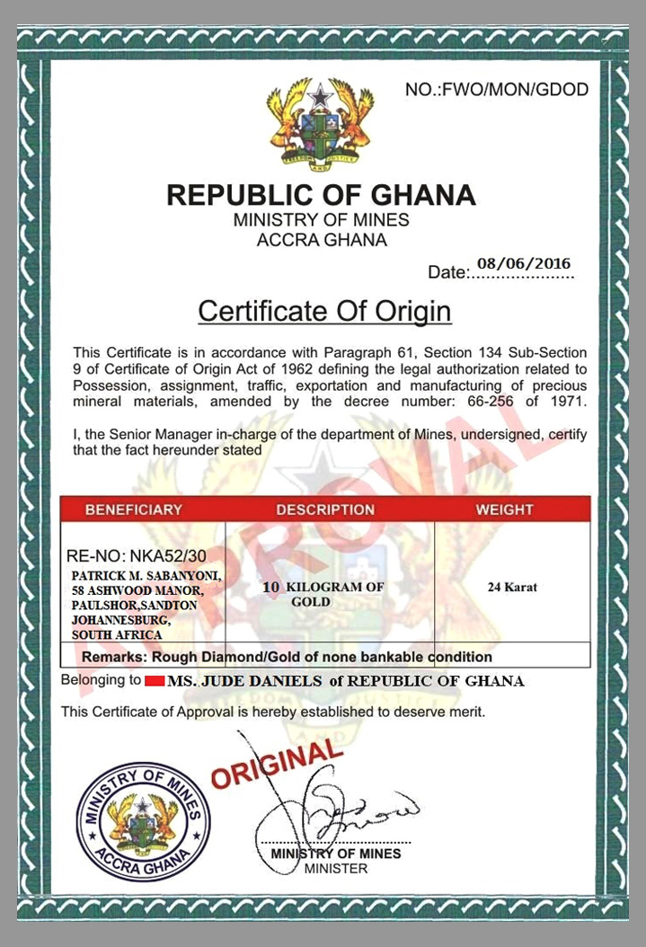
A Certificate of
Origin from
Ghana

Slide 21
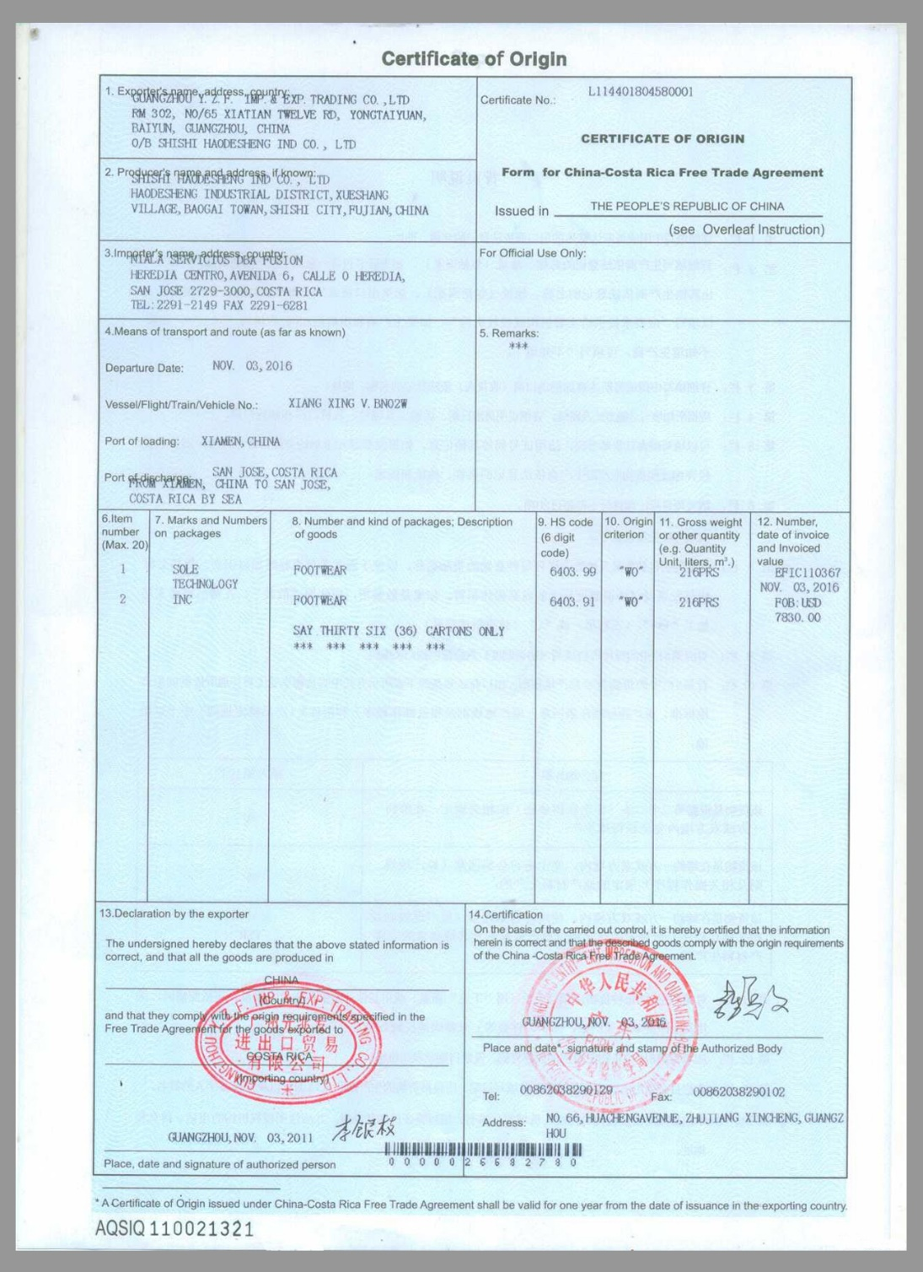
China Certificate of
Origin (Certificate of Manufacture) for Costa Rica-China FTA

Slide 22
Inspection of the Goods
Certificate of Inspection
A Certificate of Inspection is a document provided by an independent inspection company that attests that the goods conform to the description contained in the invoice provided by the exporter.
Certificate of Analysis
A Certificate of Analysis attests that the goods conform to the chemical description and purity levels contained in the invoice provided by the exporter.
Phyto-Sanitary Certificate
A Phyto-Sanitary Certificate attests that agricultural goods are free or pests and disease and conform to the standards of the importing country.

Slide 23
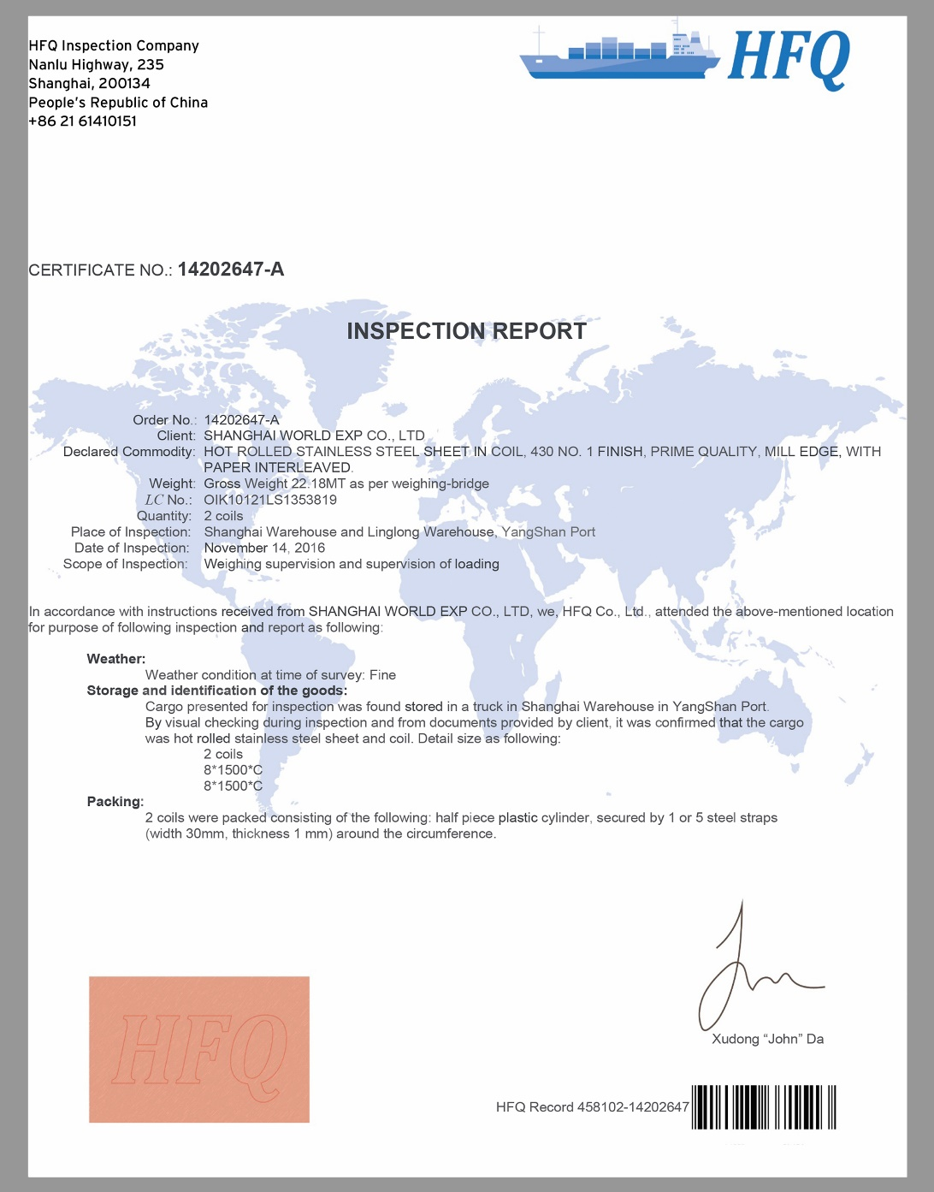
A Certificate of Inspection from China

Slide 24
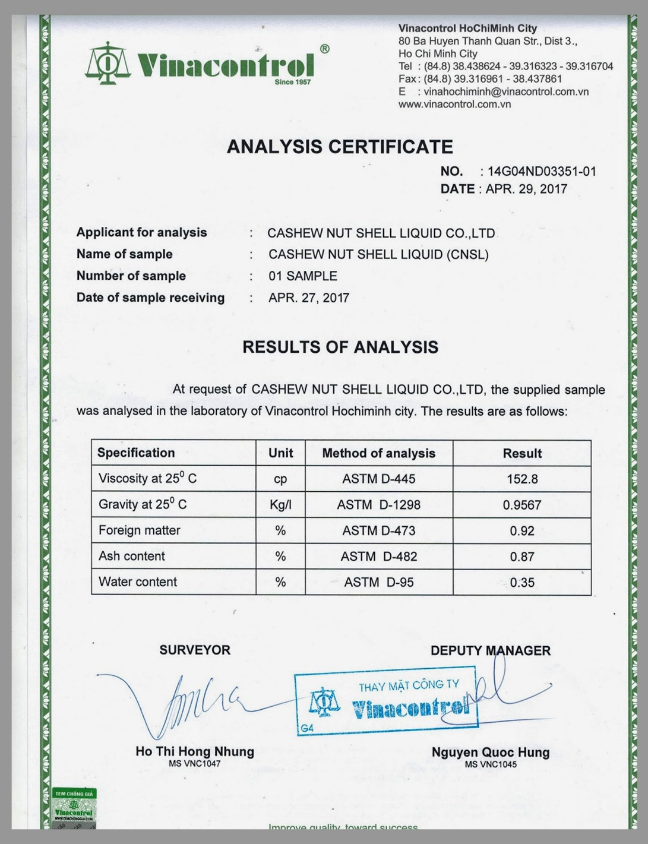
A Certificate of Analysis from
Vietnam

Slide 25
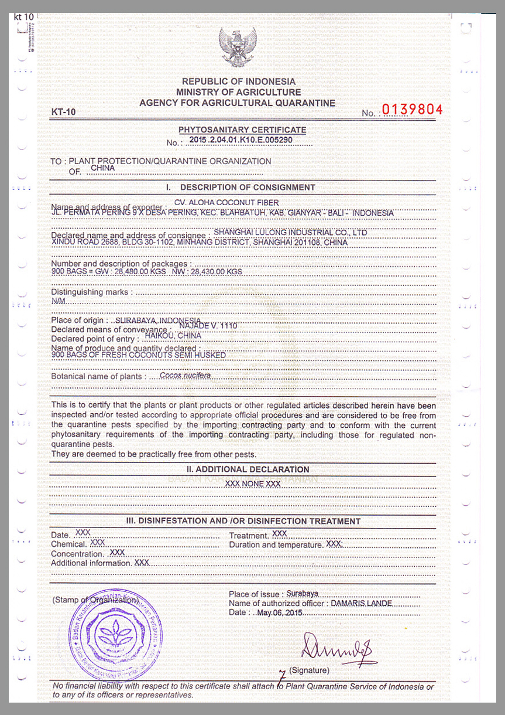
A Phyto-Sanitary Certificate from
Indonesia

Slide 26
Conformity of the Goods
Certificate of Certification
A document provided by an independent inspection company, or by the Agricultural Department of the exporting country’s government, that attests that the goods conform to the agricultural standards of the importing country.
Certificate of Free Sale
A document that attests that the product exported conforms to all of the regulations in place in the exporting country and that it can be sold freely in the exporting country.
Some importers use this certificate as a guarantee of quality
if they are worried that the exporter will ship sub-standard goods.

Slide 27
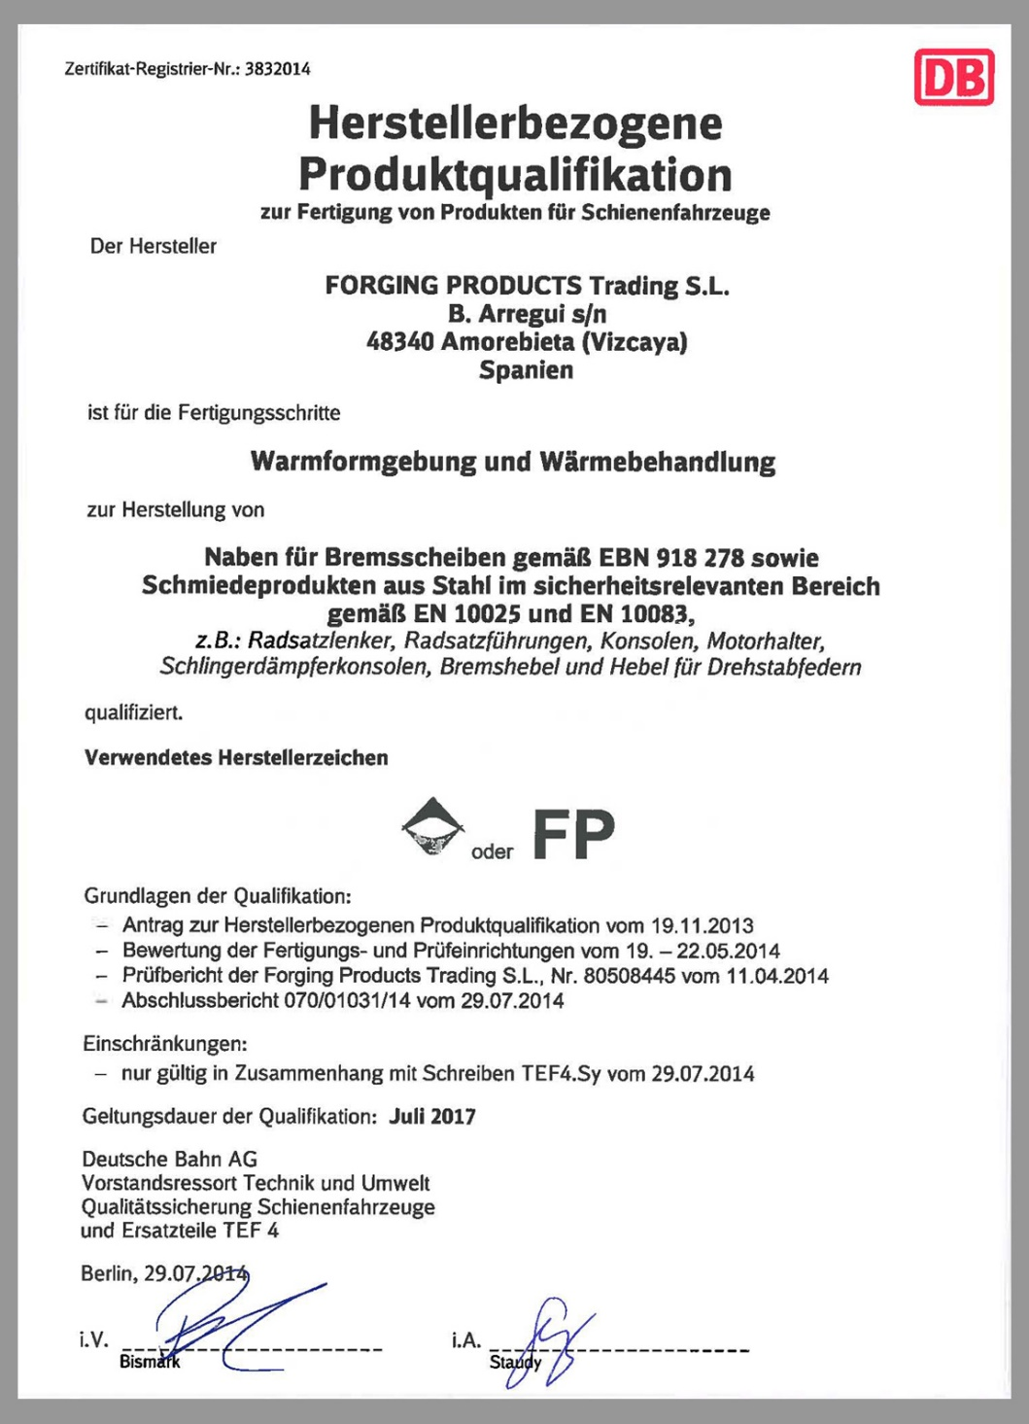
A Certificate of Certification from Germany

Slide 28
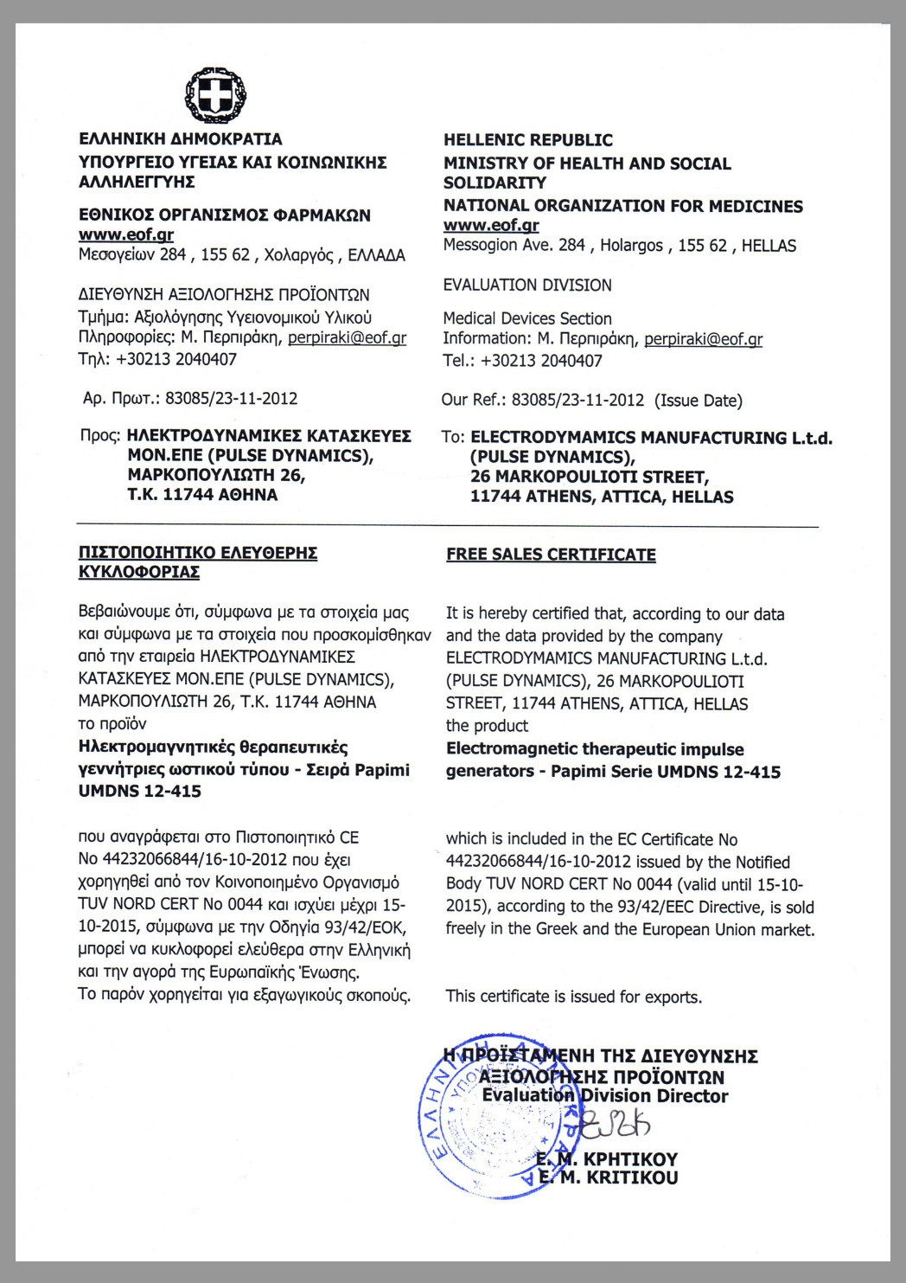
A Certificate of Free Sale from Greece

Slide 29
Certificate of Insurance
A Certificate of Insurance is a document provided by the exporter’s insurance company that attests that the goods are insured during their international voyage.
A certificate of insurance can be based on a single policy specifically contracted for a particular voyage, or it can be based on the open policy that covers all of an exporter’s shipments.
In the case of an open policy, the insurance company provides the exporter with a series of certificates that it then uses as needed.

Slide 30
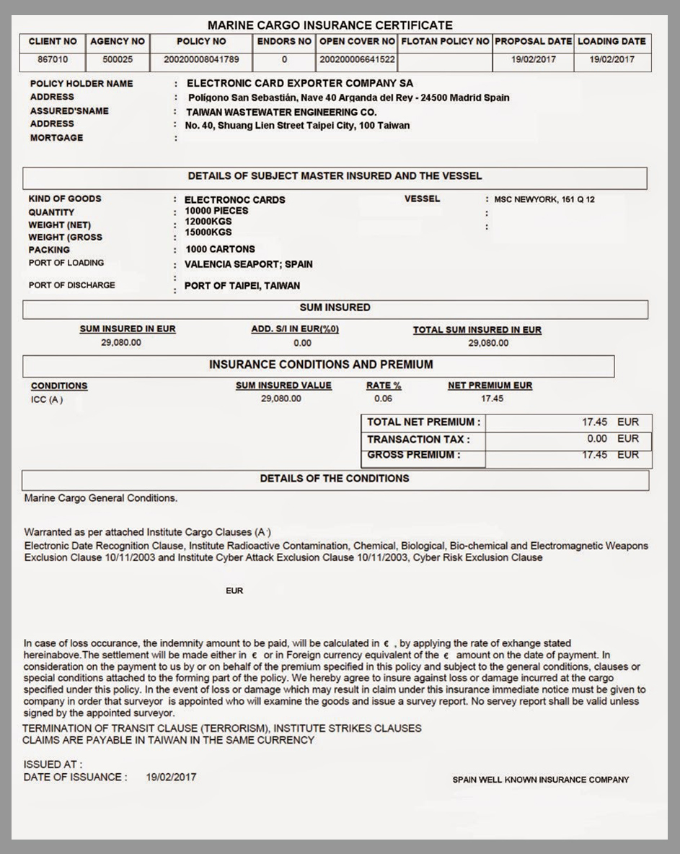
A Certificate of
Insurance from
Taiwan

Slide 31
Other Import Documents
Consular Invoice
A commercial invoice that is printed on stationery provided by the consulate of the country in which the good will be imported.
Import License
The express authorization, granted by the government of the importing country, to import a particular product in a given country.
Import Forms
All countries have specific administrative forms that have
to be submitted by the importer in order to clear Customs.

Slide 32
Transport Documents
Charter Parties
Bills of Lading
Aircraft Leases
Ocean Bill of Lading
Air Waybill
Packing List
Intermodal Bill of Lading
Uniform Bill of Lading
Manifest

Slide 33
Bill of Lading
A bill of lading is a generic term used to describe a document that fulfills three functions in international transport:
It is a contract between the and the shipper. The carrier agrees to transport the goods from A to B for a given price.
It is a receipt for the goods. Signed by the carrier, it signifies that the goods were received in good condition.
It is a certificate of title. Whichever party has the original bill of lading is the owner of the goods.
However, it can get slightly more complicated.

Slide 34
Bill of Lading as a Contract of Carriage
A bill of lading is a contract between the carrier (the company operating the mode of transportation) and the shipper (the firm that enters the contact with the carrier) .
The shipper is either the exporter or the importer, depending on the Incoterm s® rule used; the Incoterms® rule determines which is responsible to arrange for pre-carriage, main carriage or on-carriage.
For a given amount of money, the carrier agrees to transport the goods from a certain location to another.
Each contract of carriage can be negotiated, but most are standard agreements. Some include the costs of loading and unloading the goods, others do not.

Slide 35
Bill of Lading as a Receipt for the Goods
There are two alternatives when the carrier receives the goods in the exporting country:
If the goods are received in good condition, the carrier just signs the bill of lading, without any other annotation. Such a bill of lading is called a clean bill of lading.
If the goods are received in a condition that concerns the carrier (dirty, wet, poorly packaged, rusty, leaking, etc.), the shipper makes an annotation of the issue, then signs. Such a bill of lading is called a soiled bill of lading.
Letters of credit always call for a clean bill of lading.

Slide 36
Bill of Lading as a Certificate of Title
On a bill of lading, there is a box called “consignee,” in which the shipper identifies the firm that will take delivery of the goods from the carrier. There are two alternative ways to fill this box:
If the box is left blank or the words “to order” are used, then the bill of lading is said to be negotiable, and the owner of the goods in the destination port is the entity with the original bill of lading. The goods can be sold while they are being transported.
If the name of the consignee is entered, then only that firm can pick up the goods from the carrier. Such a bill of lading is called a straight bill of lading.
Only ocean bills of lading are negotiable.

Slide 37
Types of Bills of Lading
A bill of lading takes different names depending on the mode of transportation chosen:
It can be called an ocean bill of lading for transportation by ocean
An air waybill when the goods travel by air
An intermodal bill of lading when the goods travel on more than one mode of transportation under a single contract
A uniform bill of lading when the goods travel by road or rail
The shipper (the firm that enters the contact with the carrier)
is either the exporter or the importer, depending on the Incoterm s® rule used.

Slide 38
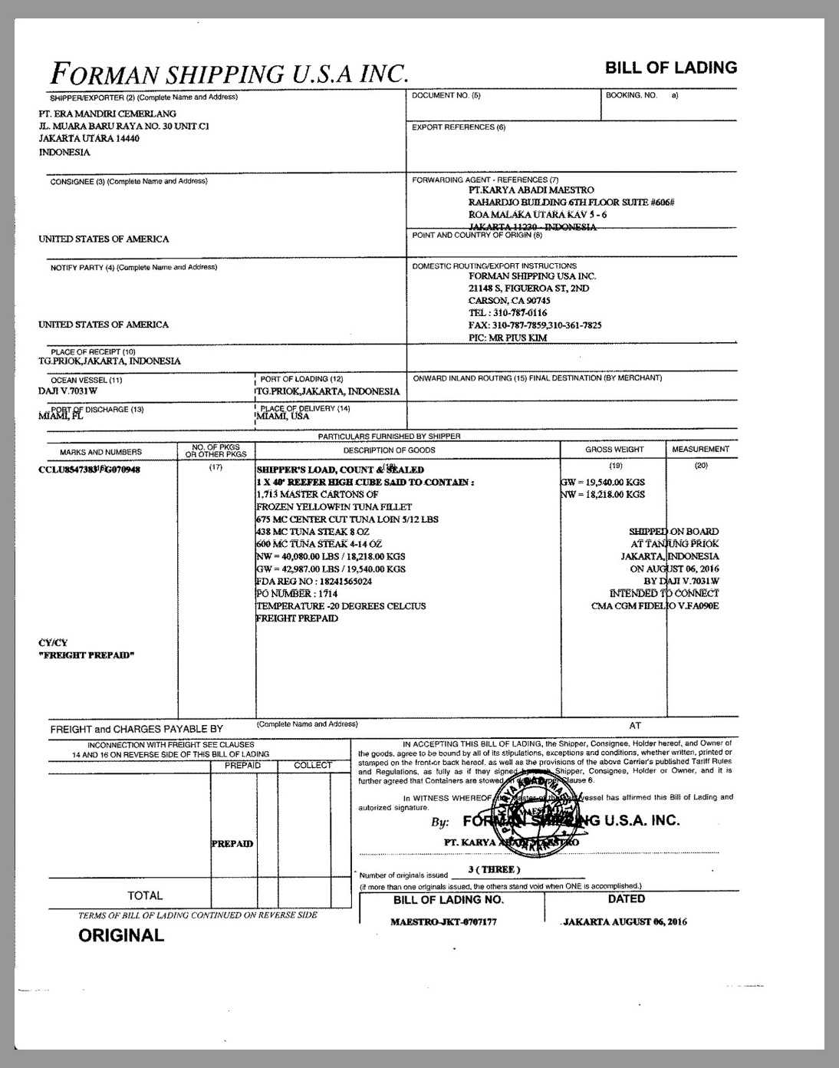
An Ocean Bill of Lading from the United States

Slide 39
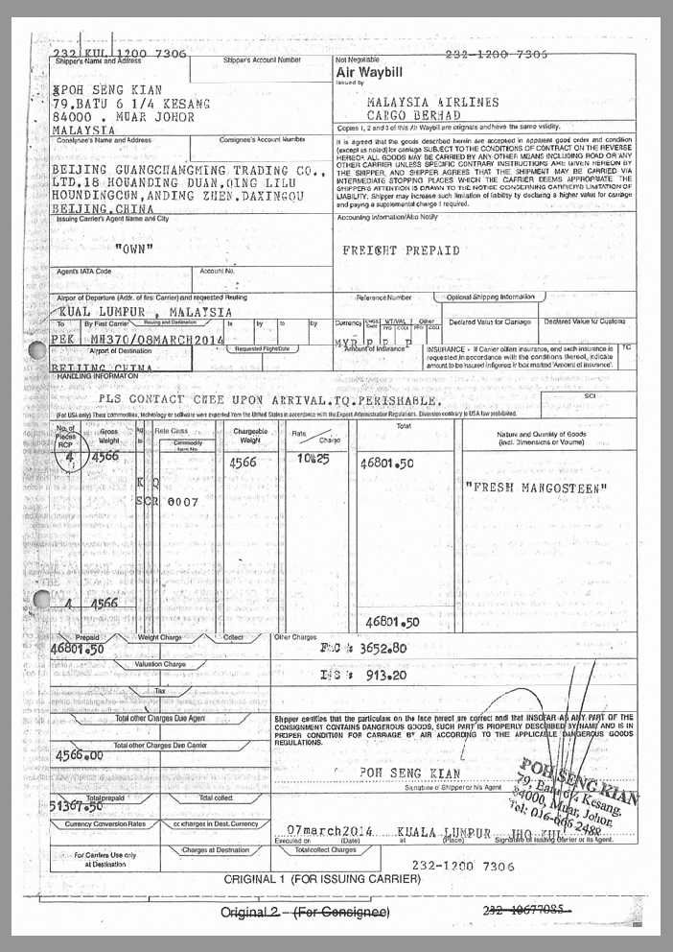
An Air Waybill from Malaysia

Slide 40
Charter Party
A charter party is a type of contract of carriage between a carrier and a shipper, in which the shipper uses all or most of the carrying capacity of the ship. It is generally used to transport bulk commodities, such as grain, fertilizer, ore, or oil.
A charter party can be a contract for a single voyage, but it can also be for a series of voyages to transport a large quantity of a particular commodity, or for a specific duration of six months or a year.

Slide 41
Aircraft Leases (I)
A shipper intent on utilizing the entire capacity of an aircraft enters into a lease agreement. The agreement can be for a single voyage, a series of voyages, or a duration.
Wet Lease
An agreement under which the owner of the aircraft provides the airplane, insurance, maintenance services, fuel, and a flight crew to the lessor, who has to cover all of the other variable costs, such as airport fees.
ACMI Lease
An agreement under which the owner of the aircraft provides the airplane, crew, maintenance, and insurance to the lessor, who has to cover all of the other variable costs, such as airport fees and fuel.

Slide 42
Aircraft Leases (II)
Dry Lease
An agreement between the owner (lessor) of an aircraft and the lessee in which the owner provides only the aircraft and no other services.
Damp Lease
An agreement between the owner of an aircraft and the lessee, under which the owner provides some services in addition to the aircraft itself . For example, an ACMI lease is a damp lease because it does not cover fuel.

Slide 43
Packing List and Manifest
Packing List
A document prepared by the exporter that lists out what a shipment contains, in great detail. A packing list always accompanies every shipment.
Manifest
A document generated by the shipping company (the carrier), which lists all cargo onboard the transportation vehicle. There is a manifest for every voyage undertaken by the carrier.
The manifest is frequently requested by the Customs authorities of a port of call.

Slide 44
Shipper’s Letter of Instruction
A Letter of Instruction is a document in which the shipper spells out how it wants the carrier to handle the goods while they are in transit.
For refrigerated cargo, it specifies the temperature that must be maintained in the container and the monitoring frequency of that temperature. For live cargo, the frequency of feeding, quantities required, and water needs.
For manufactured goods, the letter of instruction can specify a position on the ship: to minimize movements, the cargo can be stowed below deck, at the water line. If it is dangerous, the shipper can request a stow above deck.

Slide 45
Dangerous Goods
Shipments of dangerous goods are regulated by the International Maritime Organization’s International Maritime Dangerous Goods Code, the International Civil Aviation Transport Association’s Dangerous Goods Regulations, the International Civil Aviation Organization’s Technical Instructions for the Safe Transport of Dangerous Goods by Air or by local shipment codes.
All require different additional documents and specific stowing instructions.

Slide 46
Electronic Data Interchange (EDI)
Electronic Data Interchange (EDI) is the electronic exchange of documents, from computer to computer.
EDI allows the instantaneous notification of the other party when a particular step in the shipping of goods has taken place.
Under a DAT shipment, for example, once the goods have been unloaded at the terminal, the exporter can notify the importer electronically that the goods are now its responsibility.
Under a CPT shipment, the exporter can notify the importer that the goods have been delivered to the first carrier.

Slide 47
Electronic Data Interchange (EDI)
The sender and the recipient must reach two agreements in order for EDI to work well:
They must agree to a technical EDI understanding —the specific technology used for the exchange. The United Nation’s EDIFACT standard is the most likely to eventually prevail as the international standard, but there is currently no official international standard.
There must also be a legal agreement between the parties defining the responsibilities, timing, liabilities for errors, the “evidentiary value” of messages, and other legal issues.

Slide 48
Document Preparation as a Marketing Tool (I)
An exporter that does an excellent job at preparing documents can get a strategic advantage, as the importer is likely to be able to clear Customs quickly and process payment efficiently if all of the documents are conform.
The pro forma invoice must be a perfect preview of the actual invoice.
The commercial invoice must be clear, detailed, and precise. It must include all the information that is necessary for the importer to clear Customs and minimize the duty that it has to pay.
All the certificates requested have to be provided, in the manner requested.

Slide 49
Document Preparation as a Marketing Tool (II)
.
The correct number of originals and copies of all documents must be prepared or collected.
The packing list must be prepared carefully and precisely. An incomplete or imprecise packing list increases the probability of a Customs inspection.
The export paperwork must be prepared and filed correctly and in a timely manner.

