Slide 1
Chapter 8 Managing Transaction Risks

Slide 2
Managing Transaction Risks
Sales Contract’s Currency of Quote
The System of Currency Exchange Rates
Theories of Exchange Rate Determinations
Exchange Rate Forecasting
Managing Transaction Exposure
International Banking Institutions
Currency of Payment as a Marketing Tool

Slide 3
Sales Contract Elements
Terms of Trade
Incoterms® rules determine the costs the exporter should pay, the costs the importer should pay, and the point at which the responsibility for the cargo shifts from one to the other.
Terms of Sale
The terms of sale determine the method of payment and the intermediaries involved in the payment and the handling of the documents from the importer to the exporter.
Currency
The currency in which the transaction is undertaken: it can be the exporter's country's currency, the importer's country's currency, or a third country's currency.

Slide 4
Sales Contract’s Currency
Two factors should be considered when choosing a currency for the sales contract:
Risk of Currency Fluctuation
A speculative risk: the risk could result in positive or negative outcomes, depending on which way the exchange rate fluctuates.
Risk of Currency Convertibility
A pure risk: a payment received in a foreign currency cannot be converted into the exporter’s currency.

Slide 5
Currency Convertibility
Hard Currency
A currency that can easily be converted to another currency
Convertible Currency
A currency that can be converted to another currency
Soft Currency
A currency that cannot be easily converted into another currency
Inconvertible Currency
A currency that cannot be converted into another currency

Slide 6
Sales Currency Choices
An exporter and an importer can agree on three possible alternatives when choosing the currency in which a sales contract will be paid:
The exporter’s country’s currency
The importer’s country’s currency
A third country’s currency

Slide 7
Exporter’s Currency
The exporter and the importer agree that the currency of the transaction will be the currency of the exporter's country.
The exchange rate risk is nil for the exporter; all of the risks are borne by the importer, and it has to determine how it will handle its transaction risks.
In addition, the possible convertibility problems of the currency are to be resolved by the importer.

Slide 8
Importer’s Currency
The exporter and the importer agree that the currency of the transaction will be the currency of the importer's country.
The exchange rate risk is nil for the importer; all of the risks are borne by the exporter, and it has to determine how it will handle its transaction risks.
In addition, the possible convertibility problems of the currency are to be resolved by the exporter.

Slide 9
Third Country’s Currency
The exporter and the importer can agree that the currency of the transaction will be a third country's currency.
The exporter and the importer each bear the risks of currency fluctuation of their respective country's currency against the currency of the transaction.
In some cases, the exporter and the importer choose an artificial currency (a non-circulating currency) for the transaction, the Special Drawing Rights (SDRs) of the International Monetary Fund. International liability conventions are expressed in SDRs.

Slide 10
The Special Status of the Euro
The euro was first created as an artificial currency.
In January 2002, it became a circulating currency. When new countries join the euro zone, their legacy currency’s value is translated using a fixed currency exchange rate with the euro.
The stated goal of the European Union is to eventually transform the euro into a challenger to the U.S. dollar as the preferred third-country currency.
Other currencies used as a third-country’s currency are the Japanese yen, the Swiss Franc, and the British pound.

Slide 11
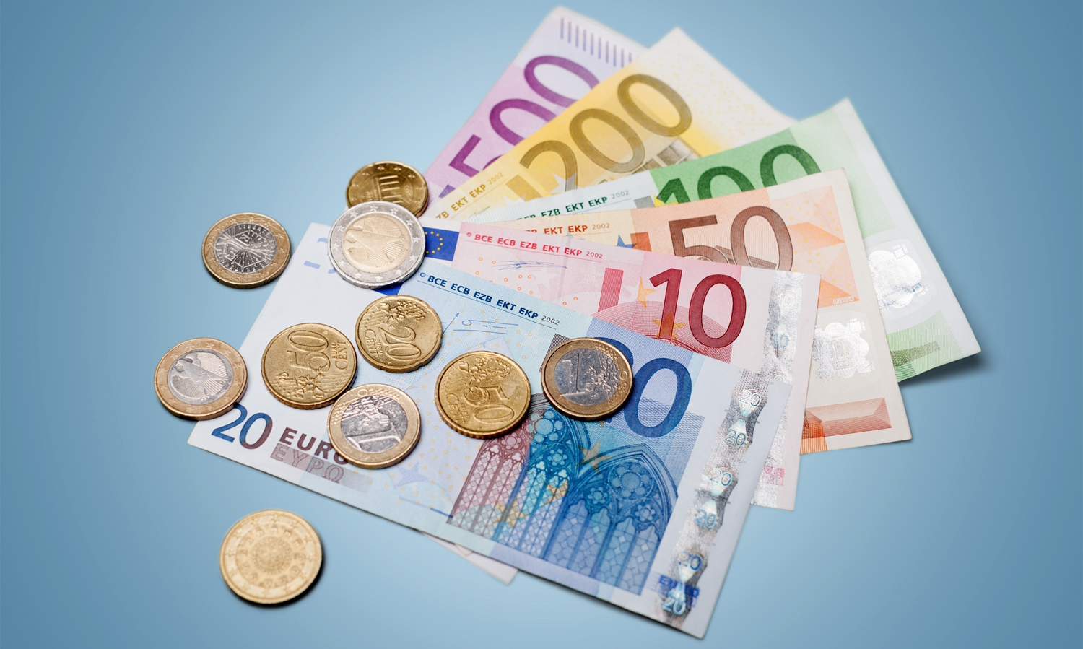
The Euro Banknotes and Coins

Slide 12
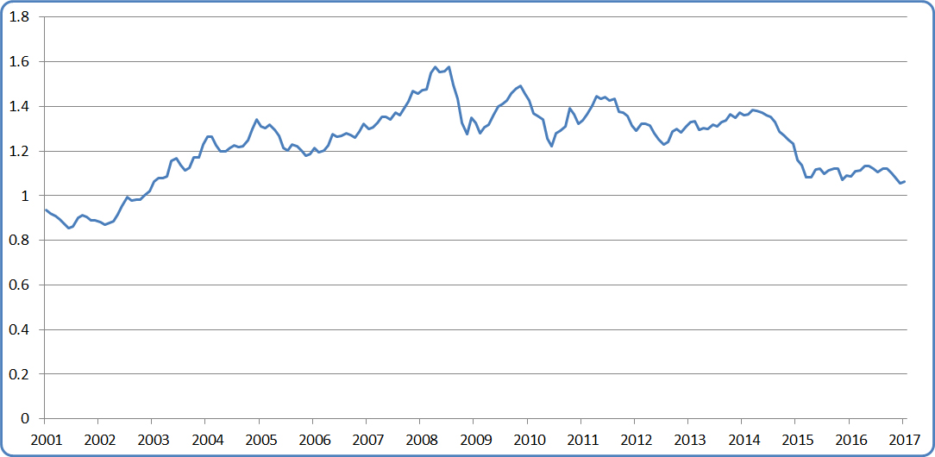
Euro-Dollar Exchange Rate 2001-2017
How many dollars a euro is worth. Source: Federal Reserve Bank..

Slide 13
Exchange Rate Quotations
Direct Quotation
The value of the foreign currency expressed in units of the domestic currency.
For example, the direct quotation for the euro in U.S. dollar terms was $1.1229/€, on June 1, 2017. This is the preferred way of quoting the euro, the British pound, and the Australian dollar.
Indirect Quotation
The value of the domestic currency expressed in units of foreign currency.
For example, the indirect quotation for the yen against the U.S. dollar was ¥111.10/$ on June 1, 2017. Most currencies are expressed as indirect quotations: the Canadian dollar, the Swiss franc, and the Japanese yen, for example.

Slide 14
Exchange Rate Quotations
There is an inverse relationship between the two methods of quoting a currency exchange rate between two currencies:
$Indirect Quotation$ =$\frac{1}{Direct Quotation}$

Slide 15
Types of Exchange Rates
The exchange rate between two currencies can be quoted in a number of ways:
Spot Exchange Rate
Forward Exchange Rate
Currency Futures
Currency Options

Slide 16
Spot Exchange Rate
The spot exchange rate is the exchange rate for a foreign currency for immediate delivery.
This “immediate delivery” is somewhat subject to interpretations that vary from country to country and, within one country, from one currency to another; however, it is (roughly) the price of a foreign currency to be delivered within 48 hours.
This is the most-commonly used exchange rate, and it can be found in just about any periodical (The Wall Street Journal, The New York Times, Financial Times) or financial website.

Slide 17
Forward Exchange Rate
The forward exchange rate is the exchange rate for a foreign currency to be delivered any number of days in the future.
The party entering into a forward currency contract with a bank is committing to purchasing one currency with another at a certain price on a certain date.
The published forward exchange rate quotes are for 30 days, 90 days, 180 days, or one year in the future.
Forward rates are only published in financial newspapers like The Wall Street Journal or Financial Times.

Slide 18
Currency Futures
Currencies are also traded as commodities, in the futures’ market.
Futures are contracts between a seller (called the “short”) and a buyer (called the “long”).
In the U.S., currency futures are limited to fixed quantities (100,000 Australian dollars, 62,500 British pounds, 100,000 Canadian dollars, 125,000 euros, 5,000,000 Japanese yen, and 500,000 Mexican pesos) and to fixed settlement dates (the third Wednesday of the months of March, June, September, and December).
Because of the limits placed on amounts and dates, futures are rarely used in international trade transactions.

Slide 19
Currency Options
Currency options is a method used to protect against fluctuations in the value of a currency in the future.
A firm can purchase options to buy, or options to sell, a particular currency at a particular price on a given date. Unlike in the futures market, options can be for any amount, and at any date.
An option is the right to buy (or sell) a currency, at a pre-determined price (called the strike price), but it is not the obligation to buy or sell at that price. The owner of the option is the one who decides whether to exercise that option.

Slide 20
Call Options
A call option is an option with which a firm agrees to buy a particular currency at a particular price on a given date.
Suppose a U.S. firm purchases an option to buy euros for $1.35/€ on 01/01/201_. It pays U.S. $5,000 for that option.
Two scenarios can take place on 01/01/201_:
If the spot exchange rate is lower than $1.35/€, the firm will purchase the euros on the spot market, and forgo the option.
If the spot exchange rate is higher than $1.35/€, the firm will exercise the option, and pay $1.35/€ for the euros.

Slide 21
Put Options
A put option is an option with which a firm agrees to sell a particular currency at a particular price on a given date.
Suppose a U.S. firm purchases an option to sell British pounds for $1.25/£ on 03/01/201_. It pays U.S. $2,000 for that option.
Two scenarios can take place on 03/01/201_:
If the spot exchange rate is higher than $1.25/£, the firm will sell the pounds on the spot market, and forgo the option.
If the spot exchange rate is lower than $1.25/£ , the firm will exercise the option, and obtain $1.25/£ for its pounds.

Slide 22
Types of Currencies (I)
Floating Currency
A currency whose value is determined by market forces. The exchange rate of a floating currency varies frequently.
Pegged Currency
A currency whose value is determined by a fixed exchange rate with another, more widely traded currency. For example, the value of the
Artificial Currency
A currency that is not in circulation. As of 2013, there is only one artificial currency, the Special Drawing Rights of the International Monetary Fund.

Slide 23
Types of Currencies (II)
Currency Bloc
A group of currencies whose values fluctuate in parallel fashion. The currencies within the group have a fixed exchange rate, but their exchange rates with currencies outside of the group float.
Before the introduction of the euro, the European currencies traded as a currency bloc. Several currencies in Europe are pegged to the euro and act as a currency bloc.
Dollarization
A phenomenon where other countries decide to adopt the U.S. dollar as their circulating currencies. Panama and Ecuador utilize the dollar as their domestic currency.

Slide 24
Exchange Rate Determination
The exchange rate between two currencies fluctuates due to a number of different relationships:
Purchasing Power Parity
Fisher Effect
International Fisher Effect
Interest Rate Parity
Forward Exchange Rate

Slide 25
Purchasing Power Parity
Purchasing Power Parity is an economic theory that holds that exchange rates should reflect the price differences of each and every product between countries.
The idea is that exchange rates should fluctuate in such a way as to “equalize” the price differences of similar products between countries, so that a set amount of currency would purchase the same goods in any country of the world.

Slide 26
The Big Mac Index
Country | Local Currency | U.S. $ Equivalent | Percentage of U.S. price
United States | USD 5.06 | $5.06 | 100%
Brazil | BRL 16.50 | $5.12 | 101%
Britain | GBP 3.09 | $3.73 | 74%
Euro Area | EUR 3.88 | $4.06 | 80%
Japan | JPY 380 | $3.26 | 64%
Mexico | MXN 49.00 | $2.23 | 44%
Philippines | PHP 133 | $2.68 | 53%
Russia | RUB 130 | $2.15 | 43%
South Africa | ZAR 26.42 | $1.89 | 37%
Sweden | SEK 48.00 | $5.26 | 104%
Switzerland | CHF 6.50 | $6.35 | 125%
Ukraine | UAH 42.00 | $1.54 | 31%
The Economist.

Slide 27
Fisher Effect
The Fisher effect is an economic theory that holds that the interest rates that businesses and individuals pay to borrow money should be uniform throughout the world and that the nominal interest rates that they actually pay in a given country are composed of this common (“real”) interest rate and the inflation rate of that country.
Therefore, if a country has a higher inflation rate than others, its nominal interest rates will also be higher:
Nominal interest rate = real interest rate + inflation rate

Slide 28
International Fisher Effect
The International Fisher effect is an economic theory that holds that the spot exchange rates between two countries’ currencies should change in function of the differences between these two countries’ nominal interest rates.
If a country has a higher nominal interest rate, it means (based on the Fisher effect), that it has a higher inflation rate.
Therefore, if a country has a higher nominal interest rate than other countries, the value of that country’s currency will decrease over time.

Slide 29
Interest Rate Parity
Interest Rate Parity is an economic theory that holds that the forward exchange rate between two currencies should reflect the differences in the interest rates in those two countries.
If a country has a higher interest rate than others, speculators would borrow in other countries and invest these funds in the high-interest country. Since this would create a demand for the high-interest country’s currency, the value of that country’s currency would go up, quickly negating the higher interest rate.

Slide 30
Forward Exchange Rates
Forward exchange rates theory is an economic theory that holds that forward exchange rates for currencies are good predictors of the future spot exchange rates of that currency.
It is self-evident that speculators forecast, from all of the information available on interest rates, inflation rates and other economic factors, what the future value of a currency will be. These forecasts are reflected in the forward exchange rates for that currency.
In essence, the forward exchange rate of a currency reflects the collective consensus of currency forecasters and speculators.

Slide 31
Difference in Nominal Interest Rates
Interest Rate
Parity
Fisher Effect
Forecasted Difference in Inflation Rates
Forward Exchange Rate Discount/Premium
International
Fisher Effect
Purchasing Power
Parity
Unbiased
Predictor
Change in Expected Spot Exchange Rate

Slide 32
Exchange Rate Forecasting (I)
Technical Forecasting
A method of forecasting exchange rates based upon time-series analysis. Future movements in the value of a currency are “mathematically” linked to its past movements.
Fundamental Forecasting
A mathematical model that uses the exchange rate of a specific currency as the dependent variable and the expected inflation rates, nominal interest rates, forward interest rates, and real interest rates as the independent variables.

Slide 33
Exchange Rate Forecasting (II)
Market-based Forecasting
A method of forecasting based on the premise that “the market knows best” and that, therefore, the forward exchange rate of a given currency is the best unbiased predictor of the future spot rate of a particular currency.

Slide 34
Managing Transaction Exposure
Transaction exposure is the risk represented by the fluctuation in exchange rates between the time at which two companies enter in an international contract and the time at which that contract is paid.
These risks can be retained by the firm or be “hedged.”
Hedging is a term used to represent several techniques designed to reduce the uncertainty of exchange rate fluctuations.
By hedging, a firm does not eliminate its transaction exposure, it only manages it.

Slide 35
Risk Retention
Risk retention strategy is a risk management strategy in which a company elects to retain a certain type of risk and decides not to insure that risk.
Three types of companies typically choose this option:
Very large traders
Exporters or importers that have little exposure
Firms that do not evaluate the international currency transaction risks clearly; they have no policy, or have a management that is not well versed in the intricacies of international trade.

Slide 36
Hedging Strategy
There are two possible strategies for a firm with transaction exposures:
Determine what its decision should be on an invoice-by-invoice basis, depending on the currency at stake, the amount of the invoice, and its forecast of currency’s exchange rate.
Set a policy that the firm follows for all of its foreign currency receivables and payables.

Slide 37
Hedging Techniques
Forward-Market Hedging
A technique that utilizes the forward market for currencies to manage a firm’s transaction exposure.
Money-Market Hedging
A technique that utilizes the banking system in the foreign country to manage a firm’s transaction exposure.
Options-Market Hedging
A technique that utilizes the options market for currencies to manage a firm’s transaction exposure.

Slide 38
Forward Market Hedging (for an Exporter)
A U.S. company is selling a product to an Italian firm on March 1, 201_; the invoice is payable in euros on June 2, 201_ (90-day credit). The amount that the firm would like to collect is $200,000.
If it used the spot exchange rate on March 1, 201_ (U.S. $1.2661/€), the firm would bill the customer for € 157,965.00.
However, as of March 1, 201_, the 90-day forward exchange rate for the euro is U.S. $1.2530/€ indicating that the market is expecting a decrease in the value of the euro against the U.S. dollar.
The firm therefore decides to invoice its customer for:
$200,000/1.2530 = € 159,617.00.

Slide 39
Forward Market Hedging (for an Exporter)
A forward market hedge, in this case, would consist of the U.S. firm entering a forward contract with a bank, in which it would promise to sell € 159,617.00 to the bank on June 2, 201_, at the predetermined (forward) exchange rate of U.S. $1.2530/€.
On that date, the U.S. company presents €159,617.00 to the bank and collects the U.S. $200,000 it wanted to collect.
The U.S. firm is unconcerned about the spot exchange rate of the euro on June 2, 201_.

Slide 40
Forward Market Hedging (for an Importer)
A German firm is purchasing a machine from a British firm for £250,000.00. The machine is delivered on April 4, 201_, and payment is expected (in pounds) on July 6, 201_.
On April 4, 201_, this amount was equivalent to € 272,200.00 because the spot exchange rate between the U.K. pound and the euro was € 1.1008/£.
However, on April 4, 201_, the pound was expected to rise in value, and the 90-day forward exchange rate with the euro was € 1.1220/£.

Slide 41
Forward Market Hedging (for an Importer)
A forward market hedge in this case would consist of the German firm entering into a contract with a bank from which it promises to purchase £250,000 on July 6, 201_, at a predetermined (forward) exchange rate of € 1.1220/£.
On that date, the German firm hands € 280,500.00 to the bank and obtains in exchange the £250,000 that it needs to pay its British supplier.
The German firm could determine on April 4, 201_, exactly how much it had to pay for the machine and is unconcerned about the spot exchange rate of the British pound on July 6, 201_.

Slide 42
Money Market Hedging (for an Exporter)
A firm located in Switzerland sells a piece of machinery to a firm located in Japan for the equivalent of SwF 150,000.00. It bills the customer in Japanese yen.
The transaction takes place on January 16, 201_, with a payment date of March 15, 201_. The transaction amount is ¥12,115,545.00, because the exchange rate on January 16, 201_, is ¥80.7703/SwF.
The Swiss firm can use a money market hedge, by borrowing from a Japanese bank the present value (as of January 16, 201_) of ¥12,115,545.00 on March 15, 201_.

Slide 43
Money Market Hedging (for an Exporter)
If the commercial lending rate in Japan is 3 percent per annum (about 0.5 percent for two months), the amount the Swiss firm borrows is
¥ (1-0.005) x 12,115,545.00 = 12,054,967.28.
On March 15, 201_, the Swiss firm pays the bank back, using the payment of ¥12,115,545.00 made by its customer.

Slide 44
Money Market Hedging (for an Exporter)
On January 16, 201_, the Swiss firm would exchange the proceeds from the loan (¥12,054,967.28) for SwF 149,250.00 (the exchange rate on January 16, 201_ is ¥80.7703/SwF).
This amount is roughly equal to the payment of SwF 150,000.00 it had expected, decreased by the cost of getting the money two months earlier.
The Swiss firm is unconcerned about the spot exchange rate of the yen on March 15, 201_.

Slide 45
Money Market Hedging (for an Importer)
On May 2, 201_, a firm located in Denmark purchases raw materials from a firm located in Australia, which asks to be paid in Australian dollars. The amount of the invoice is A$20,000,000, payable on November 1, 201_.
The Danish firm can eliminate its exposure to exchange rate fluctuations by using a money market hedge.
It can invest a sum in an Australian bank that will mature to A$20,000,000 on November 1, 201_.

Slide 46
Money Market Hedging (for an Importer)
Assuming an annual interest rate of 4 percent paid on deposits in Australia (or 2 percent for six months), the Danish firm would have to invest A$20,000,000/(1 + 0.02) = 19,607,845 krone to have enough to cover its obligation on November 1, 201_.
On May 2, 201_, the Danish firm then converts DKr 80,288,498.36 into Australian dollars (the exchange rate is A$0.2444/DKr on May 2, 201_).
The Danish firm is unconcerned about the spot exchange rate of the Australian dollar on November 1, 201_.

Slide 47
Options Market Hedging (for an Exporter)
A company located in the United States sells a large piece of equipment to a firm located in the United Kingdom and agrees to be paid in pounds. The invoice, for £1,000,000, is issued on December 10, 201_, but is not payable until March 10, 201_.
The exporting firm can minimize its currency fluctuation risk by using an option hedge; on December 10, 201_, it purchases a put option—the right to sell £1,000,000 on March 10, 201_—at an agreed-upon exchange rate of U.S. $1.3615/£.

Slide 48
Options Market Hedging (for an Exporter)
If the spot exchange rate on March 10, 201_, is lower than U.S. $1.3615/£, then the American firm will exercise its option and sell the currency at that price.
If the spot rate is higher than U.S. $1.3615/£, the firm will let its option lapse and will sell the currency it received at the spot market rate.

Slide 49
Options Market Hedging (for an Exporter)
Because the exchange rate on March 10, 201_, is U.S. $1.3842/£, the firm sells its pounds without using its option.
The firm still incurs the cost of the option, which is approximately 1.25 percent of the contract amount, or about U.S. $17,018.75; however, this cost is offset by the fact that it sells its British pounds for U.S. $22,700 more than it had anticipated.
The net profits on this financial transaction are U.S. $5,681.25.

Slide 50
Options Market Hedging (for an Importer)
A company located in Spain purchases a plant located in Canada. The contract is signed on June 28, 201_, and the firm has agreed to make three installment payments of Can$1,000,000 each on December 28, 201_, March 28, 201_, and June 28, 201_ (6 months, 9 months, and 12 months after purchase).
In order to minimize its currency risks, the Spanish firm can use an option hedge by purchasing call options—the right to buy Can$1,000,000—at exchange rates of:
Can$1.6522/ € for December 28, 201_
Can$1.7081/ € for March 28, 201_, and
Can$1.7452/ € for June 28, 201_.

Slide 51
Options Market Hedging (for an Importer)
Because the spot exchange rate for the Canadian dollar was Can$1.7316/ € on December 28, 201_, the Spanish firm did not exercise its option, purchased the Canadian dollars on the spot market, and sent them to the Canadian supplier.
On March 28, 201_, the spot market was Can$1.6488/ €, and therefore the Spanish firm exercised its option and purchased the Canadian dollars at Can$1.7081/ € (the strike price of its option), because it was a more favorable exchange rate than the spot market.

Slide 52
Options Market Hedging (for an Importer)
As for its future June 28, 201_ payment, the firm still has the possibility of saving money if the spot rate is more favorable than its option rate; if not, it will exercise its option.
The cost of these successive options for the Spanish firm was approximately 1.25 percent, 1.5 percent, and 2 percent of the contract amounts for December, March, and June, respectively, for a total of approximately € 29,000.00.
However, the costs were reduced by the fact that the firm saved € 27,753.00 in December by not having to spend as many euros as it had anticipated.

Slide 53
International Banking Institutions
Central National Banks
Every country in the world has a Central Bank, or some institution that acts as one. They are responsible for the creation and control of the monetary supply, and they function as a check clearinghouse.
International Monetary Fund
The IMF was created to oversee the fixed exchange rate system created by the Bretton-Woods Conference. Today it helps countries manage their balance of payments and lends them money when they experience difficulties with their balance of payments.

Slide 54
International Banking Institutions
Bank for International Settlements
The BIS was created after World War I to manage Germany's war reparation payments. Since then, it has evolved into a major international institution, providing support to Central Banks, and acting as a clearinghouse between central banks.
World Bank
Created to help countries rebuild their infrastructure after World War II, it has slowly changed to become the bank in charge of financing large infrastructure projects. The government borrowing the funds must be a member of the IMF.

Slide 55
International Banking Institutions
Export-Import Bank (Ex-Im Bank)
A United States federal agency whose purpose is to provide assistance to U.S. exporters in the form of loans, loan guarantees, and political risk insurance policies.
SWIFT
The Society for Worldwide Interbank Financial Telecommunication is a corporation supporting an Electronic Data Interchange network that was created by banks to obtain a secure and reliable means of transferring financial information internationally.
It allows the communication of Letters of Credit and miscellaneous fund transfers.

Slide 56
Sales Contract Currency as a Marketing Tool
There are four approaches that an exporter can pursue:
Elect to quote in the exporter’s currency.
Elect to quote in the importer’s currency and minimize the risk of exchange rate fluctuation with a forward market hedge.
Elect to quote in the importer’s currency and minimize the risk of exchange rate fluctuation with a money market hedge.
Elect to quote in the importer’s currency and minimize the risk of exchange rate fluctuation with an options market hedge.

