Slide 1
Chapter 6 International Terms of Trade

Slide 2
International Terms of Trade— Incoterms® Rules
International Commerce Terms
Understanding Incoterms® Rules
Overview of all 11 Incoterms® Rules
Electronic Data Interchange
Common Errors in Incoterms® Rules Usage
Incoterms® Rules as a Marketing Tool

Slide 3
International Terms of Trade
For each international sale, it is important to determine, who — of the exporter or the importer — is responsible for:
Pre-carriage, the domestic transportation in the exporting country
Main carriage, the international transportation between the exporting country and the importing country
On-carriage, the domestic transportation in the importing country
The risks involved in international transportation
Customs clearance in the importing country

Slide 4
International Commerce Terms Incoterms® Rules
In 1936, the International Chamber of Commerce developed International Commerce Terms rules (or Incoterms® rules) that formalized these responsibilities. Incoterms rules were revised in 1953, 1967, 1980, 1990, and 2000.
The latest version of Incoterms® rules is dated 2010, and was implemented 01/01/2011.
Incoterms rules follow international trade practices and are always reflecting the way shipping is conducted. The changes implemented in 2010 were significant, but were designed to facilitate the division of responsibilities between the exporter and the importer.

Slide 5
Incoterms® Rules 2010
Incoterms® rules formally define the following aspects of an international sale:
Which tasks will be performed by the exporter
Which tasks will be performed by the importer
Which activities will be paid by the exporter
Which activities will be paid by the importer
The exact point at which the responsibility for the goods transfers from the exporter to the importer
There are 11 different Incoterms® rules, all abbreviated with a 3-letter acronym, such as EXW, DAP, FOB, and so on.

Slide 6
Choice of an Incoterms® Rule
Choosing the correct Incoterms® rule depends on which export strategy a company is following. The following factors are particularly important:
The type of product being sold (weight, volume, perishability, value, sensitivity to temperature changes, and so on)
The method of shipment
The ability and willingness of either of the exporter and importer to perform the tasks involved
The amount of trust placed by either of the parties in the other party

Slide 7
Incoterms® Rules
The International Chamber of Commerce specifies that there are two groups of Incoterms rules:
Seven Incoterms rules that can be used for any means of transportation (ocean, road, air, train).
Four Incoterms rules that can only be used for ocean transportation (these are the oldest terms of trade).

Slide 8
Incoterms® Rules
Any mode of Transportation
EXW
Ex-Works
FCA
Free Carrier
CPT
Carriage Paid To
CIP
Carriage and Insurance Paid To
DAT
Delivered At Terminal
DAP
Delivered At Place
DDP
Delivered Duty Paid
FAS
Free Alongside Ship
FOB
Free On Board
CFR
Cost and Freight
CIF
Cost, Insurance and Freight
Ocean Transportation

Slide 9
Incoterms® Rules
Each Incoterms rule has:
A scope — The type of products for which it can be used
A modality — The mode of transport for which it can be used
A syntax — The way it has to be stated on invoices and paperwork
Each Incoterms rule defines:
The responsibilities of the exporter
The responsibilities of the importer
A specific transfer point at which the responsibilities for the goods shifts from the exporter to the importer

Slide 10
Ex-Works (EXW)
Scope
Ex-Works can be used for any type of goods. However, in the Incoterms® rules 2010, the International Chamber of Commerce clearly wants EXW to be used for small packages that are picked up by express packages services, such as FedEx or DHL.
Modality
Ex-Works can be used for any mode of transportation.
Syntax
EXW [Address in the City of Departure where goods are made available], Incoterms ® 2010.
EXW · 2400 Progress Drive, Poughkeepsie,
New York 12601, USA, Incoterms® 2010.

Slide 11
Ex-Works (EXW)
Responsibilities of the Exporter
The exporter must package the goods for the international voyage and provide the importer with the documents necessary to clear the goods for export in the exporting country and to clear customs in the importing country.
Responsibilities of the Importer
The importer must do everything else.
Point at which the responsibility for the good shifts from exporter to importer
When the exporter makes the goods available to the importer.

Slide 12
The ICC recommends that EXW be used only for small packages

Slide 13
Free Carrier (FCA)
Scope
Free Carrier can be used for any type of goods.
Modality
Free Carrier can be used for any mode of transportation.
Syntax
FCA [Address in the City of Departure where goods are delivered to carrier], Incoterms ® 2010.
FCA · Bâtiment B, 46 Allée Corbière, F-81000 Castres, France, Incoterms® 2010

Slide 14
Free Carrier (FCA)
Under the FCA Incoterms® rule, there are two choices regarding the delivery of the goods. The exporter and importer can agree on:
FCA Exporter’s Premises
The exporter loads the goods at its place of business on a truck (means of conveyance) provided by the importer.
FCA Carrier’s Premises
The exporter loads the goods on its own truck and delivers them to the carrier’s place of business, still loaded on the truck. It is the responsibility of the carrier to unload them from the truck.

Slide 15
Free Carrier (FCA)
Responsibilities of the Exporter
The exporter must package the goods for the international voyage, provide the importer with the documents necessary to clear customs in the importing country, and deliver the goods on the truck either at its own place of business or the carrier’s place of business.
Responsibilities of the Importer
The importer must do everything else.
Point at which the responsibility for the good shifts from exporter to importer
When the goods are delivered to the carrier, loaded on the truck.

Slide 16
Carriage Paid To
Scope
Carriage Paid To can be used for any type of product.
Modality
Carriage Paid To can be used for any mode of transportation.
Syntax
CPT [Address in the City of Destination where goods are delivered], Incoterms ® 2010.
CPT · Graacher Straße 20, Köln,
Deutschland D-50969, Incoterms® 2010.

Slide 17
Carriage Paid To (CPT)
Responsibilities of the Exporter
The exporter must package the goods for the international voyage, provide the importer with the documents necessary to clear Customs in the importing country, as well as arrange and pay for pre-carriage, main carriage and on-carriage to the city of destination.
Responsibilities of the Importer
The importer must do everything else.
Point at which the responsibility for the good shifts from exporter to importer
When the exporter delivers the goods to the first carrier in the exporting country.

Slide 18
Carriage Paid To (CPT)
Scope
Carriage Paid To can be used for any type of product.
Modality
Carriage Paid To can be used for any mode of transportation.
Syntax
CPT [Address in the City of Destination where goods are delivered], Incoterms ® 2010.
CPT · Graacher Straße 20, Köln,
Deutschland D-50969, Incoterms® 2010.

Slide 19
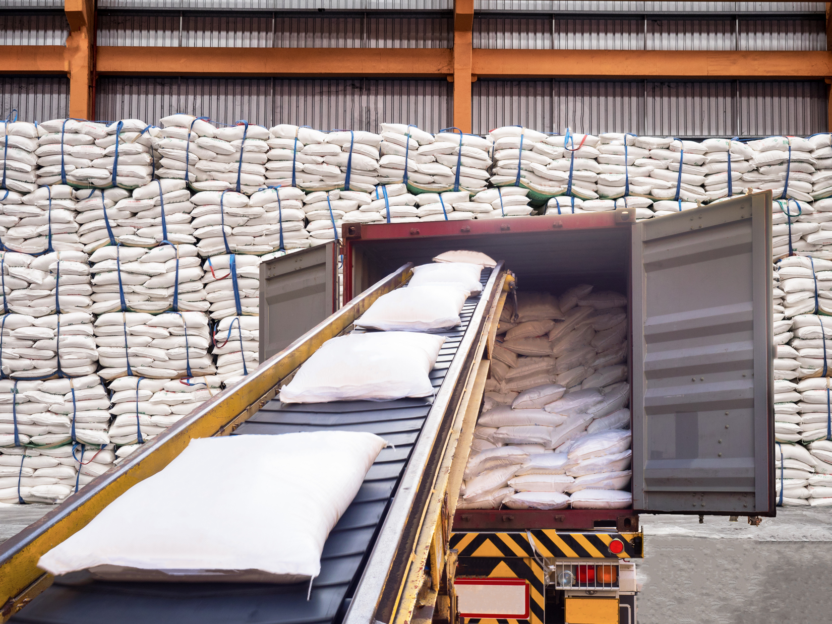
Under CPT, delivery takes place when goods are loaded in the first means of conveyance

Slide 20
Carriage Paid To (CPT)
Responsibilities of the Exporter
The exporter must package the goods for the international voyage, provide the importer with the documents necessary to clear Customs in the importing country, as well as arrange and pay for pre-carriage, main carriage and on-carriage to the city of destination.
Responsibilities of the Importer
The importer must do everything else.
Point at which the responsibility for the good shifts from exporter to importer
When the exporter delivers the goods to the first carrier
in the exporting country.

Slide 21
Carriage and Insurance Paid To (CIP)
Scope
Carriage and Insurance Paid To can be used for any type of product.
Modality
Carriage and Insurance Paid To can be used for any mode of transportation.
Syntax
CIP [Address in the City of Destination where goods are delivered], Incoterms ® 2010.
CIP · Ulitsa Poruchik Nedelcho Bonchev,
Sofia, Bulgaria, Incoterms® 2010

Slide 22
Carriage and Insurance Paid To (CIP)
Responsibilities of the Exporter
The exporter must package the goods for the international voyage, provide the importer with the documents necessary to clear Customs in the importing country, as well as arrange and pay for pre-carriage, main carriage, on-carriage and insurance to the city of destination.
Responsibilities of the Importer
The importer must do everything else.
Point at which the responsibility for the good shifts from exporter to importer
When the exporter delivers the goods to the first carrier in
the exporting country.

Slide 23
Carriage and Insurance Paid To (CIP)
Insurance under CIP
Under the CIP Incoterms® rule, the exporter must provide insurance for the goods, but it is minimum insurance (coverage C of the Institute Cargo Clauses).
The amount of insurance is always 110 percent of the value of the goods.
Incoterms® rule Variant
It is possible for the exporter and the importer to agree to a higher level of insurance (coverage A). In this case, the Incoterms syntax changes to:
CIP · Ulitsa Poruchik Nedelcho Bonchev,
Sofia, Bulgaria, Incoterms® 2010, maximum cover

Slide 24
Delivered at Terminal (DAT)
Scope
Delivered At Terminal can be used for any type of product, but it is designed for containerized cargo.
Modality
Delivered At Terminal can be used for any mode of transportation.
Syntax
DAT [Address of the Terminal where goods are delivered], Incoterms ® 2010.
DAT · Paranaguá Container Terminal, Avenida Portuária, Paranaguá, Parana 83206-410, Brazil,
Incoterms® 2010.

Slide 25
Delivered At Terminal (DAT)
The Delivered At Terminal Incoterms® rule was created in 2010. It is meant to be used for containerized cargo delivered to a port, and to replace the maritime cargo terms (FCA, FOB, CFR, CIF), which the International Chamber of Commerce wants to reserve for non-containerized cargo.
Under the DAT Incoterms® rule, the exporter and the importer can agree on a terminal that is located in the exporting country, or one located in the importing country, or yet one located in a country through which the goods will transit.
The DAT Incoterms® rule reflects the practices followed by companies that utilize containers in international trade. They deliver containers to terminals in the country of export and collect containers at terminals located in the country of import.

Slide 26
Delivered At Terminal (DAT)
Responsibilities of the Exporter
The exporter must package the goods for the international voyage, provide the importer with the documents necessary to clear Customs in the importing country, as well as arrange and pay for transportation to the terminal at which the goods are to be delivered.
Responsibilities of the Importer
The importer must do everything else.
Point at which the responsibility for the good shifts from exporter to importer
When the exporter delivers the goods, unloaded from the mode of transportation, to the terminal.

Slide 27
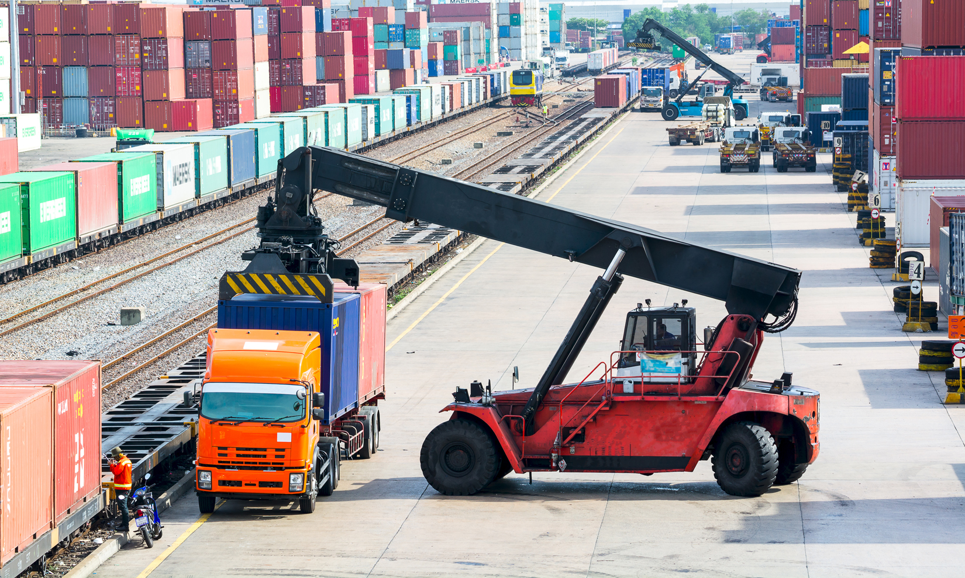
Under DAT, delivery takes place when goods are unloaded in the terminal.

Slide 28
Delivered At Place (DAP)
Scope
Delivered At Place can be used for any type of product.
Modality
Delivered At Place can be used for any mode of transportation.
Syntax
DAP [Address in the City of Destination where goods are delivered], Incoterms ® 2010.
DAP · 97 Brisbane Street, Sydenham 8023,
New Zealand, Incoterms® 2010.

Slide 29
Delivered At Place (DAP)
The Delivered At Place Incoterms® rule was created in 2010. It was meant to replace the Delivered Duty Unpaid (DDU) Incoterms® rule that had been in existence until 2010.
Under the DAP Incoterms® rule, the exporter and the importer generally agree to use a location in the importing country. However they could agree on a location in the exporting country, or one in a country through which the goods will transit.

Slide 30
Delivered At Place (DAP)
Responsibilities of the Exporter
The exporter must package the goods for the international voyage, provide the importer with the documents necessary to clear Customs in the importing country, as well as arrange and pay for pre-carriage, main carriage and on-carriage to the city of destination.
Responsibilities of the Importer
The importer must do everything else.
Point at which the responsibility for the good shifts from exporter to importer.
When the exporter delivers the goods to the place of delivery, still loaded on the mode of transportation.

Slide 31
Delivered Duty Paid (DDP)
Scope
Delivered Duty Paid can be used for any type of product.
Modality
Delivered Duty Paid can be used for any mode of transportation.
Syntax
DDP [Address in the City of Destination where goods are delivered], Incoterms ® 2010.
DDP · Kopparbergsgatan 226, Malmö 214 44, Sverige/Sweden, Incoterms® 2010.

Slide 32
Delivered Duty Paid (DDP)
Responsibilities of the Exporter
The exporter must package the goods for the international voyage, arrange and pay for pre-carriage, main carriage and on-carriage to the city of destination, and clear Customs in the importing country.
Responsibilities of the Importer
The importer must unload the goods from the means of conveyance.
Point at which the responsibility for the good shifts from exporter to importer
When the exporter delivers the goods to the delivery location, still loaded onto the mode of transportation.

Slide 33
Free Alongside Ship (FAS)
Scope
Free Alongside Ship can be used for any type of product. However, the International Chamber of Commerce would like FAS to be used only for non-containerized cargo.
Modality
Free Alongside Ship can only be used for ocean transportation.
Syntax
FAS [Address of the dock in the Port of Departure where the goods are delivered], Incoterms ® 2010.
FAS · Waalhaven Noordzijde 2089, Rotterdam,
3089KM, The Netherlands, Incoterms® 2010.

Slide 34
Free Alongside Ship (FAS)
Responsibilities of the Exporter
The exporter must package the goods for the international voyage, provide the importer with the documents necessary to clear Customs in the importing country, as well as arrange and pay for pre-carriage to the port of departure.
Responsibilities of the Importer
The importer must do everything else.
Point at which the responsibility for the good shifts from exporter to importer
When the exporter delivers the goods to the port of departure, unloaded from the mode of transportation.

Slide 35
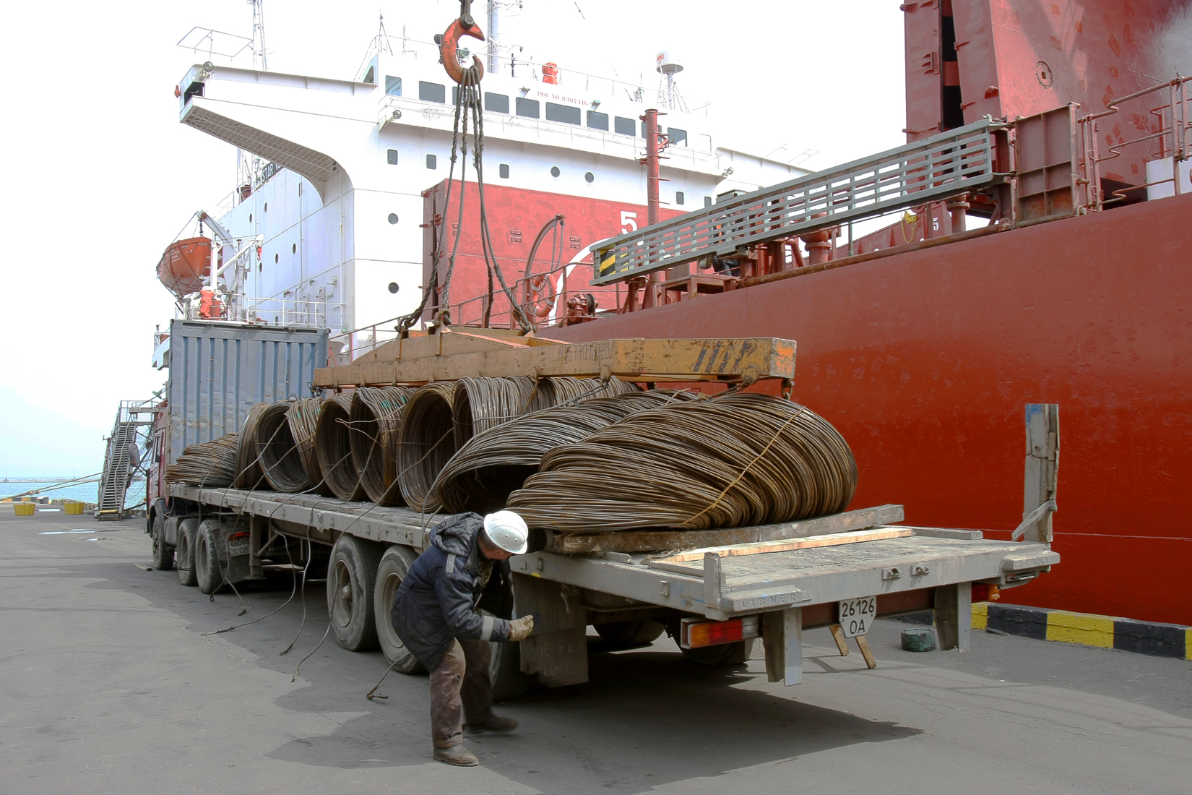
Under FAS, delivery takes place when goods arrive alongside the ship in the port of departure

Slide 36
Free On Board (FOB)
Scope
Free On Board can be used for any type of product. However, the International Chamber of Commerce would like FAS to be used only for non-containerized cargo.
Modality
Free On Board can only be used for ocean transportation.
Syntax
FOB [dock (or ship) in the Port of Departure where the goods are delivered], Incoterms ® 2010.
FOB · Breakbulk Terminal, 660 Duncan Road,
Cape Town, South Africa, Incoterms® 2010.

Slide 37
Free On Board (FOB)
Responsibilities of the Exporter
The exporter must package the goods for the international voyage, provide the importer with the documents necessary to clear Customs in the importing country, arrange and pay for pre-carriage to the port of departure and loading onto the ship.
Responsibilities of the Importer
The importer must handle everything else.
Point at which the responsibility for the good shifts from exporter to importer
When the exporter delivers the goods onboard the ship in the port of departure.

Slide 38
Cost and Freight (CFR)
Scope
Cost and Freight can be used for any type of product. However, the International Chamber of Commerce would like FAS to be used only for non-containerized cargo.
Modality
Cost and Freight can only be used for ocean transportation.
Syntax
CFR [Address of the dock in the Port of Destination where goods are delivered], Incoterms ® 2010.
CFR · ENL Multi-purpose Terminal, Apapa Wharf,
Lagos,Nigeria, Incoterms® 2010.

Slide 39
Cost and Freight (CFR)
Responsibilities of the Exporter
The exporter must package the goods for the international voyage, provide the importer with the documents necessary to clear Customs in the importing country, as well as arrange and pay for pre-carriage and main carriage to the port of destination.
Responsibilities of the Importer
The importer must do everything else.
Point at which the responsibility for the good shifts from exporter to importer
When the exporter delivers the goods onboard the ship in the port of departure.

Slide 40
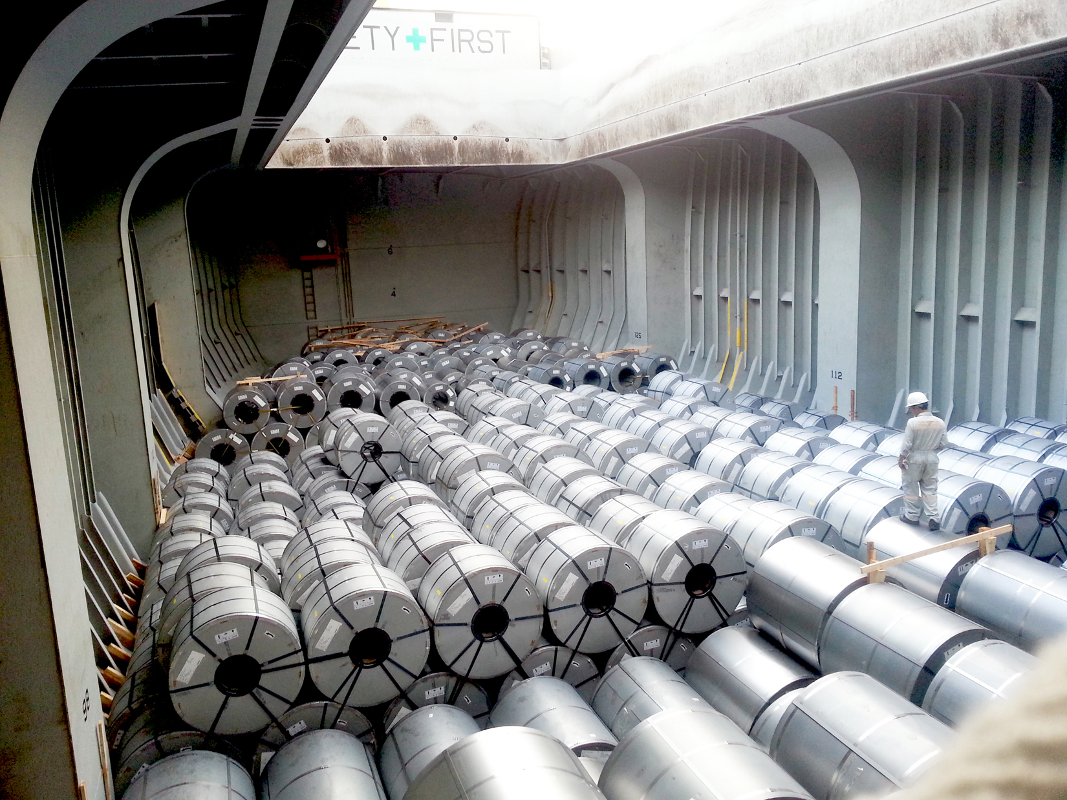
Under CFR, delivery takes place when goods are placed onboard the ship

Slide 41
Cost, Insurance and Freight (CIF)
Scope
Cost Insurance and Freight can be used for any type of product. However, the International Chamber of Commerce would like FAS to be used only for non-containerized cargo.
Modality
Cost Insurance and Freight can only be used for ocean transportation.
Syntax
CFR [Address of the dock in the Port of Destination where goods are delivered], Incoterms ® 2010.
CIF · Naigai Lines, 176 Higashi-Machi, Chuo-Ku,
Kobe 650-0031, Hyogo, Japan, Incoterms® 2010.

Slide 42
Cost, Insurance and Freight (CIF)
Responsibilities of the Exporter
The exporter must package the goods for the international voyage, provide the importer with the documents necessary to clear Customs in the importing country, as well as arrange and pay for pre-carriage, main carriage and insurance to the port of destination.
Responsibilities of the Importer
The importer must do everything else.
Point at which the responsibility for the good shifts from exporter to importer
When the exporter delivers the goods onboard the ship in the port of departure.

Slide 43
Cost, Insurance and Freight (CIF)
Insurance under CIF
Under the CIF Incoterms® rule, the exporter must provide insurance for the goods, but it is minimum insurance (coverage C of the Institute Cargo Clauses).
The amount of insurance is always 110 percent of the value of the goods.
Incoterms® rule Variant
It is possible for the exporter and the importer to agree to a higher level of insurance (coverage A). In this case, the Incoterms syntax changes to:
CIF · Naigai Lines, 176 Higashi-Machi, Chuo-Ku,
Kobe 650-0031, Hyogo, Japan, Incoterms® 2010, maximum cover.

Slide 44
Incoterms® Rules in Domestic Trade
The International Chamber of Commerce has intentionally designed the new (2010) Incoterms® rules to be used in domestic trade.
The main reason for this change is that domestic trade and international trade often use the same terminologies (for example, FOB is a frequently used domestic term of trade), but with different meanings. Consider a company doing business in several countries, all of which have a different understanding of FOB in addition to the ICC version.
In an attempt to simplify trade, the ICC would like domestic and international shipments to use ) Incoterms® rules.

Slide 45
Electronic Data Interchange (EDI)
For several Incoterms® rules, there is no transport document that is issued at the point where the responsibility shifts from the exporter to the importer (for example, a Bill of Lading).
Electronic Data Interchange has attempted to solve this problem.
Whenever there is no transport document possible, the exporter can still send an EDI “notice” to the importer, which acts as a proof of delivery for both parties. The exporter has a record of the notification sent, and the importer knows unambiguously when the goods were delivered to the quay or when they arrived in port.

Slide 46
Common Errors in Incoterms® Rules Usage (I)
Confusion with Domestic Terms of Trade
An inexperienced exporter will use “FOB factory” rather than the correct corresponding Free Carrier Seller’s Premises (FCA) Incoterms® rule.
Confusion with older Incoterms® rules
The International Chamber of Commerce modified the Incoterms® rules in 1980, 1990, 2000, and 2010. It eliminated some Incoterms® rules, modified others and created some new ones. For a number of reasons, several exporters have failed to adapt to these changes, and will use an obsolete Incoterms® rule.

Slide 47
Common Errors in Incoterms® Rules Usage (II)
Improper Use of a Correct Incoterms® rule
Some Incoterms® rules are sometimes specific to certain modes of transportation and types of cargo, and cannot be used for others.
The most frequent misuse is when FOB is used with an air shipment: FOB is designed to be used only with an ocean shipment term.
The correct Incoterms® rule to use for an air shipment should be Free Carrier (FCA), to clearly outline the responsibilities of the exporter and of the importer.

Slide 48
Common Errors in Incoterms® Rules Usage (III)
Not Specifying the Incoterms® rule version
Incoterms rules have changed from 2000 to 2010. Until the 2010 rules are solidly established, it would be advisable to always specify “Incoterms 2010”.
Since the FOB point of delivery changed from Incoterms 2000 to Incoterms 2010, some possible problems may develop should cargo be damaged during the loading of a ship if the version (2010) is not specified.

Slide 49
Incoterms® Rules as a Strategic Advantage
A strategic advantage can be gained by an exporter willing to facilitate the sale of its products by assisting a novice importer in the handling of a shipment.
On the other hand, an experienced importer may be intent on performing all or most of the tasks involved in the shipment.
Most exporters would gain by being flexible, offering a quote where they list several possible Incoterms:
FCA, 123 Main Street, Cleveland, Ohio, USA $ 245,000
FOB, M/V APL Florence, Miami, Florida, USA $ 258,000
DAT, Tecon Terminal, Santos, Brazil $ 285,000
and let the importer decide which Incoterms rule it would rather use.

