Slide 1
Chapter 4 Methods of Entry in Foreign Markets

Slide 2
Methods of Entry into Foreign Markets
Entering A New Market
Indirect Exporting
Active Exporting
Production Abroad
Other Issues

Slide 3
Entering a New Market
The determination of the appropriate method of entry in a new market depends on several factors:
Size and growth of the market
Potential market share of the exporter
Type of product and marketing strategy of the exporter
Willingness of the exporter to get involved
Characteristics of the importing country
Time horizon considered

Slide 4
Entering a New Market
The company must decide whether market factors favor
Manufacturing at home
Manufacturing abroad
Indirect Exporting
Active Exporting

Slide 5
Entering a New Market
Indirect exporting
Exporter does not seek export sales.
Allows manufacturer to concentrate on domestic market and leave exporting to the experts.
Active Exporting
Exporter actively participates in finding potential markets abroad.
Best option for large firms or firms with international experience.

Slide 6
Indirect Exporting
Export Trading Companies
Export Management Corporations
Piggy Backing

Slide 7
Export Trading Company
An Export Trading Company [ETC] is a firm with offices in multiple countries that purchases goods in one country and resells them in another.
For the “exporter” selling to the ETC, as well as for the “importer” buying from the ETC, the transactions are domestic transactions, even though the goods eventually travel internationally.
Historically, the first ETCs were created in Britain, France, and the Netherlands to facilitate trade with India and Indochina. They were then created in Spain and Portugal for trade in South America. Following World War II, ETCs became popular in Japan as the country began to trade with the outside world. Today, they are almost exclusively Japanese: Mitsui, Mitsubishi, Marubeni, Itochu, ...

Slide 8
Tradco, a trading company, buys ceramics from a Turkish company and pays in Turkish liras.
Tradco then transports the ceramics onboard its own ships to Russia.
Tradco sells them to a Russian customer and collects Russian rubles.
As far as the Turkish seller is concerned, the sale is a domestic transaction with a Turkish customer. As far as the Russian buyer is concerned, the purchase is a domestic transaction with a Russian supplier.

Slide 9
Export Management Corporation
An Export Management Corporation [EMC] is normally located in the exporting country.
The EMC acts as a representative for the exporter abroad, but never takes title to the goods. It acts as a facilitator helping the exporter find buyers, and earns a commission on the sale.
A sale through an EMC requires more involvement by the exporter: It has to ship the goods, invoice the importer, carry the risk of non-payment, and have to manage parts of the transaction.

Slide 10
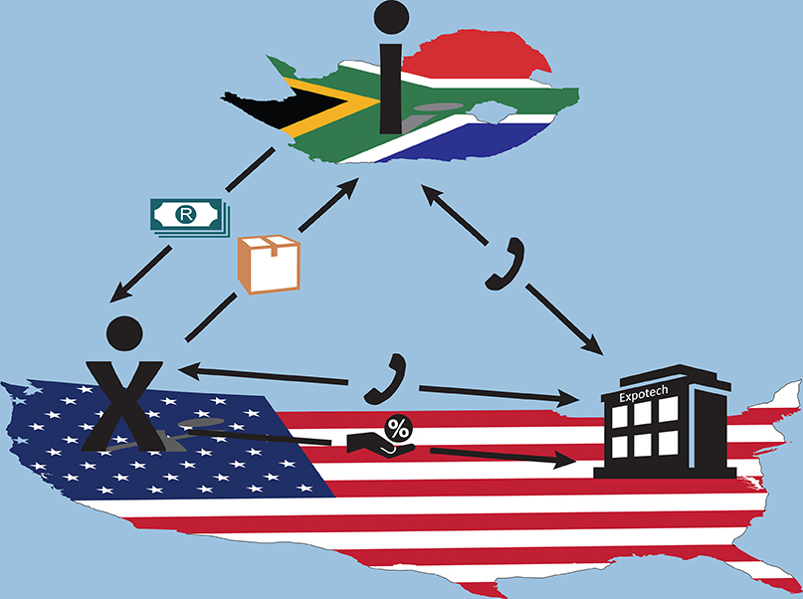
Expotech, an export management corporation finds out that a company in South Africa needs a forklift truck.
Expotech contacts a U.S. manufacturer, which agrees to sell the product to the South African customer if Expotech handles all aspects of the international transaction for a 5-percent commission.
The U.S. company ships the forklift to the customer in South Africa and sends him an invoice.
When the manufacturer is paid, it sends the commission to Expotech.

Slide 11
Piggy Backing
Piggy-backing refers to the possibility of a small firm piggy-backing on another firm’s efforts to enter a foreign market. For example:
A firm’s customer may open a manufacturing facility abroad and request that the firm continue to sell its products to that new facility. The firm ends up being an exporter, even though it never sought to enter that market.
A firm utilizes another company’s distribution channels abroad to sell its products. It uses another company’s experience to sell its products abroad.
In either case, the firm “piggy-backed” on the other’s strategy.

Slide 12
Canadian Motors Corp (CMC), a large Canadian manufacturer of automobile motors, builds a plant in Ukraine.
CMC tells to its Canadian supplier, V-Tech, that it needs to provide engine valves to the new plant.
V-Tech now supplies valves to the CMC plant in Canada as well as in Ukraine, a country to which it would not have exported without CMC’s request.

Slide 13
Active Exporting
Agent
Distributor
Marketing Subsidiary

Slide 14
Agent
An agent is typically a small firm or individual located in the importing country. The agent will act as a representative of the exporter. He or she will not take title of the goods and will earn a commission form the exporter.
The principal is the party (company) being represented by the agent.
An agent will represent multiple companies manufacturing products that complement the exporter’s products.

Slide 15
A French manufacturer of industrial machinery hires an agent in Australia to sell its products and represent the exporter in that market.
After the agent finds an Australian customer, the transaction is conducted between the exporter in France and the importer in Australia.
When the exporter is paid by the importer, he then sends the agent a commission.

Slide 16
Distributor
A distributor is typically located in the importing country. The distributor will purchase the goods from the exporter and therefore take title of them. It will then resell the goods for a profit.
In this relationship, there are two sets of invoices. One set of international invoices between the exporter and the distributor. The distributor is therefore the importer. The second set of invoices is between the distributor and its customer. The customer sees this as a domestic transaction.
A distributor may carry products from competitors in the same field. Oftentimes, it will also service products and carry replacement parts.

Slide 17
An Israeli manufacturer of irrigation equipment, Irridim, enters a contract with a Spanish distributor to sell its products in Western Europe.
The Spanish distributor purchases the parts from the Israeli manufacturer and places them in inventory.
The Spanish distributor then sells them to its own customers all over Europe.

Slide 18
Legal Issues
Agents are typically very small, sometimes even one person, and therefore fall under the protection of labor law in many countries. This puts certain limits on the way contracts between agents and exporters can be worded and enforced (see Chapter 5).
Distributors are typically much larger than agents and therefore fall under contract law.
Finally, certain countries have strict laws regarding the use of agents, sometimes even barring them altogether.

Slide 19
Marketing Subsidiary
A marketing subsidiary is a foreign office of a parent organization. The subsidiary is a separate entity incorporated in the foreign country. It is wholly owned by the parent company.
The parent company sells products to the subsidiary in an international transaction. The subsidiary in turn will sell these products to customers in the foreign country.
The costs (and risks) associated with creating a marketing subsidiary are but a subsidiary allows for greater control by the exporter.

Slide 20
A Swiss manufacturer of precision machinery, TechnoSwiss, establishes a marketing subsidiary in Brazil.
The Technoswiss subsidiary hires several employees whose role is to sell Technoswiss products to the South American continent.

Slide 21
Coordinating Direct Export Strategies (I)
A firm can use two strategies in entering foreign markets through exports, and both are appropriate:
A standardized approach, where it uses a single method of entry in all markets: agents, distributors, or sales subsidiaries. This uniformity simplifies the management of international sales.
A tailored approach, where an agent is used in some countries, a distributor in others, and a marketing subsidiary in the remainder. The decision depends on the characteristics of the market and resources.

Slide 22
Coordinating Direct Export Strategies (II)
Difficulties arise when a firm decides to change strategies in a particular market. These long-term relationships are very important and ending any one of them can be difficult and costly.

Slide 23
Manufacturing Abroad
Contract Manufacturing
Licensing
Franchising
Joint Venture
Subsidiary

Slide 24
Contract Manufacturing
A company enters into an agreement with a foreign company to manufacture its goods abroad. For example:
An American publisher may hire a British publisher to print books in Britain, instead of shipping them from the United States.
A French cement company may contract a Chinese cement manufacturer to sell cement under the French company’s name in China.
Contract manufacturing is a way for a firm to get its products in a foreign country, either when there are barriers to entry (quotas, for example), or when transportation costs are high.

Slide 25
Util, a British manufacturer of home appliances, enters a contract with a manufacturer in Korea.
The Korean company produces the appliances for the British company.
The British company is responsible for marketing them worldwide, including in Japan.

Slide 26
Licensing
A company (the licensor) allows another firm (the licensee) to use its intellectual property in exchange for a fee (royalty).
The license can allow the use of a patented technology, trademark, brand name or trade secret. The licensor retains ownership of the intellectual property and the licensee must pay the licensor a fee every time it is used.
All intellectual property is at risk of being copied or “stolen” in countries where intellectual property is not well protected.
Having a licensing agreement does not increase that risk: companies intent on violating intellectual property do it without access to the licensor.

Slide 27
Cicero Books, the United States publisher of your International Logistics book, enters a licensing agreement with Tsinghua University Press in China.
Cicero Books allows Tsinghua to publish copies of the book in the Chinese market.
In exchange, Tsinghua University Press pays a royalty to Cicero Books.

Slide 28
Franchising
Franchising is similar to licensing but involves a “bundle” of intellectual property items. A firm (franchisor) will allow an entire business model to be used by another firm (franchisee) in exchange for royalties. The intellectual property includes a large number of related trademarks, copyrights, patents and know-how, training, and methods of operation.
Franchising works best for retail establishments requiring a uniform appearance for consumers, and is most popular with fast-food restaurants, such as McDonald’s or KFC, or small-business services such as UPS stores.

Slide 29
Ace Carwash, a British chain of do-it-yourself car washes, enters a franchising agreement with Australian investors.
Ace allows the Australian investors to use its name, designs, and brands, in exchange for the payment of a royalty.

Slide 30
Joint Venture
A joint venture (JV) is a firm created and jointly owned by two or three companies.
It is created when two or three exporters want to share the costs of investing in a facility abroad. Often the joint owners are companies manufacturing complementary product lines.
Sometimes, an exporter wants a local partner to provide capital and knowledge of the market. Some countries require local partnership for foreign investors.
Joint ventures work well while the relationship is strong. Unfortunately, the two entities will often grow in different directions over time and the joint venture will suffer.

Slide 31
A Swiss pharmaceutical company creates a joint venture with a local chemical manufacturer in India to produce a drug with substantial market potential on the Indian market.
The Swiss manufacturer chose its partner because the Indian management team had much experience navigating the country’s complex regulatory environment.

Slide 32
Subsidiary
A subsidiary (or wholly owned foreign enterprise [WOFE]) is an independent company established in a foreign country but owned entirely by the exporting company.
A subsidiary allows the foreign firm to retain complete control of its foreign investment.
This strategy is normally followed by a well-established large company, as the costs associated with creating a subsidiary are very high.

Slide 33
An Italian manufacturer of appliance parts purchases an existing appliance-part company and its plants in Argentina.
The plant now manufactures parts for the South American market.

Slide 34
Other Issues
Parallel Imports
Counterfeit Goods
Foreign Trade Zones
Foreign Sales Corporations
Maquiladoras
Foreign Corrupt Practices Act – Anti-Bribery Convention

Slide 35
Parallel Imports
For a variety of reasons firms will sell goods in different markets at different prices: different methods of entry, characteristics of the market, varying exchange rates.
Entrepreneurs will often buy the goods in the country with the lowest price, and then sell them in the country with the highest price. In order to do that, they buy from the normal distribution channel, but sell through alternative channels of distribution that are not the ones that the exporter would normally use.
This phenomenon is called “parallel imports,” or gray market.
It is difficult for companies to fight these parallel imports, as they are due to market characteristics rather than strategic choices.

Slide 36
A kitchen appliance sells at a lower price in Turkey than in Germany.
An entrepreneur buys the appliances at retail in Turkey, ships them to Germany, and sells them through a discount store.
The price of the Turkish version of the product ends up being lower than the price of the German version.

Slide 37
Counterfeit Goods
A counterfeit good is a copy of a legitimate good. The product is being produced to imitate a genuine good and deceive consumers. It is almost always of much lower quality and costs less than the genuine good.
Counterfeit goods can be tangible goods like watches, clothing, or car parts, but also intellectual property like films and software.
Western countries often accuse developing countries like China and India of ignoring blatant counterfeiting, but counterfeits can be found in every country.

Slide 38
Foreign Sales Corporations
Foreign Sales Corporations (FSCs) are not actually methods of entry but a method for U.S. companies to lower their income tax. The U.S. government allows companies to take a tax deduction when they create domestic subsidiaries that meet certain conditions:
The subsidiaries must have at least 95 percent of their assets and personnel devoted to export sales.
The exported goods must have at least a 50 percent U.S. content.
The World Trade Organization has ruled against FSCs, but as soon as a particular version is found illegal, they are resurrected under a different form.

Slide 39
Foreign Trade Zones
Foreign trade zones (or free trade zones [FTZ]) are areas of a country that have a special Customs status deeming them “outside” of the country. This means goods can be shipped to FTZs without paying duties or being subject to quotas.
It is only when the goods leave the FTZ and enter the country that they are subject to duty.
FTZs were created to encourage exporting and foreign investments.

Slide 40
Foreign Trade Zones
Exporter
Duty free
Foreign Trade Zone
Duty
Collected
Duty
Collected
Customers
Customers
Country A
Country B

Slide 41
Maquiladoras
A maquiladora is a company in Mexico with a Customs status similar to that of an FTZ.
Goods from the USA can be imported duty free into the maquiladora, transformed, and re-exported to the U.S. Duty is only charged on the value added, not on the goods themselves.
Maquiladoras are now obsolete because of the North American Free-Trade Agreement, which eliminated duty between Mexico, Canada, and the United States.

Slide 42
Foreign Corrupt Practices Act Anti-Bribery Convention
In several countries, the bribing of government officials is a common and accepted form of conducting business.
The Foreign Corrupt Practices Act (FCPA) of the United States attempts to eliminate the practice of bribery, by punishing the companies and the individuals paying the bribes.
The Organisation for Economic Co-operation and Development (OECD) has implemented an Anti-Bribery Convention, which several countries have adopted, and that also criminalizes bribery practices.

