Slide 1
Chapter 3 International Logistics Infrastructure

Slide 2
International Infrastructure
Infrastructure is a collective term that refers to all of the elements in place (publicly or privately owned goods) to facilitate transportation, communication, and business exchanges.

Slide 3
International Infrastructure
Transportation Infrastructure
Communication Infrastructure
Utilities Infrastructure
Services Infrastructure
Legal and Regulatory Infrastructure

Slide 4
International Infrastructure
The Transportation Infrastructure allows goods to move efficiently within a country and between countries. This requires well-maintained seaports, airports, railways, and roads.
The Communication Infrastructure allows businesses to communicate clearly and quickly. This requires reliable phone lines, cell phone networks, internet service, and mail delivery.
The Utilities Infrastructure allows businesses to sustain their daily operations. This requires reliable electricity, energy (natural gas), water, and sewer services.

Slide 5
International Infrastructure
The Banking Infrastructure allows businesses to move funds and documents quickly and reliably, both within a country and between countries. This requires a network of bank branches and well-trained bank employees.
The Business Services Infrastructure allows businesses to find additional competent logistics help quickly. This includes freight forwarders, couriers, carriers, delivery services, packing services, and so on.
The Distribution Infrastructure allows businesses to find agents and distributors, to develop wholesale and retail channels, and promote their products.

Slide 6
International Infrastructure
The Court Infrastructure allows businesses to settle disputes quickly and fairly. This includes not only an efficient court system, but also a network of mediators and arbitrators, and the existence of clear jurisprudence.
The Intellectual Property Infrastructure allows businesses to protect their intellectual property (copyrights, patents, and trademarks) with law enforcement services intent on enforcing intellectual property laws.
The Standard Infrastructure allows businesses to determine the requirements that their products and operations must meet. This includes safety, design, and performance standards.

Slide 7
Transportation Infrastructure
Ocean and Water Transportation
Air Transportation
Railroad Transportation
Road Transportation
Other Means of Transportation

Slide 8
Port Infrastructure (I)
Water Draft
The depth of water determines the size of ships that can call.
Air Draft
Bridge clearances also determine which ships can call.
Cranes
Post-Panamax ships need wider/taller cranes than Panamax ships.
Port Operations
Many ports have strong unions which limit operations.

Slide 9
Port Infrastructure (II)
Space Limitations
The location of most ports limit their ability to expand.
Warehouse Space
Availability of reliable storage space for goods in transit.
Connection to land-based Transportation
Ports need to have reliable access to roads and/or rail lines to keep cargo moving.

Slide 10
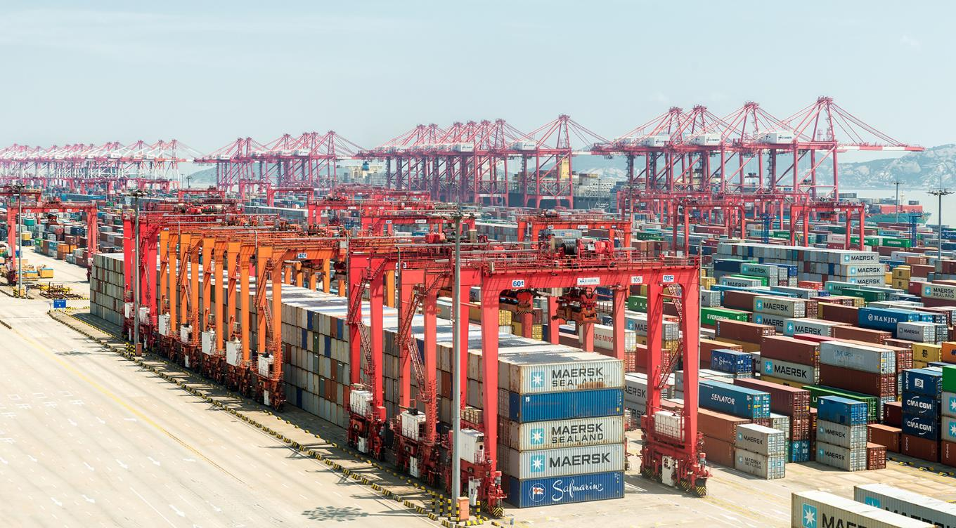
The port of YangShan, China

Slide 11
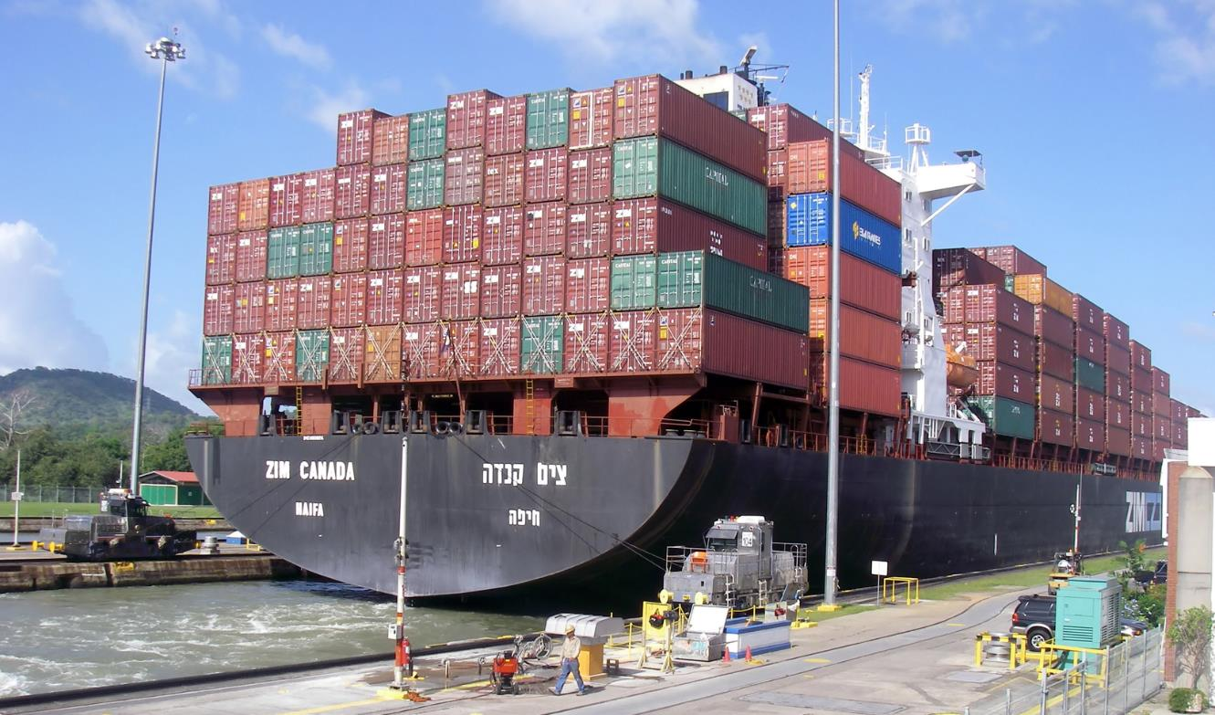
A Panamax ship

Slide 12
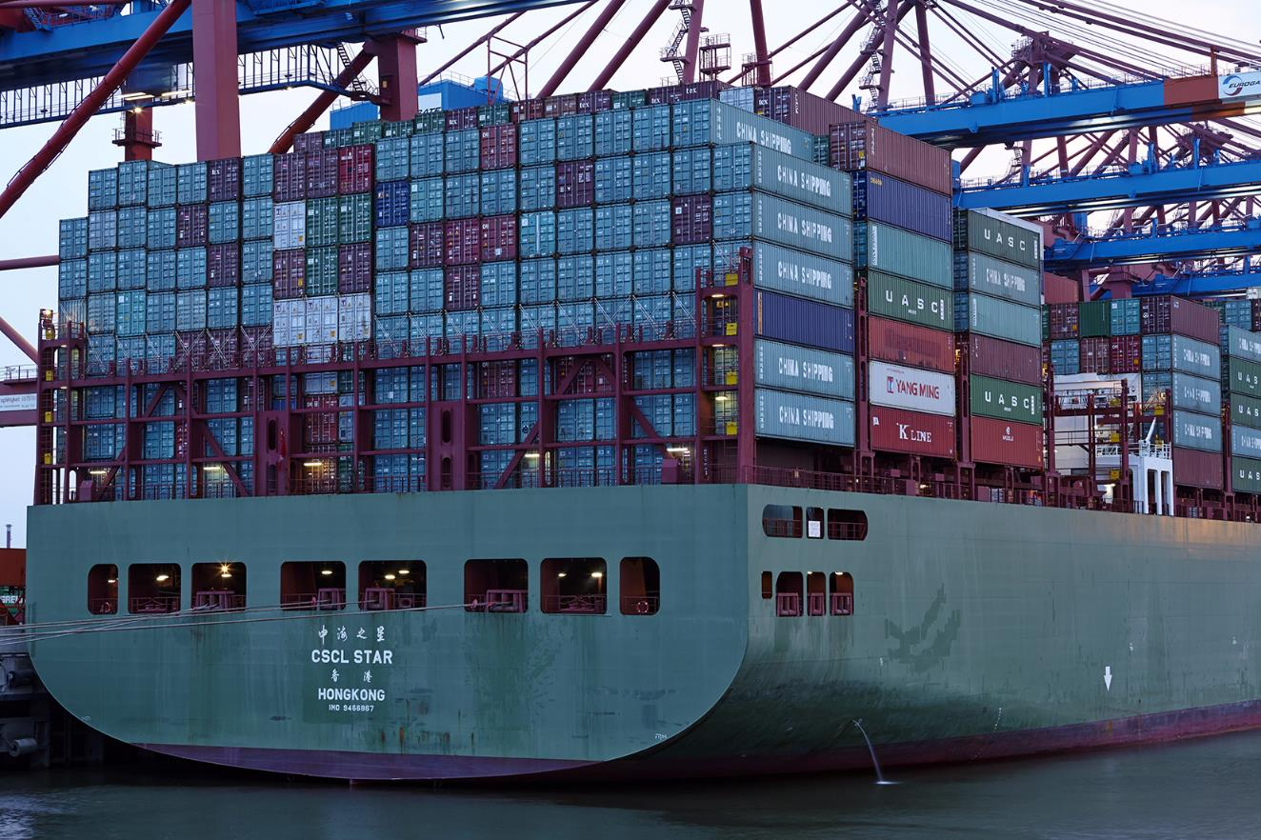
A Post-Panamax Ship

Slide 13
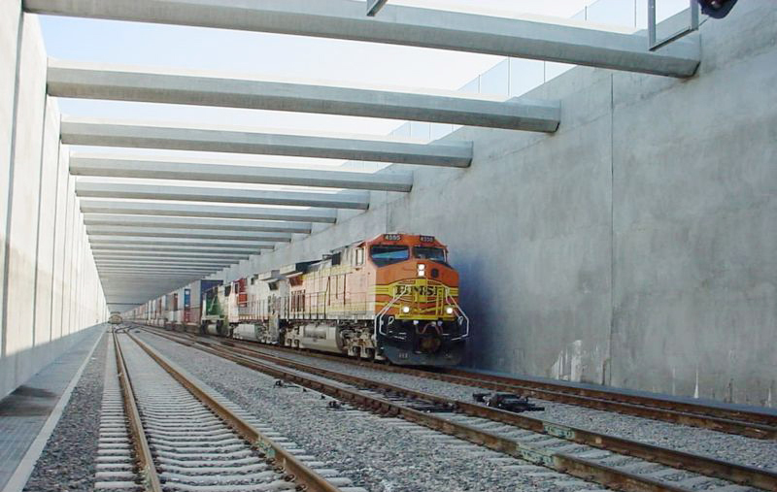
The Alameda Corridor between the Port of Los Angeles and the U.S.

Slide 14
Canals and Waterways
Maritime transportation is dependent on the existence of reliable canals.
The Suez Canal in North Africa and the Panama Canal in Central America are particularly important. The current trend of building ships too large to fit through these canals is creating new challenges for the industry.
Other key waterways include the Bosporus Strait in Turkey which connects the Black Sea with the Mediterranean and the Saint Lawrence Seaway in North America which connect the Great Lakes with the Atlantic Ocean.
Other canals are less frequently used, such as the Corinth Canal in Greece.

Slide 15
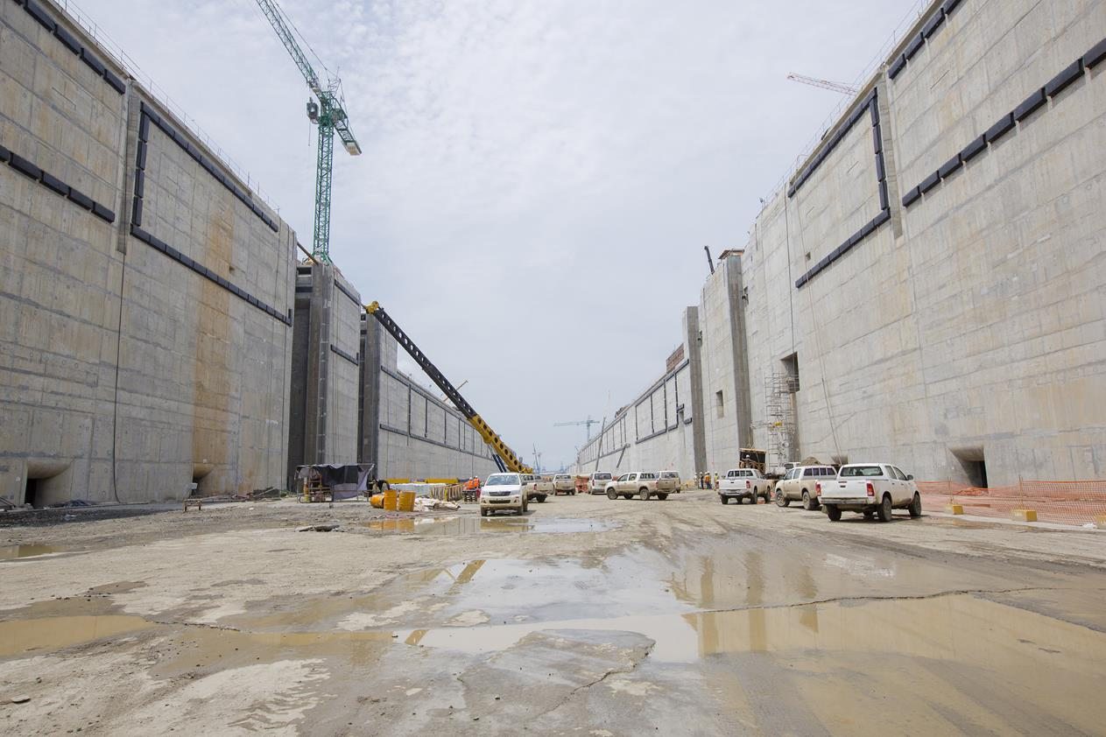
The New Locks on the Panama Canal.

Slide 16
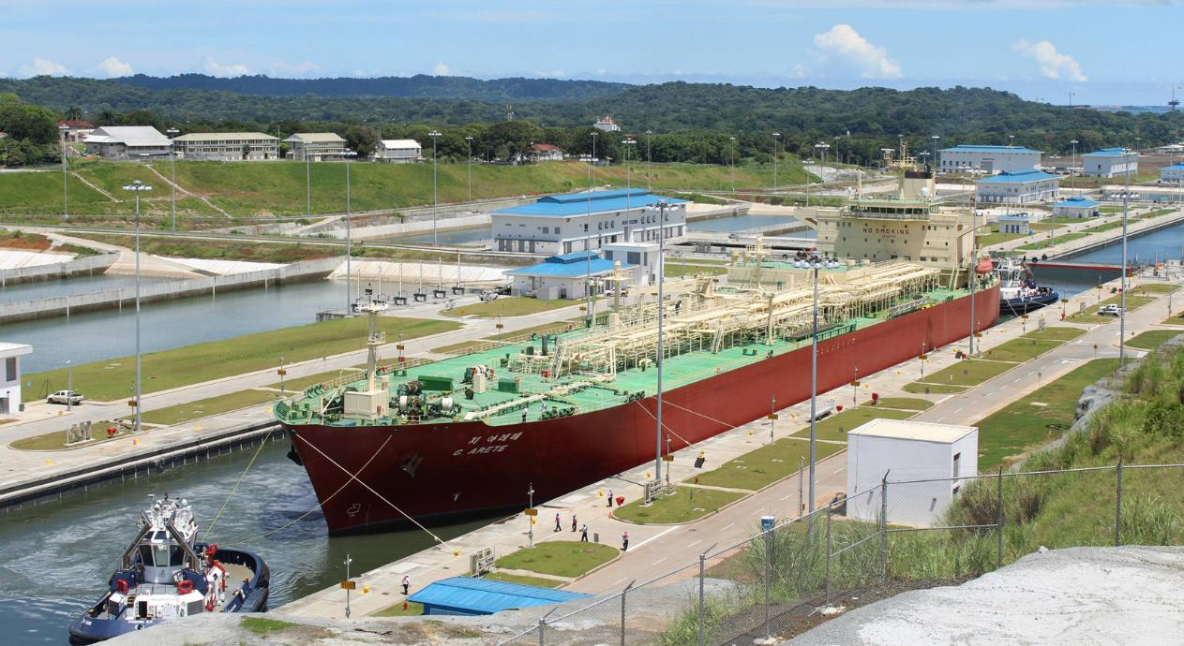
The New Locks on the Panama Canal.

Slide 17
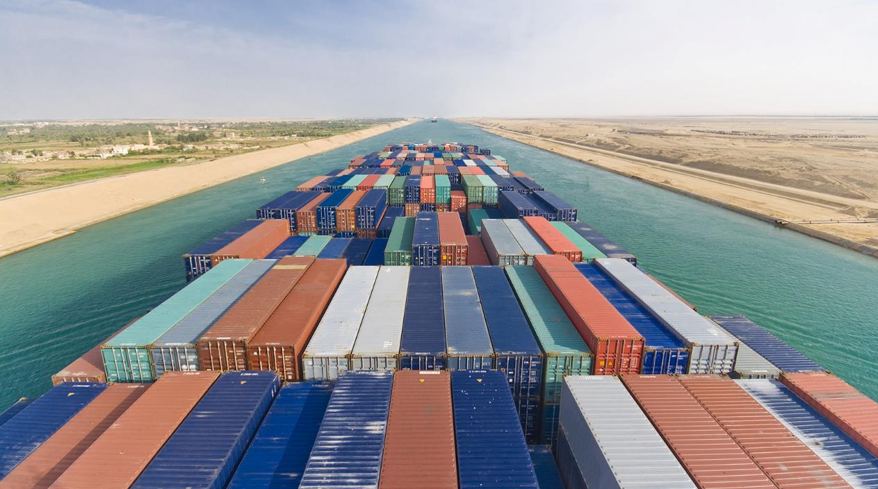
The Suez Canal.

Slide 18
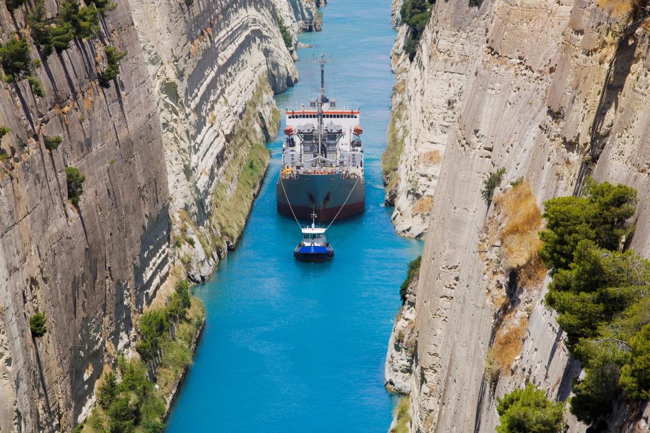
The Corinth Canal.

Slide 19
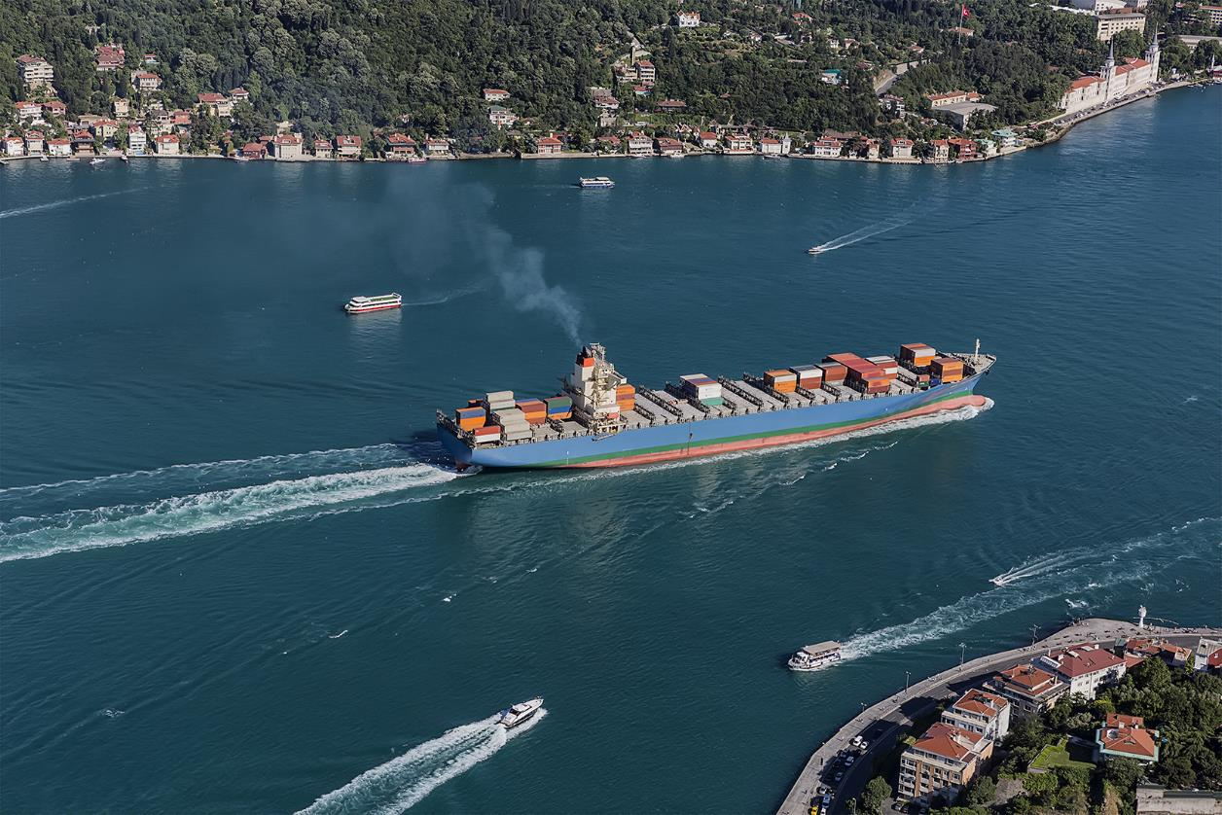
The Bosporus Strait.

Slide 20
Airport Infrastructure
Runways
The lengths of runways determines whether an airport can handle large cargo planes, and the number of runways determines its capacity.
Space
Most airports are landlocked and cannot expand.
Hours of operation
Airports need to be located away from of major cities if they are going to operate at night. Many airports do not meet this requirement.
Warehouse space
Storage facilities protect cargo from the elements.

Slide 21
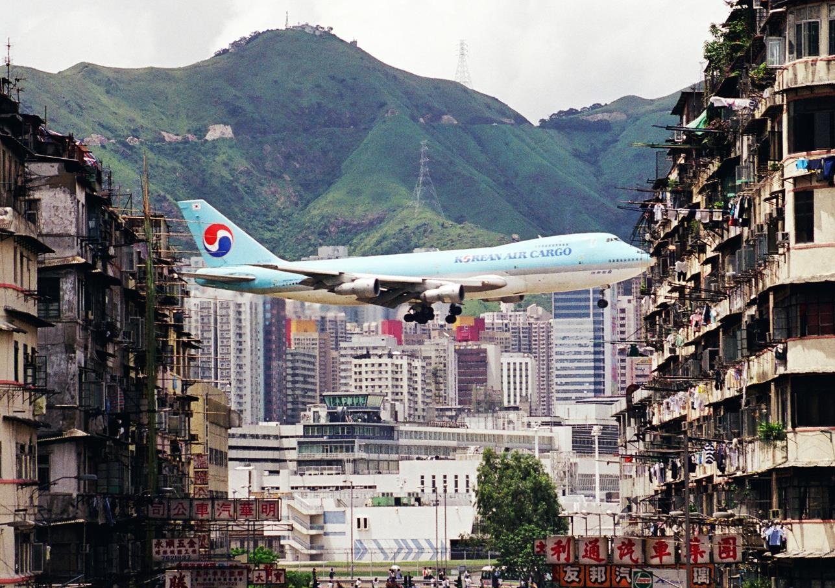
The Kai Tak Airport in Hong Kong (now closed).

Slide 22
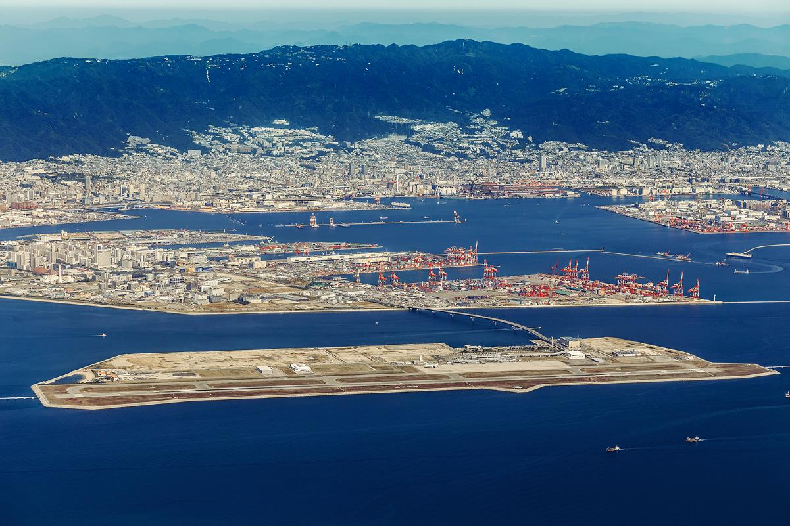
The Kobe Airport in Japan.

Slide 23
Railroad Infrastructure
Gauge
When railroads were first built, countries installed unique railroad track gauges to prevent rival armies from using them. Today, these gauge differences prevent trains from traveling quickly between multiple countries.
Multi-modal
Cargo rail transport has shifted from traditional railcars to multi-modal cars, carrying either containers or truck trailers.
Land bridges
Containers are shipped from Asia to Europe through the U.S. railroad network; they arrive in a port on the west coast, and are transported to an east-coast port by rail.

Slide 24
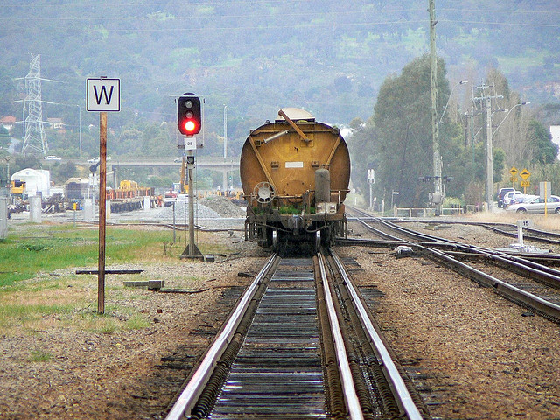
A dual-gauge track in Thailand.

Slide 25
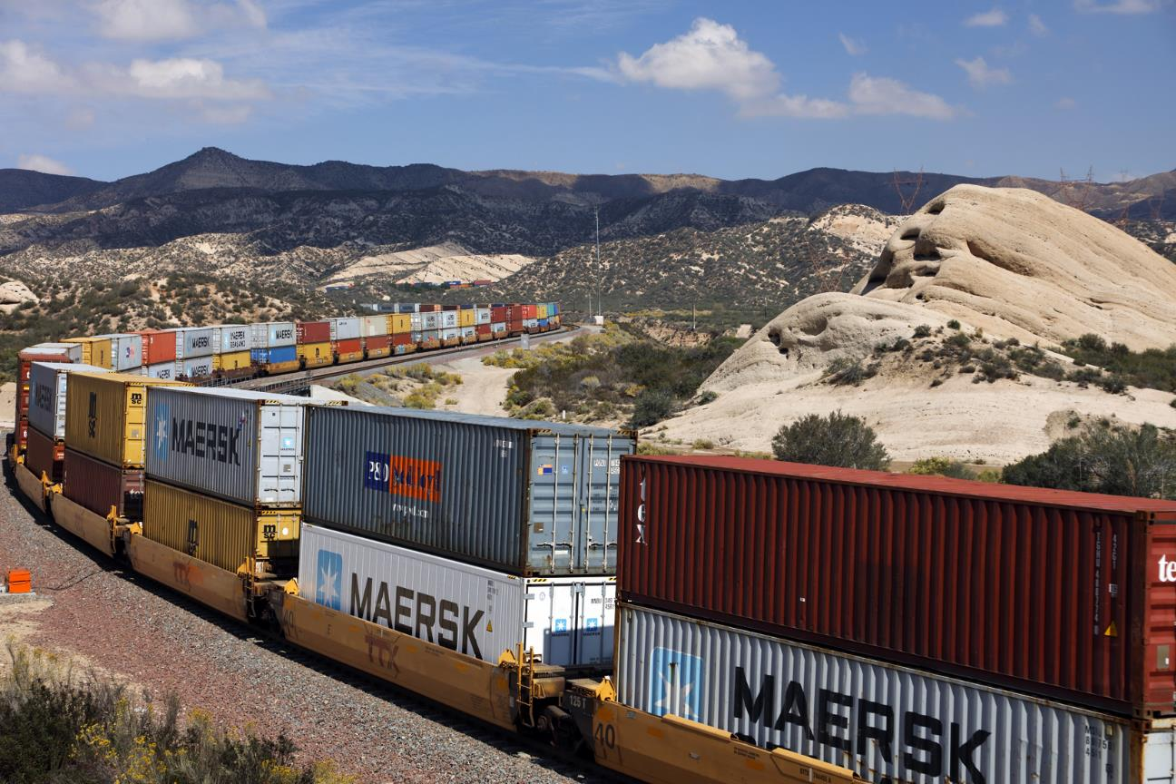
A double-stack train in the United States.

Slide 26
Road Infrastructure
Quality
The existence of high quality roadways is important to the continuous flow of goods.
Congestion
In many countries traffic congestion is stifling and prevents goods from moving quickly.
Civil engineering structures
Structures such as bridges and tunnels need to be built in many places in order to conveniently navigate the landscape.

Slide 27
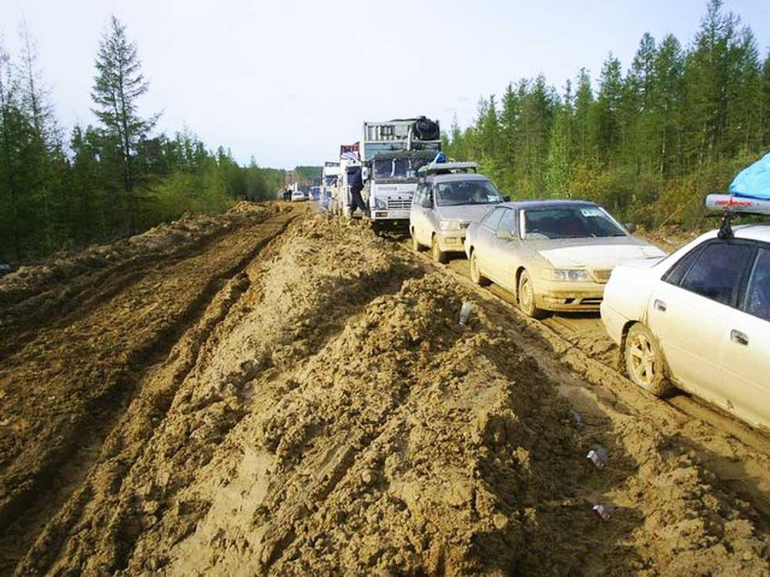
The Lena “highway” in Russia.

Slide 28
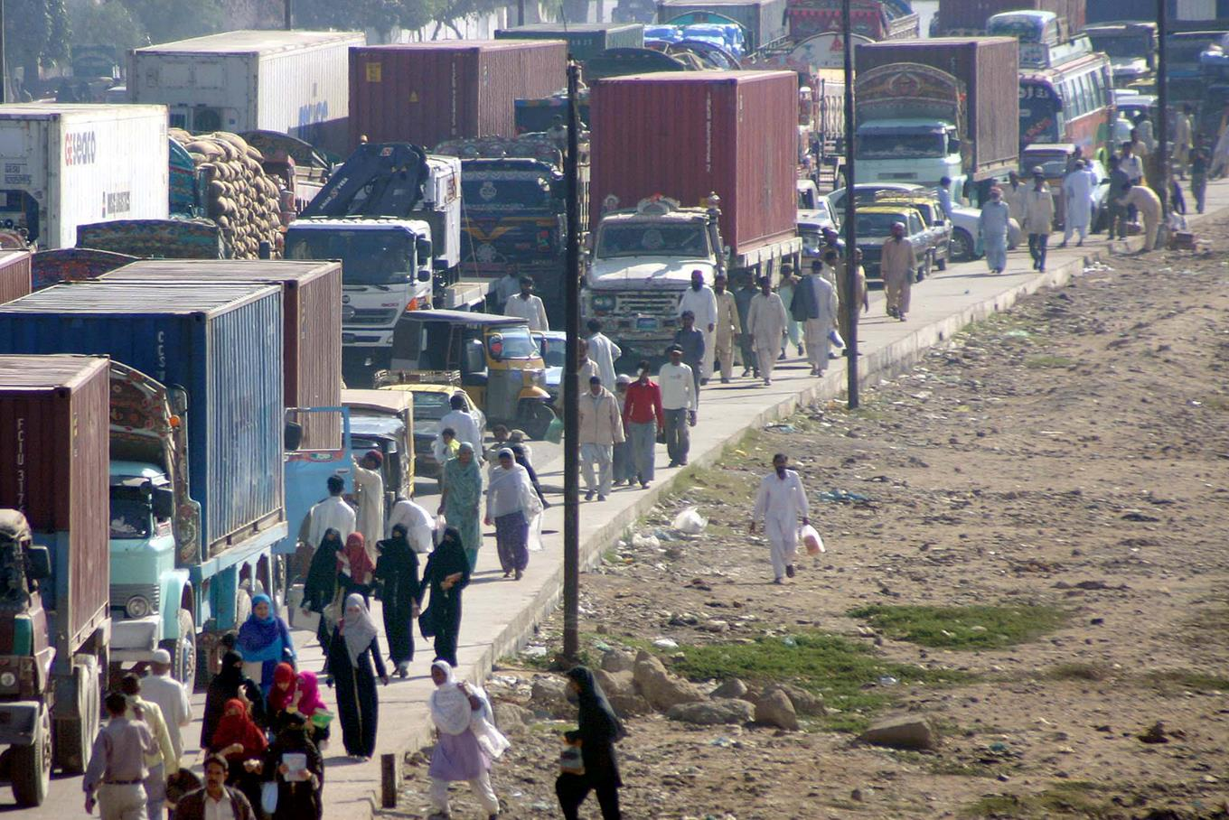
Traffic Congestion on the Road to the Port, in Karachi, Pakistan.

Slide 29
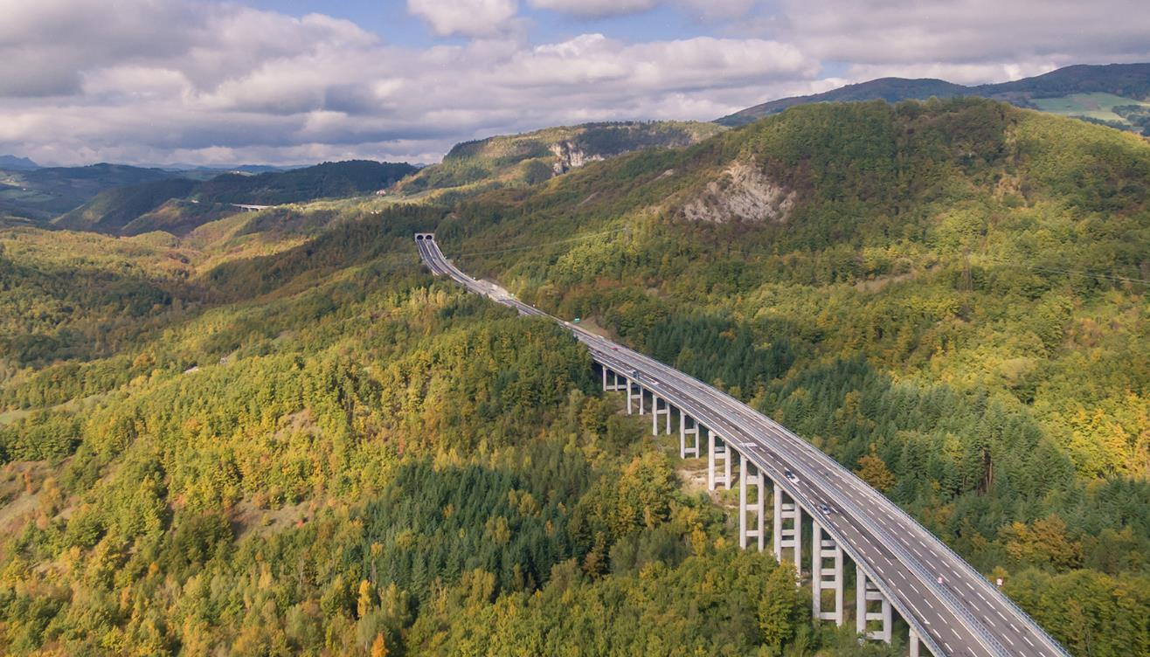
The Italian Autostrade, a Succession of Bridges and Tunnels.

Slide 30
Communication Infrastructure (Mail)
Speed
In some countries, mail delivery is quick. In others, very slow.
Reliability
In some countries, not all mail is delivered: it is lost, abandoned, or sometimes pilfered.
Delays
In some countries, postal unions have a lot of power and strikes can delay the delivery of important documents.
Competition
Firms such as FedEx, UPS, and DHL are very reliable, but they are generally much more expensive than the public postal services.

Slide 31
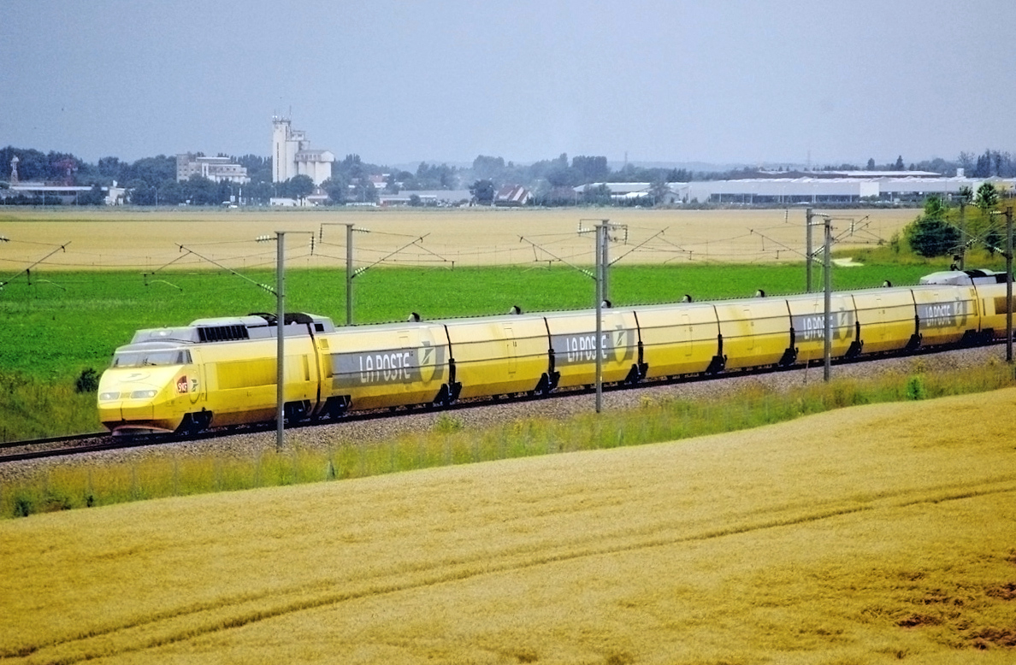
A high-speed postal train in France.

Slide 32
Communication Infrastructure (Telecommunications)
Land lines
While some countries have reliable, inexpensive phone lines, others do not have good landline telecommunication networks.
Cellular phones
Some countries built cellular phone networks quickly, often because they did not have a good landline network. They leapfrogged the landline technology, often offering better cellular access than developed countries with reliable landline networks.
Internet
Access to the internet is still limited or cost prohibitive in
some areas. In others, internet access is fast and inexpensive.
Leapfrogging
Some countries never build infrastructure in one technology, and “leapfrog” into the next one. Gabon in the next tables.

Slide 33
Landline Penetration
 | Country | Landlines/person
1 | Hong Kong | 61.8%
2 | Taiwan | 59.9%
3 | Germany | 58.2%
4 | France | 58.1%
5 | South Korea | 57.9%
6 | Switzerland | 53.4%
7 | United Kingdom | 51.6%
8 | Japan | 50.2%
9 | Greece | 48.5%
10 | Belarus | 47.0%
19 | United States | 39.9%
28 | United Arab Emirates | 35.4%
60 | China | 18.2%
49 | Panama | 15.9%
128 | Gabon | 1.0%
Countries with a population of more than 1,000,000.
Source: CIA’s World Fact Book

Slide 34
Cellphone Penetration
 | Country | Cell phones /person
1 | United Arab Emirates | 283.4%
2 | Kuwait | 268.3%
3 | Hong Kong | 242.8%
4 | Gabon | 207.1%
5 | Saudi Arabia | 187.1%
6 | Oman | 184.8%
7 | Panama | 167.3%
8 | Estonia | 166.9%
9 | Bahrain | 166.8%
10 | Uruguay | 164.1%
44 | Taiwan | 129.6%
51 | Germany | 123.3%
53 | Japan | 120.5%
96 | United States | 98.0%
102 | China | 94.6%
Countries with a population of more than 1,000,000.
Source: CIA’s World Fact Book

Slide 35
Internet Access
 | Country | Internet Access/person
1 | Denmark | 96.5%
2 | The Netherlands | 95.2%
3 | Bahrain | 94.3%
4 | Norway | 93.1%
5 | Qatar | 93.0%
6 | Finland | 92.8%
7 | Canada | 91.6%
8 | New Zealand | 89.4%
9 | United Kingdom | 88.9%
10 | South Korea | 88.1%
14 | Germany | 87.1%
16 | Japan | 86.3%
53 | United States | 85.4%
72 | China | 45.6%
125 | Gabon | 9.5%
Countries with a population of more than 1,000,000.
Source: CIA’s World Fact Book

Slide 36
Utilities Infrastructure
Electricity
Unreliable electricity grids and insufficient production capacity can cause blackouts or brownouts, limiting productivity.
Water and sewer
Access to clean water (and sewer) is fundamentally important for many manufacturing processes.
Energy
Reliable pipelines have to be available to deliver natural gas or oil products to the locations where they can be used.
Theft
In some areas, theft of utilities is common, making it difficult for utility companies to earn a profit and invest in new infrastructure.

Slide 37
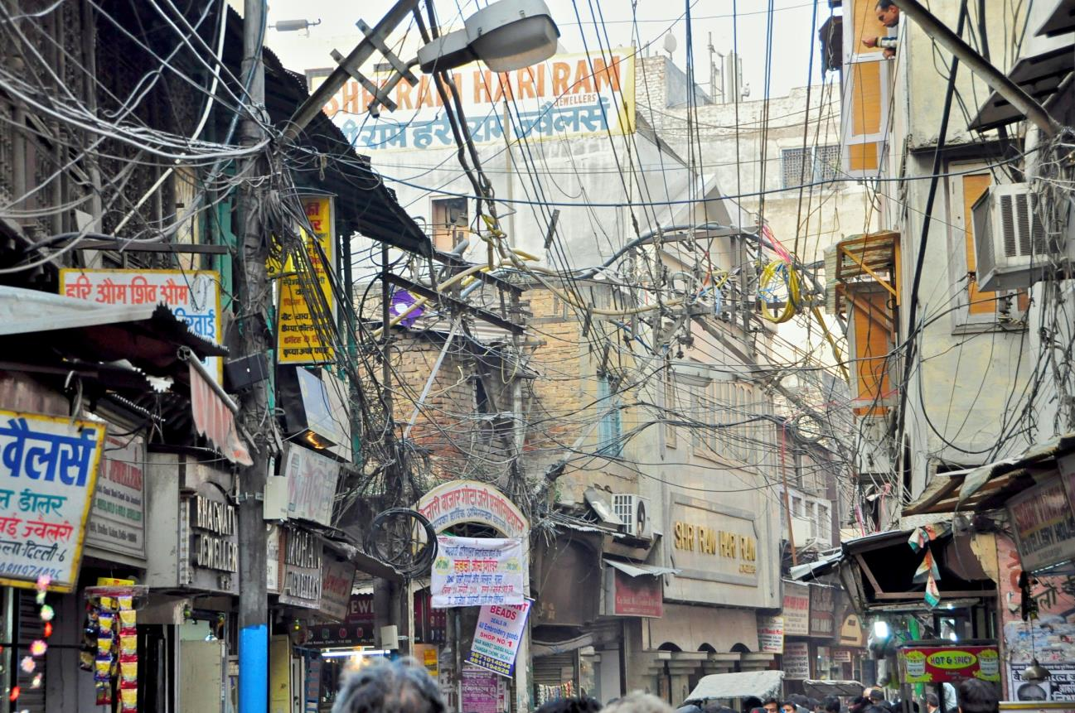
Tangled Wires in New Delhi, India.

Slide 38
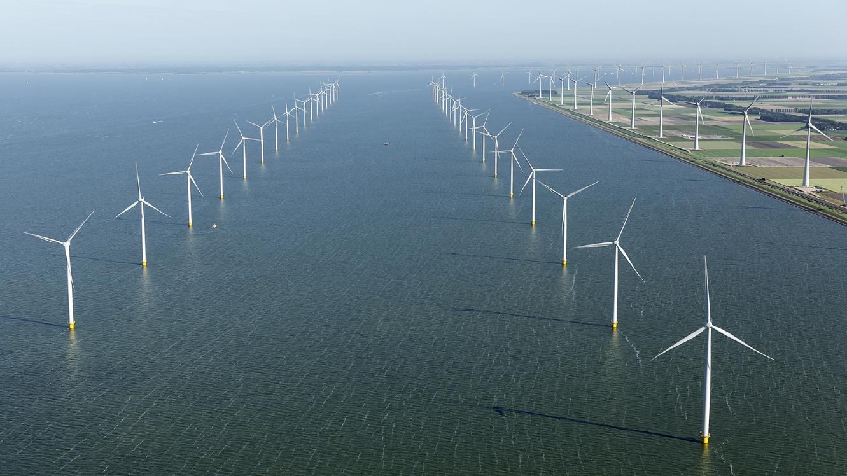
Offshore Wind Farm, the Netherlands.

Slide 39
Banking Infrastructure
Foreign currency payments
The ability to quickly purchase and sell foreign currencies, either through wire transfers or currency purchases, is important to firms engaged in international trade.
Methods of payment
The ability of the banking partners to support alternative means of payment and to provide assistance to firms engaged in international trade is very important.
Document exchanges
Banks play a fundamental role in the exchange of trade documents between an exporter and an importer.

Slide 40
Business Services Infrastructure (I)
Freight forwarders
Freight forwarders provide significant assistance to firms engaged in international trade by helping determine the best shipping alternatives.
Customs brokers
Brokers provide assistance to importers when clearing Customs.
Couriers
Couriers allow firms to ship documents and small parts using the “next available flight.”

Slide 41
Business Services Infrastructure (II)
Packing services
Packing services allow exporters to rely on professionals to pack goods destined for export.
Multiple other services
Carriers, delivery services, etc. are fundamental to implement good international trade practices, and must exist for exporters to be successful.

Slide 42
Distribution Channel Infrastructure
Agents and distributors
A strong network of agents and distributors allows an exporter to enter new markets and expand abroad.
Retail distribution
Efficient access to consumers is important to a manufacturer of consumer goods, and is not available in all countries.
Advertising and promotion
Advertising agencies and media allow promotional activities critical to the success of many products and services.
Trade shows
For most industries, trade shows present an unequaled opportunity to reach potential customers and trade partners.

Slide 43
Court Infrastructure
Speed
Speedy resolution of lawsuits allows businesses to “move on.” Some countries have slow and cumbersome court processes.
Arbitration
Disputes can be resolved faster through arbitration. The existence of experienced arbitrators is important to the conduct of business.
Mediation
Disputes can also be resolved through mediation, and therefore a group of mediators is often useful to resolve disputes.
Fairness
In some countries, the court system is perceived as corrupt or unfair, and that hinders good business relationships.

Slide 44
Intellectual Property Infrastructure
Protection
Businesses with intellectual property (patents, copyrights, trade secrets) want to make sure that the countries in which they operate will protect intellectual property. In some countries, competitors, police, and courts do not respect nor protect intellectual property, often considering that intellectual property laws favor big foreign corporations over the local entrepreneur trying to earn a living.
International Agreements
Some countries have not ratified international agreements on intellectual property and therefore do not recognize some aspects of foreign patents and copyrights.

Slide 45
Standards Infrastructure
Countries have different standards for products and services offered for sale; these standards are specific and must be followed.
Safety
Safety requirements often differ from country to country. Such is the case for vehicles, appliances, and hotels, for example.
Design
Product designs are often dictated by local conventions (electrical supply and plugs, plumbing sizes and pressures, and telecommunication standards, for example).
Performance
Several countries have performance standards for products, dictating what can be called “natural,” “organic,” “premium,” and so forth.

