Slide 1
Chapter 2 International Logistics

Slide 2
International Logistics
Historical Development
Logistics & Supply Chain Management
Elements of International Logistics
Economic Importance of Logistics
International Reverse Logistics

Slide 3
Historical Development
The early “slow” days
The move toward speed
Customer satisfaction
A strategic advantage

Slide 4
The Early “Slow” Days
The first international logisticians were traders on the Silk Road, a well-traveled trade route, in use for over 3,000 years, stretching from Europe to Asia and passing through the Middle East.
Early modern logisticians were concerned primarily with ensuring goods arrived at their destination in good condition and at the lowest possible cost.
Following World War II, logistics began to incorporate the techniques used by the military.
Logistics began to refer to not just the movement of goods but also to sales, the procurement of supplies, and the management of supplier and customer relationships.

Slide 5
The Move Toward Speed
The introduction of containers (or “boxes”) in the late 1950s, and their eventual widespread adoption, made shipping much more efficient as well as cheaper and faster.
In the 1970s, new companies, like FedEx and DHL, introduced time-defined air shipping services, and gained a large market share in domestic shipments.
In the 1980s, international air shipments grew as costs came down and the number of destinations increased. Air transport became cost-competitive with ocean transport for many products.

Slide 6
The Emphasis on Customer Satisfaction
The very high interest rates of the 1980s led companies to reduce inventory levels.
New inventory management techniques were created to reduce inventory costs. Those techniques included:
Just-in-time (JIT)
Materials Requirement Planning (MRP)
Manufacturing Resources Planning (MRP II)
Distribution Resources Planning (DRP)
Since these techniques relied on rapid and reliable deliveries, logistics firms provided reduced shipping times and time-defined deliveries.

Slide 7
Just-In-Time Techniques
Just-in-time manufacturing is a process that plans for parts to arrive on the assembly line just before they are needed. The goal of this technique is to reduce or eliminate the need for inventory.
It now includes the delivery of parts to the assembly plant just before they are needed, and the delivery of finished goods just as the retail store is running out.
JIT has become part of standard operations management practices in most manufacturing facilities.
JIT involves a risk if the supply chain is disrupted as production may have to shut down due to lack of materials.

Slide 8
Computer-Based Tools
Materials Requirement Planning (MRP) and Manufacturing Resources Planning (MRP II) are tools that allow manufacturing firms to determine what to produce (or order from suppliers), and in which quantity, in function of their sales forecasts and pending customer orders.
Distribution Resources Planning (DRP) is a tool that allows a retail firm to determine what to order from its suppliers, in which quantity, and when, in function of what it sells to retail customers.
These tools are dependent on the reliable, efficient delivery of relatively small shipments.

Slide 9
The Transformation into a Strategic Advantage
International Logistics management has become a strategic advantage for the firms that are capable of:
Containing the costs of shipping, in view of increased fuel costs
Providing “visibility” in the supply chain, or the ability to determine where a particular shipment is located, at any time
Providing reliable, dependable deliveries
Ensuring the security of the goods while they are in transit
Engaging in sustainable practices

Slide 10
The Current State of Affairs
To manage the complexity of international trade, companies have adopted Global Trade Management software that allows them to ensure:
Compliance with export rules, import rules, multilateral agreements and other requirements of international trade
Visibility of the supply chain: determining where goods and documents are at any point in time
Optimization of the supply chain: determining where problems exist and the means to resolve them

Slide 11
Sustainable Practices
Implementation of green practices by region of the world.
Source: IBM

Slide 12
Definitions
Logistics
Supply Chain Management
Evolution of Logistics
Relationship between Logistics and Supply Chain Management
International Logistics
Logistics, International Logistics and Supply Chain Management

Slide 13
Logistics
“Logistics is the part of the supply chain process that plans, implements, and controls the efficient, effective forward and reverse flow and storage of goods, services, and related information between the point of origin and the point of consumption in order to meet customers’ requirements.”
Source: Council of Supply Chain Management Professionals

Slide 14
Supply Chain Management
“Supply Chain Management encompasses the planning and management of all activities involved in sourcing and procurement, conversion, and all Logistics Management activities. Importantly, it also includes coordination and collaboration with channel partners, which can be suppliers, intermediaries, third-party service providers, and customers. In essence, Supply Chain Management integrates supply and demand management within and across companies.”
Source: Council of Supply Chain Management Professionals

Slide 15
Evolution of Logistics
Source: Alfred Battaglia

Slide 16
Logistics, International Logistics, and SCM

Slide 17
Elements of International Logistics (I)
The environment in which international logisticians operate is quite different from the domestic environment.
The decisions regarding international transportation are much more complicated than those regarding domestic transportation.
The number of intermediaries involved in an international transaction is greater than in a domestic transaction.
The inherent risks and hazards of international transportation are much greater.

Slide 18
Elements of International Logistics (II)
International insurance is much more complex.
.International means of payment are more complicated.
Terms of trade are more challenging.
The crossing of borders represents specific challenges in documentation and requirements.
Warehousing decisions involve more variables.
Inventory management includes greater risks.
Quality management is more demanding.

Slide 19
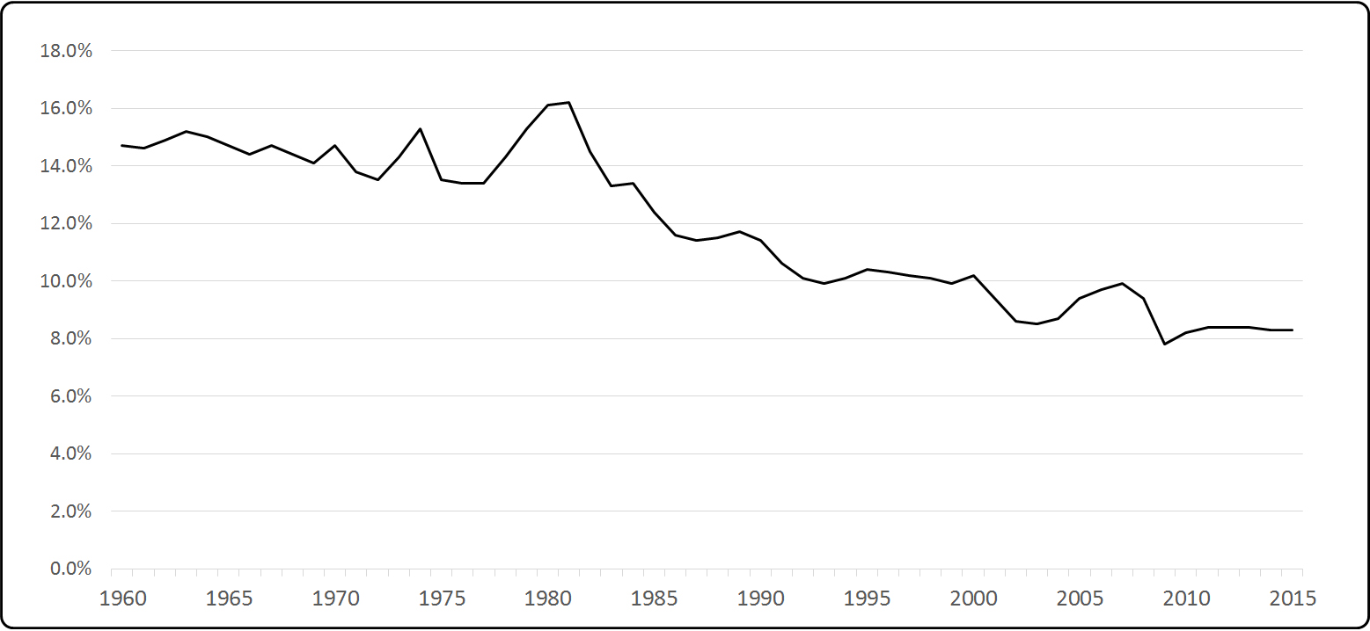
Economic Importance of Logistics in the U.S.
Percentage of GDP Spent on Logistics Activities
Source: State of Logistics Annual Reports 2000-2012

Slide 20
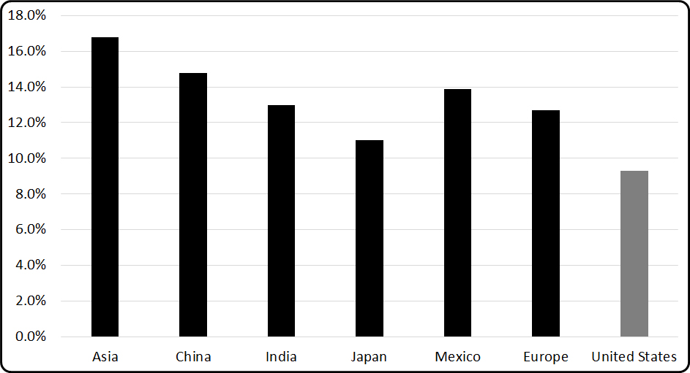
Economic Importance of Logistics in the World
Source: Supply Chain Brain

Slide 21
Reverse Logistics
Source: Lora Skarman

Slide 22
Reverse Logistics
The German approach: requiring that
companies recycle all packaging, and
creating a post-consumer recycling program.
The Curitiba approach:
using recycling as an
anti-poverty program.

