Slide 1
Chapter 1 International Trade

Slide 2
International Trade
International Trade Growth
International Trade Milestones
Largest Exporting and Importing Countries
International Trade Drivers
International Trade Theories
International Business Environment

Slide 3
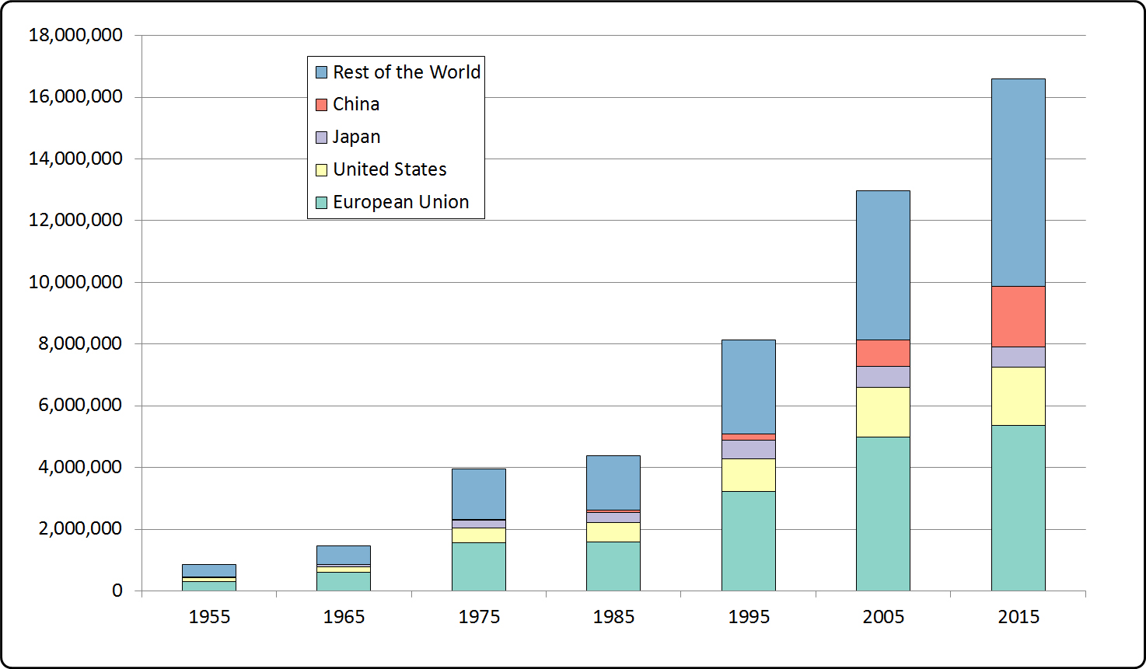
International Trade Growth
International Trade Growth 1953-2015.
Source: World Trade Organization

Slide 4
International Trade Milestones
Bretton-Woods Conference (1944)
Creation of the International Monetary Fund (1945)
First General Agreement on Tariffs and Trade (Geneva, 1948)
General Agreement on Tariffs and Trade
Multiple reductions on tariffs: GATT’s Kennedy Round (1964-67), Tokyo Round (1973-79), and Uruguay Round (1986-94). Currently in the Doha Round (started in 1998, stalled).
Treaty of Rome (1957)
World Trade Organization (1995)
The Euro’s creation (1999) and placement in circulation (2002)

Slide 5
Major Exporting Countries (2015)
Country | Exports (US$ billions) | Percentage
China | 2,275 | 13.8%
United States | 1,505 | 9.1%
Germany | 1,329 | 8.1%
Japan | 625 | 3.8%
Netherlands | 567 | 3.4%
Korea, Republic of | 527 | 3.2%
Hong Kong, China | 511 | 3.1%
France | 506 | 3.1%
United Kingdom | 460 | 2.8%
Italy | 459 | 2.8%
Canada | 408 | 2.5%
Belgium | 398 | 2.4%
Mexico | 381 | 2.3%
Singapore | 351 | 2.1%
Russian Federation | 340 | 2.1%
Rest of the World | 5,839 | 35.4%
World | 14,482 | 100.0%

Slide 6
Major Importing Countries (2015)
Country | Imports (in US$ billions) | Percentage
United States | 2,308 | 13.8%
China | 1,682 | 10.1%
Germany | 1,050 | 6.3%
Japan | 648 | 3.9%
United Kingdom | 626 | 3.7%
France | 573 | 3.4%
Hong Kong, China | 559 | 3.3%
Netherlands | 506 | 3.0%
Korea, Republic of | 436 | 2.6%
Canada | 436 | 2.6%
Italy | 409 | 2.4%
Mexico | 405 | 2.4%
India | 392 | 2.3%
Belgium | 309 | 2.2%
Spain | 280 | 1.8%
Rest of the World | 6,361,028 | 35.9%
World | 18,567,000 | 100.0%

Slide 7
International Trade Drivers
Cost Drivers
Companies increase their sales worldwide to recover their high investment costs.
Competition Drivers
Companies enter foreign markets to keep up with their competitors , retaliate against them, or enter a market first.
Market Drivers
Companies enter foreign markets because their customers expect them to be present in those countries.
Technology Drivers
Companies enter foreign markets because their customers use technology to make purchases from these markets

Slide 8
Cost Drivers
Companies in industries with high fixed costs try to spread these costs over many units, and therefore seek sales outside of their home markets.
Automobile companies were among the first to seek sales abroad:
Automobile production is dominated by 19 companies
(89 percent of all automobiles worldwide)
Automobile production is concentrated in 15 countries
(88 percent of worldwide production)
yet
Automobiles are sold in 143 countries.

Slide 9
Major Automobile Makers (2015)
Company | Units Sold Worldwide | Brands
Toyota Motors Corp. | 10,475,000 | Toyota, Lexus, Daihatsu, Hino
Volkswagen Group AG | 9,895,000 | Volkswagen, Audi, Porsche, Škoda, Scania, SEAT
General Motors Corp. | 9,609,000 | Chevrolet, Buick, Cadillac, GMC, Opel, Holden
Hyundai Motor Group | 8,009,000 | Hyundai, Kia
Ford Motor Company | 5,970,000 | Ford, Lincoln, Troller, Bedford
Nissan | 5,098,000 | Nissan, Dacia, Infiniti, Datsun
Fiat Chrysler Automobiles | 4,866,000 | Fiat, Chrysler, Dodge, Alfa-Romeo, Ferrari
Honda Motors | 5,514,000 | Honda, Acura
Suzuki | 3,017,000 | Suzuki, Maruti
Peugeot-Citroën SA | 2,917,000 | Peugeot, Citroën
Renault | 2,762,000 | Renault
BMW AG | 2,166,000 | BMW, Mini, Rolls-Royce
SAIC Motors | 2,088,000 | Wuling, Baojun
Daimler AG | 1,973,000 | Mercedes-Benz, Mitsubishi-Fuso, Setra
Chang’an | 1,447,000 | Chang’an,Chana
Mazda Motors | 1,328,000 | Mazda
DongFeng Motors | 1,302,000 | Dongfeng, Fengshen
Mitsubishi | 1,262,000 | Mitsubishi
Beijing Automotive Group | 1,116,000 | BAIC, BAW, Foton
Rest of the World | 9,958,000 | Tata, Jaguar, Land Rover, Geely, Emgrand, Englon, Gleagle, Subaru, Great Wall, Haval, FAW, Besturn, Hong Qi, Jilin, IKCO

Slide 10
Vehicle Production Countries (2015)
Country | Vehicles Produced
China | 24,503,000
United States | 12,100,000
Japan | 9,278,000
Germany | 6,033,000
South Korea | 4,556,000
India | 4,126,000
Mexico | 3,565,000
Spain | 2,733,000
Brazil | 2,429,000
Canada | 2,283,000
France | 1,970,000
Thailand | 1,915,000
United Kingdom | 1,464,000
Russia | 1,458,000
Turkey | 1,359,000
Rest of the World | 10,862,000
Total | 90,781,000

Slide 11
Competition Drivers
Companies that see themselves as global players seek to counter their competitors’ international moves in order to retain global market share.
Every move by one of the players is met with some retaliatory measure:
When Benetton—an Italian company—, entered the U.S. market, The Gap—an American company—, retaliated by entering the Italian market.
When Carrefour—a French retailer—enters a market, Walmart enters another. And when Walmart enters a market, Carrefour does as well.

Slide 12
Competition Drivers
The way Carrefour and Walmart split the world (2017)
Countries in which both are present | Argentina, Brazil, China, India, Japan, Kenya, United Kingdom.
Countries in which only Carrefour is present | Albania, Armenia, Austria, Bahrain, Belgium, Bulgaria, Cyprus, Egypt, France, Georgia, Greece, Indonesia, Iran, Iraq, Italy, Jordan, Kazakhstan, Kuwait, Lebanon, Macedonia, Monaco, Malaysia, Morocco, Oman, Pakistan, Poland, Portugal ,Qatar, Romania, Saudi Arabia, Spain, Slovakia, Slovenia, Syria, Taiwan, Tunisia, Turkey, United Arab Emirates.
Countries in which only Walmart is present | Botswana, Canada, Chile, Costa Rica, Ghana, Guatemala, Honduras, Lesotho, Malawi, Mexico, Mozambique, Namibia, Nicaragua, Nigeria, South Africa, Tanzania, Uganda, United States, Zambia.

Slide 13
Market Drivers
Companies in industries where customers travel will follow these customers internationally:
Hotel chains were first to offer a standardized experience worldwide.
Fast-food restaurants followed their customers abroad (McDonald’s first foreign ventures followed U.S. military personnel in Germany and Japan).

Slide 14
Market Drivers
Number of countries in which selected companies are present*
McDonald’s Restaurants | 121
Hilton Hotels | 91
Benetton Stores | 120
Cartier Jewelry Stores | 125
Accor Hotels | 92
Exxon-Mobil Gas Stations | 100+
* Some companies have a very “broad” definition of countries, counting
Puerto Rico, Martinique, and Jersey as separate countries. The tallies in
this table are self reported.

Slide 15
International Trade Theories
Adam Smith’s Theory of Absolute Advantage
David Ricardo’s Theory of Comparative Advantage
Eli Hecksher and Bertil Ohlin’s Factor Endowment Theory
Raymond Vernon’s International Product Life Cycle Theory
Michael Porter’s Cluster Theory
Yossi Sheffi’s Logistics Cluster Theory

Slide 16
Theory of Absolute Advantage
If a country can produce a certain good more efficiently than other countries, it will trade with countries that produce other goods more efficiently.
In this case, both countries are using the same amount of labor to produce these alternatives. France will specialize in making wine, and Germany will specialize in making machinery.
 | Wine | Machinery
France | 20,000 | 2
Germany | 15,000 | 3

Slide 17
Theory of Comparative Advantage
Nations will trade with one another as long as they can produce certain goods relatively more efficiently than one another
The UK has an absolute advantage in both machinery and wheat. However, in the UK, the relative price of 1 unit of machinery is 5 tons of wheat, and in Brazil, it is 7 tons of wheat.
The nations will trade: If the UK sells 1 unit of machinery to Brazil for 6 units of wheat, both the UK and Brazil are better off. The UK has a comparative advantage in producing machinery, Brazil in growing wheat.
 | Tons of Wheat | Units of Machinery
UK | 25 | 5
Brazil | 21 | 3

Slide 18
Factor Endowment Theory
A country will enjoy a comparative advantage over other countries if it is naturally endowed with a greater abundance of one of the factors of economic production.
Factors of Economic Production
1. Land
2. Labor
3. Capital
4. Entrepreneurship
Country | Abundance | Advantage
Argentina | Grazing Land | Beef
India | Educated Labor | Call centers
USA | Economic system where entrepreneurship is rewarded | Innovation & development of intellectual property

Slide 19
International Product Life Cycle Theory
Over its life, a product will be manufactured in different types of countries, in stages, generating trade between these countries.
Stage 1
Product is created in developed country, using new technology and serving a market need.
Stage 2
As sales grow, competitors start to make similar products in other developed countries, responding to local needs.
Stage 3
Manufacturing of product has become routine and costs need to be reduced, and production moves to developing countries.

Slide 21
Cluster Theory
Competitive clusters form when companies in the same industry, as well as their suppliers, concentrate in one geographic area. When this happens, the companies “feed” on each other’s know-how, pushing them to innovate faster. They become so efficient and innovative that they become world-class suppliers.
Cluster Examples
Silicon Valley, California, U.S. – Information technology
Sassuolo, Italy – Ceramic tiles
Genève, Switzerland – Watches
Yiwu, China – Socks & hosiery

Slide 22
Logistics Cluster Theory
Logistics clusters form when logistics companies concentrate in one geographic area. When this happens, the companies allow manufacturers to operate more efficiently, since all the services they need to ship are located in one area. The logistics suppliers, even though they are competitors, actually help each other attract new customers.
Logistics Cluster Examples
Singapore
Memphis, United States
Rotterdam, The Netherlands
Zaragoza, Spain

Slide 23
International Business Environment
To be successful in international logistics, not only is it important to have an understanding of logistics, but it is also fundamental to understand the international environment.
This can be achieved by learning a foreign language, taking classes in international economics, international finance, intercultural communication, and international marketing, but also by traveling frequently, meeting foreign nationals, and making an effort to understand what is happening in foreign countries.

